Slide 1

Docker

Slide 2



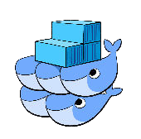
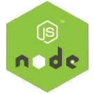





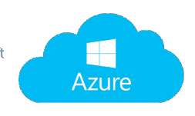


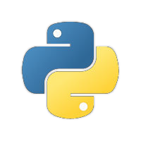






Platform as Service (PaaS)
Cluster
Developer
Controller
Consumer
Node 1
Container
Scheduling
Load Balancer
Node 2
Orchestration
Container
Service Discovery
Node N
Container
Logging
Data Store
Image Registry
Monitoring

Slide 3
Table of Contents
Problems
Container vs. Virtual Machine
What is Docker?
Who uses Docker?
Docker Ecosystem
Docker Container Management
Docker Images
Dockerfile

Slide 4
Problems
Applications run businesses. If applications break, businesses suffer and sometimes die.
Every time the business needed a new application, IT would buy a new server. And they don’t know it’s specs.
Most probably they buy super fast server.
Resulting waste of resources and money.

Slide 5
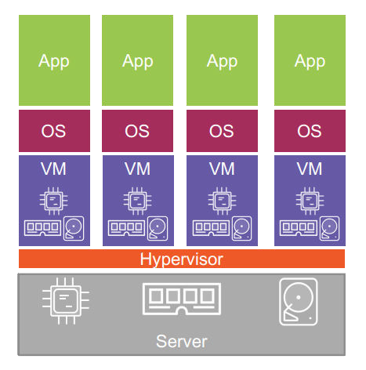
Hello Virtual Machine
Finally we had a technology that would let us run multiple applications on a single server safely and securely.
But, VMs are not perfect! The fact that every VM requires dedicated OS, consumes CPU, RAM and storage.
Also VMs are slow to boot.

Slide 6
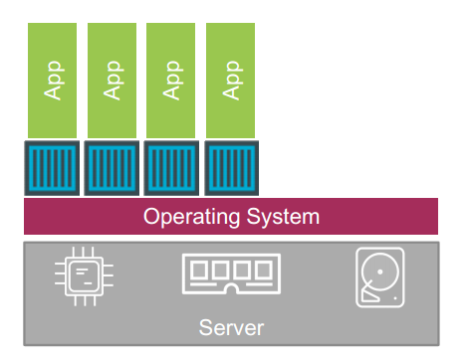
Hello Container
Containers are similar to VM but, every container does not require a complete OS.
In fact that all containers run on a single host share the same OS.

Slide 7
Container vs. Virtual Machine
Container Architecture Hypervisor Architecture

Slide 8
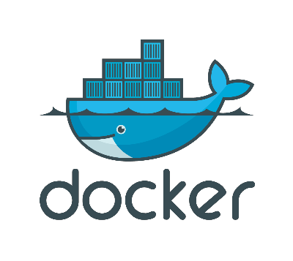
What is Docker?
A software that creates, manages and orchestrates containers.
Docker is an open-source project on GitHub. Owned by Docker Inc.
Docker Inc.
San Francisco based technology startup.
Started as PaaS provider called dotCloud.

Slide 9
What is Docker? (cont’d)
They built an internal tool nick-named it Docker.
In 2013 they rebranded company as Docker Inc., got rid of the dotCloud PaaS platform, and started to bring Docker and containers to the world.
The word Docker comes from a British colloquialism meaning dock worker - somebody who loads and unloads ships.
Docker Project
Docker project is hosted on GitHub.

Slide 10
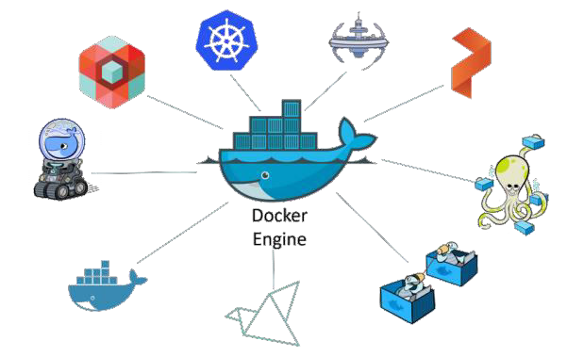
What is Docker? (cont’d)
Most of the project and its tools are written in Go Language.
Project is under the terms of Apache License 2.0.
Docker Engine
Software that runs and orchestrates containers.

Slide 11
Who uses Docker?
Developers
Solve dependency and environment problems. (It Works on my machine)
Help developers to focus on writing code.
Speed up development process.
DevOps
Speed up deployment process.
Continues Delivery/Integration.

Slide 12
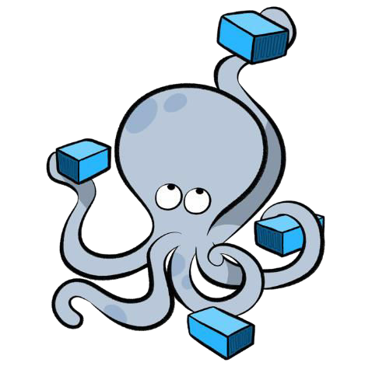
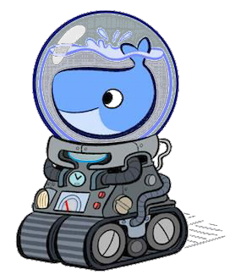
Docker Ecosystem
Docker Machine
Docker Compose
Tool that lets you install Docker Engine on virtual hosts, and manage the hosts with docker- machine commands. You can use Machine to create Docker hosts on your local Mac or Windows box.
Tool for defining and running multi-container Docker applications by using a single command.

Slide 13
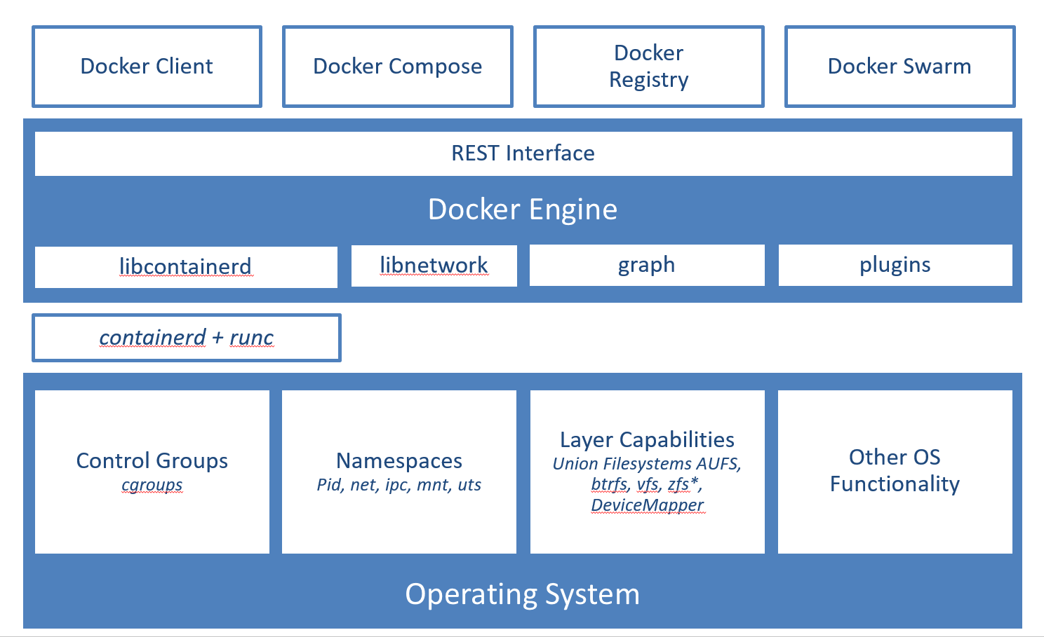
Docker Ecosystem

Slide 14

Docker Ecosystem (cont’d)
Docker Swarm
Cluster management
Scaling
Monitoring
Multi-host networking
Service discovery
Load balancing
Security
Rolling updates

Slide 15

Docker Containers

Slide 16
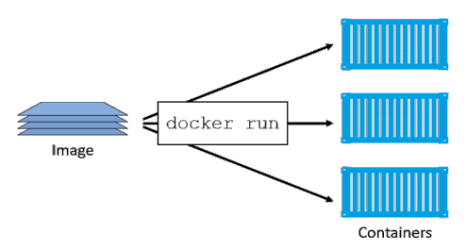
Docker Container Management
A container is the runtime instance of an image.
We can start one or more containers from a single image.
Containers run until the command they are executing exits.
Container can persist data.

Slide 17
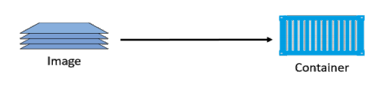
Docker Images
Images are made up of multiple layers.
Images are like stopped containers.
Images are considered build-time constructs whereas containers are run-time constructs.
You cannot delete the image until the last container using it has been stopped.

Slide 18
Docker Images (cont’d)
Docker host doesn't come with images installed by default. To list all images:
$ docker images
The act of getting images is called pulling, if you want the latest version of ubuntu.
$ docker pull <image>:<tag>
$ docker pull ubuntu:latest
Image can have more that one tag.
Docker assumes latest tag, if not provided.

Slide 19
Docker Images (cont’d)
Images Registry
Images are stored in image registry, The most common one is
Docker Hub.
Docker Hub support both private and public repository.
You can implement your own image registry, by using 3rd party
tools. Integrated with Docker API. For more info
https://docs.docker.com/registry/

Slide 20
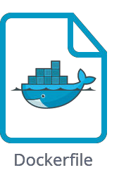
Dockerfile

Slide 21
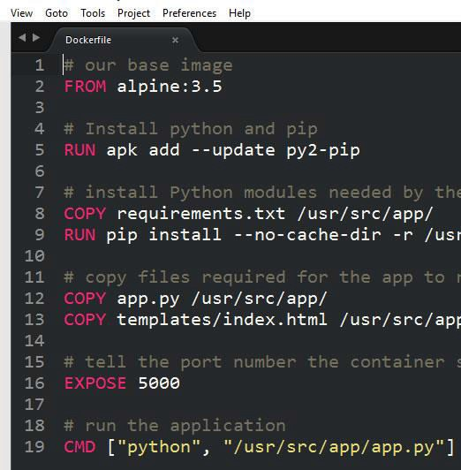
Dockerfile
Docker can build images automatically by reading the instructions from a Dockerfile.
A Dockerfile is a text document that contains all the commands a user could call on the command line to assemble an image.
Docker runs the instructions in the Dockerfile one-by-one, committing the result of each instruction to a new image.

Slide 22
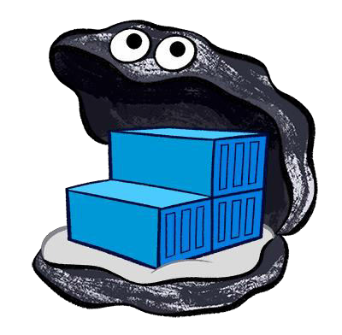
Demo
Dockerizing Apps

