Slide 1

Pairs Trading with Copula-Final Presentation
Team 6

Slide 2
CONTENTS
01
Introduction
Contents
02
Performance Analysis
03
Findings & Issues
04
Improvements

Slide 3
01
PART ONE
Introduction

Slide 4

Introduction
PROJECT INTRODUCTION
Based on the Copula in hourly base strategy we adopted before, we changed the equity indices trading frequency as daily and diversified our portfolio in 5 industries: tech, healthcare, confectionery products, energy, and financial services. Finding pairs in each industries as well as discretionary investment with fundamental analysis.
Main Strategy

Slide 5
Categories
Choose Pair
Fit Copulas
Trade
Diversified

Slide 6
02
PART TWO
Performance Analysis

Slide 7

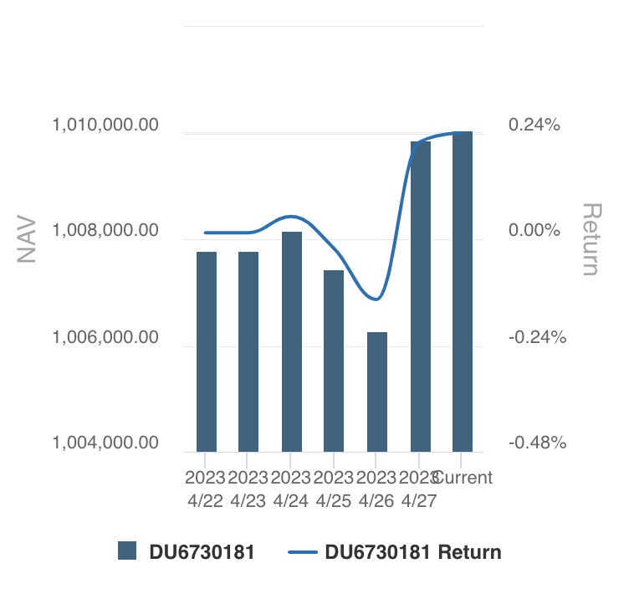
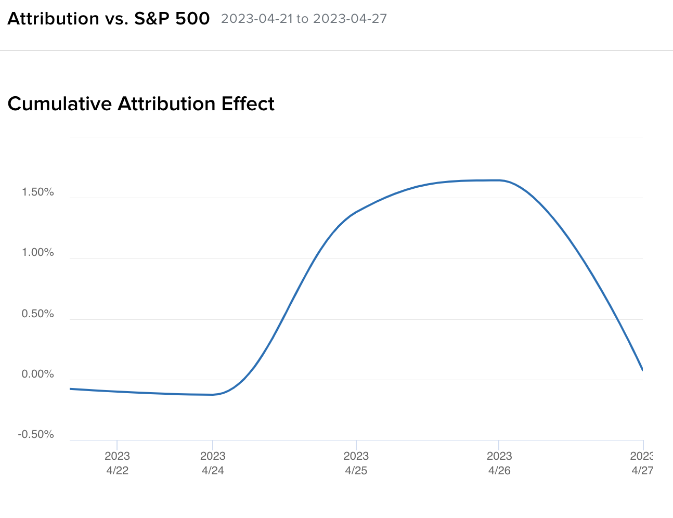
Performance- last week

Slide 8
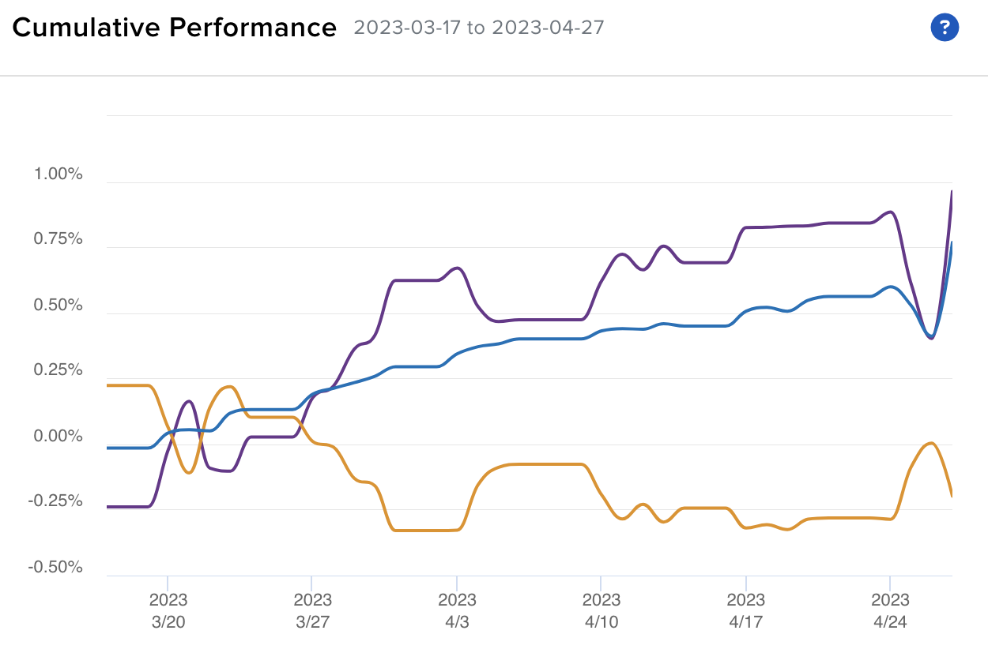
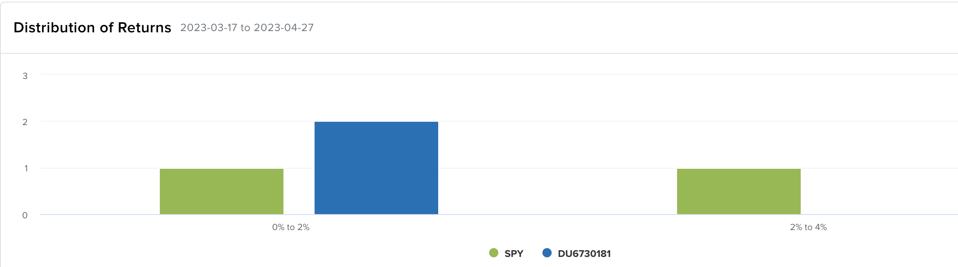

Performance- post-midterm

Slide 9

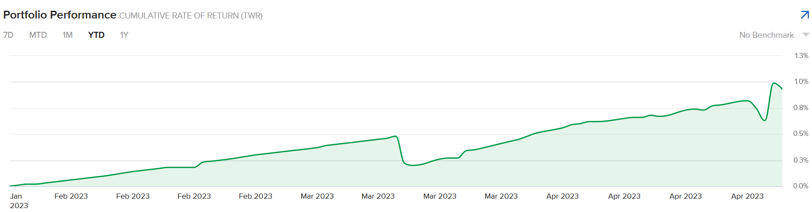
Shape Ratio: 0.92 → 1.07
Annualized E[r]: 8% → 32%

Slide 10
03
PART THREE
Issues & Findings

Slide 11

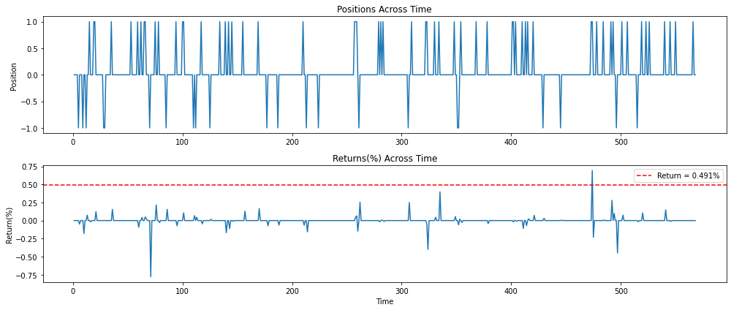
Issues – Low Expected Return
Annualized Return = 6.05%

Slide 12
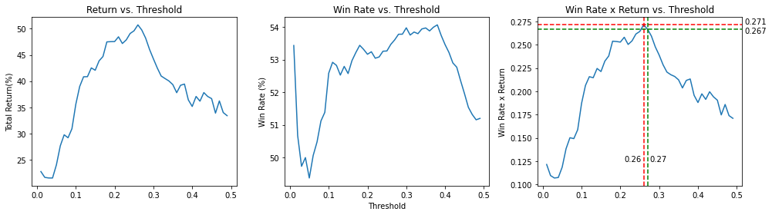
Findings – Signal Threshold
Stricter threshold ≠ Higher Win-rate
More Pairs with win-rate greater than 50% lowers the return variance

Slide 13
04
PART FOUR
Improvements

Slide 14

Improvements Consideration
Exit strategy
Impose cost on waiting
Threshold Choosing
Highly correlated – lose threshold, vice versa.
Pairs Choosing
Pairs Quality vs. Number of Pairs
Bet Size
The more abnormal, the larger the bet

Slide 15
THANK YOU

