Slide 1
Alarm System
YES
Able to connect to
Access Point?
NO
Normal Mode of Operation
AP mode
SSID:ALARM_AP
Password:ALARM_PASS
Reboot
Save New Configuration

Slide 2
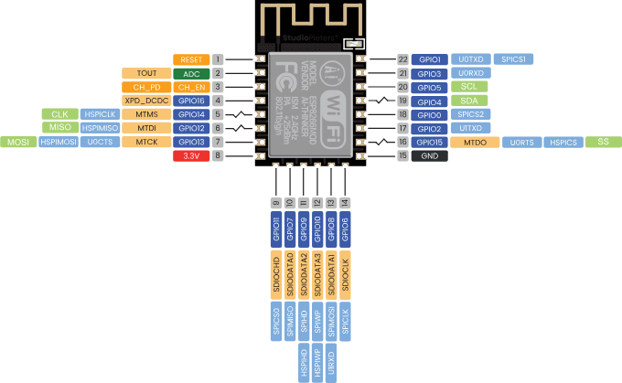
AUDIO OUT
WLED
SWITCH

Slide 3
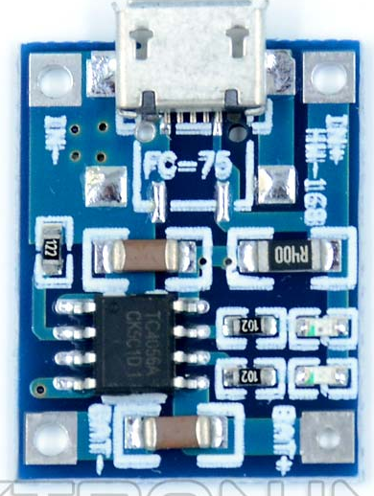

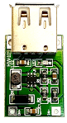
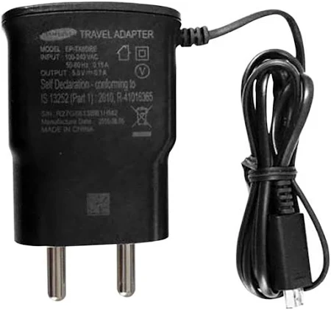
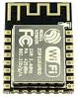
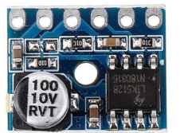

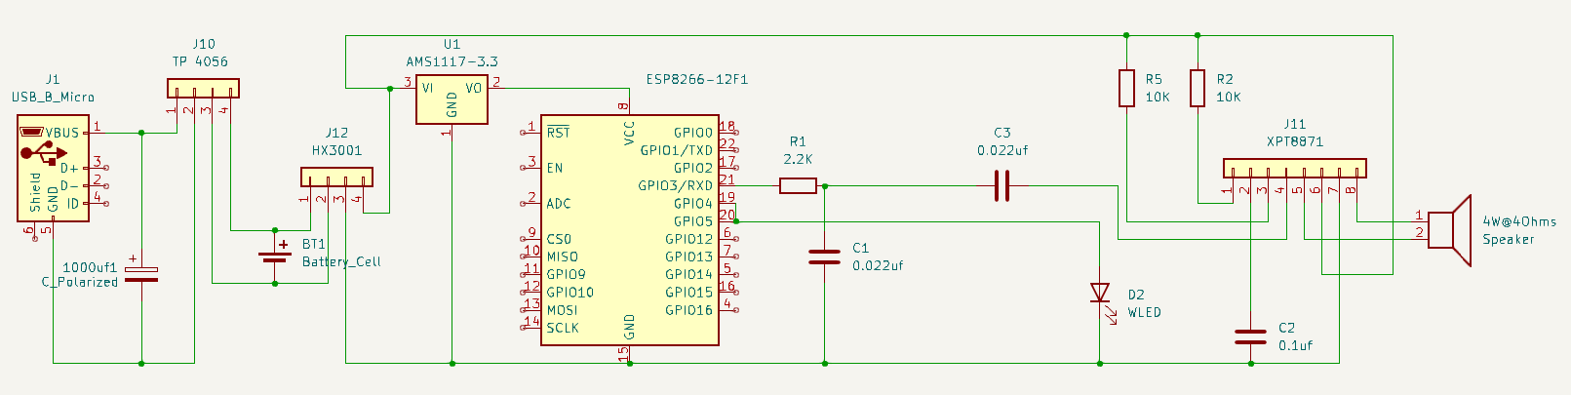
Alarm System
Wi-Fi
HW-105
(HX3001)
TP 4056
18650
ESP8266-12F
XPT8871
4W 4ohms
5V 1A

Slide 4
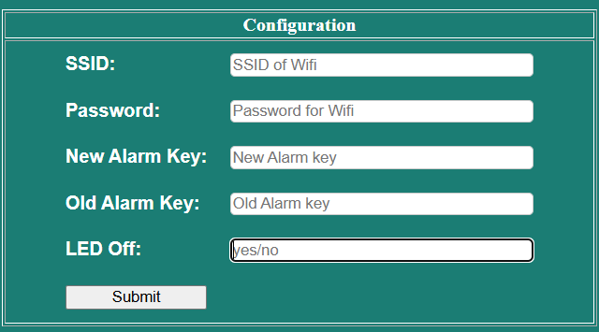
Web Interface

