Slide 1
Alarm System Schematics

Slide 2
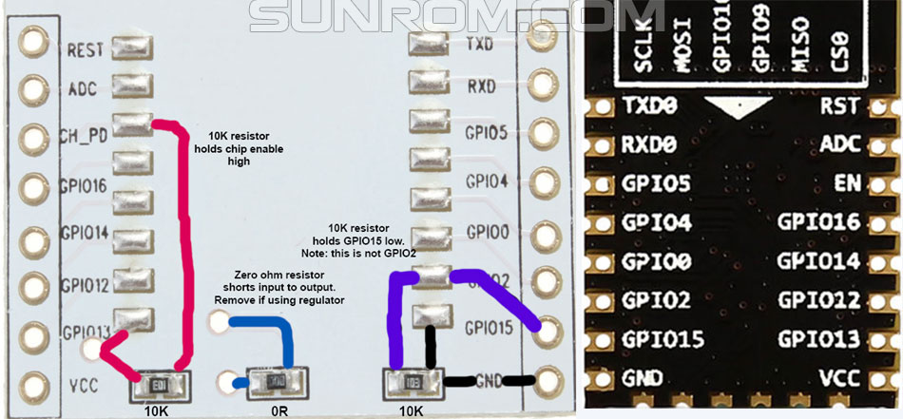
IR Blaster Schematics

