Slide 1
CA683 DATA ANALYTICS AND DATA MINING PROJECT: Traffic Accident Analysis On Imbalanced Ordinal Variable
TEAM MEMBERS:
ALFRED IYBY
GEETHU NARIPPATTA
PRIYAMOL JAMES
SARATH MUKUNDAN ADAVAKKAT
SUHARA FATHIMA SHAHUL HAMEED

Slide 2
INTRODUCTION
Significance of Traffic Road Accident Analysis
Improvements required for road safety
Usage of sophisticated data mining techniques
RESEARCH QUESTION:
What are the main contributing reasons for serious traffic accidents, and how can data mining techniques be used to create efficient preventive measures?

Slide 3
LITERATURE REVIEW:
Prediction of Traffic Accidents Severity Based on Machine Learning and Multiclass Classification Model
Data Visualization and Machine Learning Approach for Analyzing Severity of Road Accidents
Comparison of Machine Learning Algorithms for Predicting Traffic Accident Severity
Prediction of Traffic Accidents using Random Forest Model
Exploring the Risk Factors Influencing the Road Accident Severity: Prediction with Explanation

Slide 4
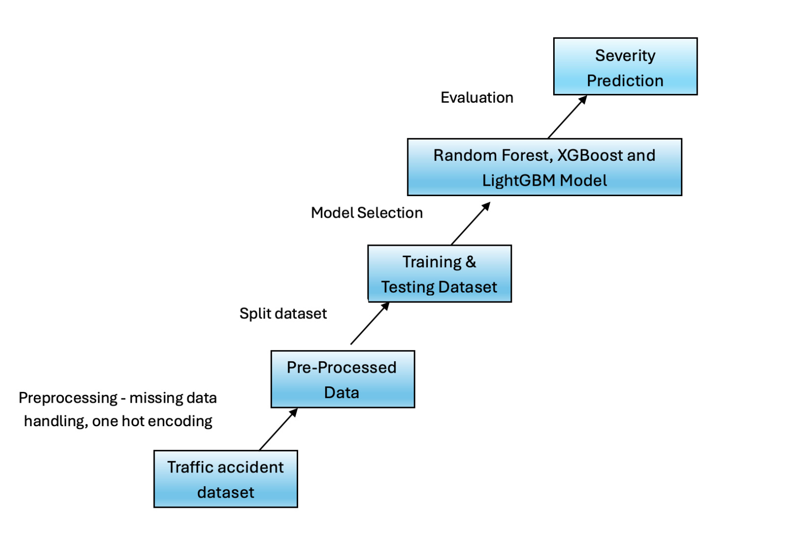
METHODOLOGY
Traffic Dataset: Collected from the Kaggle website.
This dataset was gathered in real-time using several Traffic APIs. It includes accident data for the Contiguous United States gathered between February 2016 and March 2023.
Dataset link: Traffic Dataset
1.5 million accident records
KDD methodology

Slide 5
RANDOM FOREST
An ensemble learning technique that can be used for both classification and regression tasks.
Combines multiple decision trees to improve predictive accuracy and control over-fitting.
In our model we are focusing on predicting the impact of several criterion like weather, road conditions and time of the day on the accident severity.
Using Random Forest, we can predict an accuracy of 73% for different weather attributes like temperature and wind factors.

Slide 6
XGBOOST
XGBoost, a powerful gradient boosting technique, efficiently handles diverse accident data for accurate severity predictions.
Utilizing XGBoost, our methodology involved training a model on features like temperature, wind, and visibility to predict accident severity.
To handle imbalanced severity levels, we used XGBoost's scale_pos_weight with class weights, ensuring fair representation of all severity classes.
Our XGBoost model achieved a weighted F1 score of 0.71, demonstrating accurate predictions across all severity levels.
Though there is a gap in the accuracy in the models, XGBoost is proved to be actively handling the imbalanced ordinal variable ‘Severity’.

Slide 7
LIGHTGBM
LightGBM also a popular Gradient Boosting framework that is sped and efficiency and ability to handle large dataset.
It can handle categorical features internally, simplifying the data preprocessing procedures.
LightGBM classifier utilizes num_leaves and min_data_in_leaf attributes to minimize overfitting and underfitting.
The model achieved an average weighted F1 score of 0.72 with different weather attributes.

Slide 8
CONCLUSION
Data-driven insights crucial for understanding traffic accidents.
Random Forest model shows practical applicability with 73% accuracy.
XGBoost model balances precision and recall with 0.71 F1 score.
LightGBM produces a score of 0.72 F1-score with room for improvement.
Importance of meteorological conditions and time-related variables highlighted.
Addressing imbalanced datasets vital for model improvement.
Future research directions include exploring additional features and advanced techniques like ensemble learning and deep learning.

Slide 9
WORK CONTRIBUTION
Sarath and Suhara – Literature Review, Presentation and Report
Geethu - Random forest and XGBoost model, Report
Alfred and Priya – XGBoost and LightGBM Model Comparison, Report

Slide 10
THANK YOU

