Slide 1
Presentation on SaaS pricing
Generated by AI

Slide 2
Introduction
### Slide 1: Title Slide
**🌟 SaaS Pricing Guide: SaaS Pricing Models, Strategies, & Examples 🌟**

Slide 3
Agenda
Key Points:
1. Understand Different Pricing Models: Explore the various SaaS pricing models such as Usage-based, Per-user, and Freemium to determine what works best for your product and target market.
2. Implement Pricing Strategies: Learn how to set the right price by considering factors like value-based pricing, competitive pricing, and dynamic pricing to maximize profitability.
3. Real-world Examples: Discover successful SaaS companies like Salesforce, Netflix, and Slack that have implemented innovative pricing strategies to drive growth and customer loyalty.

Slide 4
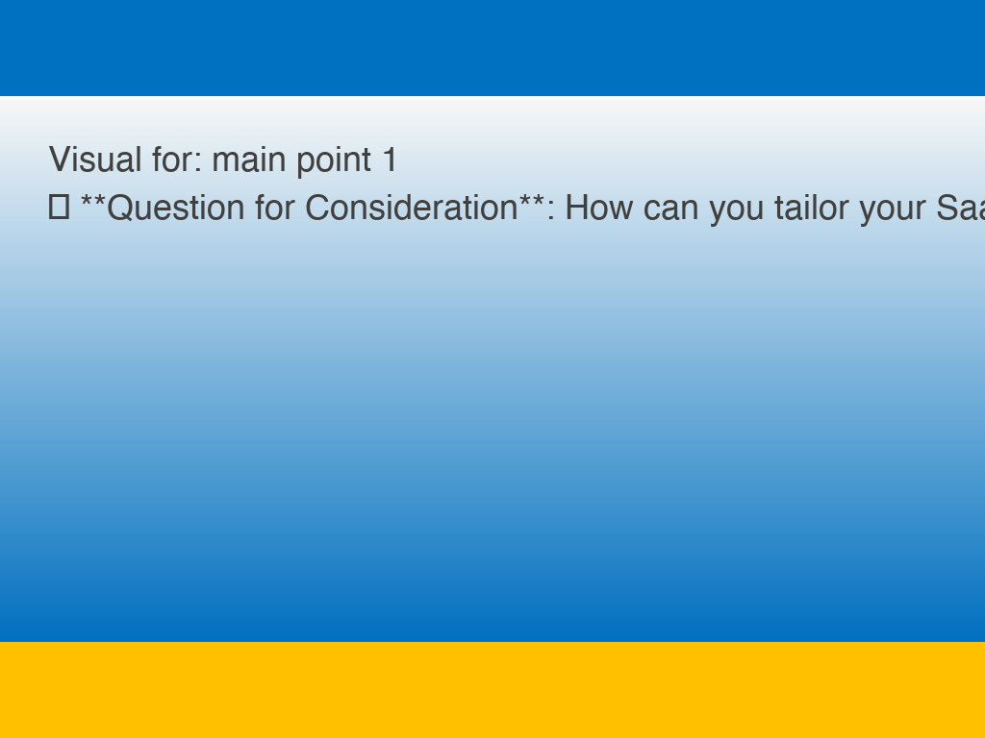
Main point 1
💡 **Question for Consideration**: How can you tailor your SaaS pricing strategy to align with your business goals and capture the maximum value from your customers?

Slide 5
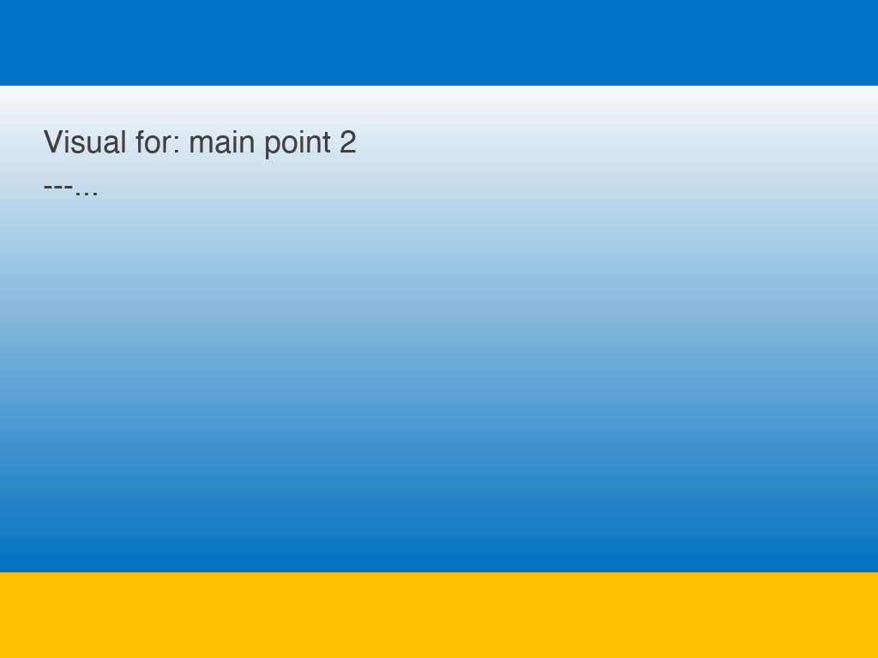
Main point 2
---

Slide 6
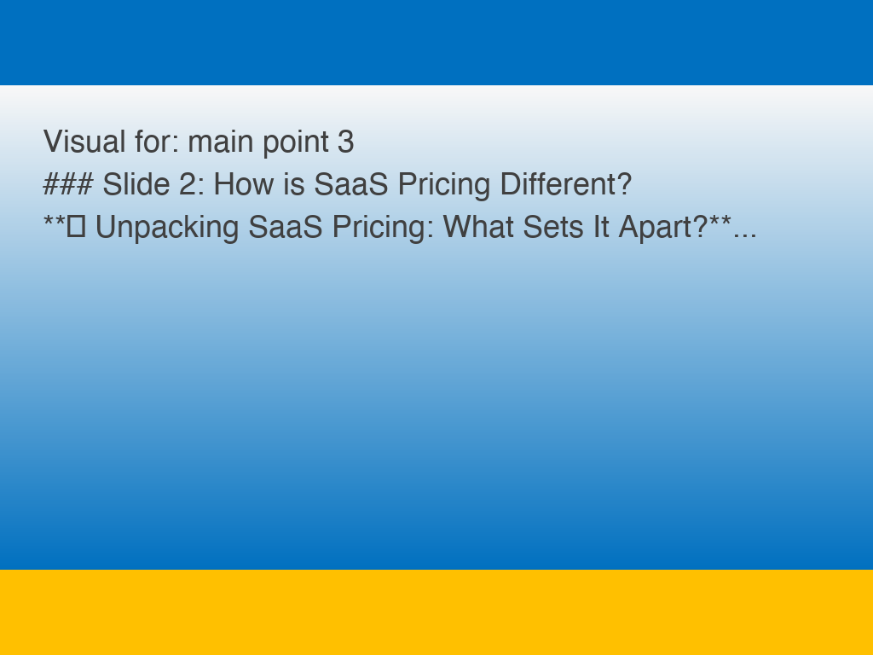
Main point 3
### Slide 2: How is SaaS Pricing Different?
**🚀 Unpacking SaaS Pricing: What Sets It Apart?**

Slide 7
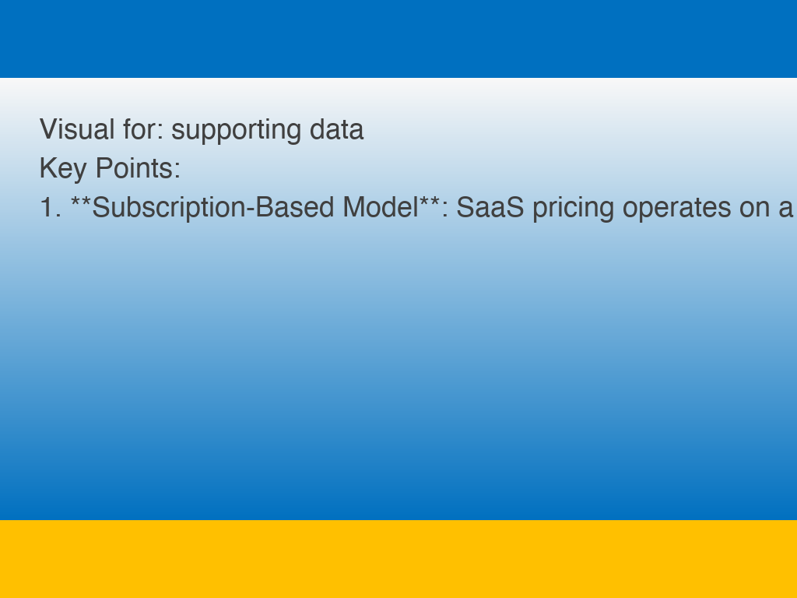
Supporting data
Key Points:
1. **Subscription-Based Model**: SaaS pricing operates on a subscription basis, providing customers with access to software through a recurring fee. This allows for greater flexibility and scalability compared to traditional upfront costs.
2. **Usage-Based Pricing**: Many SaaS companies offer usage-based pricing, where customers only pay for the services they actually use. This allows for a more cost-effective approach tailored to individual needs.
3. **Tiered Pricing Options**: SaaS pricing often includes tiered plans with varying features and levels of service. Customers can choose a plan that best suits their requirements, making it easier to customize their experience.
4. **Transparent Pricing**: SaaS companies typically provide clear and transparent pricing structures, making it easier for customers to understand what they are paying for. This transparency builds trust and helps foster long-term relationships.
5. **Value-Based Pricing**: SaaS pricing is often based on the value the software provides to customers, rather than just the cost of production. This approach ensures that customers receive fair pricing in line with the benefits they receive.

Slide 8
Case study
💭 **Question to Ponder**: How can your business leverage SaaS pricing strategies to drive growth and maximize value for your customers? 🤔

Slide 9
Conclusion
---

