Slide 1
Table of contents
Steps to get Altitude across Mileage
Visualization include all altitude point and mileage
Steps to get data for each AFE and ALT range
Visualization for each altitude and mileage range
Mileage prediction process
Accuracy plot
Predicted value

Slide 2
Steps to get Altitude across Mileage
Have merged 13 days data into single csv file
For every 6 hour gap, distance covered by truck in start point subtracted by distance covered in end point (is recorded as new ODO), Total Fuel Consumption by truck in start point subtracted by Total Fuel Consumption in end point (is recorded as new TFE) and average of all altitude point in each 6 hour gap (is recorded as new ALT)
Mileage is obtained from (ODO divided by TFC)
Removed all Null rows and saved the file

Slide 3
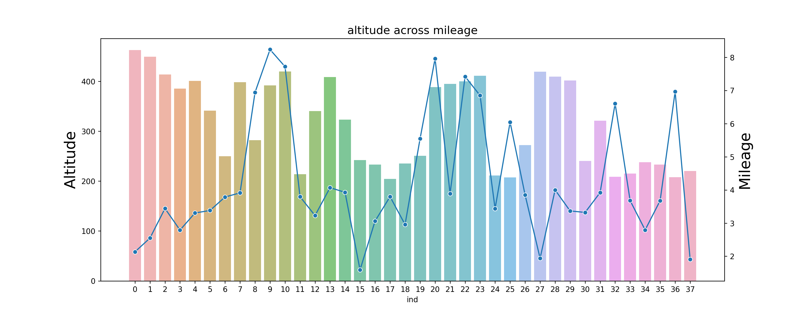
Visualization include all altitude point and mileage

Slide 4
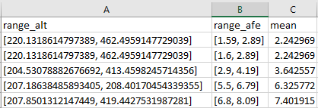
Steps to get data for each AFE and ALT range
Using while loop along with max and min altitude point, range list for AFE is created
Have only selected the data which fall in range, repeated for all AFE range
For each range data, Mean value for mileage (AFE) is calculated and altitude( ALT) (min,max) will be altitude range of each data split
Eliminated the data frame which is empty (as no data fall in that range, data frame will be empty)
Save the result in separate csv file

Slide 5
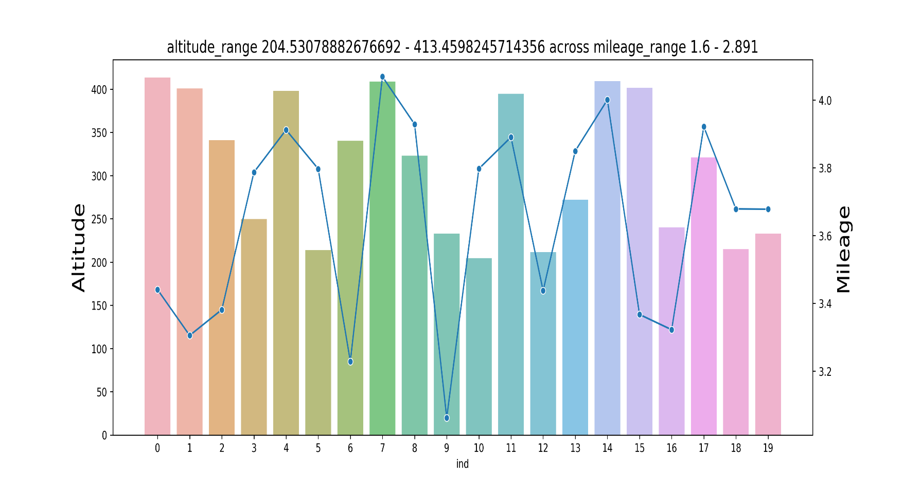
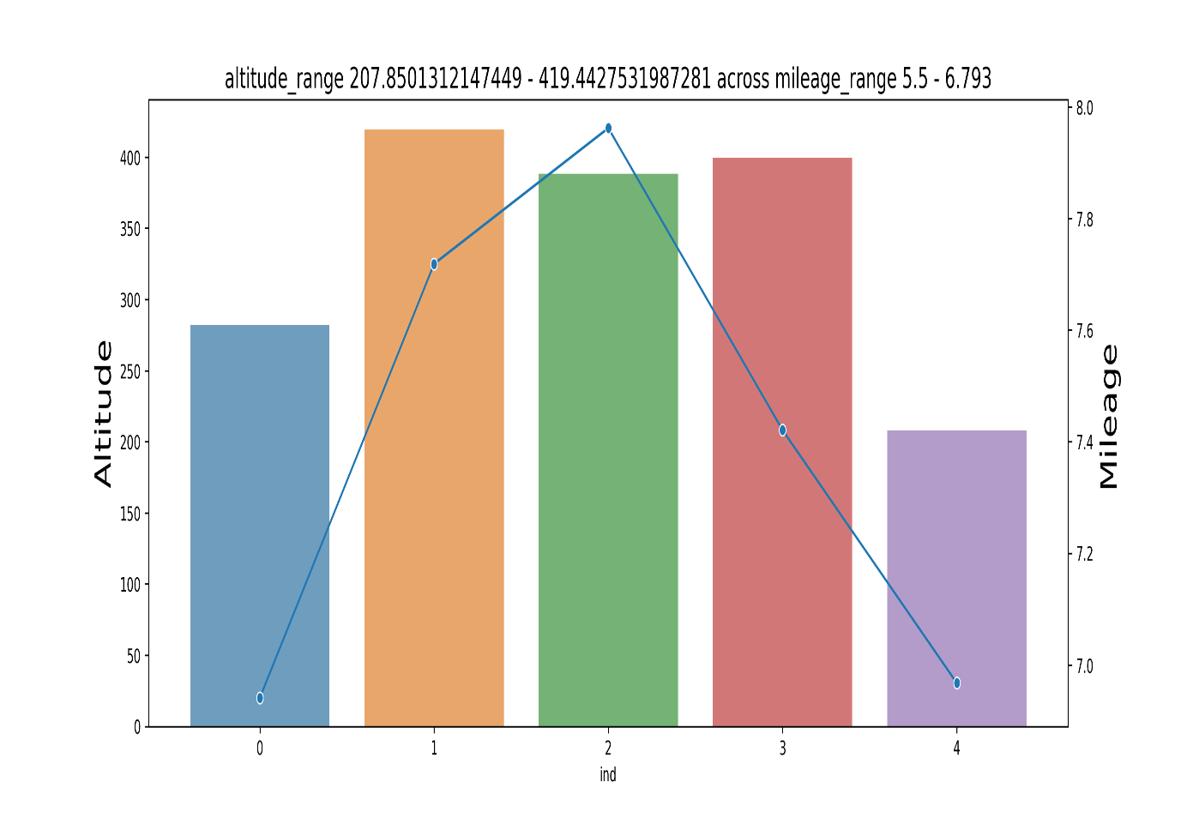
Visualization for each altitude and mileage range

Slide 6
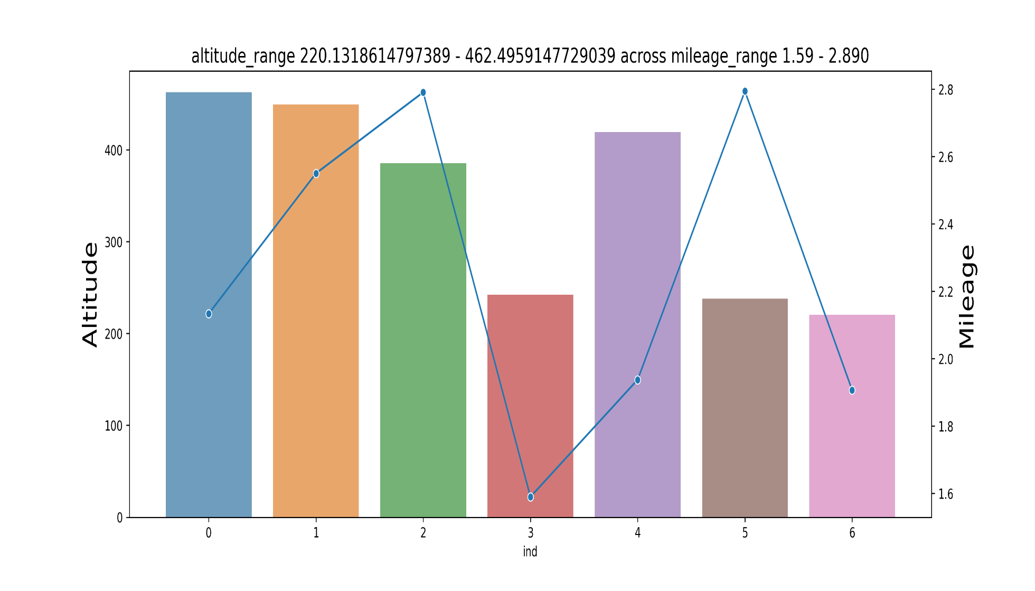
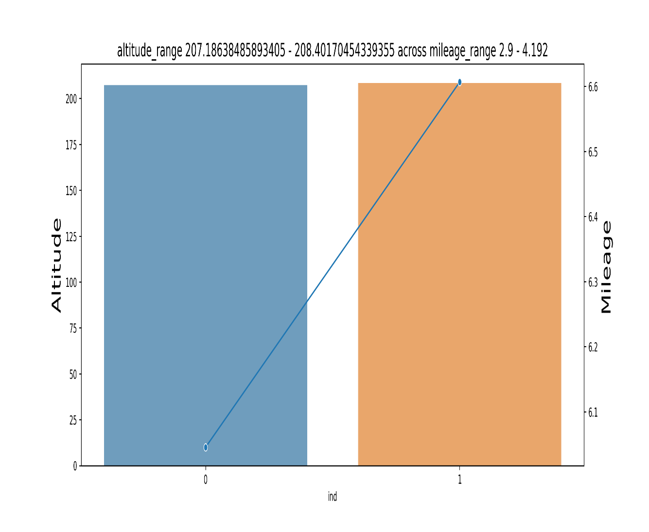

Slide 7
Mileage Prediction process
Have selected TFC and ODO feature alone to make mileage prediction
Removed all null row in both column
Created function to removed outliers from both columns using percentiles
The data have been split into train and test set
Trained three ML model (Decision tree, random forest, Xgboost)
Validated each model using (mean absolute error, accuracy of each) in test data
Accuracy is calculated by comparing actual and predicted value
Out of three model Xgboost performed well and gave good accuracy (89.7%)

Slide 8
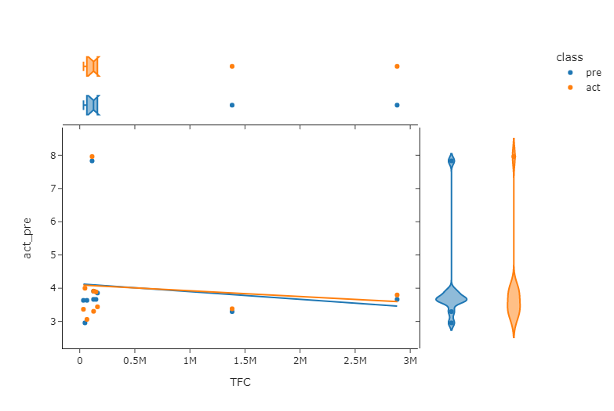
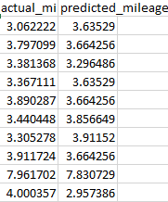
Predicted value

