Slide 1
ICP PRESENTATION 2
TEAM 13
EESHWARA SAI TOTA
SARATH KOLISETTY

Slide 2
Contents
Introduction
Android studio
Android Applications:
Features:
Login application
Pizza delivery application
Display data using public APIs
Text to speech
Conclusion

Slide 3
introduction
Mobile development using android studio:
Developed following application
Login application
Pizza delivery application
Display data using public APIs
Text to speech application
In the process of building these application we have learned various aspects of mobile development.

Slide 4
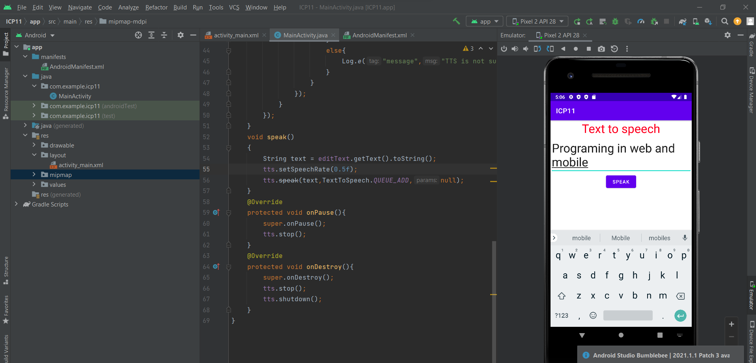
ANDROID STUDIO
Android Studio is and IDE for developing
Android applications.
Java and Kotlin are the popular languages used in
Android development.
It has a flexible Grable-based build system.
It provides several emulators to test our android
applications on different devices virtually.

Slide 5
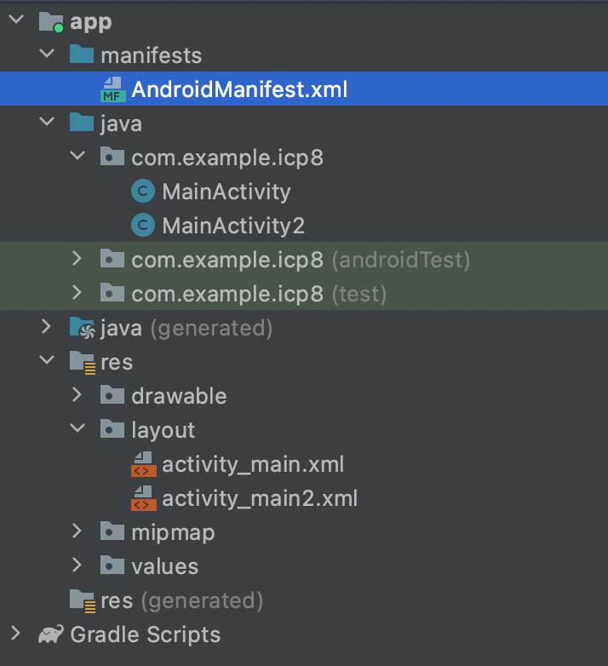
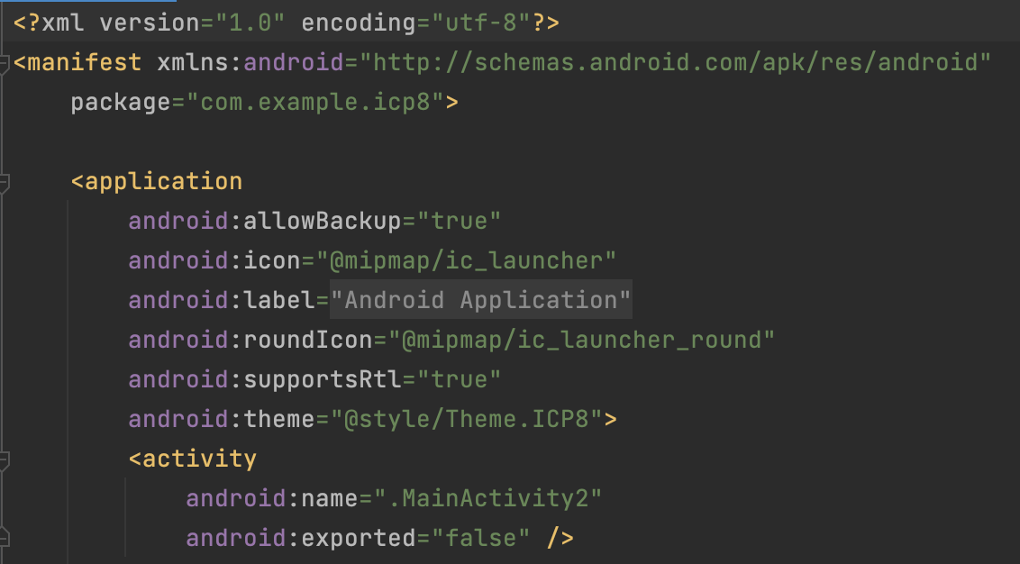
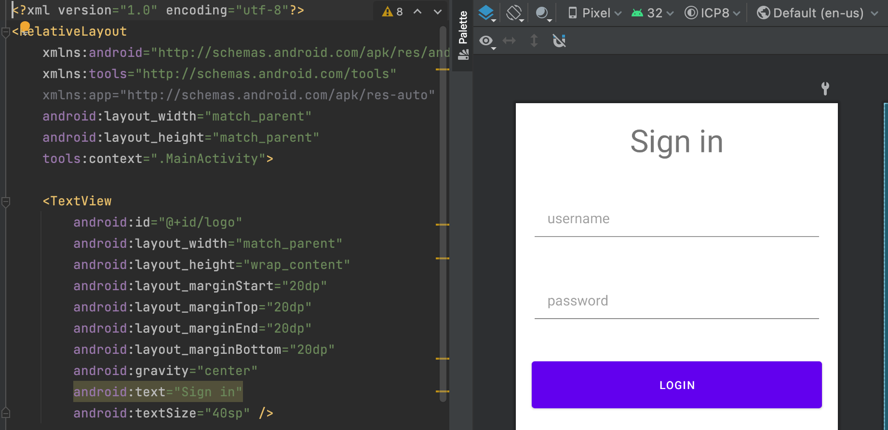
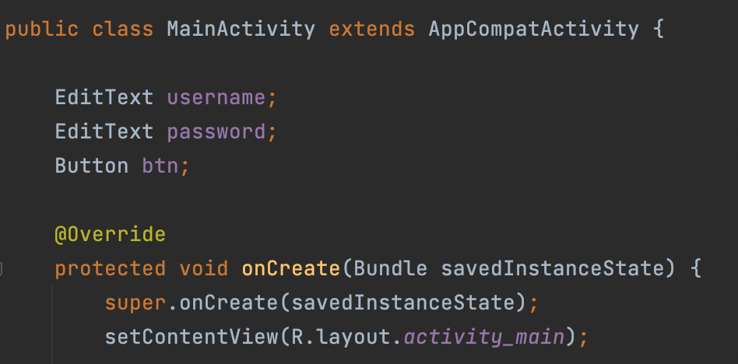
ANDROID STUDIO
Project structure:
AndroidManifest.xml
Code structure:
Manifest file:
Manifest file has XML extension, which has important metadata information about the application.
Java folder:
It has all the functionality related to application such as how to handle on click and redirect to other page (intent).
Res > layout folder:
It has all the design screen and XML code related to it.
Using tags in this file we can design different screens.
Activity_main.xml
MainActivity.java

Slide 6
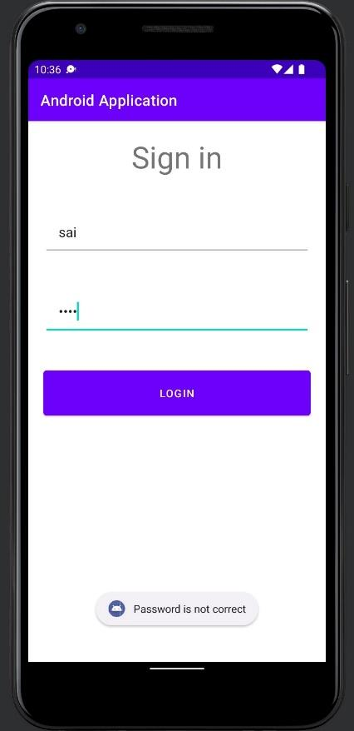
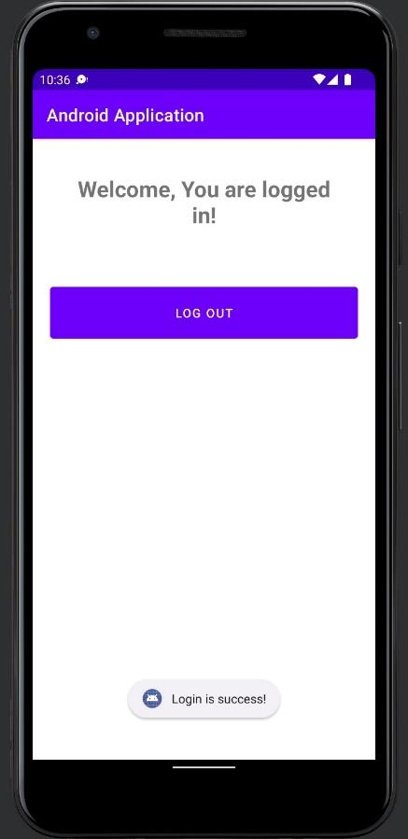
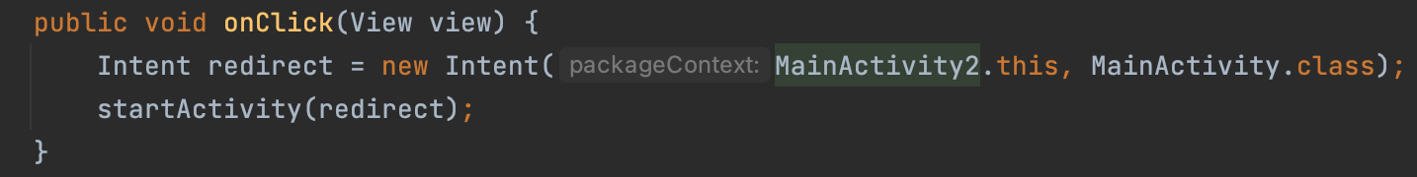
Login Application
Login screen
Successful login
The sign in screen has input validations, if login is done using either blank
fields or incorrect username or password toast message is shown.
During a successful login, screen is redirect to new intent screen where
log out button is displayed.
Toast message:
Redirect to another activity:

Slide 7
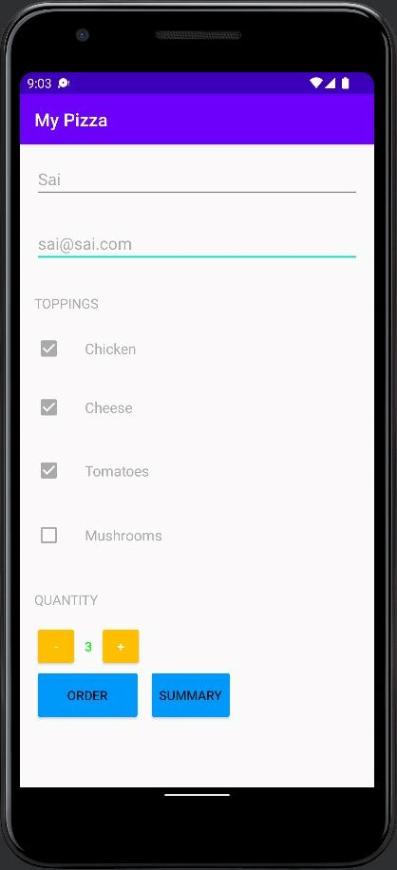
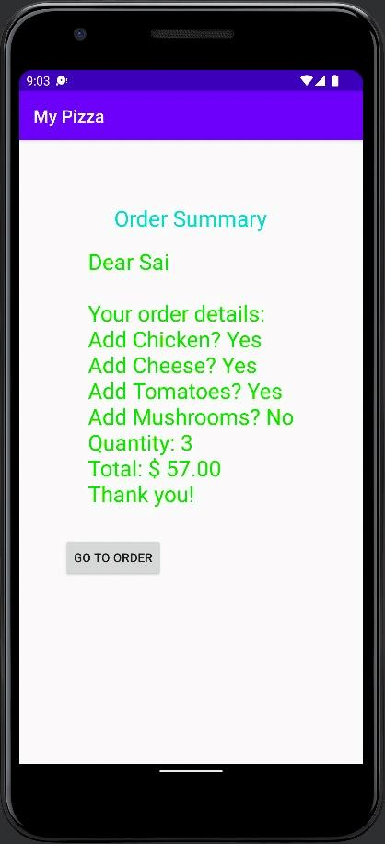
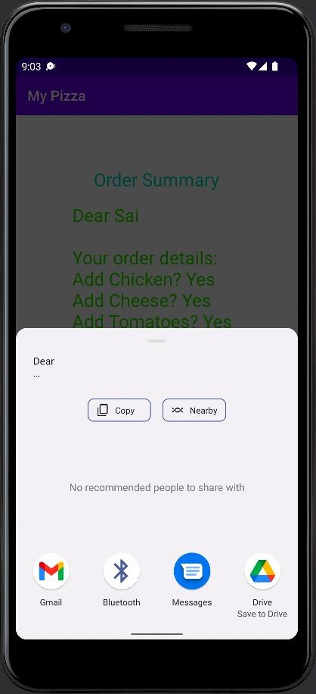
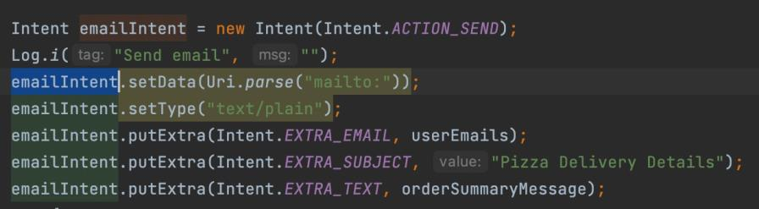
Pizza Delivery Application
Place order
Order summary
Mail to notify
Using the liner layout, we have designed form to order pizzas.
To view the summary, we redirect to new intent where we calculate price associated with each item and display final bill.
ACTION_SEND intent is used with extra information which include recipient email, subject, and content of email to send email.
Code snippet to send mail

Slide 8
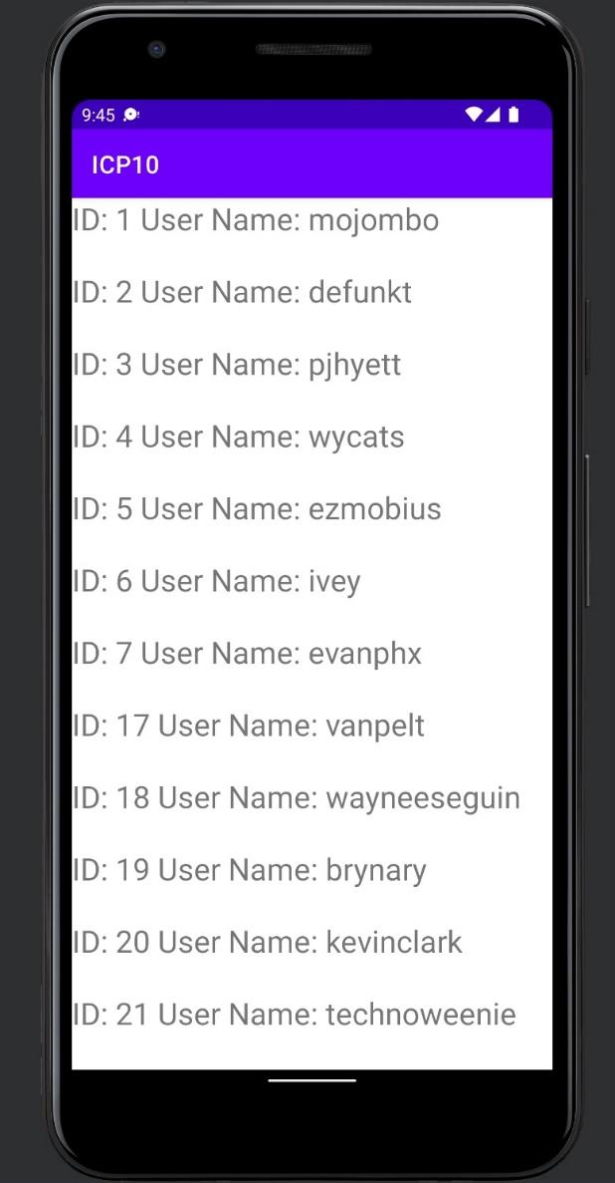
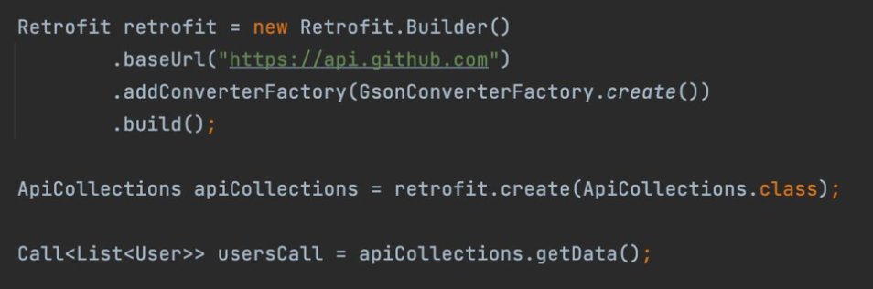
Display data using public apis
User data from GIT API
In order to fetch data from internet, user permission is added in manifest file.
Retrofit
Using retrofit we construct the API endpoint and fetch data from GIT public API.
Permission to access data from internet
Fetch data from GIT API

Slide 9
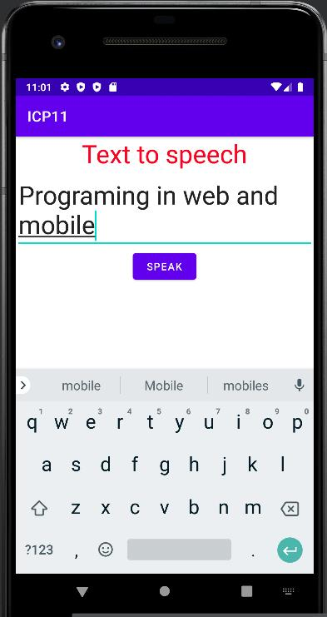
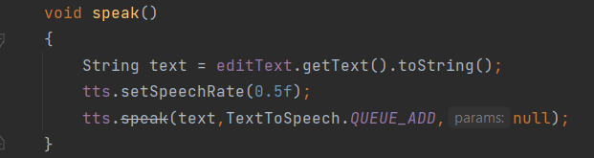
Text to speech
Text to speech application
User input is converted to text when clicked on speak button
Using TextToSpeech listener is successfully initialized we set the desired speech rate
and add the text to Queue.
The input text entered is heard in audio format.
Text to speech code snippet

Slide 10
Conclusion
By completing the above ICPs we have learnt:
Develop an android application using android studio.
The project structure followed i.e., activity_main.xml for design, MainAcitity.java for functionality and manifest file for meta data.
Redirect from one activity intent to another.
Access APIs using retrofit.
To grant user permission to access hardware components like mic and speakers and interact with them.

Slide 11
Thank you!

