Slide 1


Home Prices Analysis
Presented by: Sarita Thapar
Date: 6/13/2022

Slide 2

Introduction
The goal of this analysis is to find factors that drive home prices.
This will help investors understand what factors to consider when investing into mortgage-backed securities.

Slide 3
hypothesis
Analyzing two factors:
Garage types
Foundation types
H₁: There is no significant difference between the mean sale price for houses with built-in garage and attached garage
H₂: There is no significant difference in the mean sale price of the houses with cinder block foundation and brick & tile foundation.

Slide 4
Data
The dataset contains data for 1460 houses that were sold between 2006 and 2010 in a residential neighborhood of Ames, Iowa.
There are 82 columns with categorical and quantitative variables.
This dataset is originally from kaggle.
Descriptive Statistics of the dataset:
SalePrice
Mean | 180921.1959
Standard Error | 2079.105324
Median | 163000
Mode | 140000
Standard Deviation | 79442.50288
Sample Variance | 6311111264
Kurtosis | 6.53628186
Skewness | 1.88287576
Range | 720100
Minimum | 34900
Maximum | 755000
Sum | 264144946
Count | 1460

Slide 5
Methods
This analysis was conducted using Excel.
Pivot table was utilized to create a sample population dataset of categorical and continuous data.
Descriptive statistic in Analysis tool Pak was used to analyze the variables in the dataset.
t-Test was conducted to test the hypothesis.

Slide 6
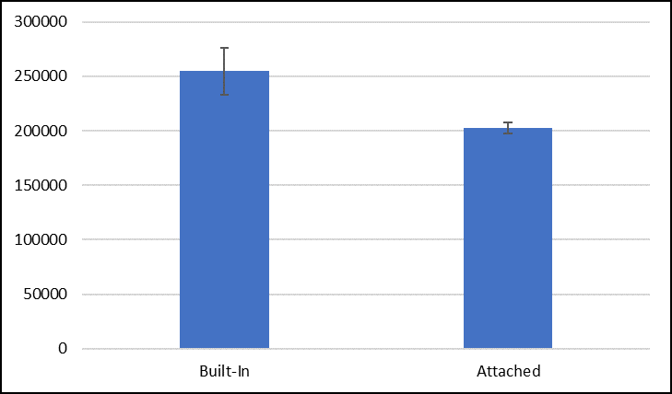
Results
H₁ : Houses with built-in garage vs attached garage
p-value of 1.14714E-05 is < our alpha of 0.05
With 95% confidence, the difference in price is between $29,615 and $74,102.
Ho: There is not a statistically significant difference between the mean
sale price for the houses with built-in garage and attached garage.
Ha: There is statistically significant difference between the mean
sale price for the houses with built-in garage and attached garage.

Slide 7
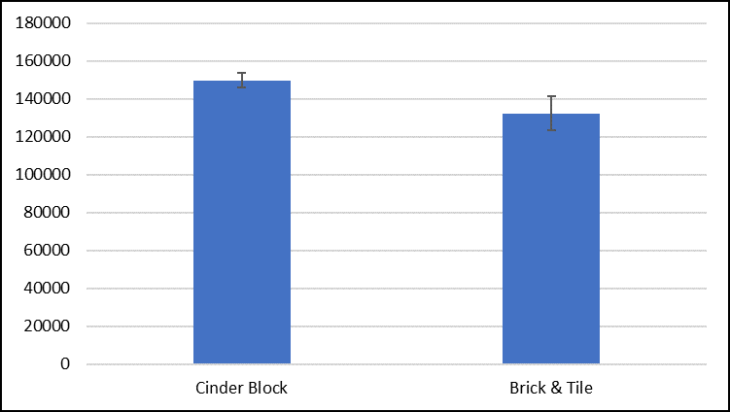
Results
H₂ : Houses with cinder block foundation vs. brick & tile foundation
p-value of 0.0004 is < our alpha of 0.05
With 95% confidence, the difference in price is between $7,835 and $27,193.
Ho: There is not a statistically significant difference in the mean
sale prices of the houses with cinder block foundation and
brick & tile foundation.
Ha: There is a statistically significant difference in the mean
sale prices of the houses with cinder block foundation and
brick & tile foundation.

Slide 8
Final recommendations
There are several factors that drive home prices and following are two factors that are recommended:
Houses with built-in garage
Houses with cinder block foundation

Slide 9
Thank you!

