Slide 1



Cost and Revenue Analysis
Prepared for: Lariat
Prepared by: thinkful consultants
Presented by: sarita thapar
Last update: 4/29/2022

Slide 2
Background
Lariat has contracted with Thinkful Consultants to perform analysis of car rental data from January to November of 2018.
The company has total of 4000 rental cars operational in 50 branches all across US.
Following are KPI based on 11 months data:
Total Revenue - $52,830,207
Total Cost - $30,320,298
Total Profit - $22,509,909

Slide 3
objective
To reduce cost and increase revenue.
Analyze the cost and revenue generated by the rental fleet.
Make suggestions on how to make smarter business decisions.
Make recommendation on how to reduce cost and increase revenue.

Slide 4
The data
Lariat has provided the following dataset from January to November of 2018. The dataset includes four data files:
car_id_mapping (maps unique car id, make, model and model year)
car_costs (monthly cost of car paid by Lariat and the insurance cost)
car_revenue (rented date, rental length in days, unique branch id, price per day, drivers age, gender and accident incident count)
branch_location (unique branch id, city and state where branch is located, true or false indicator if branch is located in an airport)

Slide 5
The process
Thinkful Consultants has taken the dataset and combined it in such a way to make it ready for analysis.
The analysis has been performed, and key findings were noted, along with recommendations to company management.
This information follows….

Slide 6
Key findings
There are cars that generate more profit than others. Top 10 of those cars with average profit are shown below:

Slide 7
Key findings
There are cars that do not generate enough profit. Average profit of 10 of those low performing cars are shown below:

Slide 8
Scenario 1
Add 100 top performing cars to the fleet.

Slide 9
Scenario 2
Discontinue 100 least performing cars from the fleet.

Slide 10
Scenario 3
This scenario is based on user input. In this chart user has entered adding 500 top ranking cars to the fleet.

Slide 11
Scenario 4
This scenario is also based on user input. In this chart user is eliminating 400 lowest ranking cars from the fleet.

Slide 12
Recommendations
Adding more top-ranking cars that are preferred by the customers is the best strategy.
Eliminating low performing cars also reduces cost.
Combining strategies to eliminate least performing cars and use the cost saving to add top performing cars would help Lariat reduce cost and increase revenue.

Slide 13
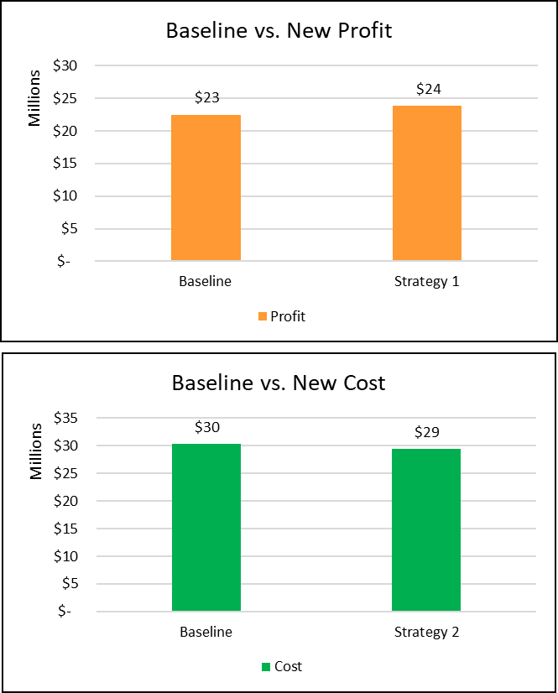
Call to action
The charts below shows how adding more top-ranking cars that are preferred by customers increases profit. It also shows how eliminating low-ranking cars can reduce cost.

Slide 14
Thank you!

