Slide 1
CUTE 4
Sarath Bhushan
Hareesh Chalamalla
SaiManasa Kudikala

Slide 2
CONTENTS
PROBLEM STATEMENT
PRE-PROCESSING
MODELS

Slide 3
PROBLEM STATEMENT
LifeLine HealthServices is a top ranked Health care provider in USA with stellar credentials.
We need to classify the ticket to an appropriate category of the call written in the “Converse” column.
Following a ticketing system for all the telephonic calls received across all the departments.
The Tickets have the details of Summary of the call and description of the calls written by various staff members with no standard text guidelines.

Slide 4
PREPROCESSING
Max length has been chosen by the number of words.
Tokenizing the sentences into words.
Padding

Slide 5
MODEL- MLP
As one-hot vectors don’t capture any relation between the words, the model was not very accurate at predicting the right class.
Accuracy on validation – 18%
To counter the problem of vanishing gradient, we have used ReLu as the activation function.

Slide 6
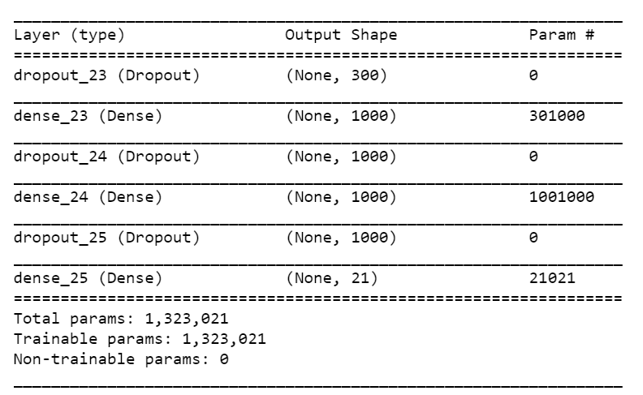
Summary of MLP

Slide 7
MODEL - MLP with Autoconders architectures
We used AE to get the initial weights for an MLP.
Accuracy -35%

Slide 8
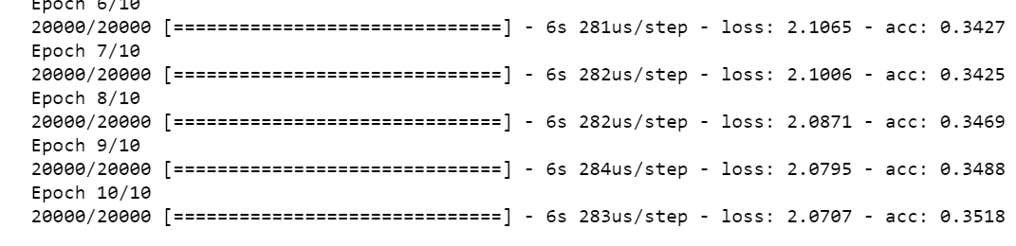
MODEL - MLP with Autoconders architectures

Slide 9
MODEL 1-D CNN
CNN-1D captures relation between consecutive words
Essence of sentence is captured hence the improvement in accuracy
Accuracy-70%

Slide 10
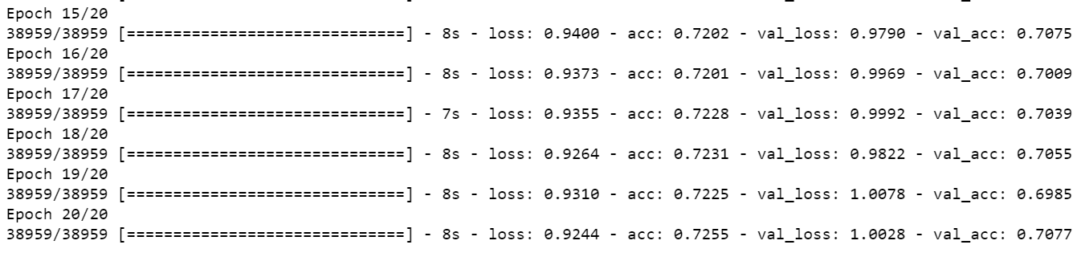
MODEL 1-D CNN

Slide 11
MODEL - LSTM
Have used 1 hidden layers 100 units with the below features
Defined initial Dropout as 0.2 and recurrent dropout as 0.2
Final activation through softmax.

Slide 12
MODEL ACCURACY
Embedded
Train-71.5
LSTM
Accuracy-70
MLP with Autoencoders
Train-35.7
MLP
Train-18.4, Validation-17.7
CNN
Train- 67.6 Validation-68.8

