Slide 1

FORMAL LANGUAGES

Slide 2

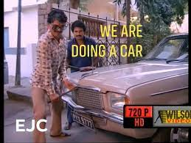
Formal Languages
Definition – A formal language consists of words whose letters are taken from an alphabet and are well-formed according to a specific set of rules.
This is a car
Sentences
Words / Strings
Letters
Alphabets
Grammar

Slide 3
Mathematically Defined Formal Languages
Languages , L
Symbols a, b, 1, 2 , Z,0,c
Alphabet (Σ)
Finite and nonempty set of symbols
{a,b,c} {0,1}
Strings
Finite set of sequence from Σ
aabbc abcccaaabb 0110110 01000000001 Є

Slide 4
Are these alphabets ?
A = { 1,2,d,v}
X={ a, b, …}
Y={}
Σ = { x,y,z}
Identify the symbols in the above alphabets !!!

Slide 5
Length of a string
Σ ={a,b}
Length of a string, n → |n|
aaabbaa
abb
a
Notes:
0 – null string – epsilon
Length of epsilon = 0

Slide 6
Powers of Σ
Σ ={a,b}
Σ^{k} = {w| w is a string of length k , k>=1}
Σ¹ Set of all strings over Σ^{k} with a length of 1
Σ² ⁼ Σ Σ Set of all strings over Σ^{k} with a length of 2
Σ^{n}
Σ⁰
Notes:
0 – null string – epsilon
Length of epsilon = 0

Slide 7
Σ ={a,b}
How many strings are possible with 2 symbols, of length 2 ?
How many strings are possible with 2 symbols, of length n ?
How many strings are possible with | Σ | symbols, of length n ?
Notes:
2
2 power n

Slide 8
Language (L)
Collection of strings
L₁ = Set of all strings with length 2
L₂= Set of all strings with length 3
L₃= Set of all strings starting with a
Finite languages
Infinite Languages
Σ ={a,b}

Slide 9
L is finite | L is infinite
Σ = {a,b} | Σ = {a,b}
L1 = Set of all strings with length 2 | L2 = Set of all strings starting with a
{aa , ab , ba , bb} | {a, aa , ab, aba, abb , abba , abadb , …}
Check whether “ab” is valid | Check whether “ab” is valid
Check whether “bbab” is valid | Check whether “bbab” is valid

Slide 10
Kleene Closure
Σ* = Σ⁰ U Σ¹ U Σ² U Σ ³ … U Σ^{n}
Null allowed
Universal Set
Infinite too !!!
Positive Closure
Σ⁺ = Σ¹ U Σ² U Σ ³ … U Σ^{n}
Null not allowed
Notes:
L1 l2 l3 are subsets of sigma star

Slide 11
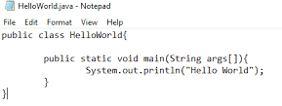
Application of Formal Languages
Java Programming
Σ
String –> Program
Language → All programs → Infinite
Is a given Program, P, present in the Language, L ????

Slide 12
L is finite | L is infinite
Σ = {a,b} | Σ = {a,b}
L1 = Set of all strings with length 2 | L1 = Set of all strings starting with a
{aa , ab , ba , bb} | {a, aa , ab, aba, abb , abba , abadb , …}
Check whether “ab” is valid | Check whether “ab” is valid
Check whether “bbab” is valid | Check whether “bbab” is valid

Slide 13
Theory of Automata

Slide 14
Finite Automaton
Finite Automata(FA) is the simplest machine to recognize patterns
Basically it is an abstract model of a digital computer.
Used to recognize patterns.

Slide 15
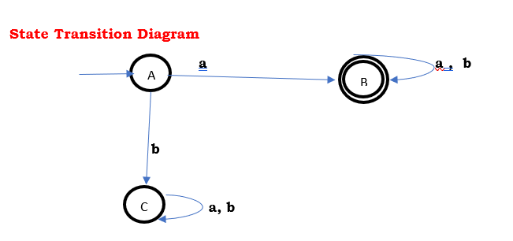
How does a FA work ?
L is infinite
Σ = {a,b}
L1 = Set of all strings starting with a
{a, aa , ab, aba, abb , abba , abadb , …}
Check whether “abba” is valid
Check whether “bbab” is valid

Slide 16
How does a FA work
It takes the string of symbol as input and changes its state accordingly.
When the desired symbol is found, then the transition occurs.
At the time of transition, the automata can either move to the next state or stay in the same state.
Finite automata have two states, Accept state or Reject state.
When the input string is processed successfully, and the automata reached its final state, then it will accept.

Slide 17
Families of Automata
Finite Automata
FA with Output
FA without Output
DFA
Moore Machines
Mealy Machines
NFA
Є - NFA

Slide 18
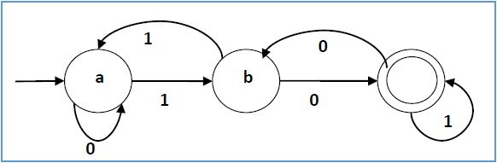
DFA Deterministic Finite Automata

Slide 19
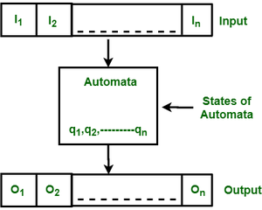
Structure of DFA - Quintuple
Input
Output
States of automata
State relation
Output relation

Slide 20
Formal specification of machine is { Q, Σ, δ ,q₀, F}.
Q : Finite set of states.
Σ : set of Input Symbols.
δ : Transition Function.
q₀ : Initial state.
F : set of Final States.

Slide 21
Formal specification of machine is { Q, Σ, δ ,q₀, F}.
Q : Finite set of states.
Σ : set of Input Symbols.
δ : Transition Function.
q₀ : Initial state.
F : set of Final States.

Slide 22
1. Define the DFA 2. Check Validity
L is infinite
Σ = {a,b}
L1 = Set of all strings starting with a
{a, aa , ab, aba, abb , abba , abadb , …}
Check whether “abba” is valid
Check whether “bbab” is valid

Slide 23
1. Construct a DFA that accepts set of all strings over Σ = {a,b} of length 2.

Slide 24
1. Construct a DFA that accepts set of all strings over Σ = {a,b} of length 2.
Σ = {a,b}
L={w| w is a string |w|=2}
L={aa, ab , ba , bb}

Slide 25
1. Construct a DFA that accepts set of all strings over Σ = {a,b} of length 2.
Σ = {a,b}
L={w| w is a string |w|=2}
L={aa, ab , ba , bb}
Take the smallest string, and construct a skeleton automata
Check all possibilities by scanning the strings
Reach a final state
Check for a trap state
Construct a State Transition Table

Slide 26
String acceptance by a DFA
Start from Initial state
Scan the entire string
Reach the final state

Slide 27
Language acceptance by a DFA
Accept all strings in the language
Reject all strings not in the language

Slide 28
String acceptance by a DFA
Start from Initial state
Scan the entire string
Reach the final state

Slide 29
2. Construct a DFA that accepts set of all strings over Σ = {a,b} of length >=2.
L= {aa, ab, ba, bb, aaa, aba , …}
Infinite → DFA can be defined

Slide 30
3. Construct a DFA that accepts set of all strings over Σ = {a,b} of length <=2.
L = {Є, a, b, aa,ab,ba, bb}

Slide 31
Relationship between string length & no: of states
Length of string | |w|=2 | |w|>=2 | |w|<=2
Number of states | 4 | 3 | 4

Slide 32
Relationship between string length & no: of states
Length of string | |w|=2 | |w|>=2 | |w|<=2
Number of states | 4 | 3 | 4
Length of string | |w|=n | |w|>=n | |w|<=n
Number of states | n+2 | n+1 | n+2

Slide 33
4. Construct a DFA that accepts set of all strings over Σ = {0,1} which ends with 0
L= {0 , 00, 10 , 000, 1010, 110 ,… }

Slide 34
5. Construct a DFA over Σ = {0,1} which accepts 101 L ={ 101} 6. Construct a DFA over Σ = {0,1} which accepts strings with three consecutive 1’s L ={ 111, 00111,1110, 1110111, ….}

Slide 35
NFA – Non Deterministic Finite Automata
DFA Vs NFA
On an input w,
q1 → q2 q1→q2
q1→q3
…
q1→qn
Ends in a single state Can end in more than one state

Slide 36
Need for NFA
Exhaustive searching
Backtracking

Slide 37
Formal specification of machine is { Q, Σ, δ ,q₀, F}.
Q : Finite set of states.
Σ : set of Input Symbols.
δ : Transition Function.
q₀ : Initial state.
F : set of Final States.

Slide 38
1. Construct an NFA that accepts set of all very string ending with ‘a’ over Σ = {a,b}
L ={ a,aa, ba, bba, ababbaaa, …}

Slide 39
2. L= {All string starting with ‘a’}
Σ = {a,b}
3. L= {All strings contain ‘a’}
Σ = {a,b}

Slide 40
4. L= {Every string starts with ‘ab’}
Σ = {a,b}

Slide 41
Equivalence of DFA and NFA
DFA is already NFA
NFA←→DFA
Principle of Subset Extraction

Slide 42
1. L= {Every string starts with ‘a’}
Σ = {a,b}
2. L= {Every string ends with ‘a’}
Σ = {a,b}
3. L= {Every string’s second symbol is ‘a’}
Σ = {a,b}

Slide 43
Regular Expressions
A sequence of characters that define a search pattern
Most effective way to represent any language.
Language accepted by finite automata can be easily described by simple expressions called Regular Expressions.
Regular Expressions are used to denote regular languages.
RE are mathematical expressions

Slide 44
Operations of Regular Expressions
Union (+)
Concatenate ( . )
Kleene Closure (*)

Slide 45
Properties of Regular Expressions
1. Primitive RE
If Φ is the empty set, it is represented as {}
If Є is the empty string, it is represented as {Є}
If a Є Σ , it is represented as {a}
2. If r1 and r2 are primitive RE
r1+r2 is an RE
r1. r2 is an RE
r1*is an RE
3. If a and b are used several times, the result is also an RE

Slide 46
RE | Language
Φ | {}
Є | {Є}
a | {a}
a* | {Є,a ,aa, aaa , …}
a+ | {a ,aa, aaa , …}
(a+b)* | {Є,a, b, aa, ab, ba, bb, …)

Slide 47
Examples of RE Σ ={a,b}
Language | Strings in the language | RE
{length of 2}
{length atleast 2}
{length atmost 2}
{Even length string}
{odd Length string}
Length of string should be divisible by 3
Length of string should be 2 mod 3

Slide 48
Examples of RE Σ ={a,b}
Language | Strings in the language | RE
Exactly 2 a’s
Atleast 2 a’s
Atmost 2 a’s
Even number of a’s
Odd number of a’s
Starts with a
Ends with a
Containing a
Start and end with a
Start and end with different symbols
Start and end with same symbols

Slide 49
Regular Grammar
Grammar – Description of a language by rules.
A grammar G can be formally written as a 4-tuple (V, T, S, P) where −
V is a set of variables or non-terminal symbols / vertices.
T is a set of Terminal symbols.
P is Production rules for Terminals and Non-terminals.
S is a special variable called the Start symbol

Slide 50
Derivation
Derivation→ Getting a string from grammar, starting from S
S → aSB
S → aB
B → b
Derivation of aabb

Slide 51
2. Set of all strings of length 2

Slide 52
3. a^{n}/n>=0

Slide 53
4. Set of all strings over a , b

Slide 54
5. Set of all strings of at least length 2

Slide 55
6. Set of all strings of atmost length 2

Slide 56
7. Set of all strings start with ‘a’ and end with ‘b’

Slide 57
8. Set of all strings starting and ending with a different character

Slide 58
9. Set of all strings starting and ending with same character

Slide 59
10. a^{n}b^{n}/n>=1

Slide 60
11. Even length strings

Slide 61
12. a^{n}b^{m}/n>=1

Slide 62
13. a^{n}b^{n}c^{m}/n>=1

Slide 63
14. a^{n}c^{m}b^{n}/n>=1

Slide 64
Types of Languages
Regular Languages
A language is regular if it can be expressed in terms of regular expression
Finite State machines will recognize Regular Languages.
Non - Regular Languages
A language is non regular if it cannot be expressed in terms of regular expression

Slide 65
Properties of Regular Languages
Union : If L1 and If L2 are two regular languages, their union L1 ∪ L2 will also be regular.
Eg: L1 = {a^{n} | n ≥ 0} and L2 = {b^{n} | n ≥ 0} L3 = L1 ∪ L2 = {a^{n} ∪ b^{n} | n ≥ 0} is also regular.
2. Intersection : If L1 and If L2 are two regular languages, their intersection L1 ∩ L2 will also be regular.
Eg: L1= {a^{m} b^{n} | n ≥ 0 and m ≥ 0} and L2= {a^{m} b^{n} ∪ b^{n} a^{m} | n ≥ 0 and m ≥ 0} L3 = L1 ∩ L2 = {a^{m} b^{n} | n ≥ 0 and m ≥ 0} is also regular.
3. Concatenation : If L1 and If L2 are two regular languages, their concatenation L1.L2 will also be regular.
Eg: L1 = {a^{n} | n ≥ 0} and L2 = {b^{n} | n ≥ 0} L3 = L1.L2 = {a^{m} . b^{n} | m ≥ 0 and n ≥ 0} is also regular.

Slide 66
4. Kleene Closure : If L1 is a regular language, its Kleene closure L1* will also be regular.
Eg: L1 = (a ∪ b) L1* = (a ∪ b)* 5. Complement : If L(G) is regular language, its complement L’(G) will also be regular. Complement of a language can be found by subtracting strings which are in L(G) from all possible strings.
Eg: L(G) = {a^{n} | n > 3} L’(G) = {a^{n} | n <= 3}

Slide 67
Non Regular Languages
Languages which are not regular
Cannot be represented and identified by a FSM
Languages which require memory
Memory of FSM is very limited
It cannot store or count strings

Slide 68
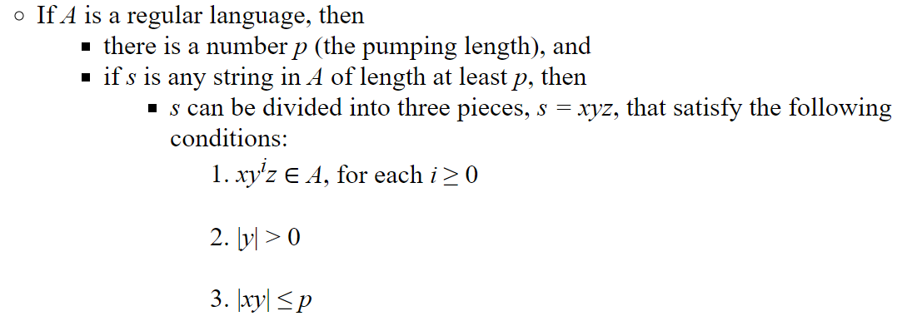
Pumping Lemma for Regular Languages
Used to prove that a language is not regular
Cannot prove that a language is regular

Slide 69
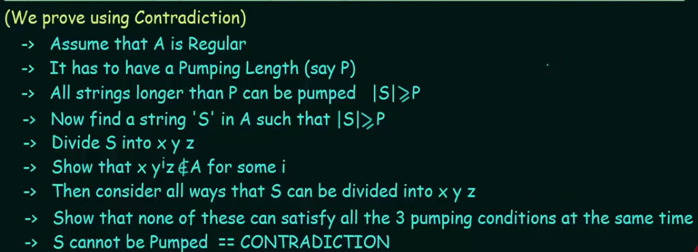
Steps to Perform Pumping Lemma (Proof by Contradiction)

Slide 70
1. P. T A={a^{n}b^{n} | n>=0} is not regular

Slide 71
2. P. T A={yy | y Є (0,1)*} is not regular

Slide 72
