Slide 1
Android Intents

Slide 2
ANDROID INTENTS - exercises
Create an app that launches a web page.
Create an app that launches another activity on a button click
Create an app that takes two numbers from the user and displays its sum on the next activity.

Slide 3
Android IntentS
Android Intents: Mechanism by which one activity can trigger the launch of another activity.
android.content.Intent (Import this class)

Slide 4
An Overview of Android IntentS
Intents also allow for the transfer of data from the sending activity to the receiving activity.

Slide 5
Explicit Intents
An explicit intent requests the launch of a specific activity by referencing the component name (which is actually the class name) of the target activity.
Most common when launching an activity residing in the same application as the sending activity.

Slide 6
Explicit Intents
Intent i = new Intent(this, ActivityB.class);
startActivity(i);

Slide 7
Explicit Intents- Pass VALUES TO RECEIVING ACTIVITY
Intent i = new Intent(this, ActivityB.class);
i.putExtra("myString", "This is a message for ActivityB");
i.putExtra("myInt", 100);
startActivity(i);

Slide 8
Explicit Intents
To extract the data values passed to ActivityB:
Bundle extras = getIntent().getExtras();
if (extras != null) {
String myString = extras.getString("myString");
int myInt = extras.getInt("myInt");
}

Slide 9
Implicit Intents
Implicit intents identify the activity to be launched by specifying the action to be performed and the type of data to be handled by the receiving activity.
Example: load a web page
  An action type of ACTION_VIEW accompanied by the URL of a web page in the form of a URI object will instruct the Android system to search for, and subsequently launch, a web browser capable activity.
Intent intent = new Intent(Intent.ACTION_VIEW, Uri.parse("http://www.ebookfrenzy.com"));
startActivity(intent);

Slide 10
Implicit Intents
When the above implicit intent is issued by an activity, the Android system will search for activities on the device that have registered the ability to handle ACTION_VIEW requests on http scheme data
  Using a process referred to as intent resolution.

Slide 11
Using Intent Filters
Intent filters are the mechanism by which activities “advertise” supported actions and data handling capabilities to the Android intent resolution process.
An activity capable of displaying web pages would include an intent filter section in its manifest file indicating support for the ACTION_VIEW type of intent requests on http scheme data.
Both the sending and receiving activities must have requested permission for the type of action to be performed.
  Achieved by adding <uses-permission> tags to the manifest files of both activities.

Slide 12
Using Intent Filters
Following manifest lines request permission to access the internet and contacts database:
<uses-permission android:name="android.permission.READ_CONTACTS" />
<uses-permission android:name="android.permission.INTERNET"/>
The following AndroidManifest.xml file illustrates a configuration for an activity named WebViewActivity with intent filters and permissions enabled for internet access:

Slide 13
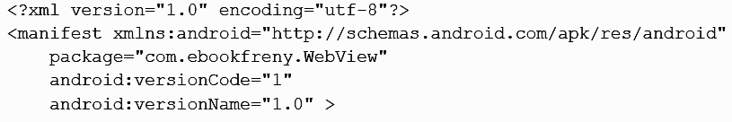

Using Intent Filters

Slide 14
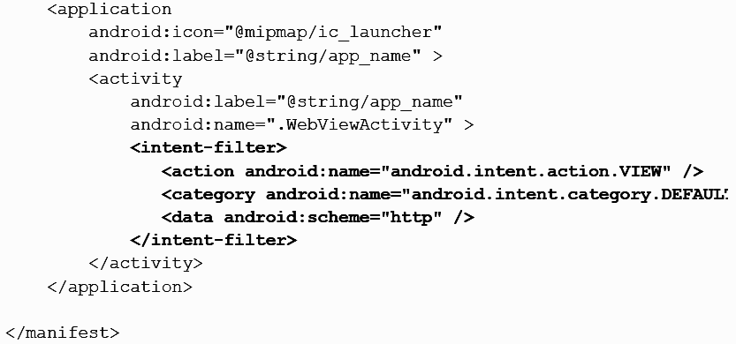
Using Intent Filters

Slide 15
Common implicit intents
https://guides.codepath.com/android/Common-Implicit-Intents

Slide 16
Thank YOU

