Slide 1
Radio Button & Check Boxes

Slide 2
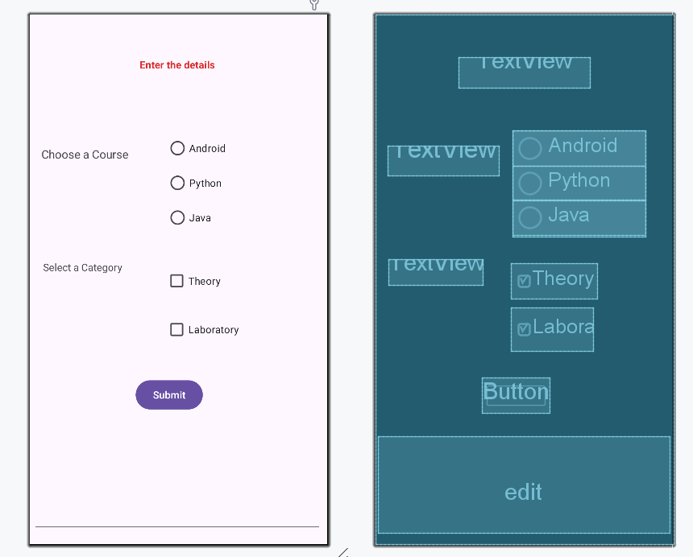
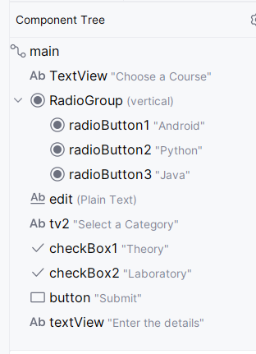
activity_main.xml

Slide 3
activity_main.xml
Insert a RadioGroup from the Palette.
  Insert three RadioButton into the RadioGroup (use drag & drop)
  RadioButton enables single selection at a time
Insert two CheckBox
  Multiple checkboxes can be selected at a time
Insert a Button
Insert an EditText (display values of RadioButton and Checkboxes selected)

Slide 4
MainActivity.java
Import the following:
import android.view.View;
import android.widget.Button;
import android.widget.CheckBox;
import android.widget.RadioButton;
import android.widget.RadioGroup;
import android.widget.EditText;

Slide 5
MainActivity.java
public class MainActivity extends AppCompatActivity {
private RadioGroup radioGroup;
private CheckBox ch1,ch2;
private EditText edit;
protected void onCreate(Bundle savedInstanceState) {
super.onCreate(savedInstanceState);
setContentView(R.layout.activity_main);

Slide 6
MainActivity.java
//write the following code in onCreate()
radioGroup=findViewById(R.id.RadioGroup);
ch1=findViewById(R.id.checkBox1);
ch2=findViewById(R.id.checkBox2);
edit=findViewById(R.id.edit);
}

Slide 7
MainActivity.java
//button onclick function: register with onclick property of button
public void submit(View v)
{
//find the id of the currently selected radio button
int selectedID = radioGroup.getCheckedRadioButtonId();
//Assign it to variable "selected“ by finding id
RadioButton selected = findViewById(selectedID);
//Extract the text from the radio button
String selected_text= selected.getText().toString();

Slide 8
MainActivity.java
//Create a string to append the texts from checkbox selections using StringBuilder class
StringBuilder ch_text= new StringBuilder();
//Checkbox permits multiple selections, append each selection to the end of previous string
if(ch1.isChecked())
{
ch_text.append(ch1.getText()).append(" ");
}

Slide 9
MainActivity.java
if(ch2.isChecked())
{
ch_text.append(ch2.getText()).append(" ");
}
//display on EditText
edit.setText("Selected Course: " + selected_text + "Selected Category: " +ch_text);
}
}

Slide 10
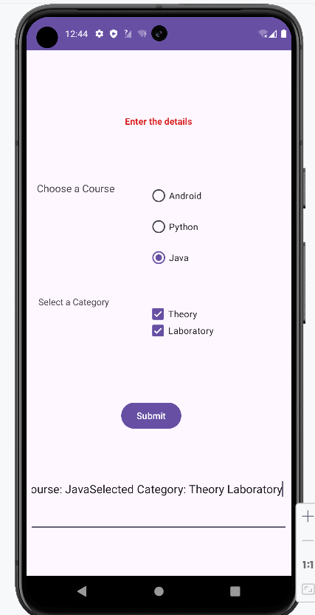
Run on emulator

