Slide 1
Exercise 1 - SQLite

Slide 2
Question
Create an app that demonstrates registration and login with SQLite Database

Slide 3
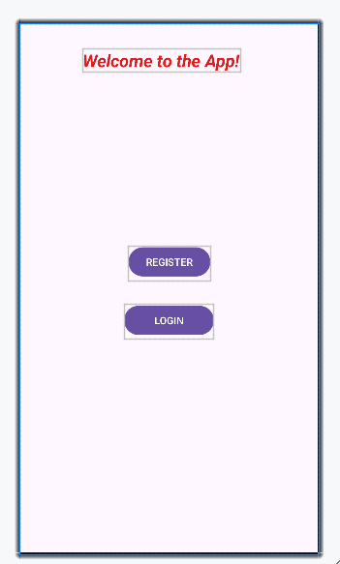
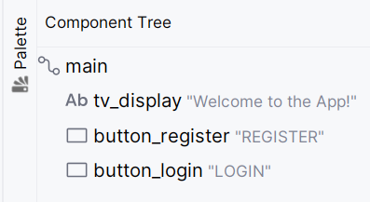
activity_main.xml
Main Activity contains two buttons.
Clicking on “REGISTER” button launches RegisterActivity
Clicking on “LOGIN” button launches LoginActivity

Slide 4
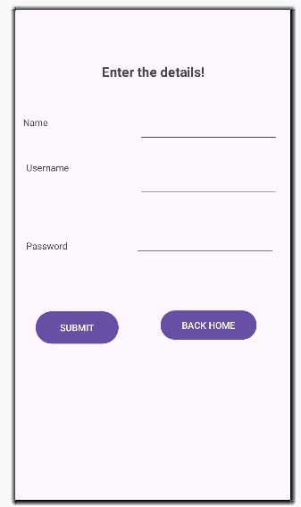
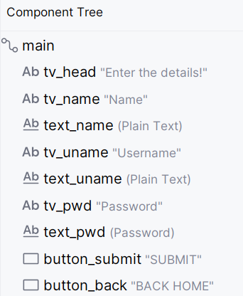
activity_register.xml
Create a new activity.
Click on Project > Package name > new > Activity > Empty Views Activity
Name: RegisterActivity
Insert EditText fields to collect Name, Username and Password from user.
Clicking on “SUBMIT” adds the data to the database.
Clicking on “BACK HOME” launches the main activity.

Slide 5
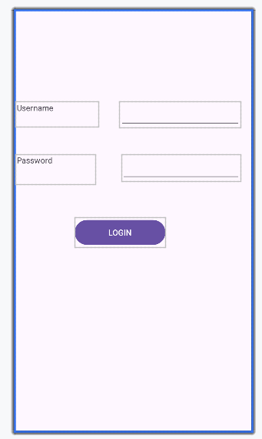
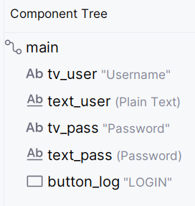
activity_login.xml
Create a new activity.
Click on Project > Package name > new > Activity > Empty Views Activity
Name: LoginActivity
Insert EditText for entering username and Password Text for entering password of the registered user.
Clicking on “LOGIN” checks the credentials and launches a new activity on successful login.

Slide 6

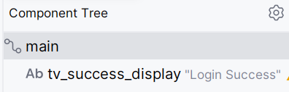
activity_success_login.xml
Create a new activity.
Click on Project > Package name > new > Activity > Empty Views Activity
Name: SuccessLoginActivity
A message “Login Success” is displayed on a textView during design
If login is success, this activity is launched.
It displays “Welcome username”

Slide 7
DBHandler.java
Create a new class
Project > java > New > Java Class
Name: DBHandler
This is the class where database is created, table is created, insert and select operations will be written.
By creating object for DBHandler, appropriate methods of this class can be invoked from other java activities.
(DBHandler.java is shared)
SQLite Classes: SQLiteDatabase, SQLiteOpenHelper, Cursor, ContentValues (study methods of each class, refer previous ppt)

Slide 8
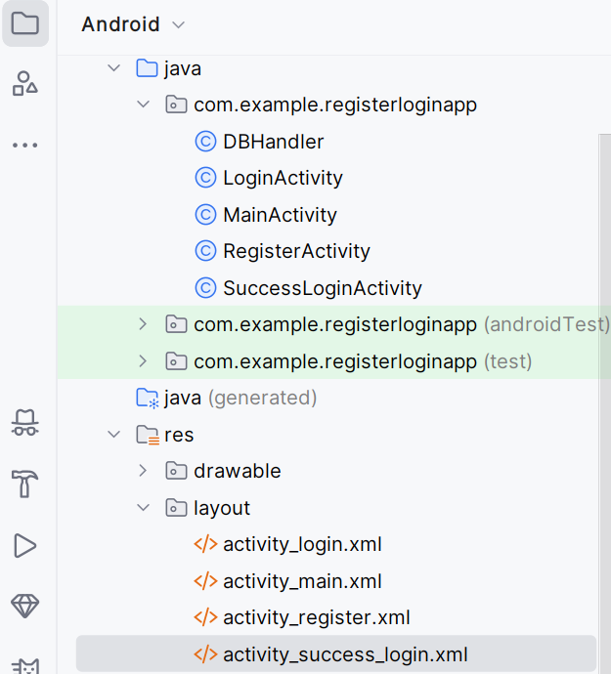
Structure of the project

Slide 9
How to see our database and table contents
One way is to use : DB Browser for SQLite
https://sqlitebrowser.org/dl/
From the above link, install DB Browser that matches the specification of your system.
How to open the database in DB Browser?
Go to Tools > Device Manager
Click on the overflow (three-dot) icon on the currently running device.
Click on “Open in Device Explorer” options from the drop down list
Click on data > data > package name (com.example.name_of_your_app)
Click on databases > name of your database > right click > save as
Select a location to save the file > click on ok

Slide 10
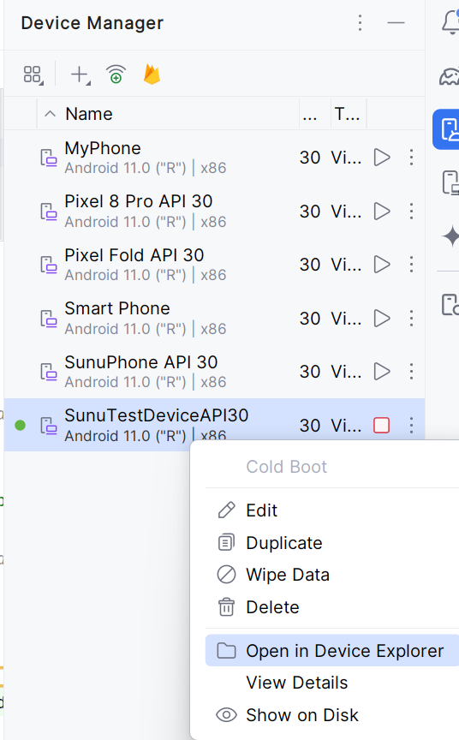

Slide 11
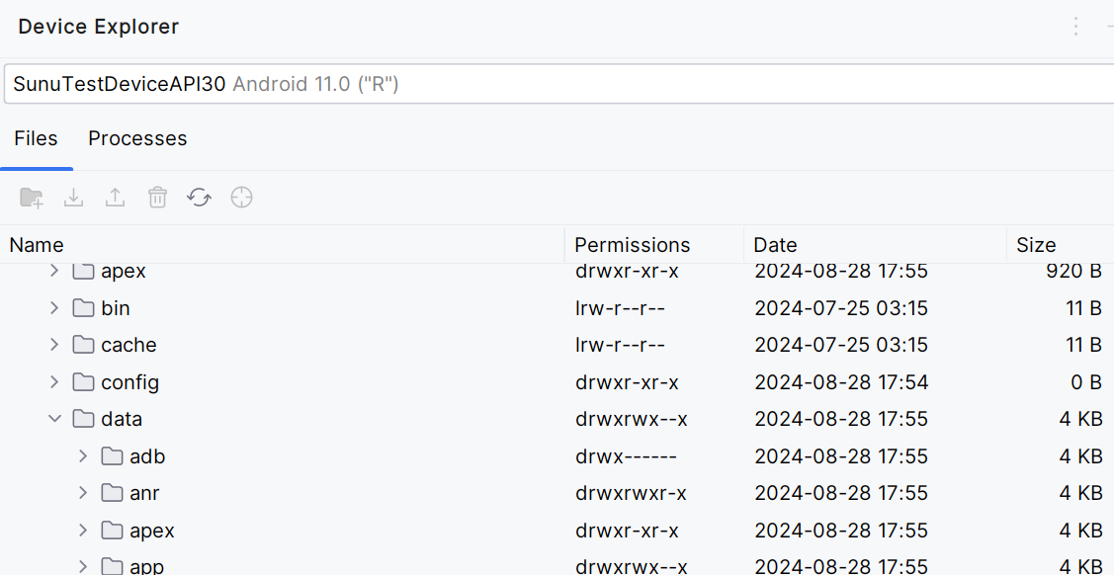

Slide 12
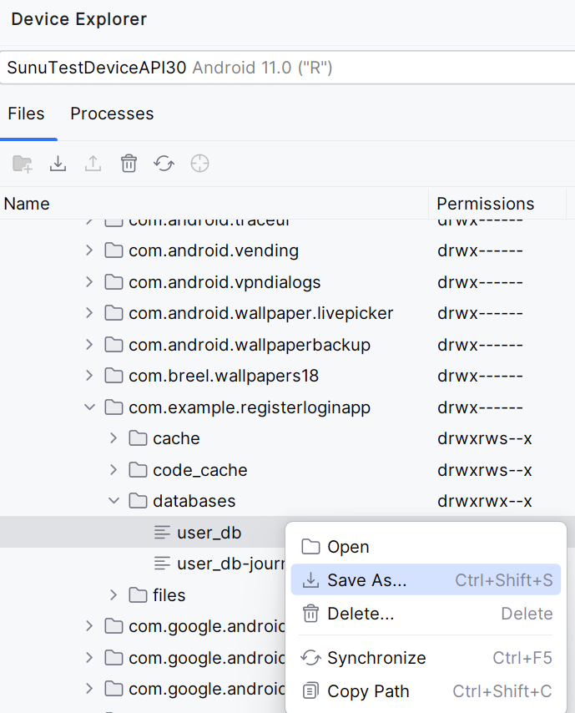
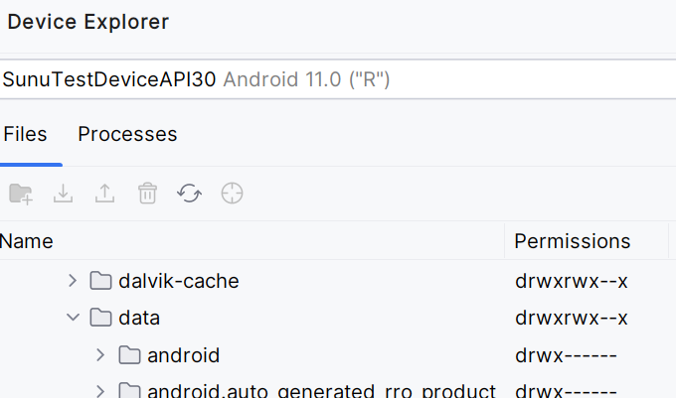

Slide 13
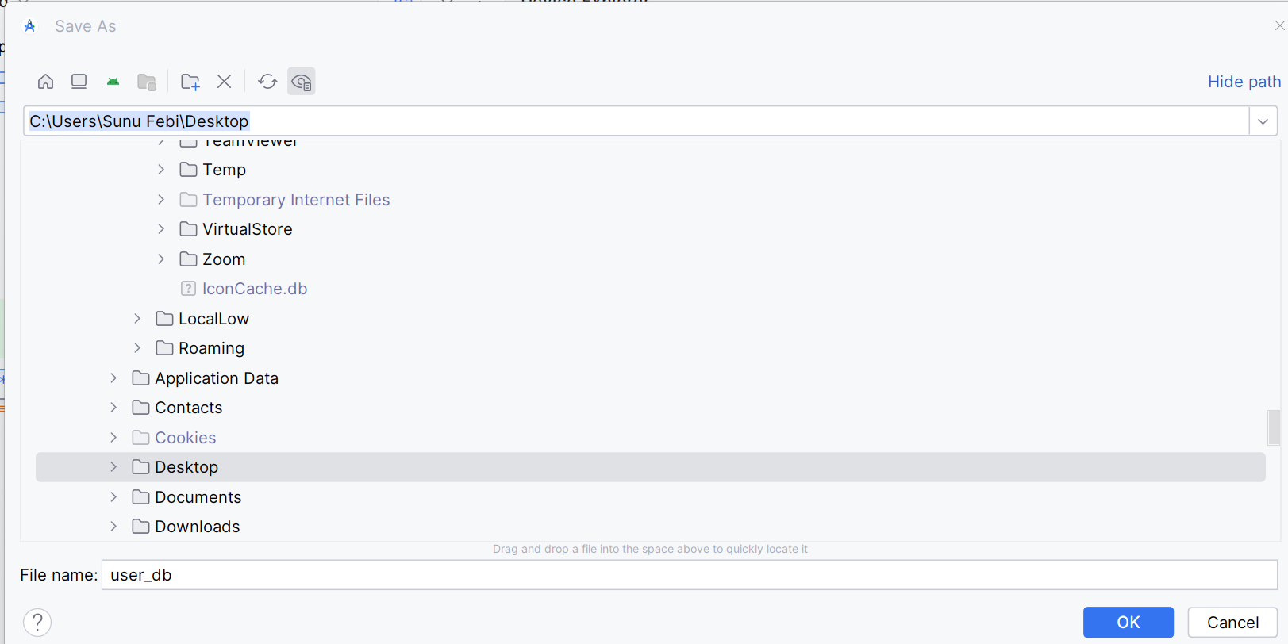

Slide 14
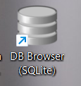
Open the database in DB Browser for SQlite
Open DB Browser
Click on Open Database
Select the location where you saved the db file
Select All files in the last window and select the db file
Click on Open
Select your table (user_details)
Right click > Browse Table
The table is opened
Note: Everytime you execute the app, repeat this procedure (download & open with DB Browser) to get updated table. (SQLite is embedded, no standalone server)

Slide 15
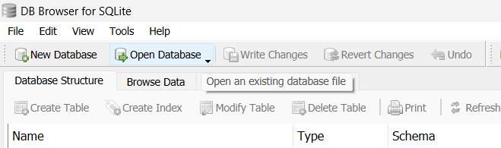
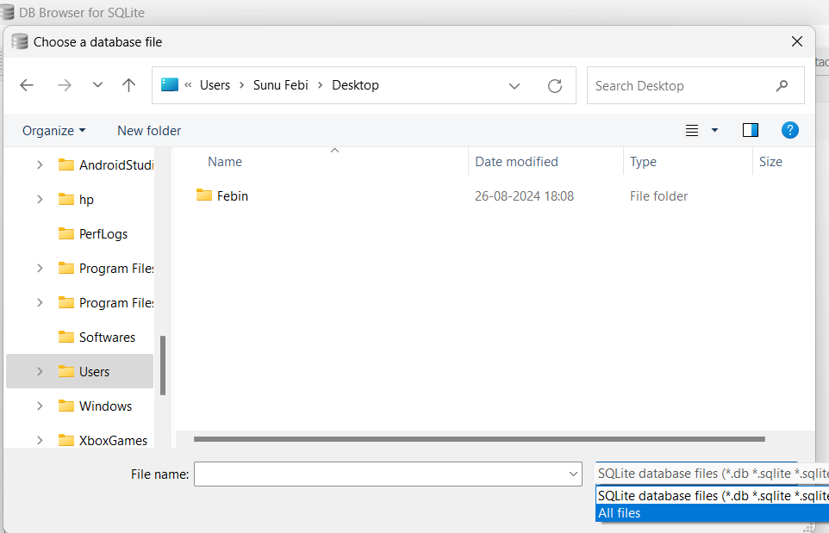

Slide 16
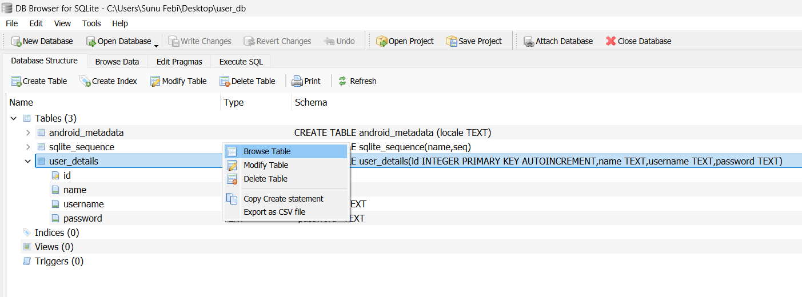

Slide 17
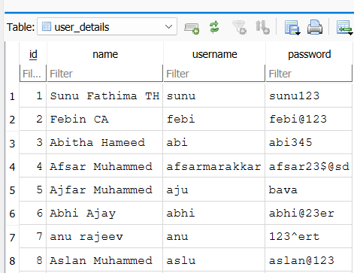

Slide 18
Please NOTE
All the java files required for this application are shared. (Comments are added to provide you details, read that & understand instead of copy paste the code)
A snapshot of component tree of every activity is also posted. (Refer that, in order to identify the ids that I have given for the widgets)
Complete the project and run the app.
Open the database in DB Browser to view the contents.

Slide 19
THANK YOU

