Slide 1
Applets
An applet is a small application that are accessed on an Internet Server, transported over an Internet, automatically installed and run as part of a Web document
Example
import java.awt.*;
import java.applet.*;
public class SimpleApplet extends Applet
{
public void paint(Graphics g)
{
g.drawString("A Simple Applet", 20, 20);
}
}

Slide 2
Two import statements
Abstract Window Toolkit (AWT)
Applet interacts with user through AWT not through console based I/O
Applet package
Subclass of Applet
Class should be public
paint() defined by AWT and overridden by the applet
used to redisplay output
Called when applet begins execution
One parameter of type Graphics
Run in a window
Output to applet is by drawString(), NOT System.out.println( )
Member of Graphics class
void drawString(String message, int x, int y)
Upperleft of window is 0,0
Does not have a main()
Executed in a web browser or appletviewer (NOT in console)

Slide 3
Using Web Browser
Once an applet has been compiled, it is included in an HTML file using the APPLET tag
Executed by a Java-enabled web browser when it sees the APPLET tag within the HTML file
Eg:
<html>
<head>
<title>Simple Applet</title>
</head>
<body>
<applet code="SimpleApplet" width=200 height=60>
</applet>
</body>
</html>

Slide 4
Using Applet Viewer
Once an applet has been compiled, execute the HTML file
C:\>appletviewer RunApp.html
Include a comment at the head of your Java source code file that contains the APPLET tag.
import java.awt.*;
import java.applet.*;
/*
<applet code="SimpleApplet" width=200 height=60>
</applet>
*/
public class SimpleApplet extends Applet {
public void paint(Graphics g) {
g.drawString("A Simple Applet", 20, 20);
}
}
Compile and execute using appletviewer
C:\>appletviewer SimpleApplet.java

Slide 5
Applet class
Java.applet package
Defines 3 interfaces AppletContext, AudioClip, and AppletStub
Support for applet execution, such as starting and stopping
Provides methods load/display images & load/play audio clips
Applet extends the AWT class Panel
Panel extends Container, which extends Component
All support for window based graphical interface

Slide 6
Applet skeleton
init()
Called when an applet begins execution. It is the first method called for any applet.
start()
Called by the browser when an applet should start (or resume) execution. It is automatically called after init( ) when an applet first begins.
stop()
Called by the browser to suspend execution of the applet. Once stopped, an applet is restarted when the browser calls start( ).
destroy()
Called by the browser just before an applet is terminated.
paint()
Called each time applet’s output must be redrawn

Slide 7
update()
Applets need to override update() defined by AWT
Update needed when portion of window is redrawn

Slide 8
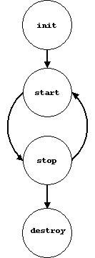

Slide 9
import java.awt.*;
import java.applet.*;
/*
<applet code="AppletSkel" width=300 height=100>
</applet>
*/
public class AppletSkel extends Applet {
// Called first.
public void init() {
// initialization
}
/* Called second, after init(). Also called whenever
the applet is restarted. */
public void start() {
// start or resume execution }

Slide 10
// Called when the applet is stopped.
public void stop() {
// suspends execution
}
/* Called when applet is terminated. This is the last
method executed. */
public void destroy() {
// perform shutdown activities
}
// Called when an applet's window must be restored.
public void paint(Graphics g) {
// redisplay contents of window
}
}

Slide 11
Applet initialization & termination
When applet begins
1. init( )
2. start( )
3. paint( )
When applet ends
1. stop( )
2. destroy( )

Slide 12
Applet display methods
void drawString(String message, int x, int y);
void setBackground(Color newColor);
void setForeground(Color newColor);
newColor – specifies constants that represent colours
eg: setForeground(Color.black);
Color getBackground();
Color getForeground();
Notes:
Sample.java Sample.html

Slide 13
Requesting Repainting
An applet writes to its window only when its update( ) or paint( ) method is called by the AWT
Whenever your applet needs to update the information displayed in its window, it simply calls repaint( )
Call applet’s update( ) method, which calls paint( )
void repaint( )
causes the entire window to be repainted
void repaint(int left, int top, int width, int height)
specifies a region to be repainted

Slide 14
A Simple Banner Applet
import java.awt.*;
import java.applet.*;
/*
<applet code="SimpleBanner" width=300 height=50>
</applet>
*/
public class SimpleBanner extends Applet implements Runnable {
String msg = " A Simple Moving Banner.";
Thread t = null;
int state;
boolean stopFlag;
public void init() {
setBackground(Color.cyan);
setForeground(Color.red);
}
public void start() {
t = new Thread(this);
stopFlag = false;
t.start();
}

Slide 15
public void run() {
char ch;
for( ; ; ) {
try {
repaint();
Thread.sleep(250);
ch = msg.charAt(0);
msg = msg.substring(1, msg.length());
msg += ch;
if(stopFlag)
break;
} catch(InterruptedException e) {}
}
}
public void stop() {
StopFlag = true;
t = null;
}
public void paint(Graphics g) {
g.drawString(msg, 50, 30);
}
}

Slide 16
The HTML APPLET Tag
< APPLET
[CODEBASE = codebaseURL]
CODE = appletFile
[ALT = alternateText]
[NAME = appletInstanceName]
WIDTH = pixels HEIGHT = pixels
[ALIGN = alignment]
[VSPACE = pixels] [HSPACE = pixels]
>
[< PARAM NAME = AttributeName VALUE = AttributeValue>]
[< PARAM NAME = AttributeName2 VALUE = AttributeValue>]
. . .
[HTML Displayed in the absence of Java]
</APPLET>

Slide 17
CODEBASE -specifies the base URL of the applet code
CODE -name of the file containing applet’s compiled .class file.
ALT -a short text message that should be displayed if the browser recognizes the APPLET tag but can’t currently run Java applets.
NAME -name for the applet instance.

Slide 18
WIDTH and HEIGHT -the size (in pixels)of the applet display
ALIGN -alignment of the applet
VSPACE and HSPACE -space, in pixels, above and below the applet
PARAM NAME and VALUE -applet-specific arguments in an HTML page.
getParameter( ) method

Slide 19
Passing Parameters to Applets
import java.awt.*;
import java.applet.*;
/*
<applet code="ParamDemo" width=300 height=80>
<param name=fontName value=Courier>
<param name=fontSize value=14>
<param name=leading value=2>
<param name=accountEnabled value=true>
</applet>
*/
public class ParamDemo extends Applet{
String fontName;
int fontSize;
float leading;
boolean active;
public void start() {
String param;
fontName = getParameter("fontName");
if(fontName == null)
fontName = "Not Found";
param = getParameter("fontSize");
try {
if(param != null) // if not found
fontSize = Integer.parseInt(param);
else

Slide 20
fontSize = 0;
} catch(NumberFormatException e) {
fontSize = -1;
}
param = getParameter("leading");
try {
if(param != null) // if not found
leading = Float.valueOf(param).floatValue();
else
leading = 0;
} catch(NumberFormatException e) {
leading = -1;
}
param = getParameter("accountEnabled");
if(param != null)
active = Boolean.valueOf(param).booleanValue();
}
public void paint(Graphics g) {
g.drawString("Font name: " + fontName, 0, 10);
g.drawString("Font size: " + fontSize, 0, 26);
g.drawString("Leading: " + leading, 0, 42);
g.drawString("Account Active: " + active, 0, 58);
}
}

Slide 21
getDocumentBase( ) and getCodeBase( )
document base -directory holding the HTML file that started the applet
code base -the directory from which the applet’s class file was loaded
These directories are returned as URL objects by getDocumentBase( ) and getCodeBase( )
URL url = getCodeBase(); // get code base
msg = "Code base: " + url.toString();
g.drawString(msg, 10, 20);
url = getDocumentBase(); // get document base
msg = "Document base: " + url.toString();
g.drawString(msg, 10, 40);

Slide 22
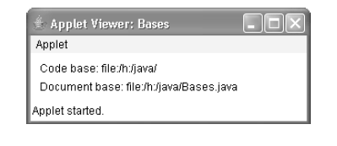

Slide 23
AppletContext and showDocument( )
AppletContext -interface that lets you get information from the applet’s execution environment.
showDocument( ) - transfer control to another URL
public void start() {
AppletContext ac = getAppletContext();
URL url = getCodeBase(); // get url of this applet
try {
ac.showDocument(new URL(url+"Test.html"));
} catch(MalformedURLException e) {
showStatus("URL not found");
}
}

Slide 24
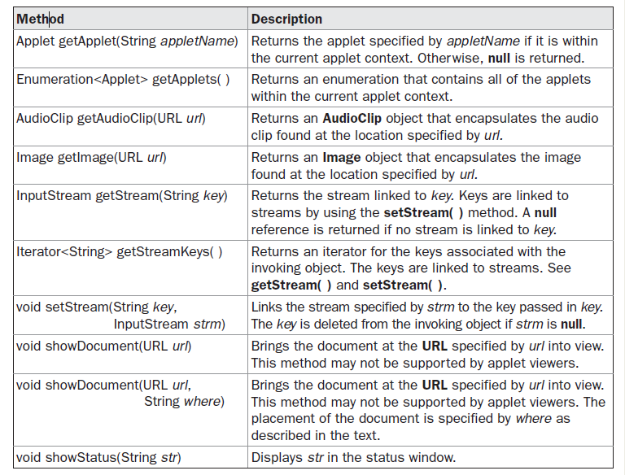

Slide 25
The AudioClip Interface
AudioClip interface defines
play( )-play a clip from the beginning
stop( ) -stop playing the clip
loop( ) -play the loop continuously
getAudioClip( )- loaded an audio clip

