Slide 1

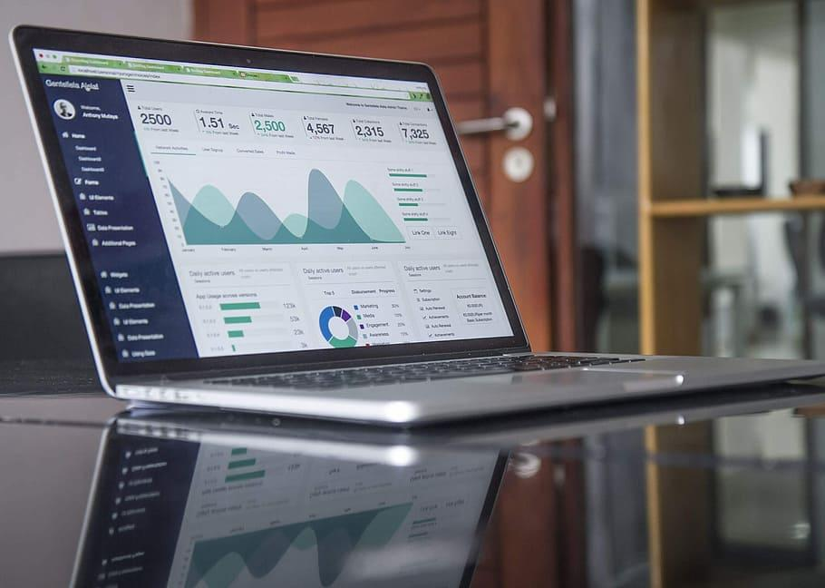
Customer Segmentation Analysis
This dashboard empowers
Stakeholders to gain real-time
Insight into sales trends,
identify areas of improvement,
and make informed decisions.
Tables
1. Order
2.People
3.Return
4.Dimdate

Slide 2
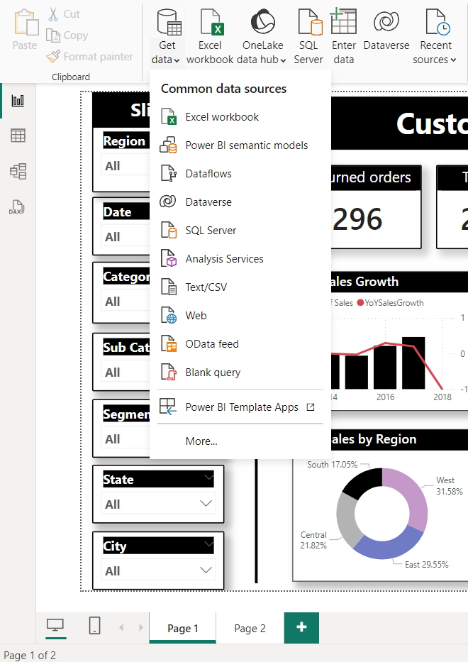
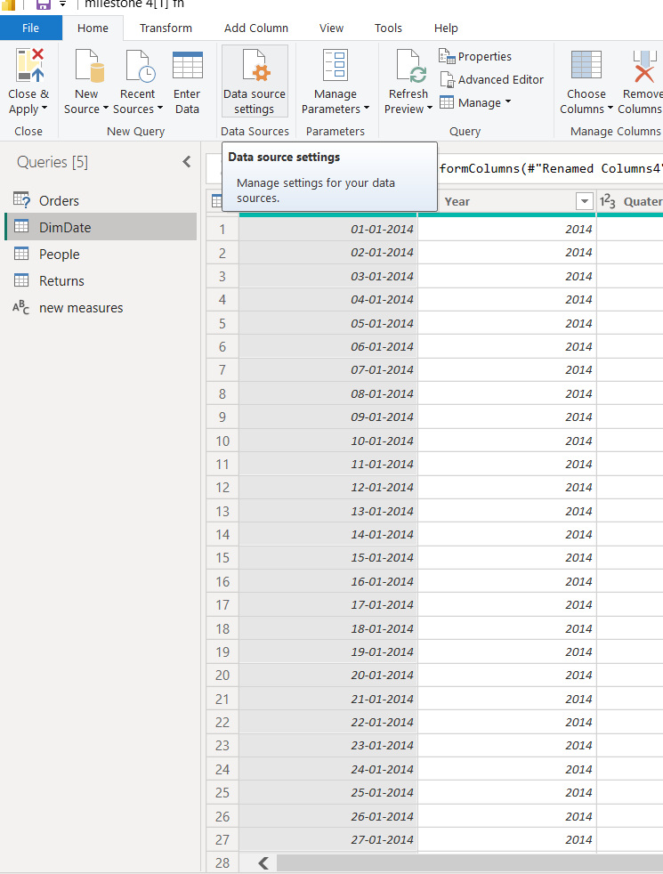
Data Preparation: Foundations for Insight
Data Source
Data is sourced from multiple sources, including our internal database, API integrations, and Excel spreadsheets.
Transformation and cleaning
Power Query efficiently cleanses and transforms raw data, addressing missing values, inconsistencies, and data type conversions.

Slide 3
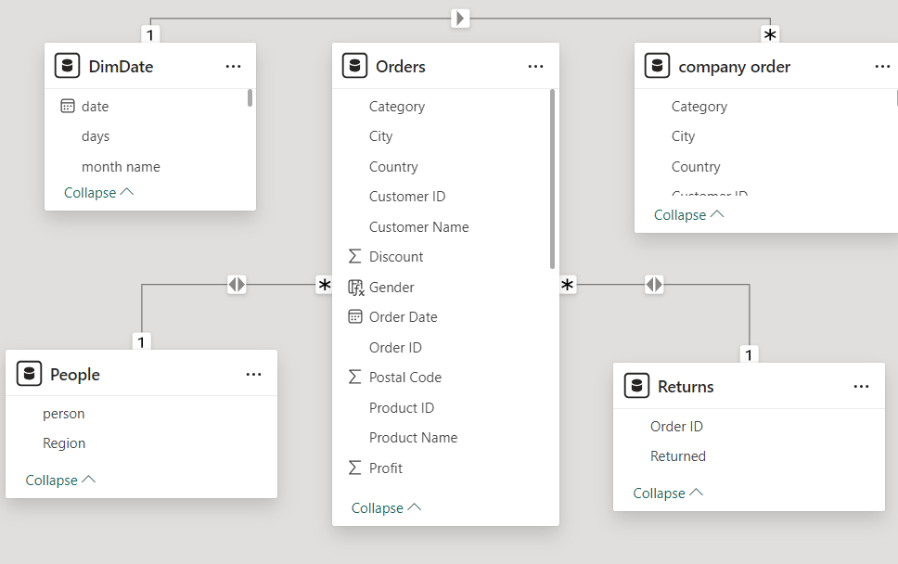
Data Modeling: Building the Analytical Framework
1.TotalSales = SUM(Orders[Sales])
2.Average Order value per customer = DIVIDE(SUM(Orders[Sales]),DISTINCTCOUNT(Orders[Customer ID]))
3. Average Order value per Order= DIVIDE(SUM(Orders[Sales]),DISTINCTCOUNT(Orders[Order ID])) 4.TotalReturns Orders=CALCULATE(COUNTROWS(Returns),KEEPFILTERS(RELATEDTABLE(Orders)))
5. Prev day sales= salesCALCULATE(SUM(Orders[Sales]),PREVIOUS DAY(DimDate[Date].[Date]))
6.quantity MTD = 7.TOTALMTD(SUM('Orders'[Quantity]),DimDate[Date].[Date]) quantity QTD = 8.TOTALQTD(SUM('Orders'[Quantity]),DimDate[Date].[Date])
9.Sameperiod_lastyear = CALCULATE(SUM('company order'[Sales]),SAMEPERIODLASTYEAR(DimDate[date].[Date]))
10.Prev_YearSales = CALCULATE(SUM('company order'[Sales]),PREVIOUS YEAR(DimDate[date].[Date]))

Slide 4
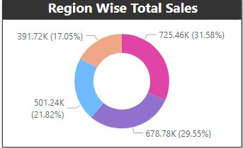
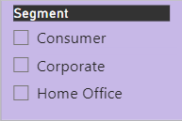
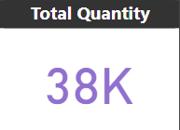
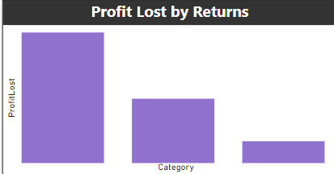
Visualization Design: Communicating Insights Effectively
Donut Chart
Slicer
Visualization
Line charts reveal sales trends over time, bar charts compare product performance, and maps visualize geographic distribution.
Interactive features
Slicers allow for filtering data, drill-throughs provide granular detail, and tooltips offer context-sensitive information.
Card
Bar Chart

Slide 5
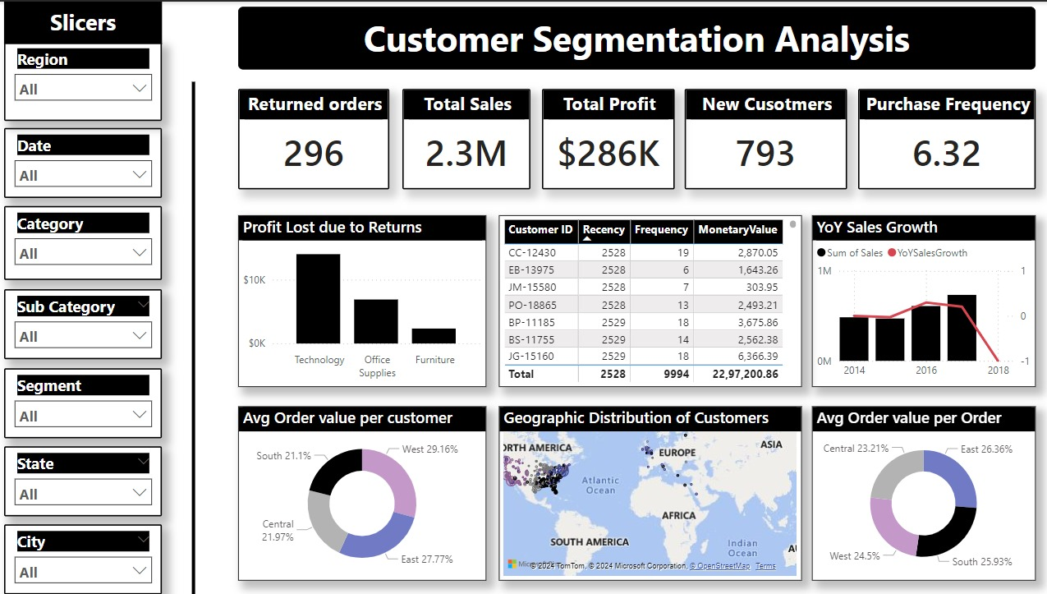
Insights and Value Addition: Actionable Knowledge
Actionable insights
The dashboard identified a decline in sales in the Central region has the less profit value(-3.63k)compared to other regions
Future enhancement
Integrating customer feedback data and incorporating advanced predictive analytics will further enhance the dashboard's value.

