Slide 1
Boot Sequence in Linux
Mayur Sadavarte
Furquan Shaikh
Notes:
Gud Morning Everyone..
I am Mayur Sadavarte, this is Furquan Shaikh and today we wil be covering detail tutorial on ‘the boot sequence in Linux’

Slide 2
Overview
BIOS
Boot Loaders
Kernel Initialization
Notes:
This are three major topics that we will be discussing today

Slide 3
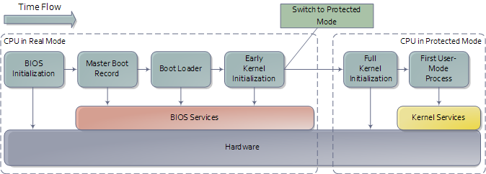
Outline of Boot Sequence
Notes:
This is the overview of the whole boot sequence..this covers the entire flow from pressing of PowerON switch to the point where you see your Login screen for the Linux

Slide 4
BIOS

Slide 5
BIOS
Basic I/O System
First program that runs when you turn-on/reset the computer
Initial interface between the hardware and the operating system
Responsible for allowing you to control your computer’s hardware settings for booting up
In a multi-processor or multi-core system one CPU is dynamically chosen to be the bootstrap processor (BSP) that runs all of the BIOS and kernel initialization code, others are called application processors(AP)
So when these processors come into play?? Wait, we will get there!!
Notes:
BIOS stands for basic input output system and this is the program which gets executed when the machine is switched on or restarted.
What is the purpose of this program?? This program acts as the interface between the hw and the OS
Lets you have your own setting for booting up your machine
What if the system is multiprocessor/core system??

Slide 6
BIOS Components
BIOS ROM
Stored on EEPROM (programmable)
Called flash BIOS
BIOS CMOS Memory
Non-volatile storage for boot-up settings
Need very little power to operate
Powered by lithium battery
Notes:
On last slide we said that this program gets executed first!! But from where?? We also said that user can set his own boot preferences with the help of this program..how??

Slide 7
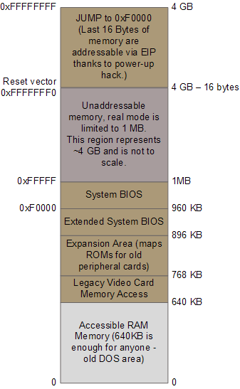
Memory Layout for the first 4GB in x86
Notes:
The hack with the intel architecture…called ‘reset vector’
Jump to BIOS entry point
The RAM is still not initialized..thus all these critical addresses are mapped to flash memory at this point

Slide 8
BIOS Tasks
Check CMOS setup for custom settings
Load the interrupt handlers and device drivers
Initialize registers and power management settings (ACPI)
Initializes RAM
POST (Power on Self-test)
Display BIOS settings
Determine which devices are bootable
Initiate bootstrap sequence
Notes:
POST: faulty video card leads to beeps…as u can’t display any fault info on the screen!!
Otherwise we see the BIOS manufacturer’s logo in case of assembled PC or the laptop manufacturer’s logo in case of branded laptops
Memory is tested, keyboard is must!!
Power interface builds a number of data tables that describe the devices in the computer; these tables are later used by the kernel.

Slide 9
Bootable devices
To boot an operating system, BIOS runtime searches devices that are both active and bootable in the order of preference defined in CMOS settings
Bootable device can be:
Floppy Drive
CD-ROM
Partition on HDD
Device on network
USB flash memory stick
Notes:
Lets talk a little bit about bootable devices..we just said that we can set these devices according to our priorities..
Any storage device that has some special content in it’s first sector is bootable device..

Slide 10
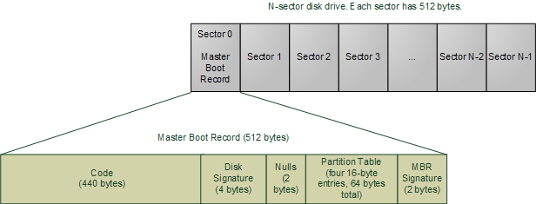
Master Boot Record
Notes:
How does bios come to know whether particular device is bootable or not??
MBR signature

Slide 11
MBR (Master Boot Record)
BIOS reads first 512-byte sector of the hard disk
Contains two important components:
OS-specific bootstrapping program
Partition table for the disk
Loaded at location 0x7c00 in RAM and control is given to this code
MBR could be
Windows specific
Linux specific
Some virus (favorite spot for hackers to get control right at the beginning)
Notes:
Lets talk a bit more about MBR
That’s why we have an option while installing Linux whether you want to overwrite existing MBR and install grup on the existing MBR

Slide 12
Outline of Boot Sequence
Notes:
k..so we have covered BIOS and MBR till this point..lets delve a bit into bootloaders..

Slide 13
Boot Loaders

Slide 14
Boot Loaders
Specialized loaders e.g the floppy boot sector
compatible with specific storage medium
General loaders running under another operating system e.g LOADLIN
Use facilities given by host OS to load guest kernel
File system aware general loaders running on firmware e.g GRUB
Almost little Operating Systems by themselves
Conversant with one or more file systems
Use facilities of firmware and sometimes have their own drivers
File system unaware general loaders running on the firmware e.g LILO
Depends on third party software (/sbin/lilo) to create mapping
Mapping stored at some predefined location
Notes:
The design of bootloader have been an evolutionary process...and hence types of bootloaders

Slide 15
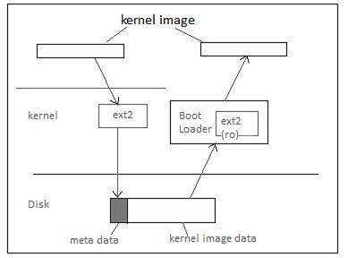
File System Awareness
Notes:
Kernel image on the left side is compiled kernel build which was put on disk by using the facilities provided by the existing kernel.
While loading bootloader supporting the read only file system, fetches the kernel image using the file system meta data and puts the kernel into the memory

Slide 16
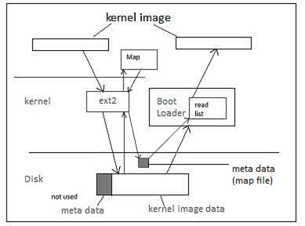
File System Unawareness
Notes:
This is a bit complex..
Kernel image is again put on the disk using the facilities of the existing running kernel but the similarity stops here..
Now the mapper program is run which converts the location of the kernel image into raw disk parameters(c,h,s) and puts in one special file ‘map file’
This file is always kept at some predefined location on disk
Now bootloader being file system unaware reads this map file and fetches the location of kernel image in disk raw format

Slide 17
File Unaware Loaders
Advantage:
No changes required in bootloader or map installer if file system of a new device is supported by the linux kernel
Disadvantage:
Map installer has to run after adding new kernel image
Or moving the kernel image to a new path
Notes:
Bootloader needs to have read only support of each new file system linux supports!!
I don’t why people want to move the location of existing kernel image!! But yeah, grub claims to support that..being file system aware!!

Slide 18
Boot Loaders - Linux
A multi-stage program which eventually loads the kernel image and initial RAM Disk(initrd)
Stage-1 Boot Loader is less than 512 bytes (why?)
Just does enough to load next stage
Next stage can reside in boot sector or the partition or area in the disk which is hardcoded in MBR
What is this next stage we are talking about?
Notes:
MBR works in pretty straightforward way..it checks for the partition table..checks for the active flag and passes the control to the bootloader stored in that partition..
bootloaders are essentially a multistage software..
Stage-1 of grub can reside in MBR actually or in first sector of any partition..even logical..

Slide 19
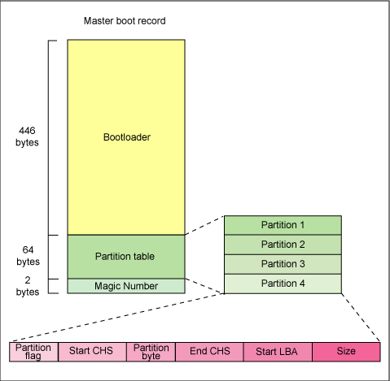
Where does Stage-1 BootLoader Reside?
Notes:
These are the first 446 bytes of the hard disk…where the MBR reside..and grup first stage overwrites this when we choose the option of overwriting MBR while linux installation.

Slide 20
Next stage
Stage-1 of GRUB mostly resides in MBR (as we just saw)
Stage-1.5 is a crucial feature (which makes grub file-system aware)
GRUB Stage 1.5 is located in the first 30 kilobytes of hard disk immediately following the MBR or in the Linux partition
Stage 1.5 loads Stage 2 from /boot/grub
What happens when this partition is corrupted?
The /boot/grub directory contains the stage1, stage1.5, and stage2 boot loaders, as well as a number of alternate loaders (for example, CD-ROMs use the iso9660_stage_1_5)
Notes:
Does anyone know the similar stage 2 loader name for windows??

Slide 21
GRUB Stage-2
Being powerful and file-system aware, it can display the boot options to user from -
/boot/grub/grub.cfg
GRUB command-line - you can boot a specific kernel with a named initrd image as follows:
grub> kernel /bzImage-2.6.14.2
[Linux-bzImage, setup=0x1400, size=0x29672e]
grub> initrd /initrd-2.6.14.2.img
[Linux-initrd @ 0x5f13000, 0xcc199 bytes]
Now it’s the time to fire the kernel!! But where are we going to place kernel image in the memory??
Notes:
Boot.ini for windows

Slide 22
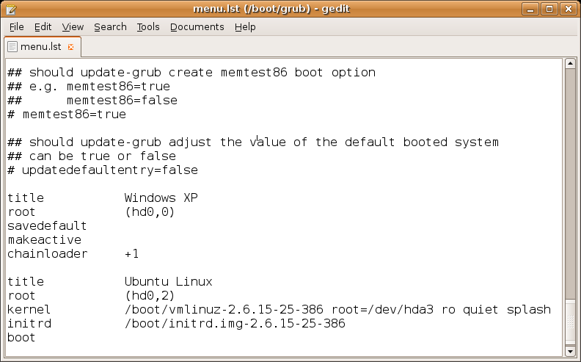
Sample GRUB Conf file

Slide 23
Memory Limitations
i386 can access 1MB in real mode
Some space required for bootloader, bios ROMs
Kernel used to come in zImage
can have maximum size as 512 KB (does seem like a constraint!)
Hence comes bzImage – loaded above 1MB
how can bootloader access memory more than 1MB in real mode??
Switch the CPU mode back and forth (unreal mode)
Still uses BIOS Functionalities
Notes:
Unreal mode - it is not a separate addressing mode
If you read GRUB source code, you’ll see these transitions all over the place (look under stage2/ for calls to real_to_prot and prot_to_real)

Slide 24
Memory Layout for the first 4GB in x86

Slide 25
Root File System
For mounting root fs kernel requires two things –
Media on which root fs resides
Driver to access this media
E.g. ext2 partition on an IDE disk
Number of root device passed as a parameter
Kernel normally has IDE driver inbuilt

Slide 26
Here come the Complications!!
What if kernel has no device driver
Can this happen?
What will be the size of the kernel if we compile it with all available device drivers?
Some drivers might upset other hardware while probing for their own devices
Notes:
Booting from network or any new device!!

Slide 27
What options do we have?
Can’t include all possible drivers as part of kernel
Having multiple pre-compiled kernels
Compiling the customized kernel
Linking the pre-compiled kernel with required modules
Detached modules - initrd
Notes:
But again how to access detached modules?? Doesn’t it seem a chicken-egg problem??
Oh but we already have a powerful program which can access any area of the hard disk given the path of that object!! And that is a bootloader..
So let the bootloader only download the important modules for you and keep it in memory.

Slide 28
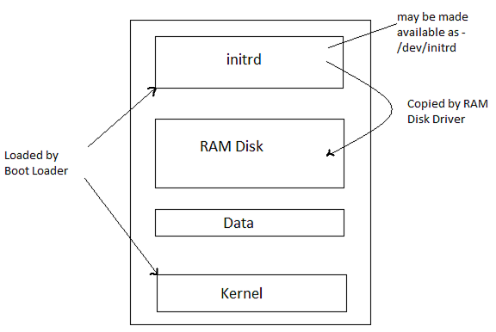
initrd

Slide 29
Outline of Boot Sequence

Slide 30
Kernel Initialization
Notes:
Thank you Mayur.
Okay. Until this point, everything that we have seen is laying the ground for the system to be ready for the most important component of the operating system. Here onwards, the actual kernel takes over control.

Slide 31
How Operating System Starts Life?
At this point, the processor is running in real mode.
Kernel image is loaded into memory by the boot loader using BIOS services
The image is an exact copy of the image on hard drive /boot/vmlinuz-2.6.38
Two major components of this image:
Small part containing real-mode kernel code loaded below the 640K barrier
Bulk of the kernel code which runs in protected mode, loaded after the first megabyte of memory
Notes:
So now lets see how the operating system comes to life.
At this point, the processor is still running in real mode. i.e. the default mode for backward compatibility.
And as we saw the boot loader has brought in the kernel image into memory using BIOS services. This image in memory is an exact copy of the image on hard drive which is located at /boot/vmlinuz.
There are basically two major components of this image:
One is a small real mode stub which is loaded below the 1MB barrier
The other big chunk of kernel code which runs almost entirely in protected mode is loaded starting at the first megabyte of memory.

Slide 32
In the beginning…
RAM
Initial ramdisk
Compressed kernel image
0x100000
Kernel Command Line
Early stack/heap
~64K
Real mode stub
Notes:
So, in the beginning, this is what the memory would look like.
We have used different coloring schemes to indicate different kinds of components.
The two light brown blocks below the 1MB mark refer to the BIOS code.
The light blue block is the kernel image.
The smaller box which is located below the 1Mb barrier is the real mode stub of the kernel.
And the bigger box is the compressed kernel image which is placed at 1Mb.
Below the 1Mb barrier, around 32K chunk is present for early stack/heap.
Above this, kernel command line parameters are stored. These parameters are the boot time parameters passed through the boot loader.

Slide 33
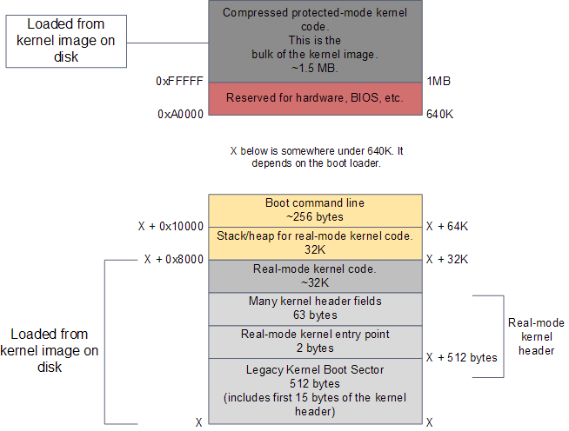
RAM contents after boot loader is done
Notes:
This is another picture which depicts the memory layout with exact addresses of each component

Slide 34
Major Steps in Kernel Initialization
Platform-specific initialization
(In assembly language)
Platform-independent initialization
(In high-level language C)
Notes:
An important point to note here is that, there are two kinds of kernel initializations:
One is the platform specific initialization. Most of this code is present in assembly language. It performs very critical tasks which require ultimate control as provided by assembly language.
The other is platform independent initialization. This code is mostly written in C language.

Slide 35
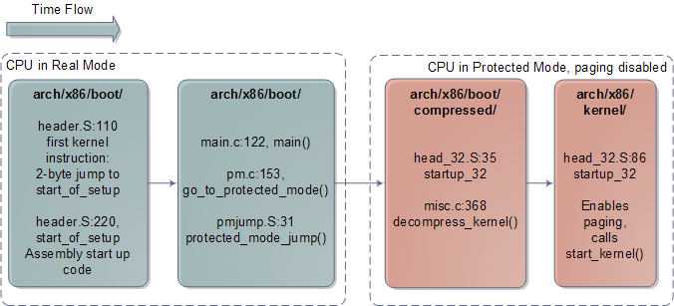
Kernel Initialization Timeline (Arch-dependent)
Notes:
This is a high level overview of the architecture dependent initialization
We enter the kernel at the first blue block. So the entry point into the kernel, the very first code that is run is the “setup” assembler function. It is a label assigned to a set of assembly instructions. One more important thing to remember is we are looking at x86 specific initialization.

Slide 36
Architecture Specific Setup on IA-32
RAM
setup assembler function (arch/x86/boot/header.S)
Checks if kernel was loaded to correct position
Probes hardware via BIOS
Determines size of physical memory
Initializes graphic card
Switches CPU to protected mode by setting PE bit in cr0 register
0x100000
Notes:
As the flow goes BIOS passed control to the boot loader which passed on control to the kernel and it starts executing here.
This code is present in arch/x86/boot/header.S
What this piece of code does is:
- It checks if the kernel was loaded to correct position
It probes the hardware via bios.
to determine how much physical memory is present, which memory ranges are safe to access
To get information about the power management schemes
Reset the graphic card
Once all this is done, it is almost ready to go to protected mode. Almost ready because, there are two important initializations that are required before switching to protected mode. Any guesses what these initializations might be?
GDT and IDT
It reinitializes the entire IDT. Now, IDT is similar to IVT but it has descriptors instead of just function pointers. However, this IDT is initialized to just NULL right now. Because we do not want to handle any interrupts until we reach a steady state.
The other structure is the GDT, which is Global Descriptor Table. It deals with how we look at memory. In order to gain access to entire 4GB of memory, it is important to setup the GDT. Now, even though Linux does not use segmentation, x86 architecture requires that you setup the segments before any use because that is how it provides protection. Hence, we reset the GDT with every segment code data spanning the entire 4GB of memory.
Finally, we are ready to switch to protected mode. This is done by writing to special register i.e.cr0.

Slide 37
Kernel Initialization Timeline (Arch-dependent)
Notes:
Now, we have reached the end of the 2nd blue block. i.e. we will now start executing in protected mode. Thus, we start execution at the first red block.

Slide 38
Prepare for decompression
RAM
Decompressed size
0x100000
Notes:
Before proceeding into any further initializations, the first task that the code does is copy itself to some higher location in order avoid coming in its own path while decompressing. Hence we need to move things around. Why do you think is it done this way? The boot loader could have actually loaded the compressed image at a higher location.
The answer is simplicity on the part of boot loader. The kernel image might or might not be compressed. So, regardless of this it is always located at 1MB.
Okay. So, now we move chunk higher in memory and forget about the earlier chunk and jump to the new chunk.

Slide 39
Architecture Specific Setup on IA-32
RAM
B) startup_32 assembler function (arch/i386/boot/compressed/head.S)
Creates a provisional kernel stack
Fills uninitialized kernel data with null bytes (data between _edata and _end constants)
Calls the C routine decompress_kernel
Decompressed
size
0x100000
Notes:
So, now we come to the startup_32 assembler function. We are running in 32-bit mode.
What it does is create a provisional kernel stack and call the function decompress_kernel

Slide 40
Architecture Specific Setup on IA-32
RAM
C) decompress_kernel() C routine (arch/x86/boot/compressed/misc_32.c)
Decompresses kernel
Writes uncompressed kernel code to position 0x100000 directly after the first MiB of memory
Uncompressing is the first operation performed by kernel
Screen Message “Uncompressing Linux…” and “Ok, booting the kernel”
Decompressed
size
0x100000
Notes:
As the name suggests, it decompresses the kernel.
It basically uses an algorithm like gunzip which is quite similar to the userland uncompress program. However, it does not use any user space library. It has its own implementation in the kernel. Decompression creates a chunk much bigger than the original chunk. And this is again located at 1MB.
Now, we again jump back to the first MB of memory.
This is the point where you see the message Uncompressing Linux… and Ok, booting the kernel.

Slide 41
Architecture Specific Setup on IA-32
RAM
D) startup_32 assembler function (arch/x86/kernel/head_32.S)
Fills bss segments of kernel with zeroes
Initializes provisional kernel Page Tables to identically map the linear addresses to the same physical addresses
Stores the address of Global Page Directory in cr3 register
Enables paging by setting PG bit in cr0 register
Puts the parameters obtained from BIOS and parameters passed to the OS into the first page frame
Jumps to start_kernel function
0x100000
Notes:
So now we are back to the first 1MB. And start the execution of the function startup_32. Though the name of the function is same as the earlier one, the location is different and we jump directly to an address so the name doesn’t matter.
What this does is:
Again initialize the segments and stack
Fill bss segments with zeroes
Setup virtual memory. It stores address of Global Page Directory in cr3 and enables paging by setting the PG bit in cr0 register.
It then copies the command line arguments to the first page frame
And finally jumps to start_kernel function

Slide 42
Kernel Initialization Timeline (Arch-dependent)
Notes:
Thus, we have arrived at the end of the two red blocks. Thus completed the arch dependent initialization. At this point, segmentation and paging both are set up.

Slide 43
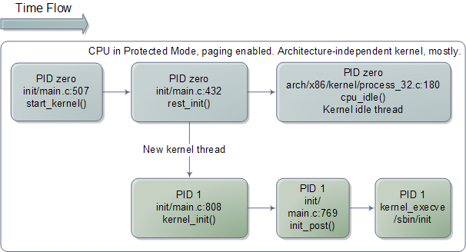
Kernel Initialization Timeline (mostly Arch-independent)
Notes:
Now, as you see we move to the second half of initializations – the architecture independent initializations
You can note the difference in the file organizations too. Initially they were located under arch/x86 and now its init/main.c.
Lets see what this does.

Slide 44
High-Level Initialization
start_kernel
Display version banner
Arch-specific high level setup for memory management
Evaluate command-line arguments
Initialize all subsystems
Determine processor and system errors
Start idle process and init thread
Notes:
As we saw the last part of arch dependent init passed control to start_kernel
This is a very long function covering more than 100 lines. It does a lot of work for initializations.

Slide 45
start_kernel: a) Version banner
First step is to output the version message
linux_banner global variable in init/version.c
Notes:
To start with, it prints the kernel version, which is located in init/version.c

Slide 46
start_kernel: b) setup_arch
setup_arch
Determine position of kernel in memory
parse_early_params
setup_memory
paging_init
Notes:
Then, it does some more setup required for memory initializations

Slide 47
start_kernel: c) Interpret command-line arguments
Interprets command line arguments passed to kernel at boot time
Arguments passed in the form key=value pairs
Notes:
It interprets command line arguments which are provided by the bootloader in the form key=value pairs.

Slide 48
start_kernel: d) Initialize various subsystems
Invoke subroutines to initialize almost all important kernel subsystems
Code Snippet:
asmlinkage void __init start_kernel(void)
{
…
trap_init();
mm_init();
sched_init();
rcu_init();
init_IRQ();
init_timers();
hrtimers_init();
softirq_init();
timekeeping_init();
time_init();
}
Notes:
Now, comes the main part..lots and lots of initializations.
This function as you see makes a lot of function calls all over the kernel to do a lot of initializations. Workqueues, locks, memory buffer pools, timers, etc. It initializes all the subsystems.

Slide 49
Sample Initialization
void __init trap_init(void)
{
set_trap_gate(0,&divide_error);
set_intr_gate(1,&debug);
set_intr_gate(2,&nmi);
set_system_gate(4,&overflow);
…
set_intr_gate(14,&page_fault);
…
set_system_gate(SYSCALL_VECTOR,&system_call);
…
}
Notes:
Here is a sample initialization. Where we initialize the various traps. 0 as divide by zero error. 80 as system call. Etc.

Slide 50
start_kernel: e) Search for known system errors
Checks for bugs in architecture (check_bugs)
Replaces certain assembler instructions – depending on processor type – with faster, modern alternatives.
Notes:
Then it looks for any know errors in the processor and checks if it can use any modern and faster assembler instructions.

Slide 51
start_kernel: f) init
Last two actions of start kernel:
rest_init : New thread that performs some more initializations and starts the first user-space program /sbin/init
The original kernel thread becomes the idle thread that is called when system has nothing else to do
Notes:
Then it continues with calling rest_init.
Role of rest_init is to fork the first process. Till now, we were running as PID 0 which is also called the idle task.
At this moment we create a kernel thread which goes on to become the process PID 1, which is the first process seen when you execute ps command on Linux. What it basically does is start the userspace program /sbin/init.

Slide 52
Code flow diagram for init
init
Register as child reaper
SMP initialization
do_basic_setup
prepare_namespace
init_post
free_initmem
Execute userspace initialization program
Notes:
Now, this init as we all know registers itself as the parent for all the orphaned child processes.
So any process whose parent process finishes execution becomes a child of this process
Another important task that it performs is wake up all the other processors. At this point, the other processors are partially initialized but they are not running yet. Now, we have a scheduler so we will wake up the processors and they will wait for work to do.
Then it calls init_post which does all the cleanup for initialization.
Thus, we our system is ready with both the kernel and the user space.

Slide 53
Outline of Boot Sequence

Slide 54
Questions?

Slide 55
References
http://duartes.org/gustavo/blog/post/how-computers-boot-up
Booting Linux: The History and the Future, Werner Almesberger
Understanding The Linux Kernel, 3rd Edition
http://www.ibm.com/developerworks/linux/library/l-linuxboot/
Kernel Walkthrough: The Boot Process by Bart Trojanowski
The Linux Boot Process by Daniel Eriksen
Intel® 64 and IA-32 Architectures Software Developer's Manual Combined Volumes 3A, 3B, and 3C: System Programming Guide, Parts 1 and 2

