Slide 1

GPA CALCULATOR

Slide 2
TEAM MEMBERS:
Sunkara Yugandhar- RA2211042020005
Sarathi V - RA2211042020026
Mannan Parakh - RA2211042020037
Nikihil Aravindh V - RA2211042020064

Slide 3
Problem Statement:
Some institutions may have unconventional grading systems that might not align perfectly with the GPA calculator's default settings. Converting non-standard grading scales to the GPA scale could be challenging.

Slide 4
Introduction:
Design and implement a GPA (Grade Point Average) calculator that computes a student’s
GPA based on their course grades and credit hours. The system should accurately calculate the GPA by considering the grade points associated with each letter grade and the credit hours of each course. The GPA calculator should be user-friendly, efficient, and provide accurate results for students to track and manage their academic performance.

Slide 5


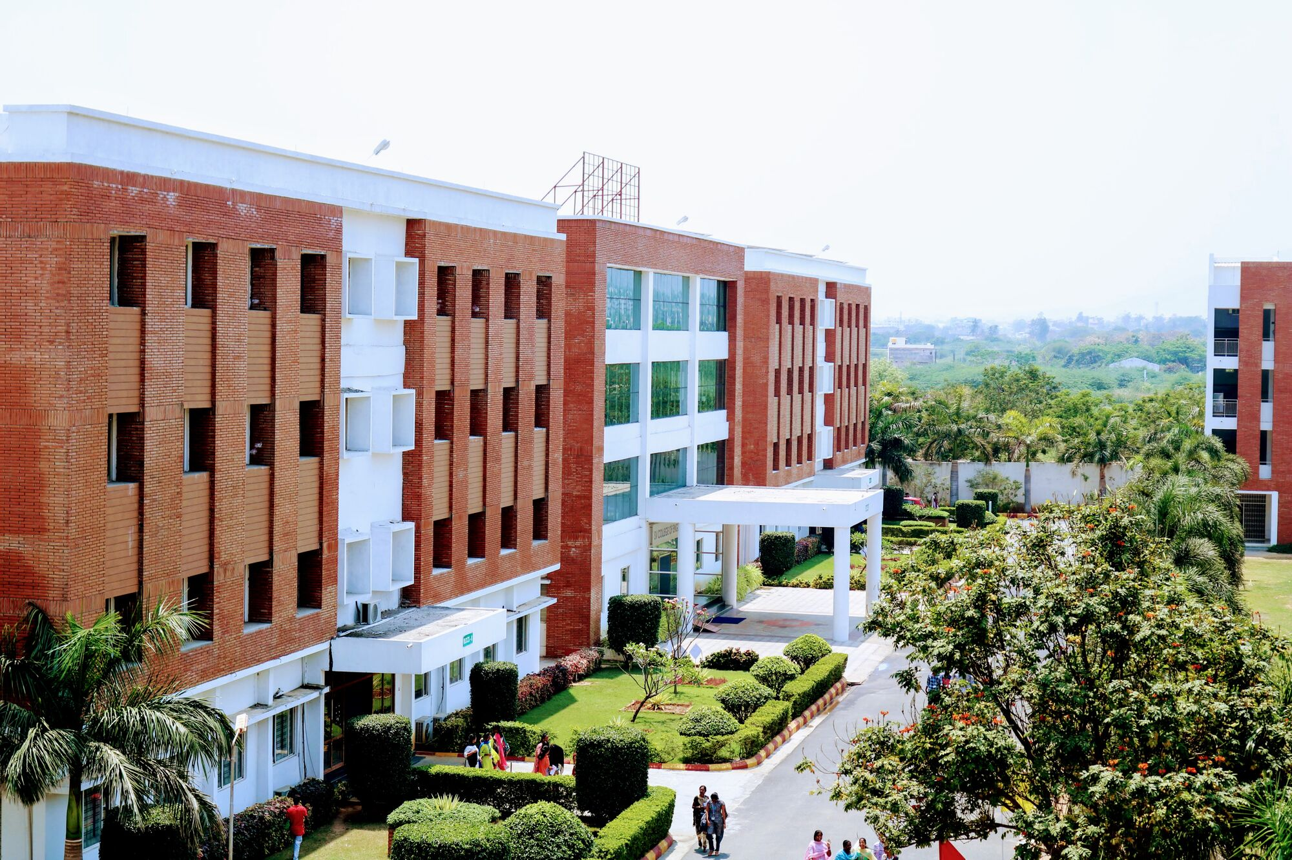
Stakeholders:
This Photo by Unknown Author is licensed under CC BY-ND

Slide 6
Stakeholders:
Students: They are the primary users of the GPA calculator. Students use this tool to track their academic performance and understand how their grades and credit hours impact their overall GPA.
Educational Institutions (Schools, Colleges, Universities): They might be interested in GPA calculators to help students monitor their academic progress. Some institutions might even have their own official GPA calculators integrated within their systems or websites.
Parents/Guardians: They might also be stakeholders, especially for students in primary or secondary education, interested in monitoring their child's academic performance and progress.
Developers/Designers: Those responsible for creating, maintaining, and improving GPA calculator software or applications are stakeholders involved in its development and functionality.

Slide 7
User Interview Questions:
What challenges do you face while calculating your GPA manually or using existing calculators?
How important is user-friendliness or ease of navigation in a GPA calculator to you?
Do you have any specific expectations regarding the accuracy and reliability of the GPA calculations?
Do you prefer using a GPA calculator on a website, mobile app, or a different platform?
How likely are you to recommend a particular GPA calculator to friends or colleagues? What factors influence your recommendation?
What features do you find most valuable in a GPA calculator?

Slide 8
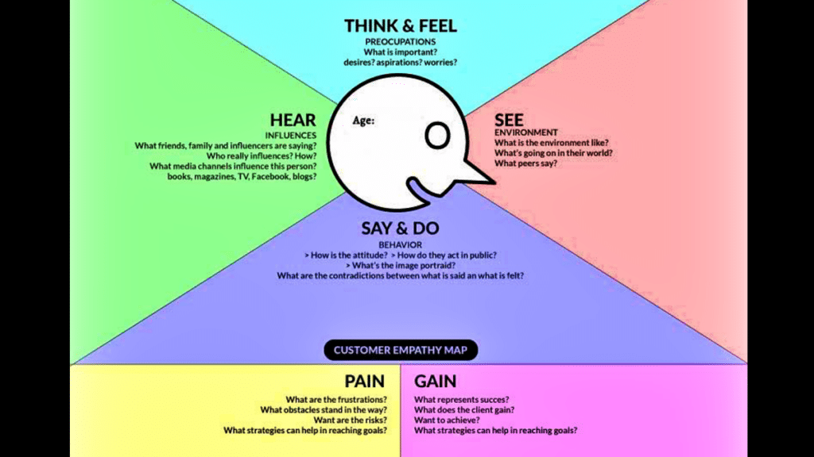
Empathy Mapping:
This Photo by Unknown Author is licensed under CC BY-NC-ND

Slide 9
Solution Statement:
The GPA calculator should be user-friendly, efficient, and provide accurate results for students to track and manage their academic performance.

Slide 10
Working For The Solution:
For a more user-friendly application, you can build a graphical user interface (GUI) or a web-based application using frameworks like Tkinter (for Python GUIs), or web development technologies if creating a web-based calculator. Additionally, consider error handling, validation of user inputs, and more robust UX/UI elements for a production-ready GPA calculator.

Slide 11
Components Of Solution:
User Interface (UI)
Input Section
Grade-to-Point Conversion
Calculation Engine
Validation and Error Handling
User Feedback and Display
Data Storage or Memory Management
Accessibility and Responsiveness

Slide 12
Business Model:
Freemium Model: Provide a basic GPA calculator tool for free, but offer premium features or additional functionalities for a subscription fee. For instance, advanced analysis, personalized insights, or the ability to save and track GPA history could be part of the premium package.
Advertisement-based Model: Offer the GPA calculator for free, supported by advertisements displayed within the tool or on the website. Consider targeted advertising to educational services or resources.
Affiliate Marketing: Partner with educational resources, bookstores, or tutoring services. Promote these services to users as additional aids for improving their grades or academic performance. Earn commissions for referrals or sales made through the GPA calculator Platform.

Slide 13
Revenue Streams:
Premium Features or Subscription
Advertisement Revenue
Sponsored Content and Partnerships
Return on Investment (ROI):
Development Costs
User Acquisition Costs
Operational and Maintenance Costs

Slide 14
Consumer Persona:
Background:
Demographics: Claire is an 18-year-old high school graduate preparing for her first year of college.
Education Level: High school graduate entering college.
Technological Proficiency: Comfortable with technology; uses smartphones, laptops, and various educational apps.
Pain Points:
Time Management: She struggles with managing time and course workload effectively.
Pressure for Performance: Claire feels the pressure to maintain a good GPA for scholarship eligibility and to stand out for future job prospects.
Behaviors and Needs:
Efficiency: Claire values tools that are easy to use, with a clear and straightforward interface to input her grades and credits.
Accuracy: She seeks accurate calculations to understand how her grades are translating into her overall GPA.
Goals and Challenges:
Academic Success: Claire aims to excel in her studies and is conscious of maintaining a good GPA for scholarships and future career prospects.
Understanding Progress: She needs a tool that helps her easily track her academic performance and understand how her grades impact her overall GPA.

Slide 15

This Photo by Unknown Author is licensed under CC BY-SA

