Slide 1







Tech Insights: Navigating the Present, Anticipating the Future, Understanding Demographics
Sarath K
2023-11-23

Slide 2



OUTLINE
Executive Summary
Introduction
Methodology
Results
Visualization – Charts
Dashboard
Discussion
Findings & Implications
Conclusion
Appendix

Slide 3

EXECUTIVE SUMMARY
Project Overview:
Concise insight into the Stack Overflow Developer Survey 2019.
Current Tech Landscape:
Top 10 Languages, Databases, Platforms, Web Frames.
Future Tech Anticipation:
Anticipated trends – Top 10 Languages, Databases, Platforms, Web Frames (Next Year).
Developer Demographics:
Gender, Country, Age, Gender and Education.
Strategic Takeaways:
Summarizing critical findings; a quick snapshot for decision-makers.

Slide 4

INTRODUCTION
Embarking on a journey of data exploration, we delve into the intricacies of the IT landscape. Using robust analytics, we aim to uncover both the current pulse and future projections of key skills in programming languages, databases, platforms, and web frameworks.
In a rapidly evolving tech realm, staying ahead requires a keen understanding of the skills in demand. This analysis addresses the challenge of discerning the ever-shifting landscape of sought-after IT skills.
Our quest for insights led us to the following pivotal questions:
Which programming languages top the charts in demand today?
What database skills are most sought after?
Tell us about the popular IDEs and Web frameworks shaping the IT horizon.
Before we dive into the analysis, here's a roadmap. We'll journey through current trends, anticipate the future, and explore the demographics that shape the IT sphere.

Slide 5

METHODOLOGY
Our exploration of technology trends involves a thorough comparison of current and future technology usage, offering a dynamic perspective on the evolving landscape.
We sourced our data from the comprehensive 'Stack Overflow Developer Survey 2019,' capturing a rich spectrum of insights from the developer community worldwide.
To bring the data to life, we've employed various chart types—bar, line, pie, tree-map, and more. These visuals serve as windows into the trends, making the insights accessible and engaging.
Powering our analysis and visualization is the robust IBM dashboard. This platform lends its capabilities to dissect the data intricately and craft compelling visual representations.

Slide 6
RESULTS
Python's Ascendancy:
Python, the fastest-growing major programming language, has surpassed Java in our survey, securing its place as the second most loved language globally, following Rust.
Coding Beginnings and Global Variances:
Over half of respondents wrote their first code before age sixteen, but experiences vary by country and gender.
DevOps and Job Satisfaction:
DevOps specialists and site reliability engineers emerge as high earners, experienced developers, most satisfied in their roles, and show the lowest job-seeking tendencies.
Optimism Across Borders:
Chinese developers top optimism, believing in a better future for the next generation, while Western European counterparts, like those in France and Germany, express less optimism.
Productivity Challenges:
Productivity blockers differ: Men cite non-development tasks, while gender minority respondents point to toxic work environments.
Stack Overflow Impact:
Our survey reveals that using Stack Overflow saves developers 30 to 90 minutes per week, streamlining problem-solving and enhancing efficiency

Slide 7
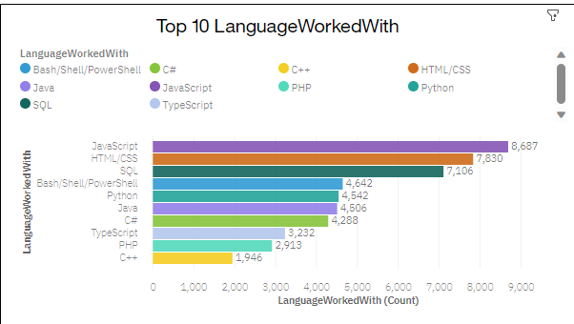
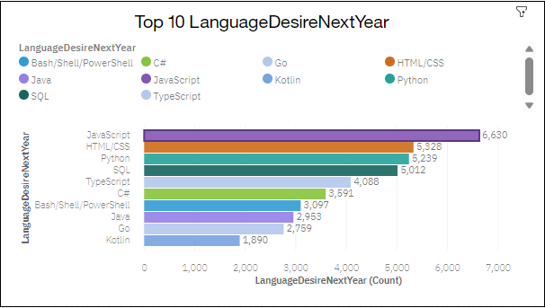
PROGRAMMING LANGUAGE TRENDS
Current Year
Next Year

Slide 8
PROGRAMMING LANGUAGE TRENDS - FINDINGS & IMPLICATIONS
Findings
Java, Python, and JavaScript stand out as the leading programming languages, with widespread adoption and extensive developer communities.
Rust, Kotlin, and TypeScript are gaining popularity rapidly, showcasing a growing interest in languages that offer unique advantages and modern approaches to development.
Frameworks associated with top languages are highly sought after: Django (Python), Spring (Java), and React (JavaScript) are essential skills in today's competitive job market.
Java remains a cornerstone in enterprise solutions, Python's versatility fuels innovation in data science, and JavaScript is pivotal for web development, reflecting distinct impacts across industries.
Implications
Organizations should align hiring strategies with the prevalence of top languages to ensure a skilled workforce that meets current industry demands.
Anticipate the trajectory of emerging languages like Rust and Kotlin and invest in upskilling programs to prepare teams for the future landscape.
Encourage professionals to focus on enhancing skills in key frameworks, such as Django, Spring, and React, to stay competitive and meet the evolving needs of the industry.
Companies can gain a competitive edge by adapting their technology stacks to align with prevalent languages, fostering innovation and staying ahead in dynamic industry shifts.

Slide 9
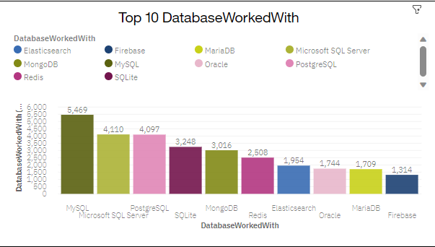
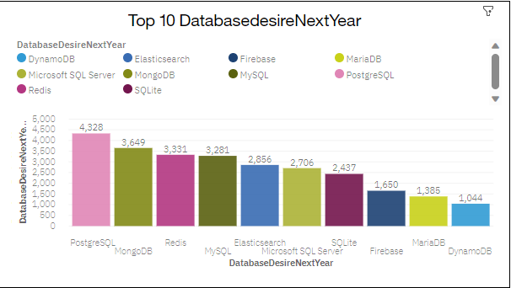
DATABASE TRENDS
Current Year
Next Year

Slide 10
DATABASE TRENDS - FINDINGS & IMPLICATIONS
Findings
MySQL Dominance Persists:
Consistency prevails as MySQL retains its position as the most commonly used database, maintaining its widespread adoption within the developer community.
PostgreSQL Surges:
A noteworthy shift sees PostgreSQL securing the second spot this year, surpassing Microsoft SQL Server in usage among developers.
Implications
MySQL Reliability:
Organizations can continue to rely on MySQL as a stable and widely adopted database solution. Considerations for compatibility and community support should reinforce its continued usage.
Embrace PostgreSQL Growth:
The rise of PostgreSQL signifies its increasing popularity. Organizations should consider embracing PostgreSQL for its evolving features and growing developer base, positioning it as a robust alternative.
Microsoft SQL Server Evaluation:
Organizations using Microsoft SQL Server should evaluate the implications of its shift in ranking. Assessing factors such as performance, scalability, and compatibility is crucial for informed decision-making.

Slide 11
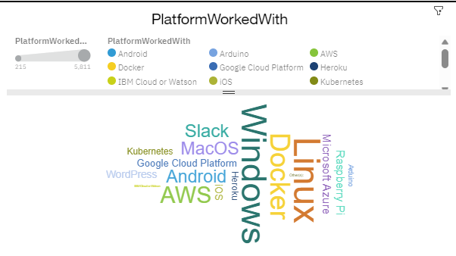
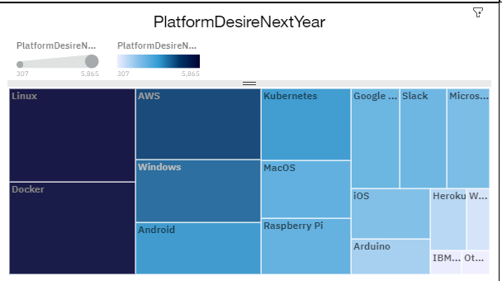
PLATFORM TRENDS
Current Year
Next Year

Slide 12
PLATFORM TRENDS - FINDINGS & IMPLICATIONS
Findings
Popular Platforms:
Linux and Windows maintain dominance as the top development platforms among respondents.
Container Revolution:
Docker emerges as the third most broadly used platform, indicating a significant shift towards container technologies.
Developer Preferences:
Linux remains the most loved platform, with high affections also for Docker and Kubernetes.
Challenges with WordPress:
WordPress stands out as the most dreaded development platform, suggesting potential pain points.
Future-Ready Aspirations:
Developers express interest in adopting Docker and AWS, signaling a readiness for cutting-edge development tools.
Implications
Leveraging Stability:
Organizations can leverage the stability and popularity of Linux and Windows for robust development environments.
Containerization Integration:
Integration of container technologies, especially Docker, is pivotal for staying current and enhancing development efficiency.
Developer-Centric Strategies:
Aligning with developer preferences for Linux, Docker, and Kubernetes fosters a positive and productive work environment.
Addressing WordPress Concerns:
Organizations working with WordPress should address concerns and challenges to improve the development experience.
Investment in Skill Development:
Investing in training for Docker and AWS responds to developer aspirations, ensuring preparedness for evolving industry trends.

Slide 13
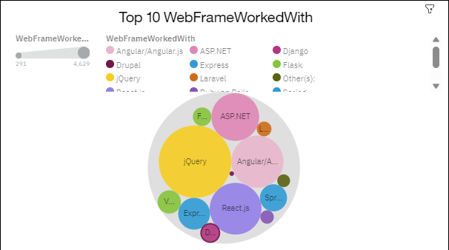
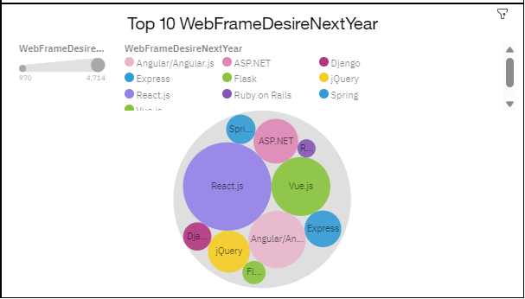
WEBFRAME TRENDS
Current Year
Next Year

Slide 14
WEBFRAME TRENDS - FINDINGS & IMPLICATIONS
Findings
Web Frameworks Shift:
jQuery remains widely used, but a notable shift has occurred: React.js surpasses Angular in usage among developers this year, marking a change from the previous survey.
Debut Technologies:
Introduction of new technologies in this category reveals Node.js as the most commonly used. The survey also indicates greater adoption of TensorFlow over Torch/PyTorch in the realm of deep learning frameworks.
.NET Usage Trend:
More developers report using .NET compared to .NET Core, indicating a current preference for the traditional .NET framework.
Implications
Adaptation to Web Framework Trends:
Organizations should consider adapting to the evolving landscape, acknowledging the shift in preference from Angular to React.js. Strategic decisions should align with the current industry standard.
Embrace Emerging Technologies:
The prominence of Node.js suggests a need for organizations to embrace emerging technologies. Exploring and integrating Node.js can enhance development capabilities and keep projects in line with industry trends.
.NET Framework Considerations:
Organizations using .NET should assess the implications of the reported trend, as more developers opt for the traditional .NET over .NET Core. Considerations for compatibility, support, and future development should be addressed.
Deep Learning Framework Choices:
The overwhelming popularity of TensorFlow over Torch/PyTorch in deep learning frameworks highlights the importance of aligning development efforts with the most widely adopted tools. Organizations should prioritize TensorFlow for deep learning projects.

Slide 15

DASHBOARD
https://dataplatform.cloud.ibm.com/dashboards/92e05aac-5fe3-493e-b6fa-f7a91e891f90/view/573ae71b1197689260f4c0e407987e0679327358b5bbd10283d07b4909627197a86f12c7c8264353da130637a2e9410a9a

Slide 16
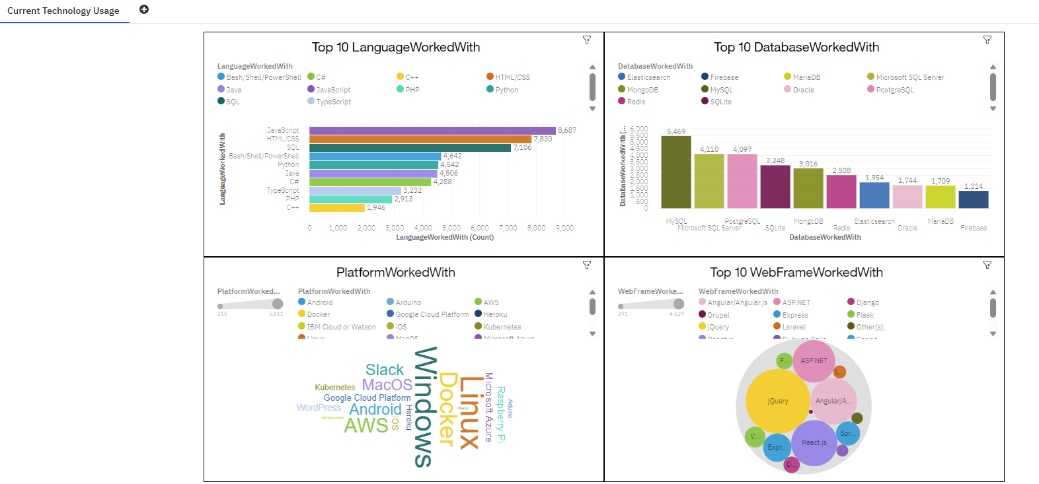
DASHBOARD TAB 1

Slide 17
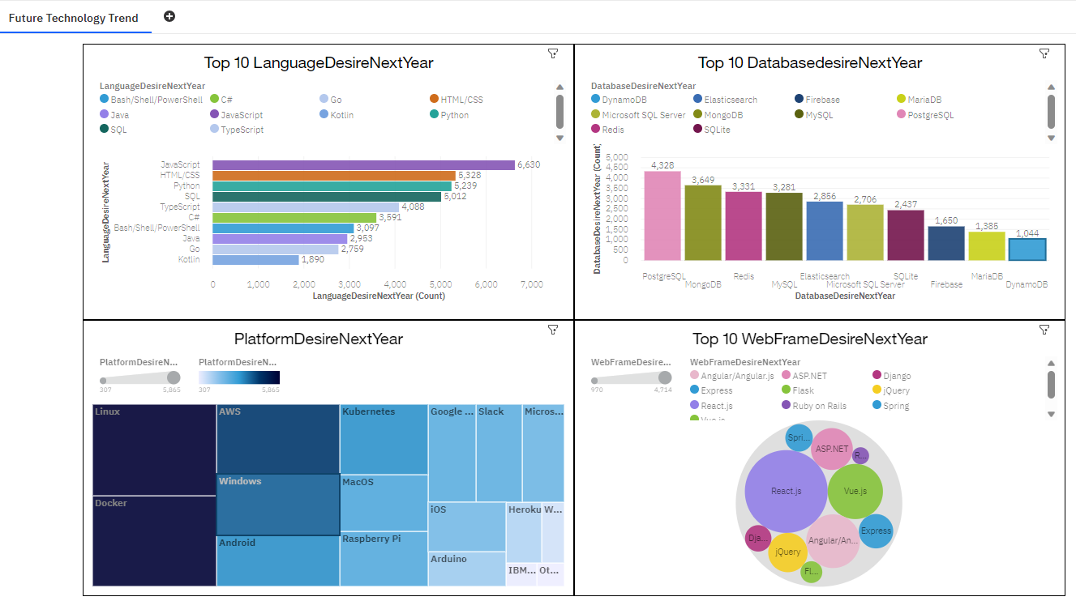
DASHBOARD TAB 2

Slide 18
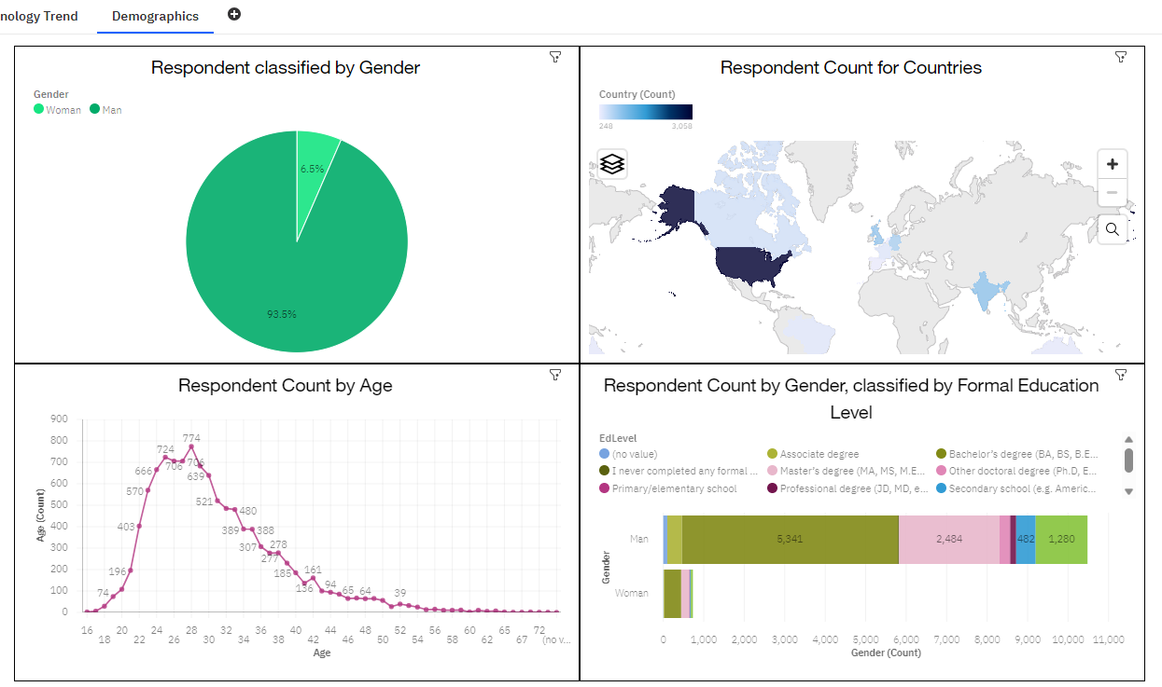
DASHBOARD TAB 3

Slide 19
DISCUSSION
With all the data presented we can deduct which technologies are the most prominent and which direction data professionals will be going in the future
We can also deduce that most developers are 30 year old males from the United States of America and there may be some biases in the survey

Slide 20
OVERALL FINDINGS & IMPLICATIONS
Findings
Programming Languages:
Java, Python, and JavaScript lead the programming landscape, with emerging stars like Rust, Kotlin, and TypeScript shaping the future.
Database Trends:
MySQL holds its ground, while PostgreSQL surpasses Microsoft SQL Server, reshaping the database hierarchy.
Platform Trends:
Linux and Windows remain dominant, with Docker emerging as a powerful force in platform preferences.
Implications
Strategic Tech Alignment:
Organizations must align strategies with both established leaders and emerging technologies in programming languages, databases, and platforms."
Agile Platform Integration:
Strategic adoption of Docker addresses the growing momentum in container technologies, enhancing agility in development workflows."
Developer-Centric Excellence:
Prioritizing developer preferences in languages and platforms fosters a positive and productive work environment, enhancing overall job satisfaction."
Tech Skill Preparedness:
Investing in training for Docker, AWS, and staying abreast of emerging languages prepares organizations for the evolving tech landscape."

Slide 21

CONCLUSION
As we conclude this tech exploration, remember: Embrace the present, prepare for the future, and empower your teams to thrive in the ever-evolving world of technology.

Slide 22

APPENDIX

Slide 23
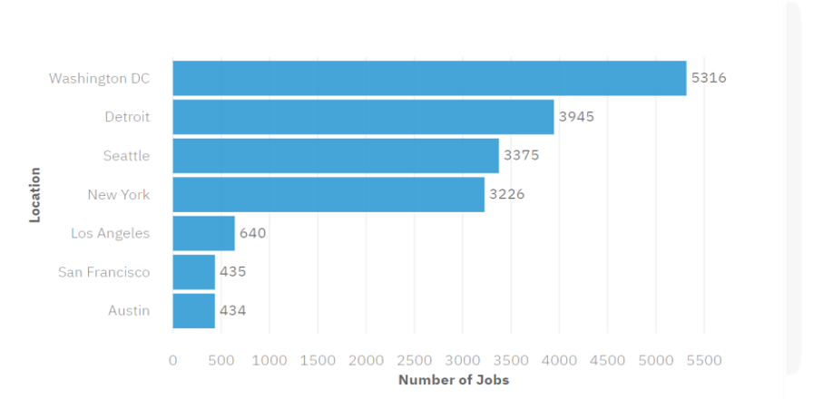
JOB POSTINGS

Slide 24
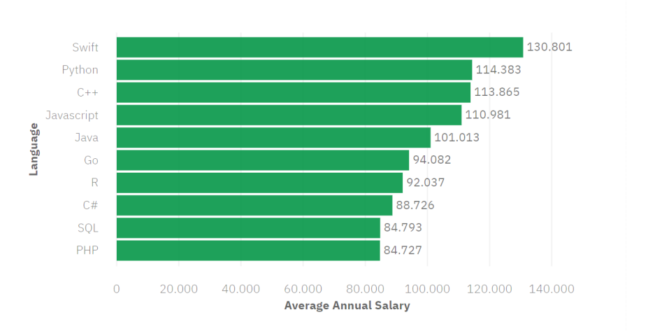
POPULAR LANGUAGES

