Slide 1
NVIDIA GenAI Specialist Program
15th Jun – 17th Jun
Notes:
Welcome attendees. 90 seconds: who you are, your role at NVIDIA, why this workshop matters. Set the tone: 'This is the GenAI Specialist Program. Over the next 3 days, you'll touch every layer of NVIDIA's full stack, anchored to one production-shaped agent.' Don't dwell — there are 18 slides of orientation ahead.

Slide 2
Welcome
Three days. Every layer. One complete stack
By the end of this 3-day Workshop
you will have explored every layer of the NVIDIA GenAI and Agentic AI stack—and developed a functional agent to see how it all connects.
Data Curator · Data Designer · NeMo Framework · Evaluator · NIM · NAT · Guardrails · Blueprint· NemoClaw · AI Factory
NVIDIA CONFIDENTIAL. DO NOT DISTRIBUTE.
Notes:
Set the tone. The 'art of the possible' frame: we're touching every layer, not rebuilding the app.

Slide 3
Your Instructors
Bios and contact — for questions during and after the workshop
📷
📷
📷
[Name]
[Name]
[Name]
[Role · NVIDIA]
[Role · NVIDIA]
[Role · NVIDIA]
NVIDIA CONFIDENTIAL. DO NOT DISTRIBUTE.
Notes:
Replace placeholders with actual instructor info on delivery day.

Slide 4
What the GenAI Specialist Program Is
Positioning vs Foundations and AI Factory Specialist tracks
Foundations
GenAI Specialist
AI Factory Specialist
Entry-level
← We are here
Infra-deep
Theory · 1 day
Hands-on · 3 days
Hands-on · 3 days
What is an LLM? · Prompting · RAG basics
End-to-end customisation: data → train → eval → deploy → orchestrate
BCM · Mission Control · Run:AI · sizing · NIM Operator @ fleet scale
NVIDIA CONFIDENTIAL. DO NOT DISTRIBUTE.
Notes:
Position the program. Specialist = hands-on, customisation-focused. We are NOT infra/AI Factory — that's a separate track.

Slide 5
The 3-Day Journey
Each day builds on the previous; everything traces back to one anchor app
Day 1
Why & What
Foundations · AI Factory backdrop · NVIDIA service map · Meet the AML agent · Data prep · NeMo Curator
Day 2
Train the Brain
CPT theory + hands-on · NeMo Data Designer · SFT (LoRA on 30B) · RL post-training · NeMo Evaluator · NIM intro
Day 3
Ship It
NeMo Agent Toolkit · K8s Operator · Guardrails · NemoClaw · Blueprints flyover · AI Factory offerings · breakouts + wrap
NVIDIA CONFIDENTIAL. DO NOT DISTRIBUTE.
Notes:
The narrative arc. Day 3 is the payoff — agent demo at the end.

Slide 6
What You'll Learn — Day 1
Foundations + Data + Curator
AI Factory in context
NCP / OEM / CSP / DGX flavours and when each applies
✓
The full NVIDIA stack
Every GenAI / Agentic service mapped to a layer
✓
The AML agent end-to-end
Live demo · architecture · 7-phase build map
✓
Hands-on: NeMo Curator
Dedup, filter, redact 100 MB of real AML corpus
✓
NVIDIA CONFIDENTIAL. DO NOT DISTRIBUTE.
Notes:
Day 1 outcomes. Read them out — they're the contract for what attendees should expect to take away by Day 1 close.

Slide 7
What You'll Learn — Day 2
Train the Brain — CPT, SDG, SFT, RL, and continuous eval
✓
CPT — Continued Pre-Training
2-stage strategy · FP8 · parallelism · packing
✓
SDG with Data Designer
Generate the SFT corpus the AML investigator learns from
✓
SFT — LoRA on 30B-A3B
Run 10-25 steps on your 2× H100 · same model as production
✓
RL post-training
DPO / GRPO theory + a 5-step DPO-LoRA demo
✓
NeMo Evaluator
Three eval modes; three-way bake-off demo
✓
NIM intro
What a NIM is + how custom checkpoints get served
NVIDIA CONFIDENTIAL. DO NOT DISTRIBUTE.
Notes:
Day 2 is the densest day — most theory + most hands-on. Set expectations.

Slide 8
What You'll Learn — Day 3
Ship It — agent orchestration, trust, blueprints, AI Factory
✓
NeMo Agent Toolkit
DAG vs ReAct · typed contracts · OTEL → Phoenix
✓
Custom NIM deployment
From sft-final checkpoint to live OpenAI-compat endpoint
✓
NIM Operator (K8s)
Fleet-scale lifecycle, autoscaling, CRDs
✓
Guardrails + NemoClaw
Application-level rails · runtime sandbox · belt and braces
✓
Blueprints flyover
Enterprise RAG · Data Flywheel · AI-Q · Safety blueprint
✓
AI Factory offerings
BCM · Mission Control · Run:AI · infra sizing
NVIDIA CONFIDENTIAL. DO NOT DISTRIBUTE.
Notes:
Day 3 is the climax — you've trained a model, today you ship it. End-of-day breakouts let attendees pick a deep-dive topic.

Slide 9


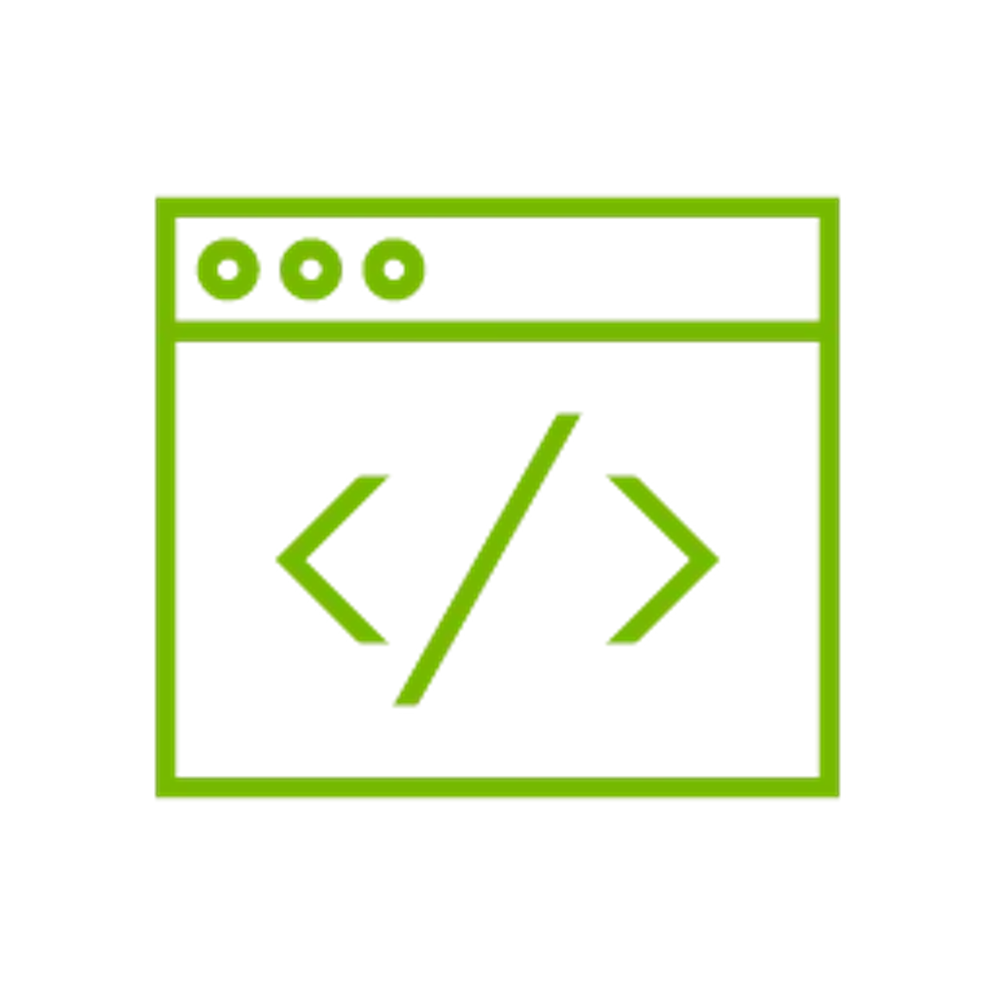

Prerequisites Checklist
NGC API key
Brev account
From ngc.nvidia.com
signup link in your welcome email
Lab - Instance Spin up
Brev CLI and connection to Lab instance
NVIDIA CONFIDENTIAL. DO NOT DISTRIBUTE.
Notes:
Walk through each. Ask 'who's missing X?' for each — fix in real-time.

Slide 10
Welcome — let's begin
First up: AI Factory + the NVIDIA full-stack story
Notes:
Transition. Tell the room: 'Logistics sorted, lab is up. Now we set the technical scene with the AI Factory backdrop.' Move directly into M2 without a break — the energy from setup carries into the overview if you don't pause.

