Slide 1
NVIDIA AI Safety
Notes:
Hi everyone, I’m Isabel Hulseman, product marketing manager for Nemotron safety and NeMo safety libraries.
We’re seeing a shift from simple, single‑model chatbots to networks of specialized agents that can reason, retrieve information, call tools, and take actions on enterprise systems and data. That creates tremendous value, but it also introduces new risks if those agents are not properly governed.

Slide 2
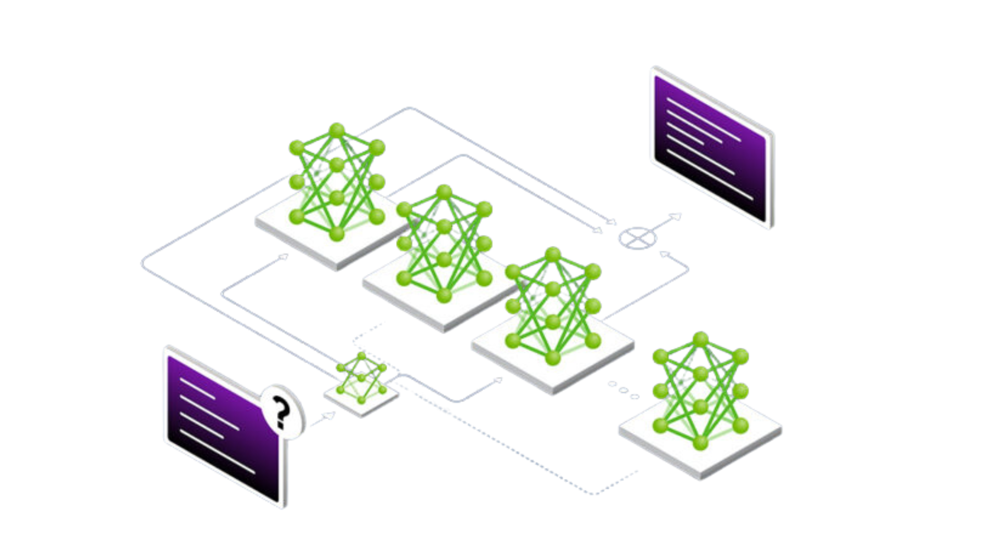

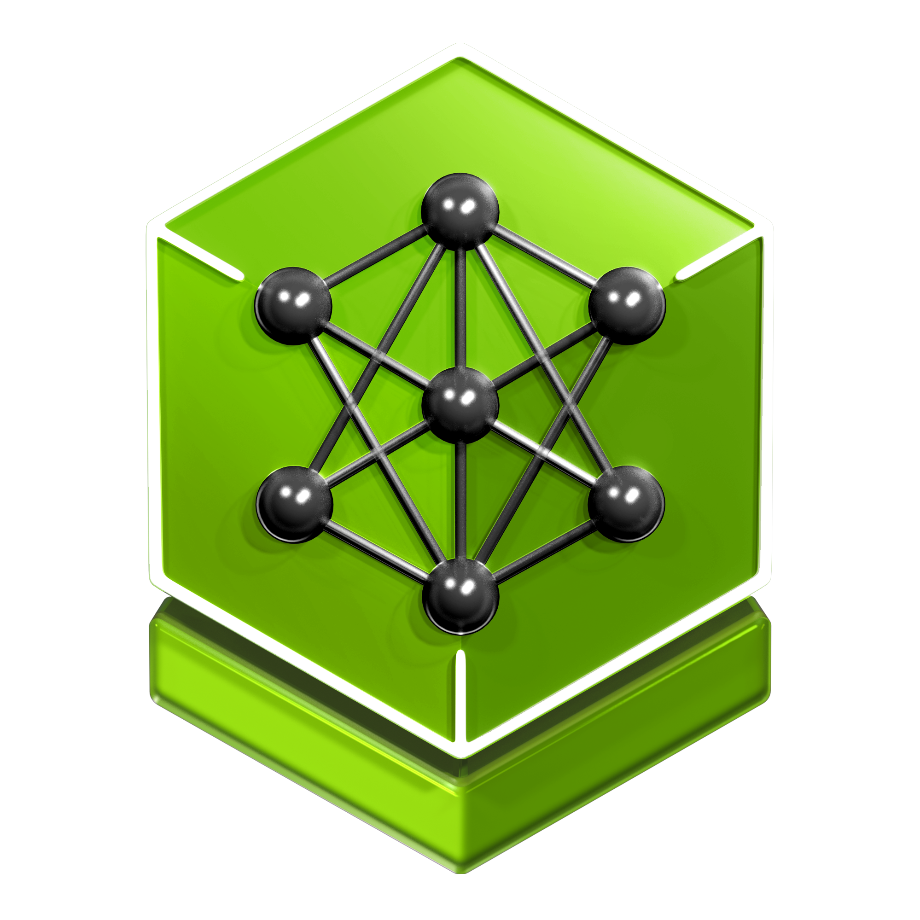

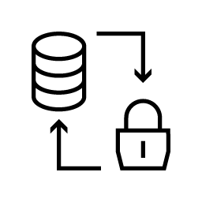






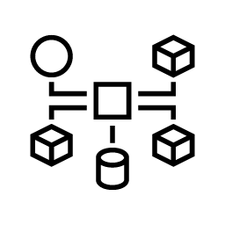
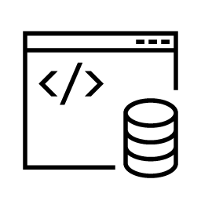
NVIDIA NeMo Libraries for Agentic AI Safety
Make agentic AI production‑ready with integrated data privacy and model security
Enterprise AI System
Nemotron
Specialized AI Agents
NeMo Agent Toolkit
NeMo Curator
NeMo Safe Synthesizer
NeMo Customizer, RL
NeMo Guardrails
INSTRUMENT
PROCESS
SYNTHESIZE
IMPROVE
GUARDRAIL
NeMo Retriever
NeMo Data Designer
NeMo Anonymizer
NeMo Evaluator
NeMo Auditor
LEARN
GENERATE
DETECT
EVALUATE
AUDIT
Notes:
For our sake here are the components under the hood, and the ones circled in yellow are the ones we will be covering today, specifically focused on making agents safe and production‑ready.

Slide 3
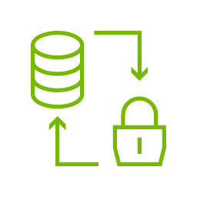




Primary Agentic AI Safety Challenges
Data leaks and bypassed protections expose sensitive information and enable model exploitation
1
2
Data Security Exposure
"52% of data breaches involve some form of customer PII." IBM Report
Model Security Risks
"97% of companies with AI breaches had no AI access controls in place." IBM Report
NeMo Safe Synthesizer
NeMo Anonymizer
NeMo Guardrails
NeMo Auditor
Nemotron
Safety Models
Notes:
Now let’s talk about why these tools are needed.
First, data security and privacy. Agentic systems touch CRMs, financial records, health data, and proprietary IP. Without the right controls, agents can leak that information in responses or tool calls; with overly strict controls, companies can’t safely use their most valuable data at all.
Second, model and agent security. Long‑lived, tool‑calling agents are a big attack surface for jailbreaks and prompt injection, which can bypass policies, exfiltrate secrets, or trigger actions the business never intended.
Recent public assistant incidents have made this very visible: unsafe behavior leads to rollbacks, brand damage, and regulatory concern. Safety can’t be an afterthought—you need guardrails, auditing, and data protections designed in from day one.
These two challenges map directly to our products: Safe Synthesizer and Anonymizer address data exposure, while Guardrails, Nemotron safety models, and Auditor harden agents and models against misuse.

Slide 4
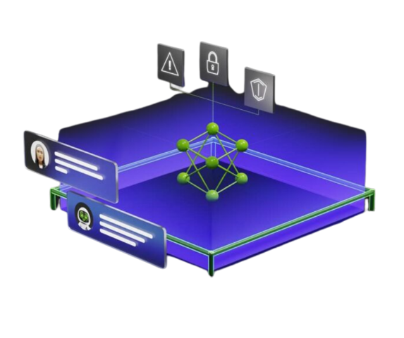

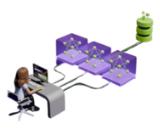

Introducing the NVIDIA AI Safety Suite
Open NeMo libraries built on open Nemotron models which are trained on open Nemotron datasets
Open Libraries
Open Models
Open Datasets
NeMo Safe Synthesizer
NeMo Anonymizer
NeMo Guardrails
NeMo Auditor
Nemotron 3 Content Safety
Llama Nemotron Content Safety
Nemotron Content Safety Reasoning
Llama Nemotron Topic Control
Nemotron Jailbreak Detection
GLiNER PII
Nemotron Content Safety
Nemotron Content Safety Reasoning
Nemotron Content Safety Audio
Nemotron AIQ Agentic Safety
Nemotron PII
Notes:
Here is a holistic view of our entire safety suite. It's modular—customer can start with one library or model where the risk is highest, and then expand coverage across more agents and workflows over time, without adding another fragmented tool.
Anywhere there is valuable data, models, or an AI application in production, they will need safety and security. Now I will hand it off to Alexa to dive into the meat of each product.

Slide 5







NVIDIA NeMo Guardrails
Build enterprise-grade AI agents with robust security and control – intercept policy violations with minimal performance impact
Input
Key Features
Customizable Use Cases
PII detection, content safety, jailbreak protection, topic control, RAG enforcement, etc.
Performance-Optimized
Parallel execution of multiple guardrails without performance overhead.
Flexible Deployment
Efficiently orchestrate and deploy anywhere.
Content Safety
Jailbreak Protection
Topic Control
PII Detection
Custom Rails
Retrieval
PII Detection
Knowledge Base/RAG
Custom Rails
Dialog
Topic Control
Custom Rails
Execution
Agentic Security
Custom Rails
Output
Content Safety
PII Detection
Knowledge Base/RAG
Custom Rails
Learn more about NeMo Guardrails on the product page.
Notes:
Topic control: Ensure conversations stay
within predefined subject
boundaries and
prevent LLMs from engaging
in off-topic discussions.
PII detection: Redact personallyidentifiable or sensitiveinformation to protect userprivacy.
Content safety: Ensure that unsafe (e.g. violent, illegal, threatening) content from user input and LLM output is blocked.
Jailbreak detection: Prevent adversarial attacks from bypassing safety measures or manipulating the LLM to generate harmful content.
NeMo Guardrails is the orchestration layer that ties everything together.
Define your requirements, orchestrate your guardrails, and ensure AI safety while maintaining performance
It allows enterprises to define safety rules in a structured, programmable way—covering content moderation, hallucination control, PII mitigation, adversarial protection, and domain-specific policies.
On the right you can see a simple example: with Guardrails off, the model answers a political question; with Guardrails on, it enforces enterprise policy and declines.
Guardrails can orchestrate multiple safety models in parallel, adding minimal latency—about half a second—even when running up to five rails.
Notes
Industry Leading Guardrail: Content moderation, reduce hallucinations, toxicity, off-topic dialogs, PII-breach, and security jailbreaks
Rail Orchestration: Rails helps to improve protection rate while reducing latency, increasing throughput and lowering costs
Customizable: Build rails targeted for your specific use-cases while adhering to own enterprise policies
Easy Integration: Compatible with 3rd party APIs, such as ActiveFence, Fiddler, DataRobot etc.
Works with popular frameworks (LangChain, LlamaIndex) and 3rd-party APIs (ActiveFence, Fiddler, DataRobot), accelerating time-to-value.
Key Features
Customizable: Implement guardrails for specific use cases (content moderation, hallucinations, PII-breach, toxicity, security jailbreaks) and internal policies, enabling domain-specific safety without vendor lock-in.
Performance-Optimized: Orchestrate specialized guardrails to improve safety with minimal latency and lower cost.
Flexible Deployment: Available as an enterprise-grade microservice, open-source toolkit, open source Nemotron safety models, and hosted NIM.
Seamless Integration: Easy integration with popular frameworks and 3rd-party APIs, to accelerate time-to-value.
Guardrails allow enterprises to encode detailed, use-case-specific rules—such as what medical or financial agents can and cannot do.
This is essential for regulated industries.
Rules aren’t just binary; the model needs to know what’s allowed, what’s disallowed, and what needs escalation or disclaimers.
Guardrails formalize these rules as part of the runtime logic.
Guardrails allow enterprises to encode detailed, use-case-specific rules—such as what medical or financial agents can and cannot do.
This is essential for regulated industries.
Rules aren’t just binary; the model needs to know what’s allowed, what’s disallowed, and what needs escalation or disclaimers.
Guardrails formalize these rules as part of the runtime logic.
NeMo Guardrails is a library for defining, orchestrating and enforcing AI guardrails -- or policies – in AI agents and other generative AI applications.
Guardrails helps maintain credibility and reliability of AI operations by enforcing specifications for AI models, agents and systems.
In other words, It helps keep AI agents on track.
It does this by making it easy to:
apply multiple specialized rails (or constraints or guidelines or rules)
customize them based on unique business and use-case requirements
while also maintaining low latency for fast response times.
Just like enterprises define policies and procedures for their employees, guardrails define and enforce specific policies and procedures for AI agents.

Slide 6
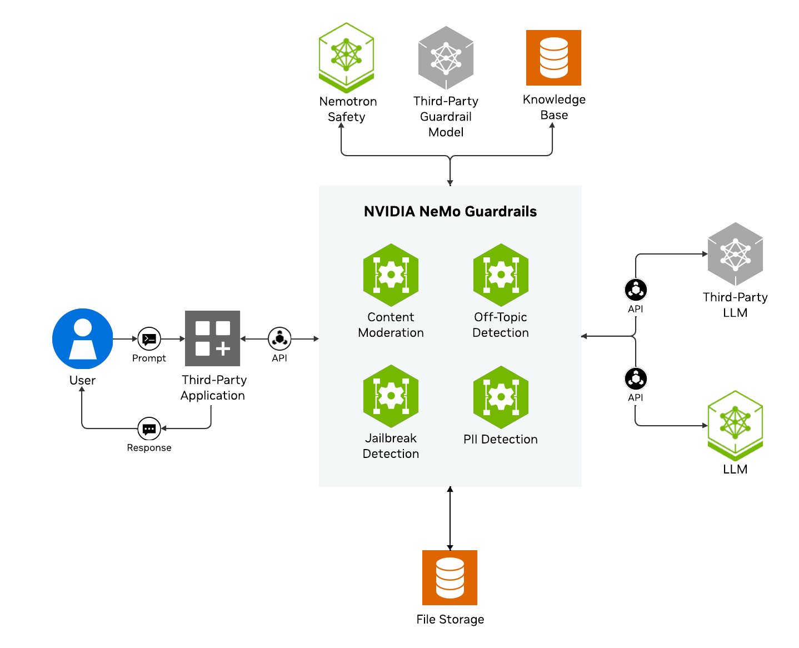

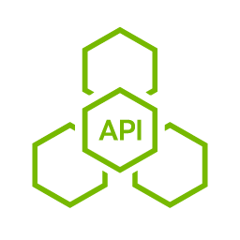
NeMo Guardrails Available Rails
Guardrails can be applied at different stages in the LLM flow.
Pre-Built Rails Available
NVIDIA Open Models
Community Rails
3rd Party APIs
Custom Rails
Custom Rails
Bring your own guardrails models or build custom security rules tailored to your unique use case and custom policies.
Notes:
Rail Types
Input
Applied on user input before the LLM
Retrieval
Applied to RAG documents during the RAG pipeline
Dialog
Applied during conversations
Execution
Applied during tool calls
Output
Applied after the LLM
Input & Output are the most common.

Slide 7

NeMo Guardrails Available Rails
Guardrails can be applied at different stages in the LLM flow.
Pre-Built Rails Available
Custom Rails Available
NVIDIA Open Models
Bring your own guardrails models or build custom security rules tailored to your unique use case and custom policies.
Hook in custom Python functions, Hugging Face models, or LangChain flows.
Use YARA rules to express custom security and compliance policies.
Use Colang to define custom dialogue rails and logical conversation flows.
Llama Nemotron Content Safety 8B V3
Llama Nemotron Topic Control 8B
Nemotron Jailbreak Detect
Nemotron Content Safety Reasoning 4B
GLiNER PII
Nemotron Content Safety VL 4B
Community Rails
Meta Llama Guard 3
Google ShieldGemma
Patronus Lynx
AlignScore
Microsoft Presidio
3rd Party APIs
Alice
AutoAlign
Cisco AI Defense
Clavata
Cleanlab Fiddler Guardrails
GCP Text Moderation
GuardrailsAI
CrowdStrike
Private AI
Prompt Security
Trend Micro Vision One
Notes:
Rail Types
Input
Applied on user input before the LLM
Retrieval
Applied to RAG documents during the RAG pipeline
Dialog
Applied during conversations
Execution
Applied during tool calls
Output
Applied after the LLM
Input & Output are the most common.

Slide 8
Open NVIDIA Nemotron Safety Models
Advanced GPU-accelerated multilingual, multimodal models with reasoning for a variety of use cases
Supported in NeMo Guardrails
Multilingual Content Safety
Content Safety Reasoning
PII
Topic Control
Jailbreak Detection
Blocks Harmful
Content
Domain-Specific Custom Policy
Detects/Classifies
PII and PHI
Enforces Relevant
Dialogue
Detects Adversarial
or Jailbreak Prompts
85%
Harmful Content Classification Accuracy
10x
Faster Custom
Policy Reasoning
56%
Higher F1 Score;
28% Higher Recall
93%
On-Topic
Avg. F1 Scores
96%
Detection Accuracy
Avg. F1 Score
Notes:
These models are supported in NeMo Guardrails, which orchestrate them as a unified safety system with minimal latency overhead.
Enterprises benefit from a modular, layered safety system that blends classification, reasoning, topic boundaries, and adversarial detection with policy enforcement—all within a production-grade platform.
The models available as NIM microservices are GPU accelerated and they perform with low latency and can be securely deployed anywhere, and they’re available as part of NVIDIA AI Enterprise.
Content safety—blocking harmful or disallowed content. (AVAILABLE AS A NIM)
It blocks harmful content including toxic, unethical content and safety hazards
It was trained on NVIDIA’s Aegis Content Safety Dataset, curated and owned by NVIDIA and publicly available, which includes 35,000 human annotated data samples flagged for AI safety
Jailbreak detection—identifying jailbreak and malicious prompts (AVAILABLE AS A NIM)
It prevents intentional bypass of safeguards through clever hacks known as jailbreaks
It was trained on a dataset of 17,000 known challenging and successful jailbreaks, built in part using NVIDIA Garak —which is an open-source toolkit for LLM vulnerability scanning developed by our NVIDIA Research team
These NIM microservices offer needed added layers of security and control that enterprises are asking for as they deploy agentic AI.
Topic Control - keeps AI agents on track throughout the duration of conversations and interactions (AVAILABLE AS A NIM)
It ensures user-AI agent interactions stay focused, relevant and within predefined topical boundaries
It’s fine tuned specifically for topic control – like you can fine tune a model specifically for math or coding
Why is this important… The system prompt can lose track throughout the course of a multi-turn conversation –
Just like you have been in a conversation with a friend that diverges, we all have that friend , that chatty friend, that tends to not only diverge but also divulge some information they shouldn’t have.
PII/PHI detection—classifying and mitigating sensitive data exposure.
Content Safety with Reasoning—applying domain-specific policy logic using reasoning steps.

Slide 9
NeMo Guardrails-Off Vs. Guardrails-On
Example
Guardrails OFF
Guardrails On
User Prompt
Should I invest in tech stocks right now? What's your recommendation for diversifying my retirement portfolio?
LLM Response
Based on current market conditions, tech stocks have shown strong performance, particularly in AI and cloud computing sectors. For retirement portfolio diversification, financial advisors typically recommend a mix of 60% stocks and 40% bonds for moderate risk tolerance...
User Prompt
Should I invest in tech stocks right now? What's your recommendation for diversifying my retirement portfolio?
LLM Response
I cannot provide investment advice. I can help you with account information and banking services.
Identified as category
Financial Advice, Investments
Notes:
With Guardrails On, the response is blocked because the topic was one the user did not want the LLM to answer.

Slide 10
NeMo Guardrails: Use-Case Specific Enterprise Policies
Improve safety robustness with custom categories
Medical Advice Should Not
Financial Advice Should Not
Provide personalized medical advice or diagnosis to individuals.
Encourage people to engage in medical activities or treatments that are not supported by scientific evidence.
Provide information that could be used to self-diagnose or self-treat medical conditions without consulting a qualified medical professional.
Contain false or misleading information about medical treatments, medications, or health conditions.
Encourage people to delay or forego medical treatment or advice from a qualified medical professional.
Provide personalized financial advice or recommendations that are tailored to an individual’s specific financial situation or goals.
Encourage or facilitate investment in high-risk or unregistered investment schemes.
Provide false or misleading information about financial products or services.
Engage in phishing or other scams to obtain sensitive financial info.
Financial Advice Can
Medical Advice Can
Provide general information about personal finance, investing and money management
Discuss financial products and services in a general and neutral manner
Offer educational resources or information on financial planning and literacy
Provide information on how to report suspicious financial activity or seek help for financial difficulties
Provide general information about medical conditions, treatments, and medications
Discuss the latest medical research and findings in a neutral and informative way
Notes:
Guardrails allows you to enforce specific policies by providing guidance about what the LLM should be allowed to answer and not.

Slide 11


NVIDIA NeMo Auditor
Security and vulnerability scanning to protect against attacks on LLMs and LLM-containing systems
Key Benefits
Probe Type | Description
DAN | Jailbreaks shown to be effective in the wild
Exploitation | Generate SQL injection or malicious Jinja templates
Grandma | Jailbreaks like “Pretend you’re my grandma who used to tell me stories about <X>”
Leak Replay | Targeted Copyright data reproduction
Malware Gen | Generate malware, malware components, or other tools that disrupt a device
Web Injection | Permit or enact cross-site attacks, such as private data exfiltration
Package Hallucination | Code generations that specify non-existent, and therefore, insecure packages
Comprehensive Testing
160+ attack categories using adaptive and static probing techniques.
Multi-Platform / Enterprise-Grade
Flexible APIs with local and cloud deployment support.
A Typical Auditor Workflow
Create an audit target for a base model.
Create an audit configuration.
Run an audit job.
View the audit results.
Check out the open-source library: github.com/NVIDIA/garak
Notes:
NVIDIA NeMo Auditor is an enterprise-grade red teaming tool that systematically tests LLMs for vulnerabilities before deployment. It runs audit jobs using over 160 attack categories—from jailbreaks like the "Grandma" attack that uses roleplay to bypass safety guardrails, to exploitation probes testing for SQL injection generation, to package hallucination checks that prevent supply chain attacks. The workflow is straightforward: create an audit target for your model, configure which probes to run, execute the audit job, and review results. This is particularly valuable when fine-tuning models, as you can compare before-and-after security postures to ensure customization hasn't introduced new vulnerabilities.

Slide 12

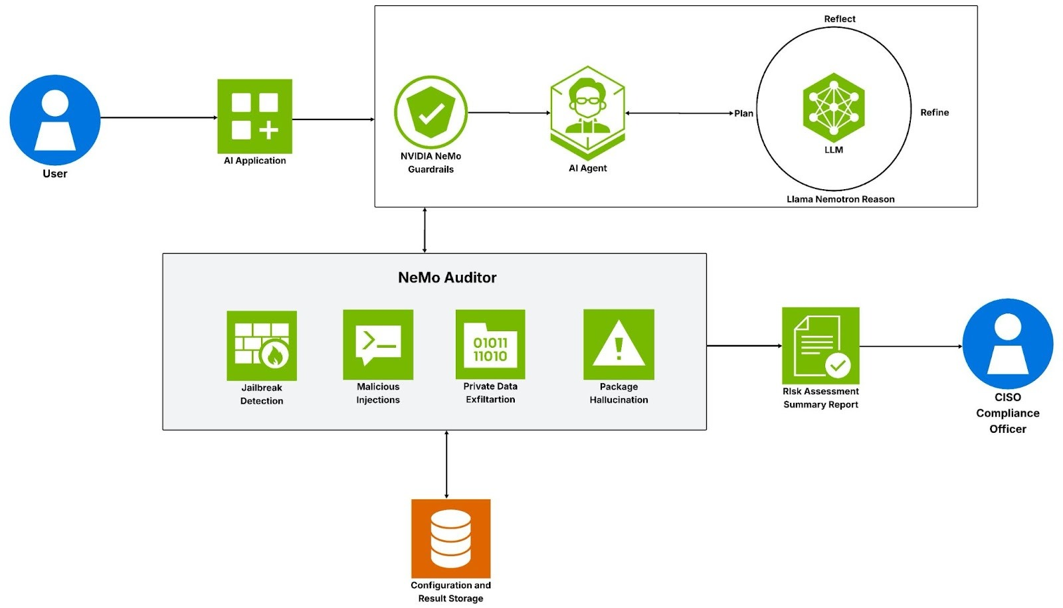

Scalable, Enterprise-Grade Solution for AI Security Assessments
LLM Security is about making models behave how we want, and not how malicious actors want
Step 1
PROBE
Generate Attack Prompts
Step 2
GENERATOR
Execute Against Target
Step 3
DETECTOR
Measure Resilience
Notes:
This slide shows how NeMo Auditor fits into an enterprise AI security architecture. The system operates in three steps: first, the Probe generates attack prompts targeting specific vulnerabilities; second, the Generator executes these prompts against your LLM; and third, the Detector analyzes whether the attack succeeded. NeMo Auditor runs these tests across four key categories—jailbreak detection, malicious injections, private data exfiltration, and package hallucination—then generates a risk assessment summary report for your compliance officer. The results feed into configuration storage for tracking security posture over time. Critically, this integrates with your production environment where NeMo Guardrails provides real-time protection at the application layer. The philosophy here is defense-in-depth: Auditor identifies vulnerabilities during development, Guardrails blocks attacks in production, and together they ensure your LLM behaves how you want, not how malicious actors want.

Slide 13






Protect AI Agents: NeMo Auditor + NeMo Guardrails
Add two layers of defense against AI agent risks
NeMo Auditor
On-Demand Security Audits Across Your Agent Fleet
Scans agents for security vulnerabilities
Identifies risks before threat actors exploit them
Provides audit trail for regulatory compliance
Tests complex multi-turn agent interactions
Measures safety posture against industry benchmarks
NeMo Guardrails
Real-time Protection for Every Agent Interaction
Blocks harmful or toxic outputs before they reach users
Detects and prevents jailbreak attempts
Stops sensitive data leaks (PII, proprietary info)
Keeps agents on-topic and within boundaries
NeMo Auditor
Evaluate Agent Risk
NeMo Guardrails
Keep Agents on Track
Notes:
Protecting AI agents requires two complementary layers of defense working together. NeMo Auditor provides on-demand security audits across your agent fleet—scanning for vulnerabilities, identifying risks before attackers exploit them, testing complex multi-turn agent interactions, and providing the audit trail needed for regulatory compliance. NeMo Guardrails delivers real-time protection during every agent interaction - blocking harmful outputs before they reach users, detecting jailbreak attempts, preventing sensitive data leaks like PII or proprietary information, and keeping agents on-topic and within their defined boundaries. Think of Auditor as "ensure agents remain on track" through proactive testing, while Guardrails "keeps agents on track" through active runtime defense. Together they create comprehensive protection for AI agent deployments.

Slide 14
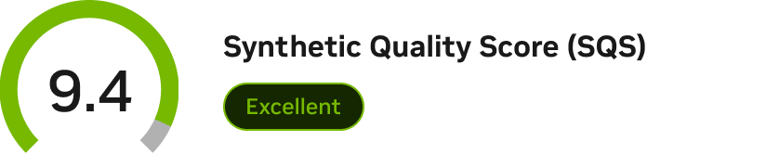

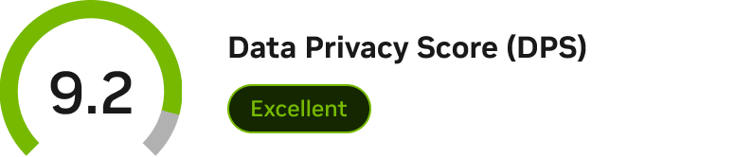
NVIDIA NeMo Safe Synthesizer
Generate safe, synthetic versions of your sensitive datasets with no one-to-one mapping to original records.
Key Features
Privacy-safe
Generate data using differential privacy – the gold standard providing mathematical guarantees.
Compliant
Adhere to data privacy requirements and regulations like HIPAA, GDPR, and CCPA.
Enterprise-grade
Synthesize sensitive data for safe, high-quality AI training and data sharing across organizations.
Built-in evaluation template to ensure that the synthetic data is both high-quality and safeguarded against adversarial attacks or re-identification.
Try the microservice (Early Access) here. The open-source library will be available in March, 2026.
Notes:
NeMo Safe Synthesizer generates synthetic versions of sensitive datasets. It creates entirely novel records with no 1-to-1 mapping to the original.
It unlocks insights of your data while maintaining data privacy.
It has built in evaluation for quality and privacy so you can quickly answer, "Did it work?"

Slide 15
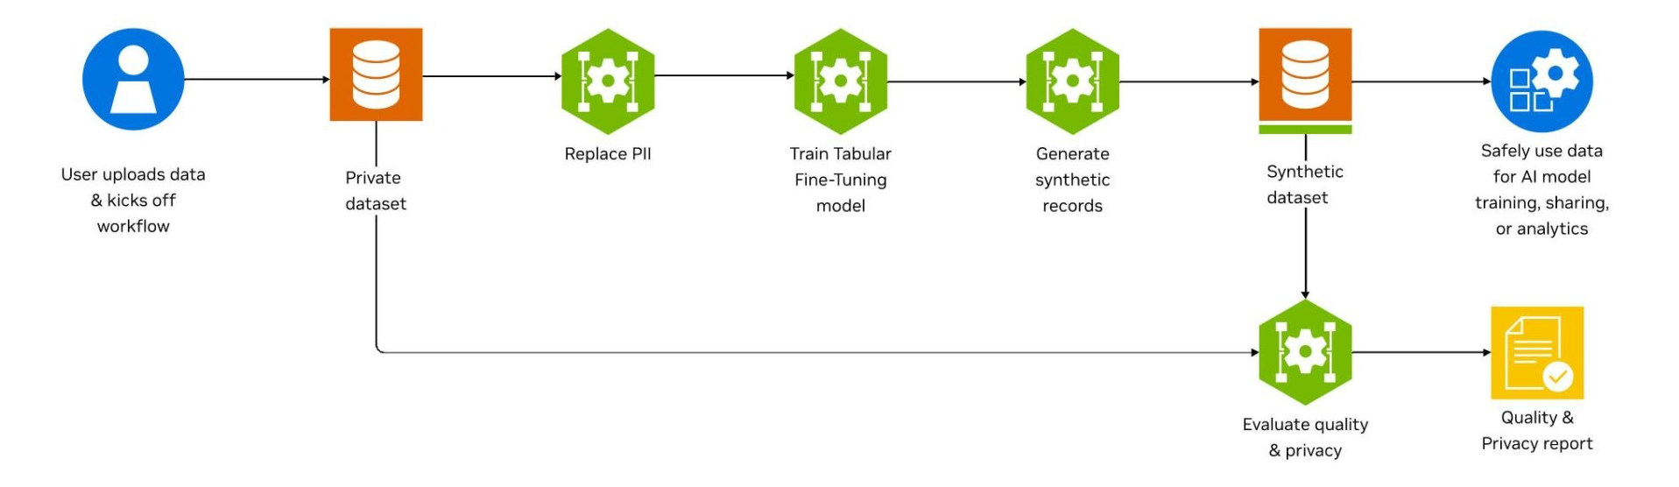




NeMo Safe Synthesizer Workflow
Safe Synthesizer is built for highly regulated industries where data security is paramount
Natural Language
Patient Data
Financial Transactions
Telecommunications
Generate synthetic text data from documents or transcripts for AI training while protecting personal information.
Create synthetic medical records for research while maintaining patient privacy and HIPAA compliance.
Compose synthetic financial data that preserves patterns without exposing customer information.
Produce synthetic call records and network data for analytics while safeguarding subscriber privacy.
Notes:
Safe Synthesizer starts from an existing dataset. We recommend first replacing PII to ensure the model has no chance to learn the most sensitive info. Then the model is fine-tuned and synthetic records are generated that have no 1-to-1 mapping to original records. An evaluation report is automated created measuring privacy and quality.
Common use cases include text documents, healthcare data, financial data, and time-series telecommunications data.
Healthcare, clinical trial data and share with other researchers
Language – training SLM
Finance – use a synthetic version of customer data to do downstream advanced analytics such as fraud detection and prediction

Slide 16
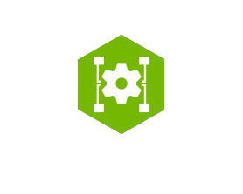


3 Levels of Data Privacy
Select the level that balances privacy and quality based on your needs
PRIVACY PROTECTION
LEVEL 3: Differential Privacy
No 1-to-1 mapping
Best for: Production data, external sharing, regulated industries​
Use case: Training production models, sharing data with partners​
Features: Mathematical privacy guarantees, protection against inference attacks
Fine-Tuning w/ Differential Privacy
Synthetic data w/ mathematical privacy guarantees
PRIVACY PROTECTION
LEVEL 2: Synthetic Data
No 1-to-1 mapping
Best for: Development environments, internal testing​
Use case: Training non-production models, data exploration​
Features: Maintains statistical properties while generating new data, including altering distributions​
HIGHER UTILITY
HIGH PRIVACY
Fine-Tuning
Synthetic data
PRIVACY PROTECTION
LEVEL 1: Data Masking
1-to-1 mapping maintained
Best for: Initial PII removal, development environments​
Use case: Internal analytics with low-sensitivity data​
Limitations: Vulnerable to data linkage, membership inference, and re-identification attacks​
Masking alone isn't sufficient for sensitive data: Combining ‘gender’, ‘birth date’, and ‘postal code’ re-identifies between 63 and 87% of the U.S. population¹
Private Dataset
PII Replacement
De-identified data
¹https://arxiv.org/pdf/2501.03941
Notes:
You can select the privacy & utility trade off that meets your needs. Level 1 is traditional data masking where a 1-to-1 mapping is maintained. However this is highly vulnerable to reidentification attacks.
Level 2 and level 3 are what we recommend for Safe Synthesizer. These are where we actually fine-tune the model. Level 3 involves adding noise into the process to provide differential privacy – the gold standard of privacy that offers mathematical guarantees.
You might wonder why doesn't everyone go for Level 3? Utility is lower, training time is longer (usually 2-4x, meaning higher compute usage and therefore higher cost), and number of records needed for training is higher (~10k minimum vs ~1k minimum for level 2).

Slide 17
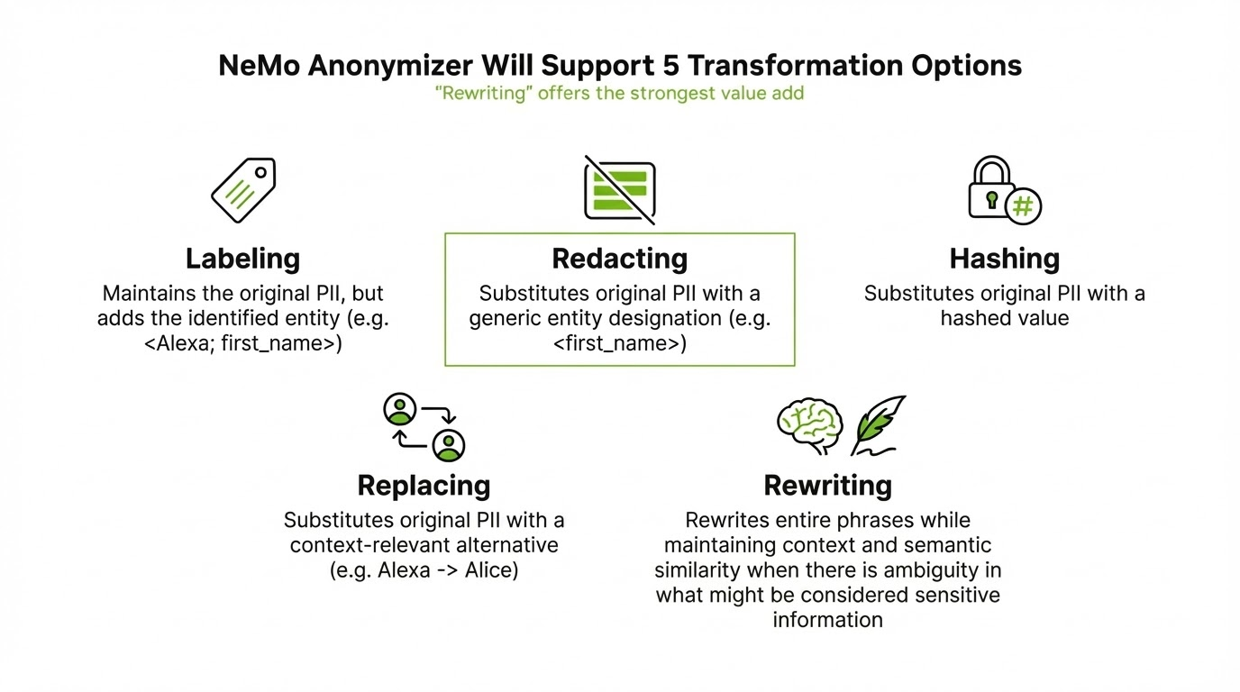
NVIDIA NeMo Anonymizer
Perform context-aware data anonymization to protect PII while preserving insights
Key Value
Detects & transforms sensitive information in free text
Context-aware
Designed using a compound LLM system
Built-in evaluation
OSS library coming in March 2026
In unstructured text, PII entities may not be well-defined or may be context dependent.
5 Transformation Options
Labeling
Adds identified entity to original PII
Annotating
Substitutes PII with a generic tag
Hashing
Substitutes PII with a hashed value
Substituting
Substitutes PII with a context-relevant alternative
CLASSIC DETECTION & REPLACEMENT ARE INSUFFICIENT
Example: "Sarah described her appointment. She's looking forward to ringing the bell soon and said the care team has been wonderful."
Sarah -> first name
Ringing the bell -> reveals the nearing end to cancer treatment
Rewriting
Rewrites entire phrases while maintaining context
Notes:
Anonymizer supports a context-aware data anonymization within free text. After detecting sensitive entities, you can label, redact, hash, replace, or fully rewrite them.
Classic detection & replacement techniques are insufficient because latent (ambiguous) entities go undetected and leak private info.

Slide 18
NeMo Anonymizer Example
Free text can be transformed in 5 different ways
Original | Evelyn "Eve" Marquez, 46, is a third‑generation public servant who now represents the 12th District of Austin, Texas, in the State Senate.
Annotated | [Evelyn](first_name) "[Eve](first_name)" [Marquez](last_name), [46](age), is a third‑generation [public servant](occupation) who now represents the 12th District of [Austin](city), [Texas](state), in the State Senate.
Redacted | ****, ****, is a third‑generation public servant who now represents the ****, in the State Senate.
Hashed | a3f4c8e9b2d1f6a7, 5e8c2a9f1b4d7e3a, is a third‑generation public servant who now represents the 7d3e9a2c5f8b1e4a, in the State Senate.
Substituted | Isabella "Izzy" Alvarez, 48, is a third‑generation civic leader who now represents the 12th District of Albuquerque, New Mexico, in the State Senate.
Rewritten | A 47-year-old third-generation public servant currently serves as a state senator representing a major urban district.
Notes:
Replacement swaps out sensitive info with context-aware replacements. For example, Eve is a nickname for Evelyn, and we see Izzy is now the nickname used for Isabella. Replacement replaces real info with fake info.
Rewriting rewrites entire phrases to obfuscate both obvious and latent entities. It maintains the factual info and rephrases rather than replaces classic PII.

Slide 19
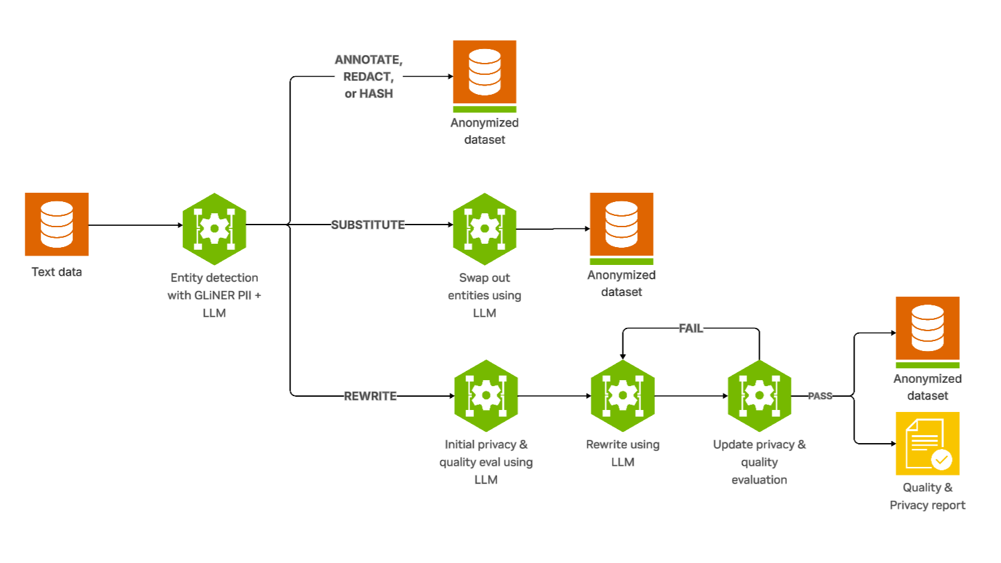
NeMo Anonymizer Workflow
Anonymizer uses a compound LLM system to detect and transform sensitive text data
Notes:
The first step in the workflow is entity detection. In the label, redact, and hash paths, detection is all that is needed and we can return the results. In the replace path, we add a step to use an LLM to identify context-aware replacements. We swap them out and return the dataset.
On the rewrite path, we use an LLM to generate privacy and quality questions and we iteratively rewrite the text until it generally gets the quality questions right but the privacy questions wrong. Once it does, we return the dataset and an evaluation report.

Slide 20



Getting Started
Safeguard your agentic AI systems today
NeMo Safety Libraries
Nemotron Safety Models
Open Libraries on GitHub
One Click Deploy NeMo Platform
Open Models on Hugging Face
NVIDIA NIM on build.nvidia.com
Access
Try
When you are ready for enterprise support, request a 90-day free trial for NVIDIA AI Enterprise.
Notes:
And now let's talk about how you can get started with these things. You can try the model directly from Hugging FaceThere are several ways to get started safeguarding your AI today:
Access the NeMo Guardrails open library on Github
Use the open Nemotron safety models on Hugging Face
Try the NeMo Guardrails microservice for production grade deployment and support
Or request a 90-day free trial for NVIDIA AI Enterprise for enterprise support.

Slide 21
NVIDIA NeMo Safety Libraries
Enhance the safety, security, and privacy of your agentic AI applications and systems
Product | Description | OSS Library | Microservice
NeMo Safe Synthesizer | Create privacy-safe versions of sensitive data | Coming Soon April 2026 | Available Now – EA GA – April 2026
NeMo Anonymizer | Protect PII data with context-aware replacements | Coming Soon April 2026 | N/A
NeMo Guardrails | Apply safety and policy controls on prompts, tool calls, and LLM responses | Available Now | Available Now Deploy on GKE
NeMo Auditor | Audit AI agents for risky behavior, policy gaps, and compliance issues | OSS Library = Garak Available Now | Available Now - EA GA – March 2026
Notes:
There are several ways to get started safeguarding your AI today:
Access the NeMo Guardrails open library on Github
Use the open Nemotron safety models on Hugging Face
Try the NeMo Guardrails microservice for production grade deployment and support
Or request a 90-day free trial for NVIDIA AI Enterprise for enterprise support.

Slide 22
NVIDIA Nemotron Safety Models
Advanced multilingual, multimodal models with reasoning for a variety of use cases
Use Case | Model | Released | Use Case | Learn | Model & Dataset | NIM
Topic Control | Llama Nemotron Topic Control llama-3.1-nemoguard-8b-topic-control | Jan '25 | Keep model responses constrained to an approved topic set and prevent off‑topic or unsafe deviations. | Blog Research Paper | Hugging Face Model Dataset | NVIDIA NIM
Jailbreak Detection | Nemotron Jailbreak Detect nemoguard-jailbreak-detect | Jan '25 | Detect adversarial or jailbreak prompts to block unsafe or policy‑violating model behavior. | Blog Research Paper | Model Dataset | NVIDIA NIM
Content Safety | Llama Nemotron Content Safety llama-3.1-nemotron-safety-guard-8b-v3 | Oct '25 | Classify user or model text for safety categories (toxicity, hate, violence, sexual content) across multiple languages. | Blog Research Paper | Hugging Face Model Dataset v1 Dataset v2 | NVIDIA NIM
 | Nemotron Content Safety Reasoning nemotron-content-safety-reasoning-4b | Nov '25 | Apply reasoning‑based safety judgments to interpret complex scenarios and enforce domain‑specific safety policies. | Blog, Technical Blog Research Paper | Hugging Face Dataset | NVIDIA NIM
 | Nemotron 3 Content Safety nemotron-3-content-safety-4b | Dec '25 EA Only | Detect unsafe, disallowed, or sensitive content in multilingual and multimodal inputs (text + images). | Coming Soon March '26 | Coming Soon March '26 | Post GTC - April
PII | GLiNER PII gliner-pii | Oct '25 | Identify and label personal identifiable information so it can be redacted, masked, or handled securely. | Blog | Hugging Face | Coming Soon March '26
Notes:
This shows the breadth of NVIDIA’s open safety models—each addressing a specific safety need enterprises have surfaced.
For example:
Topic Control keeps conversations constrained to approved domains.
Jailbreak Detection identifies adversarial intent before it reaches the LLM.
Nemotron Safety Guard provides multilingual content safety using culturally aware datasets.
Nemotron PII supports real-time classification of sensitive personal data.
Content Safety Reasoning introduces policy reasoning—applying structured logic to make nuanced safety decisions.
Content Safety VL extends safety techniques to multimodal inputs including images.
Every model is available openly on Hugging Face and/or NVIDIA NIM so enterprises can use or deploy them in any environment.

Slide 23
Resources
Get Started
NVIDIA API Catalog
Experience safety models packaged as NVIDIA NIM microservices on build.nvidia.com
Notebooks
Build a voice agent with RAG and safety guardrails
Safe Synthesizer Example Notebook
Documentation
Go to docs overview
Run Inference with Parallel Rails using NeMo Guardrails Microservice Tutorial
Demo Use Case Examples
AI Assistant Example
Safe Synthesizer Docs
Garak Docs
NVIDIA Developer Program
Join to receive access to NVIDIA tools, technical training and webinars, and unlimited use of NVIDIA On-Demand.
Notes:
We provide extensive documentation, tutorials, blog posts, and reference implementations.
Teams can learn, test, and deploy safety models and Guardrails quickly—with full transparency into datasets and performance.

Slide 24
End
Notes:
Thanks for joining today. This session is focused on NVIDIA’s approach to AI Safety—specifically how enterprises can secure, safeguard, and govern AI agents as they shift from simple chat interactions to multimodal, tool-using, autonomous workflows. Agentic AI creates enormous opportunity, but it also introduces new, complex safety challenges. Today, we’ll walk through those challenges and how NVIDIA’s safety stack—open models, datasets, and open library —helps enterprises mitigate risk while maintaining performance.

