Slide 1
NeMo Data Designer + Safe Synthesizer
Synthetic data for training, fine-tuning, and evaluating AI models
Notes:
Open the module. ~30 min total — the first 11 slides are general product, the last 4 show how the workshop's AML use case leveraged Data Designer. Set expectations: this is about the NVIDIA stack first, the AML app second.

Slide 2






Challenges
Training models like Nemotron requires domain-specific data, but most AI teams are data poor.
Accuracy
Privacy
Scarcity
Cost
Innovation Velocity
$
Inaccurate, biased, or outdated data leads to poor quality data and reduced model accuracy.
Inadequate data privacy protections expose sensitive information barring usage for external use cases.
Insufficient data availability forces trade-offs between model accuracy, fairness, and reliability.
Manual data collection and labeling methods drive high costs and delays.
Lack of access to high-quality, domain-specific data hinders AI development.
Notes:
Data is critical for every AI project, but most teams run into data challenges. From lack of high-quality data, to biased or private and sensitive data that can't be used for training, many projects stall before they even begin. Traditional methods of data collection and enrichment are time-consuming and costly processes, and often still result in subpar data quality – this stalls innovation and hinders AI development.

Slide 3
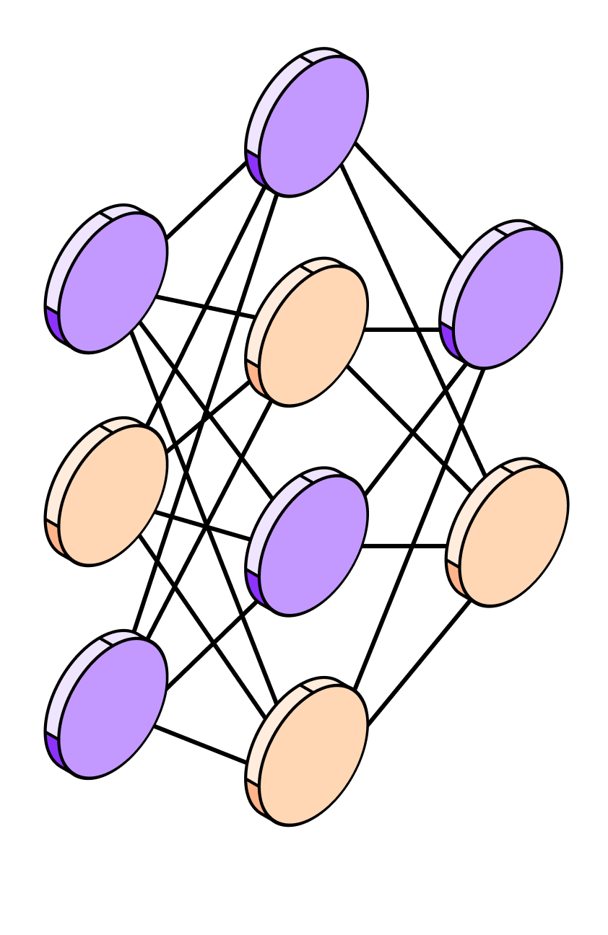
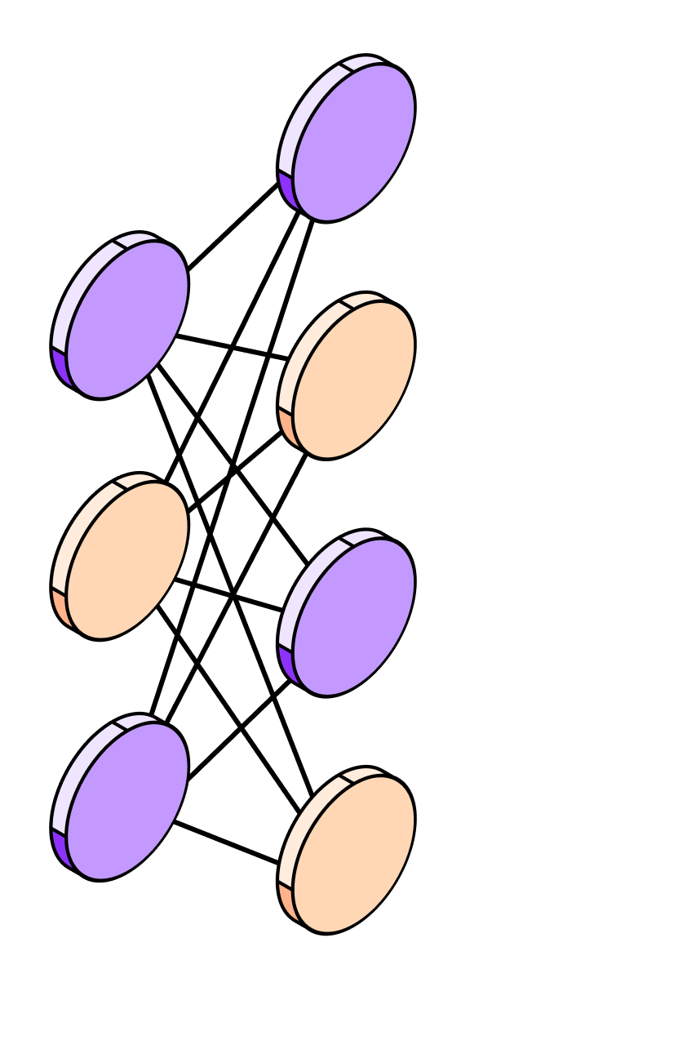
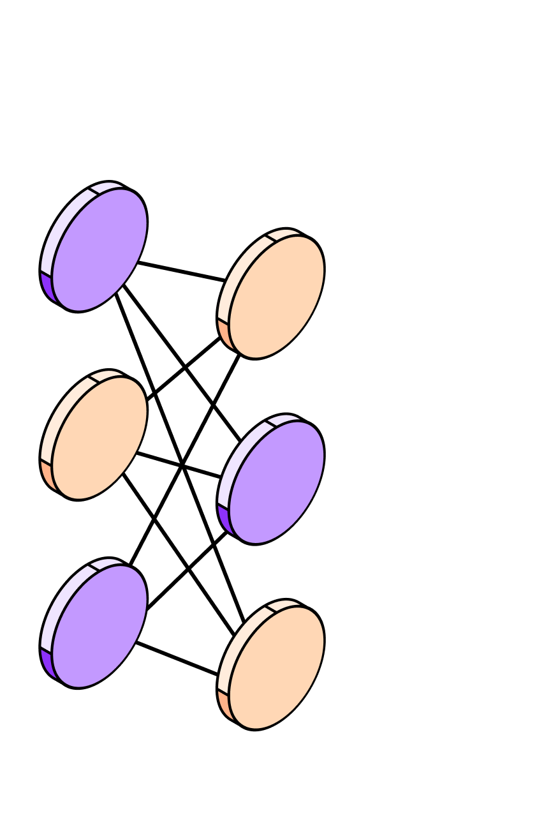
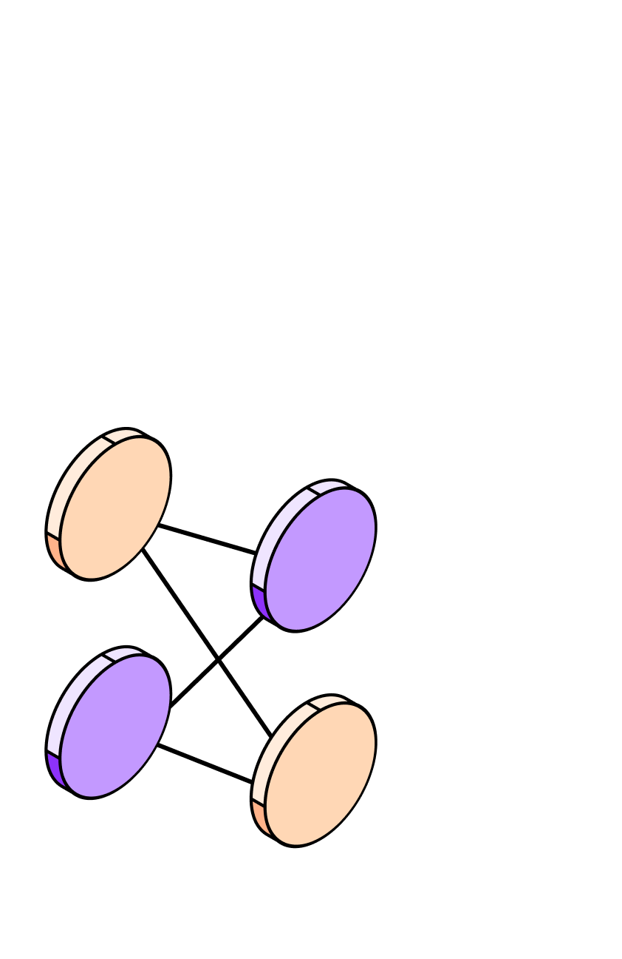

What is synthetic data?
Synthetic data mimics the statistical properties and patterns of real-world data without directly replicating it. It is created using techniques such as statistical modeling, rule-based simulations, and generative AI models to produce realistic, high-quality datasets.
5
4
Advanced systems integrate multiple models and tools to generate consistent and realistic synthetic data.
They create complex, interconnected datasets that mimic real-world relationships and handle edge cases.
Highly adaptive, these systems adjust to varying data needs while maintaining coherence across outputs.
3
LLMs generate diverse synthetic data with an understanding of context, relationships, and complex patterns.
They can adapt to different data domains and adjust outputs based on specific requirements.
While highly capable, they still have limitations and struggle with certain edge cases.
2
Specialized AI models, like GANs for images or fine-tuned LLMs for text, generate highly realistic synthetic data for specific tasks.
Models excel in their domains but lack broader understanding.
The models operate within defined constraints, making them powerful but not adaptable.
1
More advanced than fixed rules, this approach uses statistical methods and basic machine learning to replicate data patterns within strict limits.
Adapts to patterns, but lacks true decision-making, keeping data generation constrained.
Synthetic data techniques
Basic synthetic data follows fixed rules, random generation, and simple templates, producing predictable but limited outputs.
Tools like Faker generate names, addresses, and text based on predefined patterns. Can be reliable for simple use cases.
Basic rules & templates
Statistical modeling
Single-purpose AI models
General-purpose LLMs
Compound AI systems
Synthetic data maturity
Notes:
Synthetic data can unlock the data bottleneck that most teams face. Synthetic data mimics the statistical properties and patterns of real-world data, creating safe data for AI. There are various techniques to create synthetic data from using tools like Faker to prompting general purpose LLMs. Techniques like prompting an LLM, however, can result in generic, low-quality data output that does not scale. Our approach is a compound AI system that integrates multiples models and tools to generate the most realistic, high-quality data that can scale for a specific use case, resulting in domain-specific data that's as high-quality as the original seed data and usable for scalable AI training, fine-tuning, and evaluation.

Slide 4





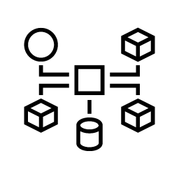



NVIDIA NeMo Manages and Accelerates the AI Agent Lifecycle
Data Designer and Safe Synthesizer provide data for
training, fine-tuning, and evaluating models
NeMo Data Designer
NeMo Safe Synthesizer
NeMo Customizer
NeMo Evaluator
NeMo Guardrails
NeMo Retriever
NeMo Auditor
GENERATE
CUSTOMIZE
EVALUATE
GUARDRAIL
LEARN
SCAN
NeMo Agent Toolkit
OPTIMIZE
Notes:
As part of the NeMo suite to build, monitor, and optimize AI agents – these two new synthetic data solutions, NeMo Data Designer and NeMo Safe Synthesizer, provide an easy way to generate safe data for training, fine-tuning, and evaluating models in your AI agent workflows.

Slide 5


What’s blocking your AI projects?
Challenge
Solution
Data Designer
Data Scarcity
Don’t have any starting data.
Generate data from scratch
Extrapolate beyond seed data (if any)
Used for when the data doesn’t cover all your cases
Data Privacy
Have the data, but it’s sensitive.
Safe Synthesizer
Generate a safe version of data with privacy guarantees
Interpolate within seed data
Used for when you have the data you need, you just can't use it due to privacy reasons
Notes:
What's the difference between the two solutions?
Not enough data – if you don't have any starting data or it's limited, low-quality or biased, NeMo Data Designer allows you to generate data from scratch or a few seed examples
You have data but it's private or sensitive – if you have data, but you can't use it it to train models – think medical records, financial data, etc., you can use NeMo Safe Synthesizer to create privacy-safe synthetic versions of that data with mathematical guarantees of privacy (Differential Privacy)

Slide 6
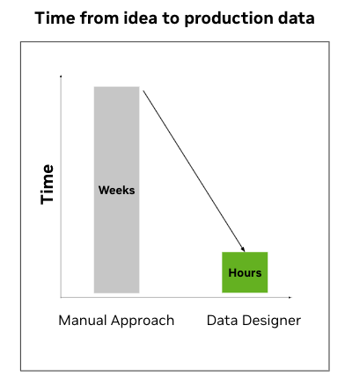


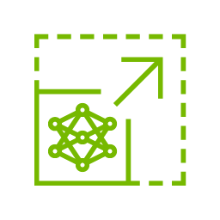
NVIDIA NeMo Data Designer
Design data from scratch or seed examples
Purpose-built for AI developers to design high-quality, domain-specific synthetic data at scale.
High-quality
Accurate, realistic synthetic datasets built for production-grade AI.
Customizable
Easily configurable tool to integrate any LLM such as Nemotron, GPT-5, etc.
Scalable
Optimized for high-throughput synthetic data generation at scale.
Secure
Avoids sensitive data exposure with safe, synthetic alternatives.
Notes:
NeMo Data Designer is purpose-built for AI developers to design high-quality, domain-specific synthetic data at scale—unlike one-size-fits-all LLMs that struggle to deliver consistent, reliable results. Start from scratch or just a few seed examples to accelerate AI development, saving time while improving model performance and accuracy

Slide 7



NeMo Data Designer - Popular Use Cases
Evaluation & Benchmarks
Conversational
AI
Synthetic
Documents
Low Resource Adaptation
Build evaluation and benchmark datasets (such as question-answer pairs) to improve RAG systems or evaluate multiple models on a use case.
Create domain-specific synthetic dialogues to fine-tune AI for chatbots, virtual assistants, and interactive learning systems, ensuring natural and context-aware responses.
Design high-fidelity synthetic datasets for large-scale AI model training in tax form validation, mortgage approvals, and other structured data applications.
Generate realistic, diverse, and complex synthetic datasets for low resource domains like proprietary coding languages or under represented languages—enhancing AI models’ reasoning and performance.

Slide 8
Three Building Blocks
Every Data Designer record is composed from these three primitives
Samplers
LLM text columns
Dependency mapping
Statistical / categorical columns
Open-text generation via any LLM
Column B conditioned on column A
Deterministic primitives: UUID, uniform int/float, category (with weights), person-from-Faker, date ranges, normal / log-normal distributions.
Use for: structural fields — IDs, scores, dates, categorical buckets.
Calls a teacher LLM with a templated prompt. References earlier columns via `{{column}}` substitution. Output schema can be enforced via structured decoding.
Use for: free-text fields — narratives, descriptions, Q&A pairs.
Any later column can reference earlier columns' values — both inside prompts (samplers + LLM) and inside expression columns (deterministic post-processing).
Use for: keeping records internally consistent (typology → KYC → transactions).
Notes:
How Data Designer actually works under the hood. These three primitives compose to build any dataset shape. Tell the room: most real datasets are ~50% samplers, ~40% LLM-text, ~10% dependency mapping.

Slide 9
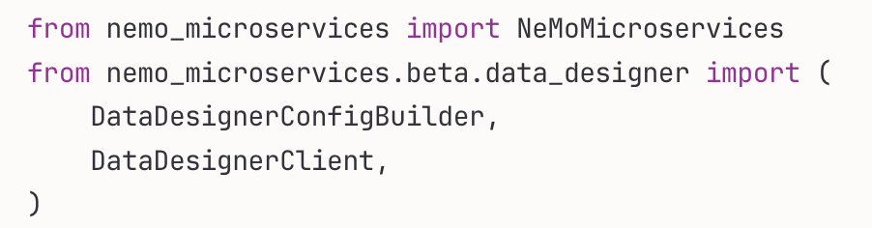
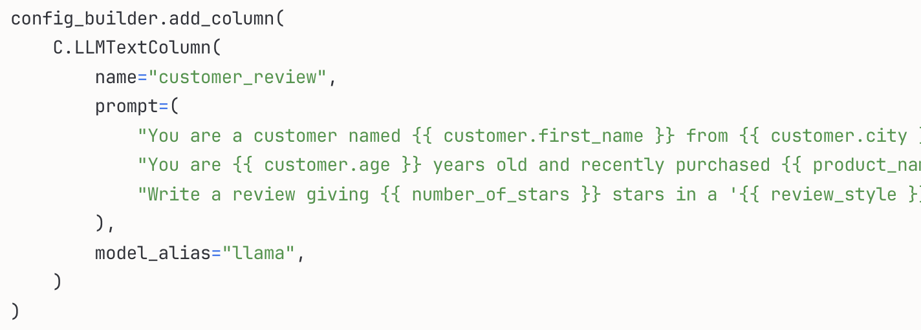
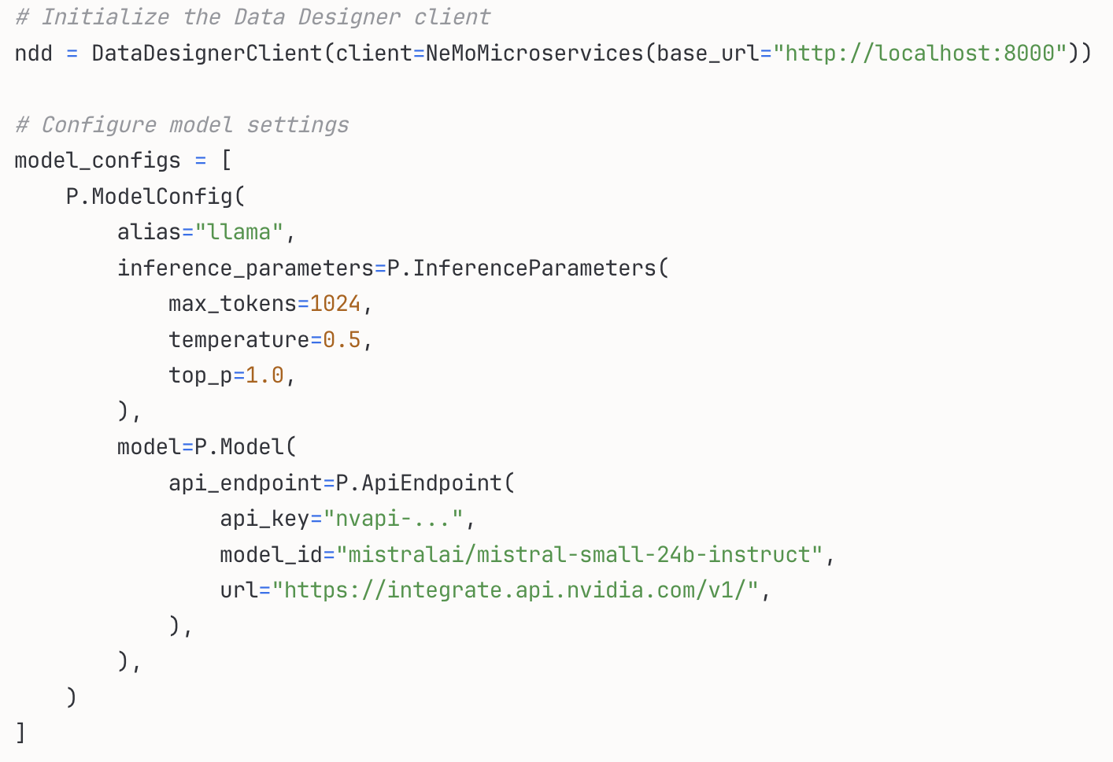
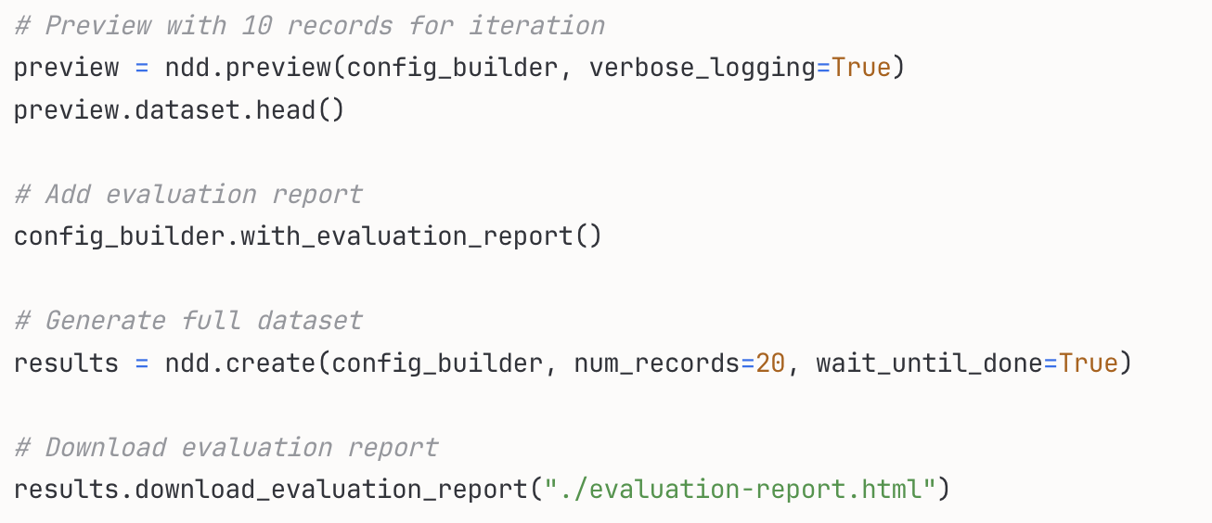
Generating Synthetic Data
Install the Data Designer SDK and connect to NeMo Data Designer

Slide 10
Two Deployment Modes
Pick by scale and operational stance — both run the same SDK code
Quickstart
Platform
Rapid deploy, single node
Distributed microservices, enterprise scale
✓ Deploy with Docker Compose
✓ Deploy via NeMo Microservices Helm chart
✓ Runs on a laptop or VM
✓ Scales on Kubernetes
✓ Requires CPU only (LLM is remote)
✓ Horizontal scaling across workloads
✓ Connect to any OpenAI-compatible endpoint
✓ Connect to NIMs on K8s or hosted endpoints
✓ Best for: development, prototyping, demos
✓ Best for: production, multi-tenant, governance
Notes:
Same SDK code, two deployment targets. From customer slides 10-12. The Workshop's M6.2 hands-on uses Quickstart on the attendee's pod.

Slide 11

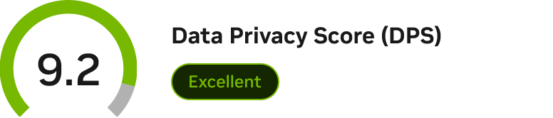
NVIDIA NeMo Safe Synthesizer
Create privacy-safe data
Safe Synthesizer unlocks the insights of your sensitive data by generating privacy-safe, synthetic versions.
Privacy-safe
Generate data using differential privacy – the gold standard providing mathematical guarantees.
Compliant
Adhere to data privacy requirements and regulations like HIPAA, GDPR, and CCPA.
Enterprise-grade
Synthesize sensitive data for safe, high-quality AI training and data sharing across organizations.
Built-in evaluation template to ensure that the synthetic data is both high-quality and safeguarded against adversarial attacks or reidentification.
Notes:
Safe Synthesizer unlocks insights from sensitive data by generating privacy-safe versions of it that can be used for model training and data sharing. Safe Synthesizer includes built-in data quality and evaluation metrics so you can rest assured your data is safeguarded against adversarial attacks or reidentification.

Slide 12
Data Privacy 101
Privacy <> Utility Tradeoff
Level 1 (Basic) - Data masking using Transform API
Use case: Internal analytics with low-sensitivity data
Limitations: Vulnerable to data linkage, membership inference, and re-identification attacks.
While direct PII is removed, an attacker with access to a database could still identify a specific person by matching the combination of age, zip code, and height, demonstrating why masking alone isn't sufficient for sensitive data.
Level 2 - Synthetic data generation
Use case: Training non-production models, data exploration
Features: Maintains statistical properties while generating new data, including altering distributions
Level 3 - Differential privacy-enabled synthetic data
Use case: Training production models, sharing data with partners
Features: Mathematical privacy guarantees, protection against inference attacks
More Privacy
Better Quality
Notes:
Depending on specific use case needs, there's a trade-off between privacy and utility with synthetic data generation. With Safe Synthesizer, you can adjust these filters to find a balance that works best for your needs--from basic data transformation up to mathematical guarantees of privacy with Differential Privacy.

Slide 13

NeMo Safe Synthesizer - Popular Use Cases
Built for highly regulated industries where data security is paramount
Natural Language
Patient Data
Financial Transactions
Generate high-quality, safe data for AI model development while protecting end-user privacy.
Protect patient privacy while enabling medical research and data sharing across institutions.
Enable innovation with AI by creating balanced, fair datasets without compromising customer information.
Notes:
Healthcare, clinical trial data and share with other researchers
Language – training SLM
Finance – use a synthetiv version of customer data to do downstream advanced analytics such as fraud detection and prediction

Slide 14
Getting Started with Synthetic Data Generation

Slide 15
WORKSHOP USE CASE
How We Used Data Designer
for the AML SAR Investigator
An anchor exhibit — what the product does in a real workload
Notes:
Transition. Up to this point, all theory. The next 3 slides show how we used Data Designer to build the AML SAR investigator's SFT corpus — 75K records.

Slide 16
Our AML SDG Pipeline at a Glance
Two parallel sub-pipelines · 9 + 4 stages · ~75K records out
Non-aux pipeline — 9 stages (build the SAR judgment record)
Drivers
KYC
Tx
Sanctions
Grounding
Aux find
SAR jdg
Adversarial
Validate
→ 50K sar_judgment records
Aux pipeline — 4 stages × 4 task types in parallel (build typed findings)
Extract
Generate
Assemble
Audit
→ 25K aux records (behavioral / numeric / citation / statutory)
Notes:
The 90-second overview of how the AML workshop used Data Designer. Don't deep-dive any stage; if asked, point to workshop-appln/4.sdg_sft/run-v3/.

Slide 17
Quality Gates and the Final Corpus
Generation is cheap; what gets shipped is what survives the gates
Three gates per record
What we produced
1.
Per-record validators
sar_judgment
50,000
67%
Schema rules: no label leakage, length band, balance ±2pp
auxiliary_numeric
6,250
8%
auxiliary_citation
6,250
8%
2.
LLM-judge reviewer
auxiliary_statutory
6,250
8%
Scores grounding / statute / tone; drop <0.7
auxiliary_behavioral
6,250
8%
3.
MinHash dedup
TOTAL
75,000
100%
Drop near-duplicates across the corpus
Balanced 45/55 positives/negatives · 8 typologies · adversarial mutations baked in
Notes:
Combined the AML quality-gates and the corpus-output slides from the original deck. The 75K records → fed Phase 5 SFT training.

Slide 18
What Data Designer Did for AML
Three concrete payoffs from using the product (vs. rolling your own SDG)
Saved engineering time
1
Without Data Designer, building this pipeline from scratch would have been ~3 engineer-months. With it, the pipeline definition is ~600 lines of Python.
Multi-stage dependency mapping was free
2
Each AML record has 12 fields where field N depends on fields 1..N-1. Data Designer's dependency-mapping primitive made this declarative.
LLM-judge quality gate ships with the framework
3
We didn't write the judge runner, retry loop, score parser, or distribution audit. All shipped in Data Designer.
→ Hands-on next: run a 100-record version of this pipeline yourself
Notes:
The 'why this product, not roll-your-own' slide. Quantify with the 3-engineer-month number — that's a real anchor for SAs in customer conversations.

Slide 19
From product story to running pipeline
Hands-on next: 100-record AML SDG run on your 2× H100
Notes:
Hand off to M6.2 hands-on. Notebook M6/data_designer.ipynb pre-loaded on each pod. Take 5 min to verify everyone has it open before kicking off.

