Slide 1
NeMo Evaluator
How do you know your model actually got better?
Notes:
15-minute module on NeMo Evaluator. Compressed because Evaluator is demo-only in this workshop (not hands-on per user decision). Keep moving — there's a 30-min Evaluator demo right after this. Slides 5-7 are the eval-mode taxonomy; slide 7 includes the calibration warning that's the takeaway.

Slide 2
Why Evaluation Is Hard
Three problems every customization project hits
1
2
3
No single number captures "good"
Regression after every step
Benchmarks ≠ your task
Accuracy on MMLU ≠ usefulness for SAR generation. Domain tasks need domain metrics.
CPT, SFT, RL each adds capabilities and silently breaks others. Continuous eval is the only defence.
A model that aces HumanEval might still hallucinate the FFIEC citation you trained it on.
NVIDIA CONFIDENTIAL. DO NOT DISTRIBUTE.
Notes:
Set up the eval problem statement. The third bullet is the killer — show the room how a domain-tuned model can underperform on MMLU but be 10x better at the actual task.

Slide 3



Agentic AI Development is Becoming Increasingly Evaluation-Driven
Developers must evaluate both component- and system-level regressions for any changes
Prompt
Response
User or Machine
System Level
Calculate
Search
LLM
Generate
Evaluation
Critique
Plan
Calculate
Search
Generate
Component Level
Use
Tools
Retrieve
Information
Use
LLMs
Notes:
Agentic AI and generative AI application development are becoming increasingly evaluation-driven. For every update at the component level, developers must evaluate changes both at the component and at the overall system level.
For example, AI agents use an LLM to generate a plan, use tools and/or retrieve information, or invoke other LLMs to respond to user queries.
Developers need to evaluate AI agents at the system level—i.e., whether the agents are effectively solving what the user is asking for.
At the component level, developers might evaluate the following:
Whether the right tools are being called with the correct parameters
Whether the responses from other LLMs are as expected
Whether the retrieval pipeline responses are accurate, and whether the embedding or re-ranking models are suitable for the specific use case
To simply put, evaluation is very important for any enterprises building Agentic AI or Generative AI applications and developers must use the right tools to simplify evaluation

Slide 4

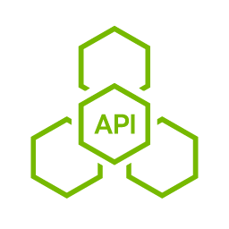



Accelerate Agentic AI Evaluation with NeMo Evaluator
API-driven evaluation that can be easily integrated into your CI/CD pipelines.
Accelerated Evaluation
Streamlined Evaluation
Scale LLM-as-a-Judge
Parallelized evaluation with multiple NIM endpoints for custom LLM-as-a-Judge
21
45
Faster Time-to-Market
Rapid iterations with API driven integration in CI/CD pipelines
# of Steps
Evaluation Time (mins)
Comprehensive Suite of Options
LLM-as-a-Judge, academic benchmarks, similarity metrics and retrieval metrics
5
8.5
Run Anywhere
Provides higher security, privacy and flexibility
OSS Libraries
NeMo Evaluator
1
8
A100 GPUs
Enterprise-Grade Containers
The benchmark represents the number of steps for end-to-end evaluation of a customization job with NeMo microservices and a leading open-source alternative library.
Evaluation time using LLM-as-a-Judge with
NeMo Evaluator and NVIDIA NIM Operator
Secure, stable and supported software
Notes:
NVIDIA NeMo Evaluator™ microservice simplifies the end-to-end evaluation of generative AI applications, including retrieval-augmented generation (RAG) and agentic AI with an easy-to-use API.
It provides LLM-as-a-judge capabilities, along with a comprehensive suite of benchmarks and metrics for a wide range of custom tasks and domains, including reasoning, coding, and instruction-following.
You can seamlessly integrate NeMo Evaluator into your CI/CD pipelines and build data flywheels for continuous evaluation, ensuring AI systems maintain high accuracy over time.
NeMo Evaluator’s flexible cloud-native architecture allows you to deploy it wherever your data resides, whether on-premises, in a private cloud, or across public cloud providers.
This enables a faster time-to-market by making it easy to set up and launch evaluation jobs, allowing you to evaluate more efficiently.
As you can see in the chart on the right, NeMo Evaluator allows developers to streamline the evaluation of custom models, reducing the process from 21 steps with alternative open-source libraries to just 5 steps.

Slide 5
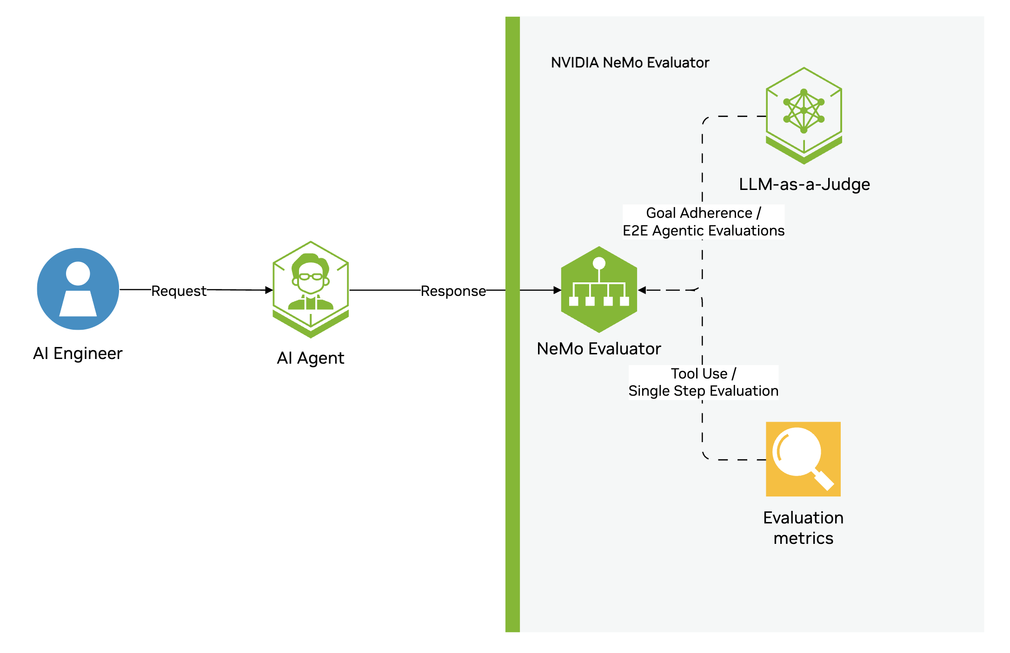
Agentic Evaluation
Evaluate whether agents are using the correct tools and generating accurate responses
Notes:
This architecture diagrams shows the evaluation of Agentic AI applications.
NeMo Evaluator provides a custom metric to evaluate the tool calling for AI agents. Using this metric, you can evaluate whether the agent called the right function with the right parameters. Alternatively, you can also evaluate the outputs of the agents with LLM-as-a-judge.

Slide 6
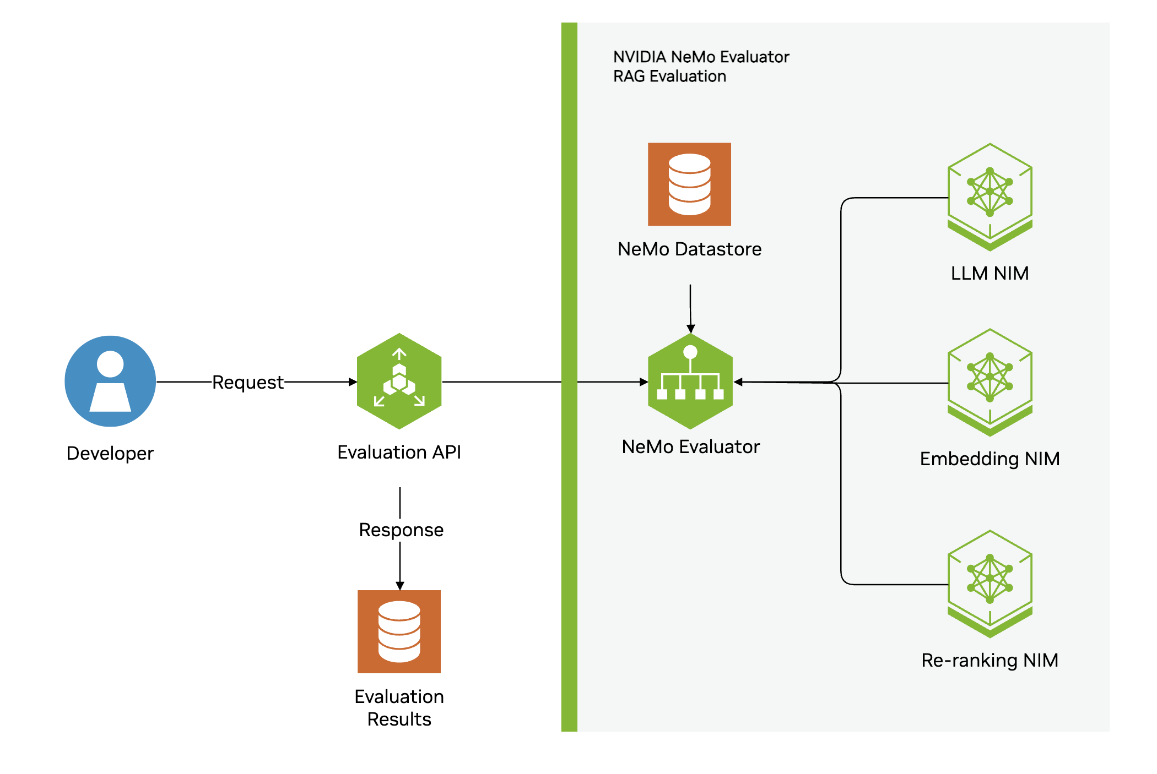
RAG Evaluation
Evaluate embedding models, re-ranking models and end-to-end retrieval pipelines
Notes:
For retrieval-augmented generation pipelines, you can evaluate step-by-step by assessing accuracy metrics for the LLM generator, embedding, and reranking models.
NeMo Evaluator also supports offline evaluation—simply provide the RAG queries, responses, and metrics in the API payload.

Slide 7
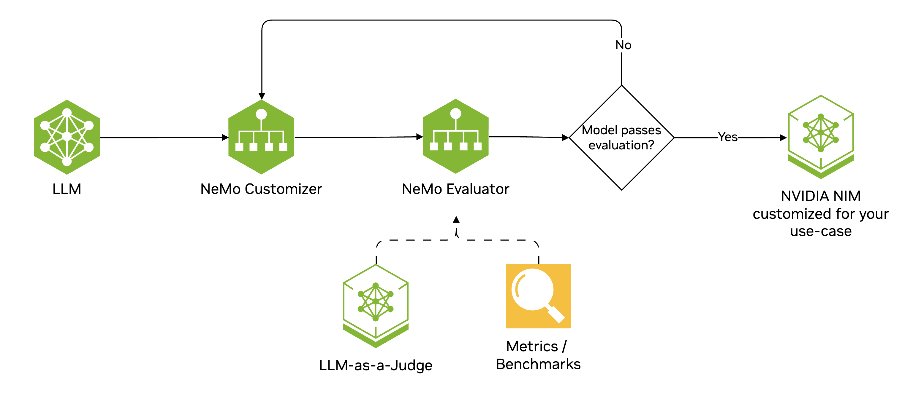
Custom Model Evaluation
Evaluate whether custom models are accurate for various use cases and if there is any regression from base models
Notes:
To tailor models for enterprise needs, use NeMo Customizer and NeMo Evaluator together and keep refining and testing until you achieve the desired accuracy, and evaluate on academic benchmarks to ensure no regression in accuracy.
The customized model can be deployed as NVIDIA NIM™ microservices for higher throughput and lower latency.

Slide 8
NeMo Evaluator Supports Both Online and Offline Evaluations
Comprehensive Suite of Evaluation Types
LLM-as-a-Judge
Similarity Metrics
Supports OpenAI API compatible Judge LLM
Standard MT-Bench data or custom data
Evaluate a model on custom datasets
Compares the LLM generated response with a ground truth response
F1, BLEU, ROUGE, EM
Retrieval and RAG Metrics
Academic Benchmarks
Supports standard academic datasets and custom datasets
Metrics include recall, ndcg, faithfulness, answer_relevancy
60+ academic benchmarks through LM Evaluation Harness
10+ code generation tasks through BigCode Evaluation Harness
Notes:
Let’s dive into the various functionalities of NeMo Evaluator.
NeMo Evaluator supports both online and offline evaluations:
Online evaluation allows you to integrate the evaluator directly into your application and assess model responses before displaying them to the user.
Offline evaluation lets you prepare evaluation datasets and run assessments at specific times to determine whether the model or application is performing as expected and to ensure there are no regressions.
At a high level, NeMo Evaluator supports LLM-as-a-Judge, similarity metrics, retrieval and RAG pipelines, and evaluation using academic benchmarks.
For each box, use the points mentioned in the slide

Slide 9




Evaluator Components
Four pieces — pick one of each per eval job
Runners
Judges
Invoke the model under test
(NIM, vLLM, OpenAI, HF endpoint)
Score the output
(LLM-as-judge, rubric, exact, similarity)
Datasets
Reports
The questions
(MMLU, HumanEval, custom JSONL)
Aggregated scores
(W&B, MLflow, JSON, dashboard)
Runner → Judge → Dataset → Report (composable, swap each piece independently)
NVIDIA CONFIDENTIAL. DO NOT DISTRIBUTE.
Notes:
Composability is the design pillar. You bring your dataset; Evaluator brings runners + judges + reports.

Slide 10
Eval Mode 1 — Academic Benchmarks
Generalisation sanity-check, not your final answer
When to use
Bundled with Evaluator
✓ Regression: did CPT break general capability?
MMLU
57-subject multiple choice
✓ Cross-vendor comparison
GSM8K
Math word problems
✓ Reporting in papers / customer decks
HumanEval
Python code generation
When NOT to use
BBH
Big-Bench Hard reasoning
MT-Bench
Multi-turn dialogue quality
✗ Your task is domain-specific (SAR, AML)
ARC-C
Grade-school science
✗ You care about format / grounding
✗ You're tuning for a specific tool-use flow
HellaSwag
Commonsense completion
NVIDIA CONFIDENTIAL. DO NOT DISTRIBUTE.
Notes:
Academic benchmarks tell you the model didn't break itself. They don't tell you your AML investigator works.

Slide 11
Eval Mode 2 — Task-Specific Judges
Custom rubrics for the metric that actually matters for your use case
What you write
AML SAR Rubric (excerpt)
1. A scoring rubric (typed criteria)
2. A JSONL dataset of expected I/O pairs
3. (Optional) reference answers
Evaluator gives you:
· Per-criterion scores
· Per-record explanations
· Aggregate dashboards
Best for: regulated, format-strict
domains (AML, healthcare, legal)
{
"criteria": [
{ "name": "grounded",
"desc": "Every tx index cited is real",
"weight": 0.30 },
{ "name": "statute_correct",
"desc": "Cites the right 31 U.S.C. §",
"weight": 0.25 },
{ "name": "length_band",
"desc": "Narrative 250–800 chars",
"weight": 0.20 },
{ "name": "regulator_tone",
"desc": "Qualified language only",
"weight": 0.25 }
]
}
NVIDIA CONFIDENTIAL. DO NOT DISTRIBUTE.
Notes:
The AML rubric is what attendees will see in M8.2 demo. It's the same shape as what production teams ship in week 1 of a customisation project.

Slide 12
Eval Mode 3 — LLM-as-Judge
Powerful, scalable — but treat it like a calibrated instrument, not an oracle
How it works
Why NeMo Evaluator
• Pairwise (A vs B) or scalar (score 1-10)
• Judge model is usually large + general (GPT-4, Nemotron-340B)
• Evaluator parallelises across NIM endpoints (this is where it gets fast)
• Scale to 100K+ comparisons in hours, not weeks
8.5×
faster LLM-as-judge
vs. OSS libraries (21 min → 5 min, 8 A100s).
Source: NVIDIA benchmark with NIM Operator parallelisation.
⚠ Calibration pitfalls
• Position bias (A always wins) → randomise order
• Verbosity bias (longer answer wins) → constrain length
• Self-preference (judge favours similar style) → use diff family
NVIDIA CONFIDENTIAL. DO NOT DISTRIBUTE.
Notes:
Calibration is the most important nuance. Always validate the judge on a small human-labelled holdout before trusting its scores at scale.

Slide 13


NeMo Evaluator — One Tool, Two Surfaces
Python SDK for local; microservice for K8s & CI/CD integration
Evaluator SDK
Evaluator Microservice
• pip install nemo-evaluator
• Python-native; runs in notebooks
• Choose runner, judge, dataset
• Direct W&B / MLflow integration
• Best for: research, iteration
• REST API; K8s-native deployment
• Parallel jobs across NIM endpoints
• CI/CD-driven evaluation gates
• Part of NeMo Microservices stack
• Best for: production, regression
Same evaluation logic. Pick the surface that matches your workflow.
NVIDIA CONFIDENTIAL. DO NOT DISTRIBUTE.
Notes:
The SDK is what attendees will see in M8.2 (demo). The microservice is what powers continuous-evaluation flywheels in production.

Slide 14
Evaluator measures the lift.
Demo next — three-way bake-off: base vs CPT-only vs SFT-final
Notes:
Hand off to M8.2 Evaluator demo. Open the demo notebook and walk through the 3-way bake-off live. Attendees watch — this is demo, not hands-on. Real numbers: base scores 0.4 range; SFT-final scores 0.9 range on grounding and statute. That's the lift training bought.

