Slide 1
NVIDIA NIM
Inference Microservices — from checkpoint to stable endpoint in one command
Notes:
30-minute module on NVIDIA NIM. By the end, attendees should be able to deploy any HuggingFace checkpoint as an OpenAI-compatible endpoint in 3 commands. The 2-endpoint AML deployment (slide 13) is the bridge to the hands-on. Don't dwell on theory — get them to the curl command on slide 5 quickly.

Slide 2
The Deployment Problem
What it costs to serve an LLM in production — without NIM
Hours from checkpoint to endpoint
Reproducibility is fragile
Container, server, batching, TRT-LLM compile, API surface, health probes — all DIY
Backend versions drift
API surface is non-standard
Optimisation is dark art
Every team writes their own /chat /completions /embeddings
Picking TRT-LLM / vLLM / SGLang per model is a research project on its own
Every team rediscovers these problems on every deployment — that's what NIM eliminates
NVIDIA CONFIDENTIAL. DO NOT DISTRIBUTE.
Notes:
Frame the pain. Many in the room will have lived this — let them nod, then introduce NIM as the cure.

Slide 3




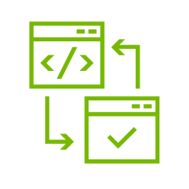



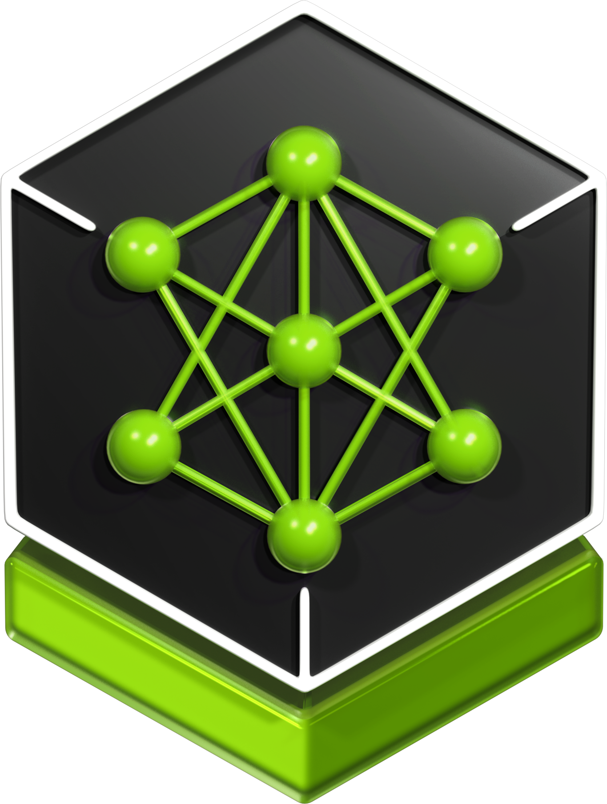


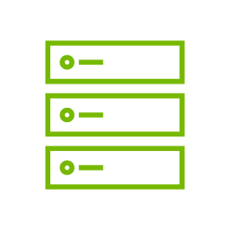

Model Deployment Lifecycle
NIM turns weeks of engineering effort into hours
Multi-backend performance sweeps
Security hardening & code audit
QA & validation testing
Monitoring & Logging implementation
Kubernetes Deployment
Monthly Updates
3-6 weeks per model
5-10 days
3-5 days
2-5 days
2-5 days
2-5 days
2-5 hours/month
0 hours per model
NVIDIA NIM Factory
Notes:
It sounds great - pull down the latest model as a production-ready NIM and deploy in 5 minutes anywhere!
But what goes into building a NIM? A bunch of work that NVIDIA takes off your plate so you can focus on shipping production AI.
Moving left to right at the top, each step is a key phase in taking a model from the community and preparing it for enterprise deployment at scale:
1. Multi-backend performance sweeps: The NVIDIA NIM factory does full config sweeps for every model and supported GPU configuration for every inference backend – TensorRT-LLM, vLLM and SGLang, identifying the best backend across different conditions, so that the NIM chooses the best backend upon deployment based on the model+GPU. Doing those sweeps and finding those configs can take 1-2 weeks (as well as compute hours). NIM does this for you, so you can save time and reserve your GPU hours for AI running in production.
2. Next, the NIM Factory does Security hardening and code audit of the model and everything else in the container: everything is deeply analyzed—checking every component, scanning for vulnerabilities, and applying fixes. That’s up to a week of specialized effort for every model. With NIM, you get fully hardened, audited containers out of the box—zero hours for your team.
3. Next, we do QA & validation testing: Reliability and accuracy require integration testing, multi-GPU validation, and making sure everything works across environments. Again, this is 20 to 40 hours of careful testing—or with NIM, it’s automated and handled for you.
4. Next, we do the Management and monitoring implementation: this means instrumenting the models and implementing the observability APIs so everything plugs neatly into an enterprise monitoring stack — this can take up to 20–40 hours per model. With NIM, the observability APIs and Prometheus metrics are built in, so you can just hook up Grafana or New Relic and see dashboards instantly.
5. Next, we make the NIM ready out of the box for Production Kubernetes deployments: Done yourself, this means complex setup, scripting Helm charts, and all the scaffolding to handle upgrades and rollbacks. That’s another dozen or more engineering hours—that NIM cuts out by providing you with standardized Helm charts and the NVIDIA NIM Operator for managing autoscaling, rolling updates, and multi-model orchestration.
6. Next, we handle Monthly updates and maintenance: With every update cycle—whether its new models or security patching or backend upgrades— that’s about 10 to 20 hours of engineering per model, per month. With NIM, it’s just a pull new container, deploy, and you’re done.
When you add it all up, DIY means 3 to 6 weeks per model – say 10-50 thousand dollars of engineering time -- and days each month just for maintenance. And this doesn’t include the cost of compute time – using up valuable system time for performance and validation testing – or the opportunity cost of using engineering teams for this effort when they could be focused on something else.
With NIM, you’re talking about minutes to deploy and minutes to roll out monthly updates, because the NIM factory at NVIDIA does all the heavy lifting for you.
We take the industry leading models from NVIDIA and the community and then give you production-ready, run-anywhere NIM.
That’s how NIM delivers velocity, so your teams can focus on building value, not wrangling serving infrastructure.

Slide 4
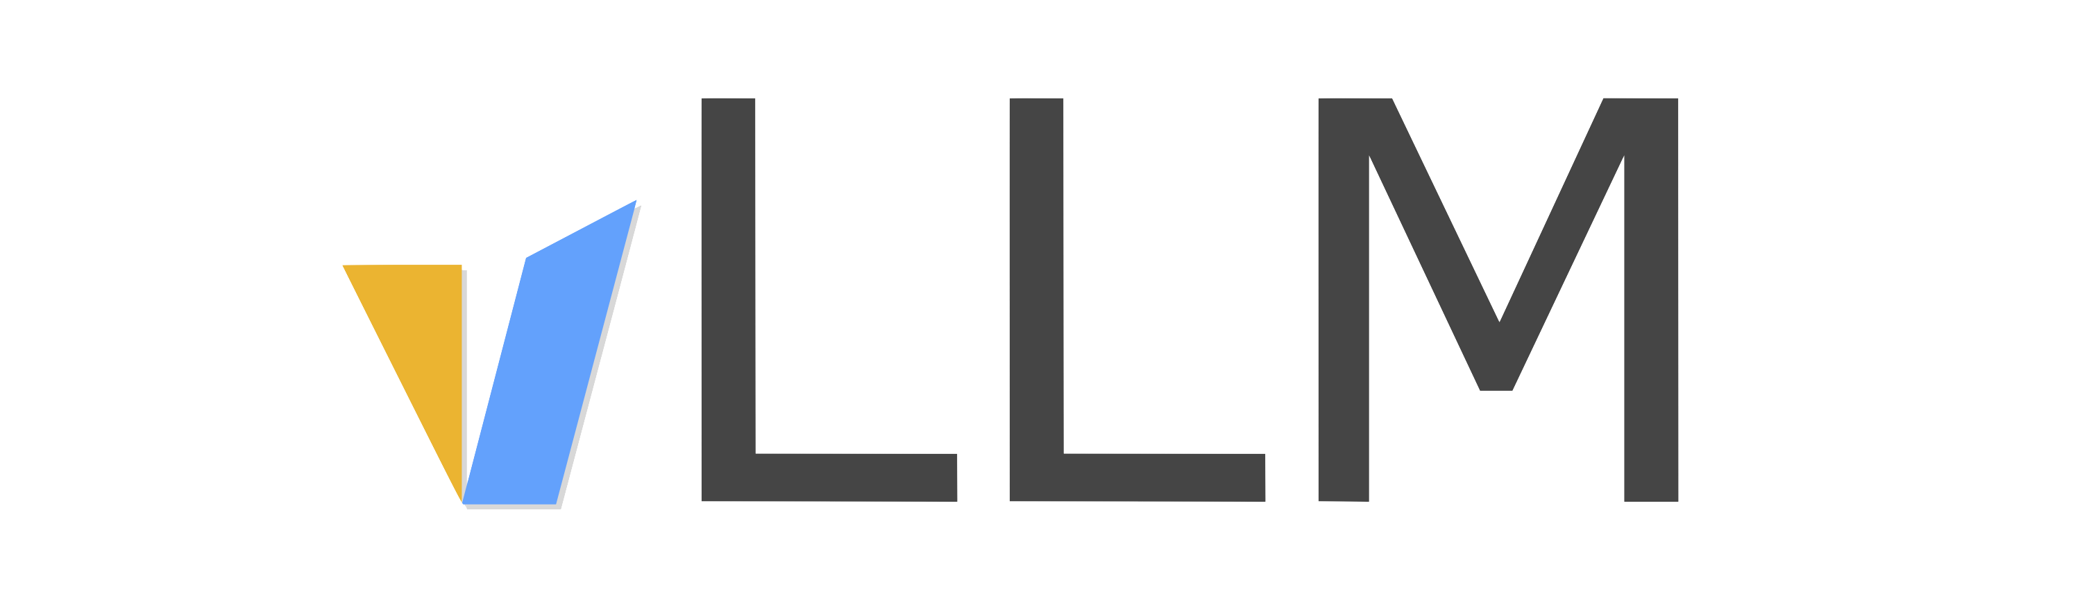
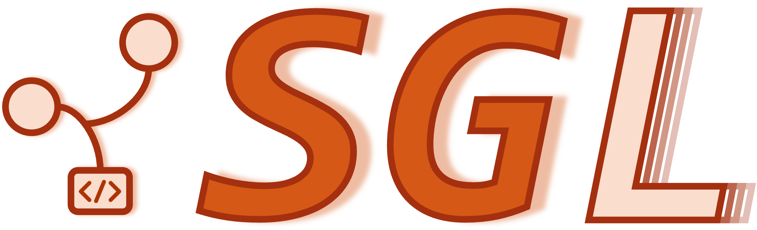
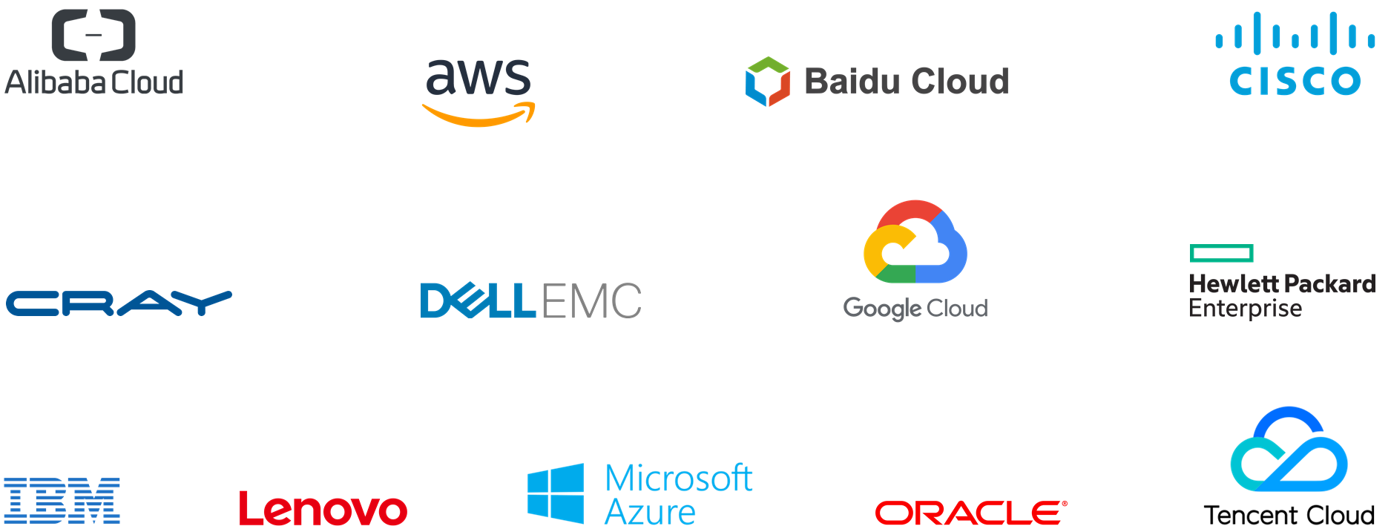
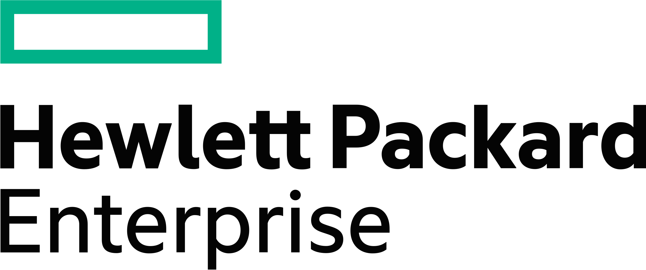


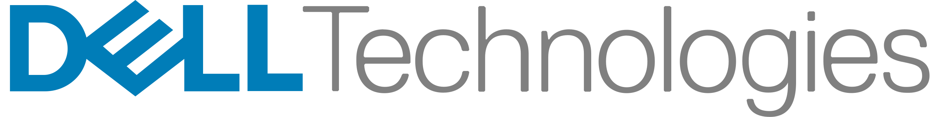

NVIDIA NIM
Scale models, not ops
Portable Run and scale cloud-native containers anywhere, maintaining control of data and apps
Easy Spin up production-ready endpoints in minutes with built-in observability, autoscaling and continuous updates
Enterprise Ready Gain confidence with NVIDIA-secured and verified software including monitoring and patching
Performant Leverage the best performing inference technology, preoptimized and continuously updated
TensorRT-LLM
DGX &
DGX Cloud
Notes:
That unified serving layer that abstracts away the complexity is NIM.
NIM handles the complexity of deploying and operating models at scale—so your teams don’t have to.
NIM combaines managed-API simplicity with self-hosted control. NIM microservices package everything needed: the latest models, optimized inference runtimes, standard inference and observability APIs, and a secure, cloud-native runtime—delivered as enterprise-grade containers that run anywhere: workstation, datacenter, or cloud.
Why AI builders adopt (tie to the right-side stack):
Portable & consistent. NIM microservices are standard, portable containers supported across the NVIDIA ecosystem shown below. Same APIs and controls wherever you run—so your performance & reliability targets can be maintained consistently across frameworks, GPUs, and environments.
Ease of use, for fast time to production. When a new model drops, there’s a NIM for it. You can spin up a production-ready endpoint in minutes, integrate it into agents/apps, and get built-in observability, autoscaling on Kubernetes, and security – out of the box.
Enterprise-grade software. NIM is maintained and supported by NVIDIA—QA, patching, dependency management, and continuous updates are handled for you.
Performance that improves over time. NIM bundles the best inference technology from NVIDIA and the community—TensorRT-LLM, vLLM, SGLang—pre-optimized and continuously updated. No need for further optimization like quantization, config selection, profile optimization, etc. – NVIDIA tests and finds the best serving configs, bakes them into a NIM, and continuously updates them, so your performance improves over time on the same infrastructure, without manual inference stack upgrades or migrations.
With NIM, you scale models, not ops—getting the ease of a managed service with the flexibility, security, and predictability of self-hosting.
Now I’ll walk you through each of these aspects of NIM.

Slide 5
What a NIM Is
A pre-packaged, OpenAI-compatible, GPU-accelerated microservice for one model
One container · one model · one endpoint
Pre-optimised
TRT-LLM / vLLM / SGLang chosen per hardware + model automatically
OpenAI-compatible
Drop-in /v1/chat/completions, /v1/completions, /v1/embeddings, /v1/rerank
GPU-native
FP8 / FP16 / BF16, in-flight batching, paged KV-cache by default
Single command
docker run … → ready endpoint in minutes, not hours
Healthchecks built-in
/v1/health/ready, Prometheus metrics, structured logs
NVIDIA CONFIDENTIAL. DO NOT DISTRIBUTE.
Notes:
One-line pitch: NIM is what production inference looks like when you've solved all the boring problems.

Slide 6
Under the Hood
NIM picks the right inference backend for your model + GPU automatically
OpenAI-compatible HTTP API
NIM runtime + scheduler + KV-cache mgmt
Backend: TRT-LLM · vLLM · SGLang
CUDA kernels + Transformer Engine
NVIDIA GPU (H100 NVL / A100 / B100 / RTX PRO)
NIM picks TRT-LLM (H100 + dense models), vLLM (variable), or SGLang (constrained-decoding) per model card
NVIDIA CONFIDENTIAL. DO NOT DISTRIBUTE.
Notes:
Backend abstraction is the magic. Tell attendees they should NOT pick TRT-LLM vs vLLM manually — let NIM do it.

Slide 7
OpenAI-Compatible API
If you can call OpenAI, you can call a NIM — no client rewrite
curl
Python (openai client)
curl http://localhost:8088/v1/\
chat/completions \
-H "Content-Type: \
application/json" \
-d '{
"model": "aml-custom-task-nim",
"messages": [
{"role":"system",
"content":"You are..."},
{"role":"user",
"content":"investigate..."}
],
"temperature": 0
}'
from openai import OpenAI
client = OpenAI(
base_url="http://localhost:8088/v1",
api_key="not-needed",
)
resp = client.chat.completions.create(
model="aml-custom-task-nim",
messages=[...],
temperature=0,
)
print(resp.choices[0].message.content)
NVIDIA CONFIDENTIAL. DO NOT DISTRIBUTE.
Notes:
Migration story: change one URL, you're using NVIDIA NIMs.

Slide 8
NVIDIA NIM for Every Domain
LANGUAGE NIMs
VISUAL / MULTIMODAL NIMs
DIGITAL HUMAN NIMs
OPTIMIZATION / SIMULATION NIMs
DIGITAL BIOLOGY NIMs
Llama 3.1 family
Cohere 35B
Gemma 7B
Adept 110B
Deplot
Edify.
Getty
Audio2Face
Riva ASR
cuOpt
Earth-2
DeepVariant
APPLICATION NIMs
Jamba
Code Llama 70B
Mistral 7B
Edify.
Shutterstock
FuYu
8B, 55B
Kosmos-2
DiffDock
ESMFold
Llama
Guard
Retrieval Embedding
Retrieval Reranking
Mixtral 8x7B
Nemotron-3
22B Persona
Phi-2
NeVA
SDXL
1.0
SDXL
Turbo
MolMIM
Vista 3D

Slide 9
Browse + Pull from build.nvidia.com
The model catalog + a playground + the docker pull command
Catalog: build.nvidia.com
From catalog to running NIM
nemotron-3-nano-30b-a3b
Nemotron-3 Nano · 30B MoE · FP8
# 1. Auth to NGC once
echo "$NGC_API_KEY" | \
docker login nvcr.io \
-u '$oauthtoken' --password-stdin
# 2. Pull
docker pull nvcr.io/nim/nvidia/\
nemotron-3-nano:latest
# 3. Run
docker run --gpus all \
-p 8089:8000 \
nvcr.io/nim/nvidia/\
nemotron-3-nano:latest
llama-3.3-70b-instruct
Llama 3.3 · 70B · Instruct
nv-embed-v2
Embedding · 1024-d · 4096-ctx
llama-3.2-90b-vision
Vision · 90B · multimodal
parakeet-ctc-1.1b
ASR · CTC · multilingual
NVIDIA CONFIDENTIAL. DO NOT DISTRIBUTE.
Notes:
Three commands from catalog to live endpoint. This is the same flow attendees will run in M9.2.

Slide 10

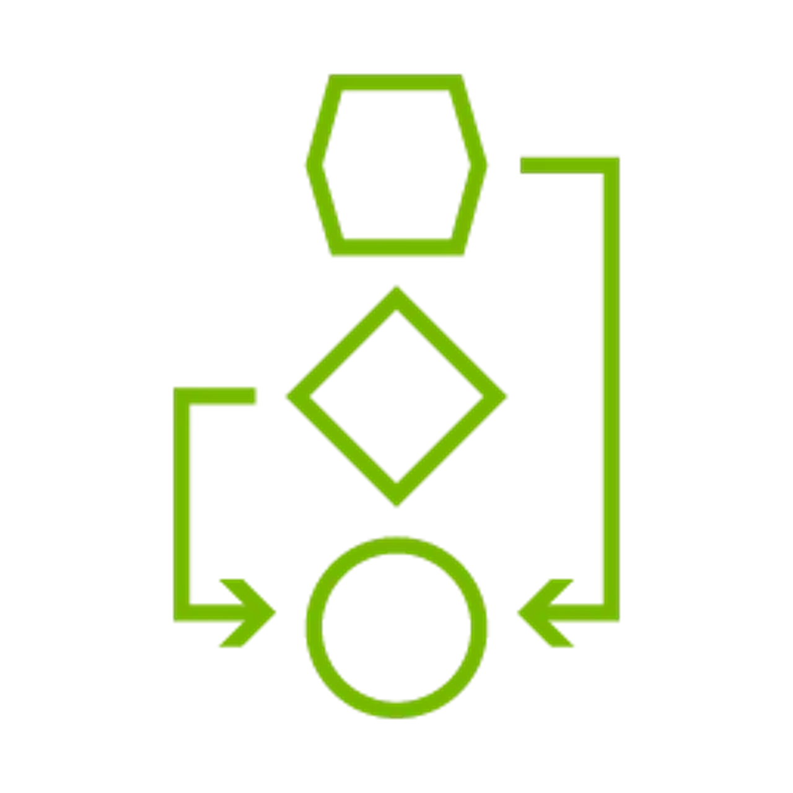

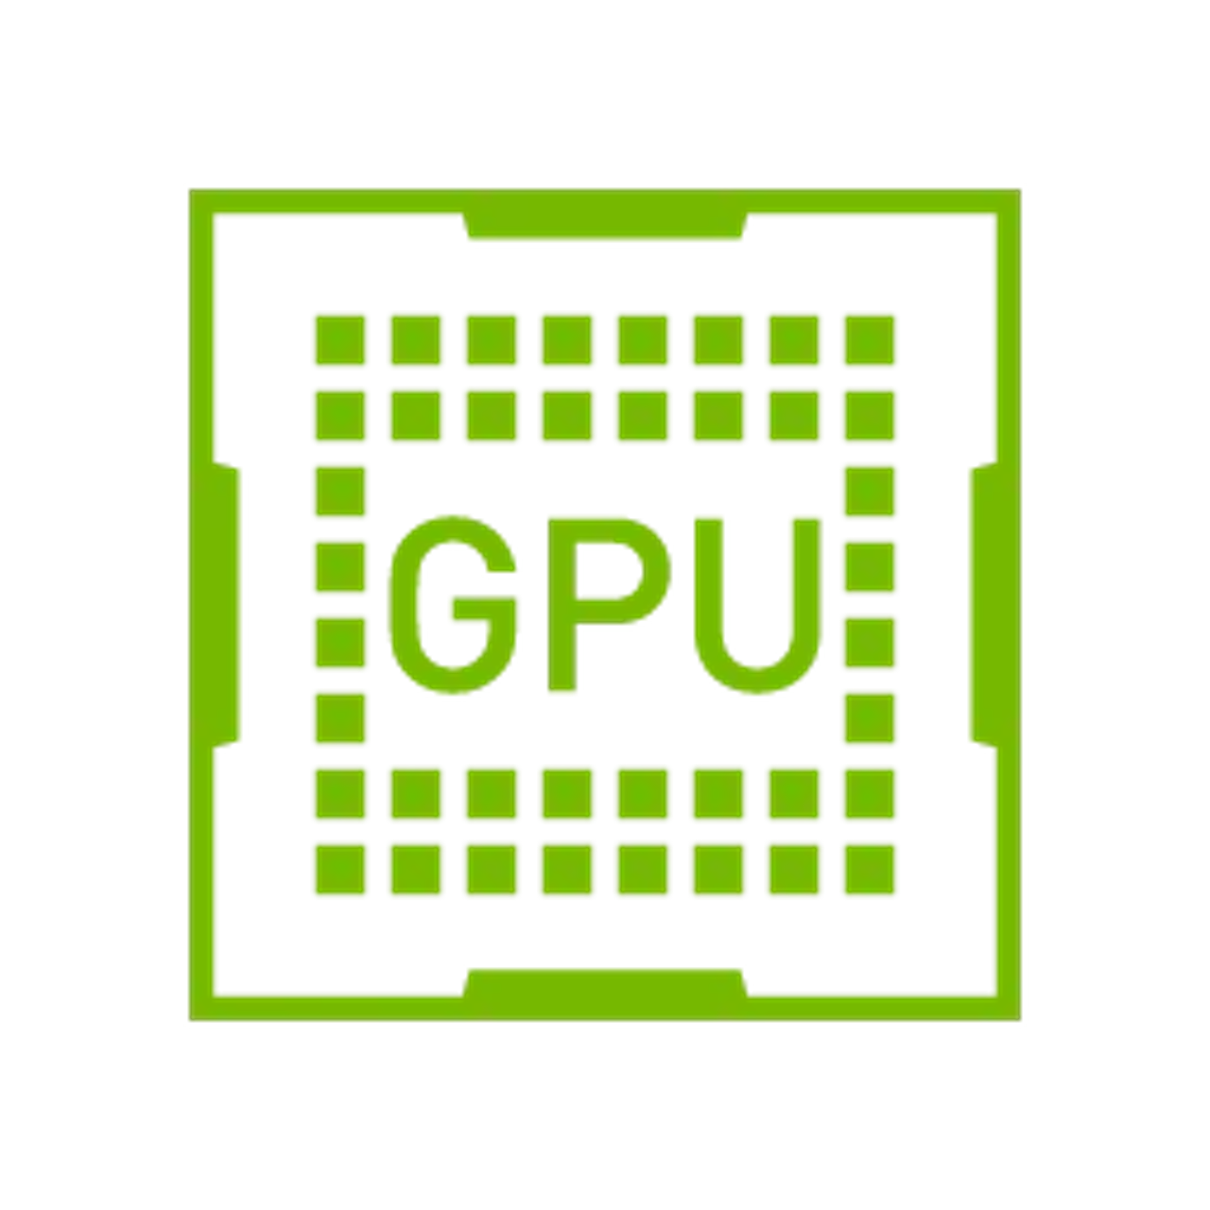


Performance Knobs
What makes a NIM faster than naive inference
TRT-LLM kernels
In-flight batching
Paged KV-cache
Fused GEMM, paged attention, GQA-aware
Multiple requests share one forward pass
Pages allocated on-demand; ~2× context for free
FP8 / FP16 / BF16
Quantisation-aware
Streaming + chunking
Backend picks based on model + hardware
INT8 / FP8 weights where accuracy permits
First-token latency tightly bounded
NVIDIA CONFIDENTIAL. DO NOT DISTRIBUTE.
Notes:
These are mostly invisible — NIM configures them per model. But attendees should know the names so they recognise them in production logs.

Slide 11
Custom NIM with `model-free-nim`
Bring any checkpoint; NIM wraps it as a serving container
Your checkpoint
model-free-nim
OpenAI endpoint
HuggingFace format
or consolidated NeMo
+ tokenizer config
nvcr.io/nim/nvidia/
model-free-nim:2.0.5
+ NIM_MODEL_PATH env
/v1/chat/completions
production-ready
TP, KV-cache, metrics
Our AML custom NIM
Phase 5 produced `sft-final/`; Phase 6 wrapped it with model-free-nim → port 8088
NVIDIA CONFIDENTIAL. DO NOT DISTRIBUTE.
Notes:
model-free-nim is the magic for custom checkpoints. Lift, shift, and your model is behind the same OpenAI-compatible API as the catalog ones.

Slide 12


Health, Metrics, Observability
NIMs ship with production-grade observability built in
Health probes
Prometheus metrics
OpenTelemetry
/v1/health/ready
/v1/health/live
→ Kubernetes-native
/v1/metrics
request latency, token throughput,
KV-cache util, queue depth
Auto-export traces
for every request →
Jaeger, Phoenix, Tempo
NVIDIA CONFIDENTIAL. DO NOT DISTRIBUTE.
Notes:
These three are why NIM is production-ready out of the box. You don't bolt on observability — it ships with it.

Slide 13
Ongoing Performance Improvements
NIM standardizes on the best performing option, continuously updated
Llama 3.1 70B FP8, 4x H100 SXM, ISL/OSL = 1000/1000, concurrency = 100
Find LLM NIM Latency-Throughput Benchmark Data at aibenchmarking.ngc.nvidia.com/benchmark
Notes:
And, we know performance is important - generating more tokens on the same infrastructure equals cheaper tokens, equals better ROI.
But it’s not as simple as which framework offers the best performance for my model today.
NVIDIA works with all the leading community inference frameworks including TensorRT-LLM, vLLM and SGLang to optimize inference performance on NVIDIA.
And these are open communities with innovation coming from all directions. There is variation, and innovation can show up in some frameworks faster than others – one month TensorRT-LLM is the best for my use-case, next month it’s vLLM or even SGLang.
That’s why we test all the leading frameworks for a given model across different GPUs and release that NIM with the best performing inference backend and configuration as the default out-of-the-box – whether that is vLLM, SGLang or TensorRT-LLM.
And we update that consistently over time, so you don’t have to think about it – you just lock-in to a trend that’s up and to the right.
That’s what you see here in the chart: NIM performance gains for the same model on the same infrastructure through software updates that include the latest optimizations from all the frameworks:
For example In Q1 of this year, NIM performance for the same model on the same infrastructure was 1.2 times better than the previous quarter
In Q2, it was 1.6 times better…
To today, in Q425, where performance is over 2 times better than at this time last year
And NIM performance is consistently on-par or often better than what we refer to as ‘NIM OFF’ - which is deploying the same model on the same infrastructure with the leading open source alternative, which is typically vLLM.
That’s what you see in the magenta curve – performance of ‘NIM OFF’ relative to the fully swept and optimized NIM for the same model on the same infrastructure.
The key takeaway here is that you get best performance, continually improving, without having to do the heavy-lifting — you just pull and deploy an updated NIM, and the performance upgrade gets delivered to your production endpoints.
And I wanted to point out that we have a new public website for all things NVIDIA AI performance, and we publish all our NIM latency-throughput benchmark data there so you can dive into it more detail. You’ll have this deck and the link after our meeting.
Go to: https://aibenchmarking.ngc.nvidia.com/benchmark. Start with the AI Inference tab on the left panel, then you will see all the models and versions available. Access is auto-approved for NGC users.
INTERNAL ONLY – right-hand side chart source data: https://docs.google.com/spreadsheets/d/1c2qnUp8-KqibkYVHUSySTZO9U4HuAnRt76I9Gk1-9Yc/edit?usp=sharing

Slide 14
Rapid Integration Requires Rapid Endpoint Deployment
NIM handles the heavy lifting
SELF-HOST DIY: 5+ Days
Implement API
Build optimized engines for all accelerated systems
Implement pre & post processing logic and observability
QA, security & performance testing
Maintenance…
5 MINUTES TO NIM
DEPLOY
RUN
BUILD
docker run /path/new-model-name
curl –X ‘POST’ \ ‘local_host/v1/completions \
‘{
model = “new-model-name”
}’
)
completion = client.chat.completions.create (
model = “new-model-name”
)
Notes:
The harder part is what it takes to deliver that model at the developer’s endpoint, so they can make that fast and easy switch.
You have to be able to quickly deploy the brand new model, which means:
Implementing the API
Building optimized inference engines for all GPU systems the Developer wants to run on
Implement all the pre & processing logic and observability feeds
Package everything including all the dependencies and then do QA, security and performance testing
That should take 5 days at a minimum. And then you have to update and maintain the software over time as new model and inference software versions are released.
NIM turns 5 days into 5 minutes.
You deploy a NIM container in a few simple steps, and the endpoint is up and running, so Developers can immediately invoke the new model in their code.
And NIM are continuously updated by NVIDIA – we do the software updates including all the dependency management, security patching and performance testing, and you just pull a new container from NGC.

Slide 15
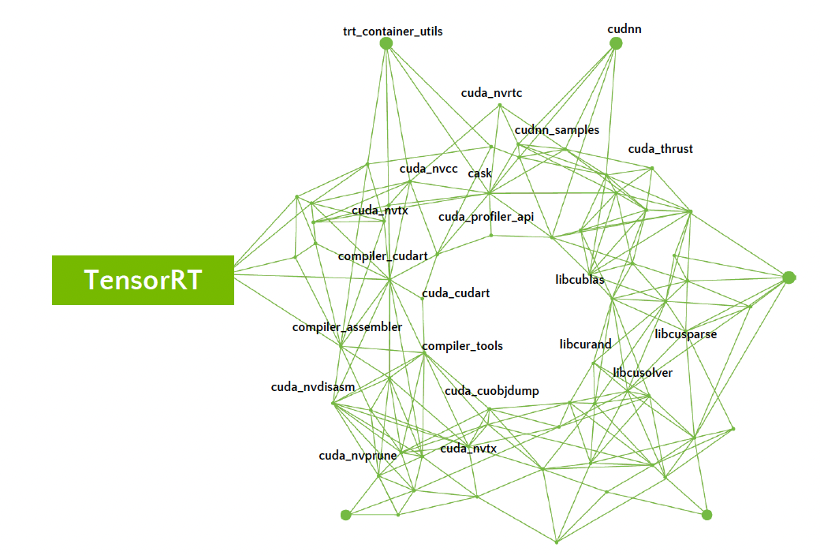


For Enterprises that Run their Business on AI
NVIDIA managed secure, stable AI stack with expert support
Triton Inference Server
Continuous monitoring and security patch releases for common vulnerabilities & exposures (CVEs)
Stable APIs with dedicated feature, production and long-term support branch lifecycles
Direct access to NVIDIA AI expertise and enterprise support including defined SLAs and SLOs
436 3rd party and OS software
29 NVIDIA software packages
Dependency
Notes:
Now, let’s go into more detail on NIM as part of NVIDIA AI Enterprise software.
It’s not trivial to manage a stable and secure AI software stack.
Looking at the visual here on the left, we can see that TensorRT alone contains 465 software packages (the green dots), with numerous dependencies between them (the green lines).
With more packages come more potential security vulnerabilities. Managing and containing the vulnerabilities and exposures – or CVEs -- in a stack with this many dependencies is challenging, requiring:
Constant monitoring and scanning for CVEs
Expertise to understand the impacted of a detected CVE
Engineering to do the patching and updates without breaking dependencies
And this has to be done on a daily basis. NIM are part of NVIDIA AI Enterprise, so NVIDIA does this work for you.
In terms of continuous updates, NIM are delivered in monthly feature branch releases with the latest software updates and optimizations. NIM APIs are consistently stable across feature branch updates, but NIM are also released in production branches for guaranteed API stability across a longer lifecycle (~6 months).
Finally, NIM come with enterprise support and direct access to NVIDIA AI expertise, not just for NIM, but for everything included in NVIDIA AI Enterprise. Support includes defined response times with various tiers for your needs.

Slide 16





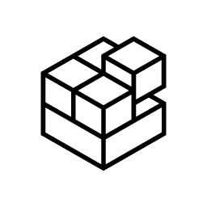

NVIDIA AI Enterprise Product Lifecycle
Flexibility with Security for different use cases
Feature Branch
Production Branch
Long-Term Support Branch
Latest top of tree features
Includes all supported AI software
1 branch / month with 1-month lifetime
CVE patches & bug fixes in roll forward release
API Stability
Includes foundational tools and frameworks
2 branches / year with 9-month lifetime
3-month overlap between 2 PBs
Monthly CVE patches & bug fixes
For highly regulated industries
Includes
Foundational tools and frameworks
Paired with stable version of infrastructure software
1 branch / 3 years with 3-year lifetime
6-month overlap between 2 LTSBs
Quarterly CVE patches & bug fixes
Infrastructure Software
Drivers, Kubernetes Operators, Cluster Management
Two releases / year
Quarterly updates
Notes:
NVIDIA works to actively patch vulnerabilities as they are identified and publish updates in a timely manner. However, we recognize that different types of software is used in different ways, and so we have organized the way we publish software to give customers flexibility while still maintaining security.
NVIDIA AI Enterprise software is split into two categories: application software and Infrastructure software.
The Infrastructure software enables and optimize the use of NVIDIA GPUs and Networking. It includes hardware and virtualization drivers, K8s operators, and Base Command Manager Essentials software for cluster management. A new version of this collection is published roughly twice a year and typically aligns with support for the latest GPUs and Networking hardware.
All application software is updated monthly with the latest, top of tree features, in what are known as Feature Branches. These are performance-catalog and and all go through rigorous security checks and are only published if they have no critical or high vulnerabilities, as defined by the CVE system. The lifetime of these containers is one month, after which a new version is published. Any bug fixes and security patches that are created during that month get rolled forward and applied to the next month’s release. Feature Branch software is targeted at developers who want the latest and greatest features, even if it comes at the expense of APIs being altered so that application changes are required
For a subset of this software, we also create a Production Branch. This is done by designating a specific version of software as the production branch version and maintaining that version for 9 months. New versions of this software are published monthly with bug fixes and security patches, but without any changes that could break API dependencies. A new production branch is created every 6 months, thus allowing a 3-month overlap for customers to transition before the earlier production branch reaches its end of life. By providing API stability, customers can use production branch software as part of larger applications. They can benefit from regular security updates without having to worry about API changes that could break their application.
Long-term support branch software follows a similar principle to production branch, except it is a smaller subset of the AI & Data Science software catalog and includes a stable version of the Infrastructure Software Collection. It is maintained for 1 year with quarterly updates. It is targeted at highly regulated industries such as health care and government.
Through the NVIDIA AI Enterprise subscription, enterprises have access to all three branches, providing them peace of mind knowing they have the flexibility to choose the branch that is best for their development and deployment without compromising on security.
NVIDIA manages and release Infrastructure software independently because doing so enables a stable infrastructure platform upon which to run AI and data science applications. On the other hand, the flexible branch options for application software allows for developers to choose the option that matters most to them: API stability or top of tree features.

Slide 17
From checkpoint to OpenAI-compatible endpoint
Hands-on next: curl + Python against both deployed NIMs
Notes:
Hand off to M9.2 NIM hands-on. Tell the room: 'You've seen the recipe; now run it.' Verify NGC login works on every attendee pod before kicking off (common breakage point). The first curl against port 8088 is the verification step.

