Slide 1
Adversarial attack on a CNN based Malware detection systems
Akshitha Koganti
Nitesh Bhutani
Rohit Kulkarni
Sarath Patlolla

Slide 2
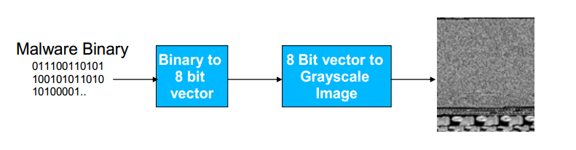
MalImg DataSet
8339 Malware binaries.
25 Malware classes.
Training-test split: 80-20%

Slide 3
CNN Detection System
INPUT: 32 × 32 × 1
CONV5: 5 × 5 size, 36 filters, 1 stride
ReLU: max(hθ (x),0)
POOL: 2 × 2 size, 1 stride
CONV5: 5 × 5 size, 64 filters, 1 stride
ReLU: max(hθ (x),0)
POOL: 2 × 2 size, 1 stride
Flatten:
FC: 1024 Hidden Neurons
ReLU: max(hθ (x),0)
Dropout: keep_prob : 1.0
FC: 25 Output Class
SOFTMAX:

Slide 4
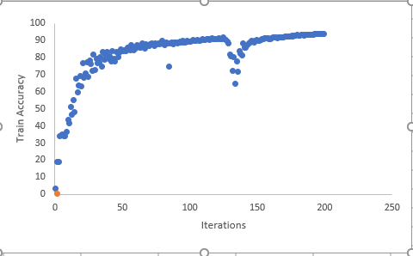
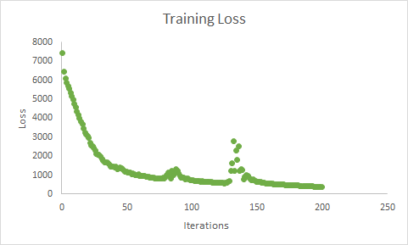
Training loss and accuracy
Test accuracy: 74%

Slide 5
Generation of Adversarial Images
Iterative FGSM
ATN
Jacobian
C&W attack

Slide 6

Iterative FGSM.
FGSM applied Iteratively.
Parameters:
Epsilon - 0.25, 1.7
Iterations - 20, 50, 100, 200

Slide 7
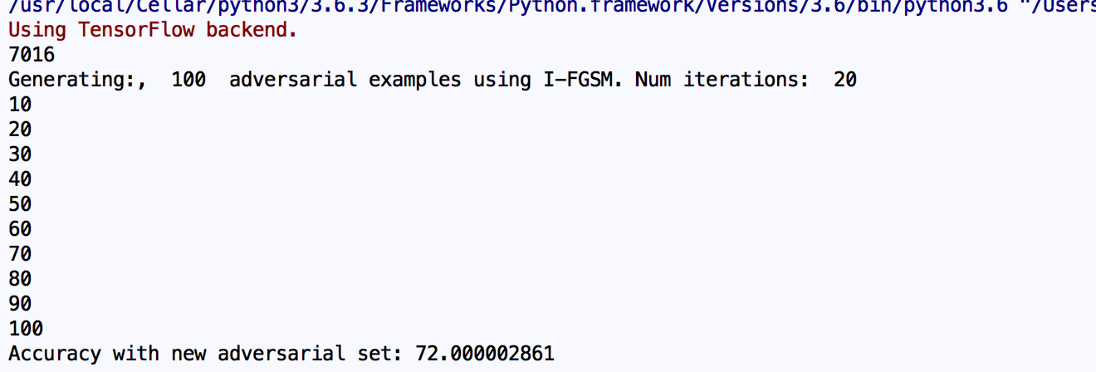
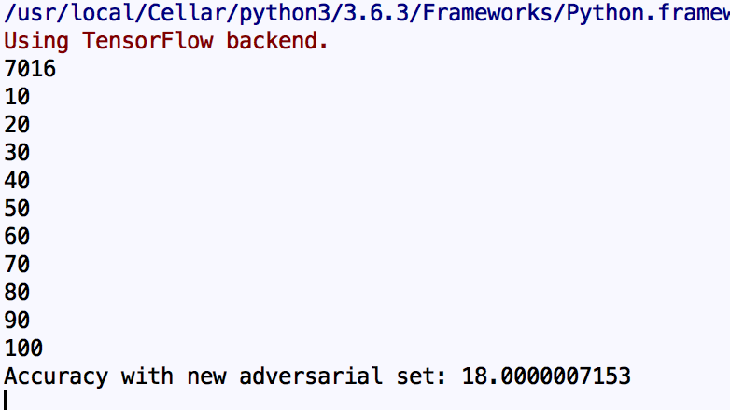
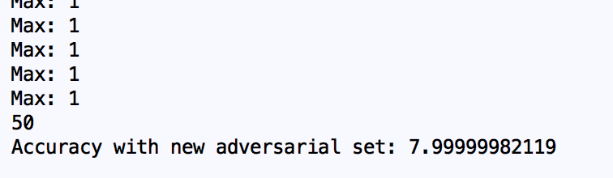
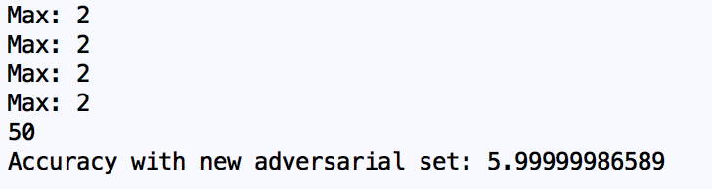
Results:
Adversarial Images: 100, Epsilon: 0.25
20 iterations - Accuracy 72%
200 iterations - Accuracy 18%
Adversarial Images: 50, Epsilon: 1.7
1 iteration - Accuracy 7.9%
2 iterations - Accuracy 5.9%

Slide 8
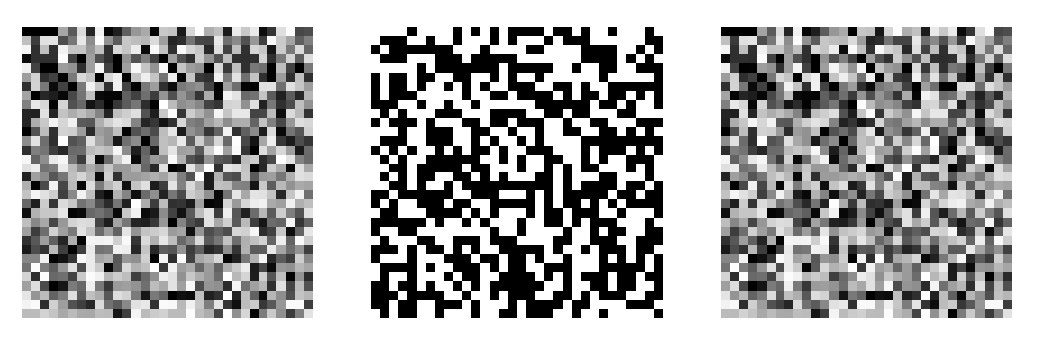
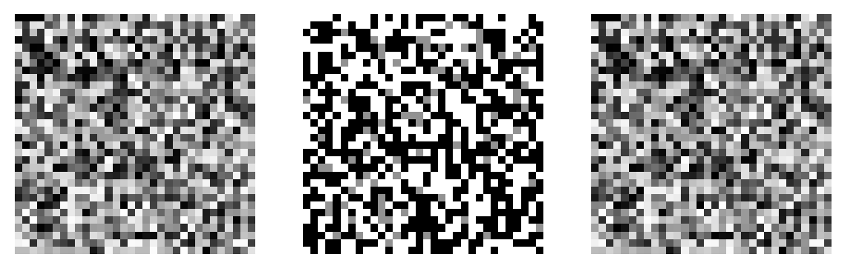
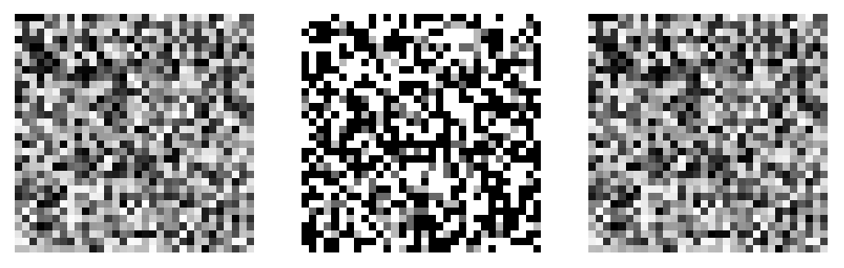
Visualizing Perturbations iteratively
Actual label: 3
Misclassified: 12
Epsilon: 1.7
Original Image Perturbation Adversarial Image

Slide 9
ATN
An ATN is a neural network that transforms an input into an adversarial example against a target network
9 convolution layers with relu activation
Convolution layer parameters:
Kernel size : 3x3
Number of Filters : 48
Stride : 1
Hidden neurons in the falten layer: 1024

Slide 10
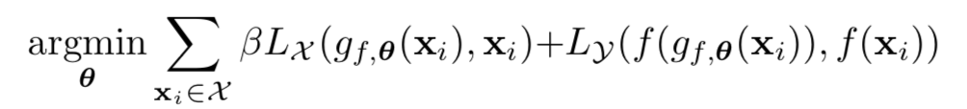
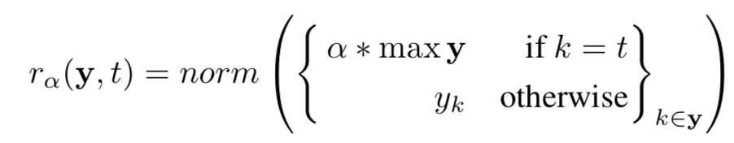
Training :
Reranking Function:

Slide 11

Hyper Parameters in ATN
α = 1.5
β = 0.01
Learning rate = 0.0001
Batch size = 20
Iterations = 1600
Epoch = 4

Slide 12
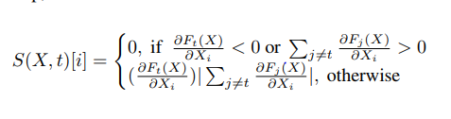
JSMA (Jacobian-based Saliency Map Attack)
Targeted misclassification
To achieve a target class t, F_{t}(X) must be increased while the probabilities F_{j} (X) of all other classes j ≠ t decrease, until t = arg max_{j} F_{j} (X). This is accomplished by exploiting the adversarial saliency map.
Starting with a normal sample x, we locate the pair of features {i, j} that maximize S(X, t)[i] + S(X, t)[j], and perturb each feature by a constant offset , theta.

Slide 13
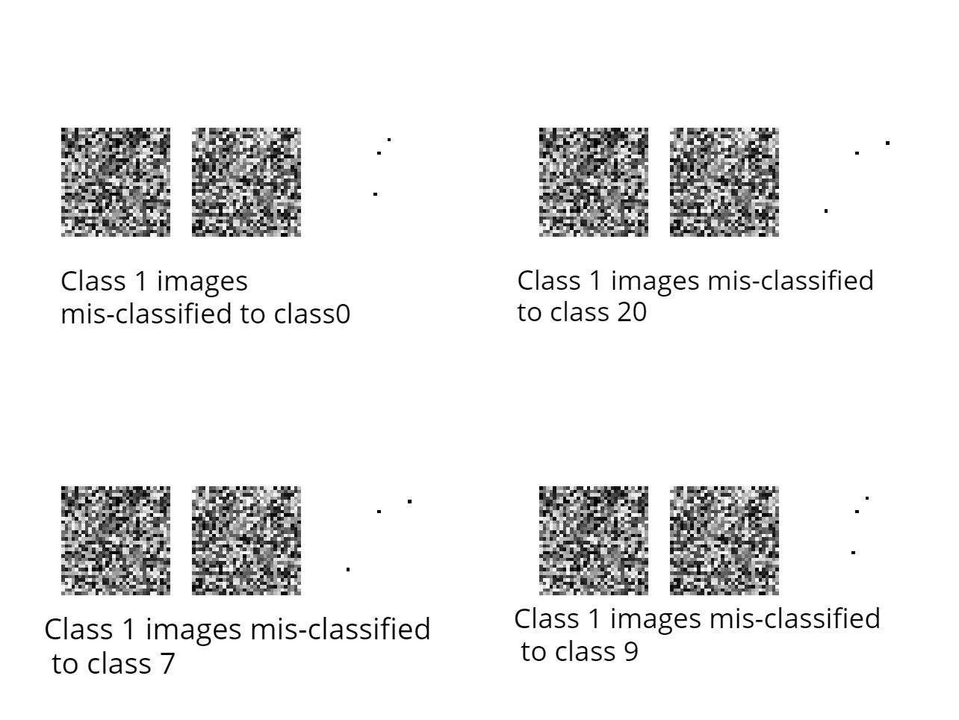
Θ = 0.01
Γ percentage = 0.75
Success Rate = 10 %

Slide 14
Carlini and Wagner Attack
It is an optimization problem.
Distance Metric:
L 0 norm
L2 norm
L∞ norm
Approach:
Reduce the p-norm distance between original and the adversarial image.
Iterate till it encourages incorrect classification of images

Slide 15
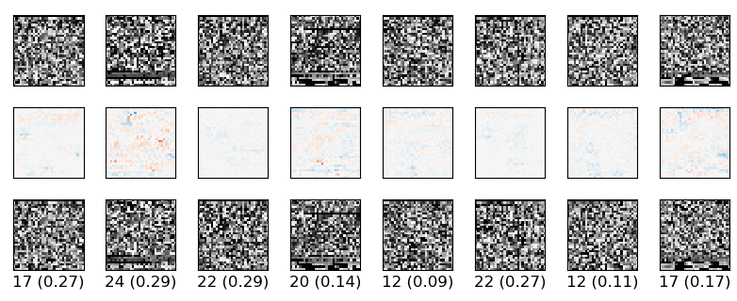
Main Objective
minimize D(x, x + δ)
such that C(x + δ) = t

Slide 16
Conclusion and Future work
We tested 4 attacks on the CNN based malware detection system and were successfully able to decrease the accuracy of the detection system in each case.
To add benchmark for further analysis of attacks on such systems following things are required:
Dataset with more examples and equal distribution of malware classes is needed.
Generating malware binaries from images and test their maliciousness.

