Slide 1
A Study of Spiking Neural Network Architecture
Sarath Patlolla
764816172

Slide 2
Abstract
Communication in the human brain is done by sending small “packets” of data through complex paths to various destinations, whereas in many conventional computers the communication is based on point to point communication. This led to the inefficiency in the high-speed data transfer in many of the super computers
Spiking Neural Network Architecture(SpiNNaker) is a parallel, neuromorphic supercomputer architecture which simulates a human brain. This architecture was developed by the University of Manchester. SpiNNaker was generally for high speed computing operations. The SpiNNaker architecture has 65,536 identical 18 core processors of ARM 968 130 mm process, which in total is 1,179,648 cores. Each neuron in this architecture has a link to 6 neighbours (toroidal network)

Slide 3
Introduction
SpiNNaker architecture was developed by University of Manchester in December 2009.
Biologically inspired to simulate human brain
Neuron and Spikes
Neuron is the fundamental part of the architecture
The information transfer among the neurons is done by the transfer of “spikes” among the neurons.

Slide 4
SpiNNaker
SpiNNaker is built from “Point Neuron Model”
It has a multi processor die
1,036,800 ARM9 cores and 7 TB of RAM distributed throughout the system in 57 thousand nodes, and each node contains 18 cores plus a 128 MB SDRAM
Single core is made up of 64KB of DTCM and 32 KB of ITCM
In human the information is transferred in the form of “packets” from difficult paths to multiple targets, whereas the mode of transfer in that of the supercomputers the communication done is point-to-point

Slide 5
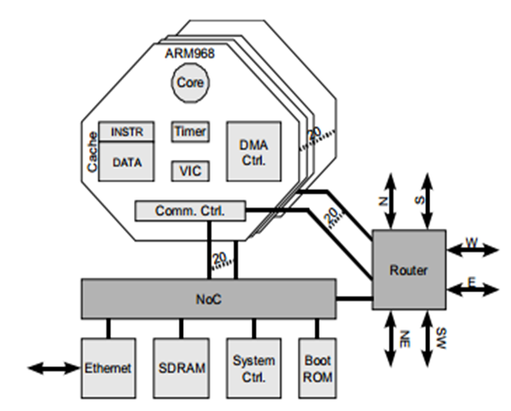
Analysis
SpiNNAker Node
There are multi-core SoC having 20 low-power ARM 968 cores. In each core there is tightly coupled memory having capacity of 32 KB of instructions and 64 KB of data in it.
Every node in the SpiNNaker system is an event driven neural process where events are generated by various modules such as timer, vector interrupt controller (VIC), DMA controller and communication controller.

Slide 6
Software
The software which runs on the SpiNNaker is written in C and mainly uses the SDP or the multicast needs for the communication process.
The interface between the SpiNNaker and the other machines from the outside world is done by IP and Ethernet protocols.
SpiNNaker Control and Monitor Program (SC&MP) is the primary software which is mainly responsible for the control of the SpiNNaker system. The SpiNNaker chips is mainly written in primary boot-strap code which would load the Ethernet interface, and this would be loading the SC&MP.
The protocol which would load the SpiNNaker architecture is SpiNNaker Datagram Protocol (SDP),
A command-line interface “ybug” program provides for this function and allows the scripted interface for the system.

Slide 7
Software Model Extraction
The SpiNNaker Neural network model can be extracted by the software simulators:
NEST
Nengo
ORION
Noxim

Slide 8
DPN Architecture
DPN is used to process data stream which depends on the type of the instruction.
The instruction set produced by the DPN compiler
initialisation
iteration and
the conclusion sequence

Slide 9
Future work
to deliver a neural network machine which has over half a million processors embedded on it, so that it could be used as one of the neuromorphic “platform” to a wider brain project community.
The SpiNNaker machine model can be deployed in cloud services, so that the services of the simulation of human brain can be used on the distributed systems.
more research and study could be carried out on evaluating the system under multiple failure models and various traffic models

Slide 10
References
1. Steve B. Furber, Francesco Galluppi, Steve Temple and Luis A. Plana: “The SpiNNaker Project” Vol 102, No 5, May 2014 Proceedings of the IEEE
2. Eustace Painkras, Luis A. Plana, Jim Garside, Steve Temple, Francesco Galluppi, “SpiNNaker: A 1-W 18-Core System-on-Chip for Massively-Parallel Neural Network Simulation” IEEE journal of solid-state circuits, vol. 48, no. 8, august 2013.
3. Steve B. Furber, David R. Lester, Luis A. Plana, Jim D. Garside, Eustace Painkras, Steve Temple, and Andrew D. Brown, “Overview of the SpiNNaker System Architecture” IEEE transactions on computers, vol. 62, no. 12, December 2013.
4. Yu Ji, You-Hui Zhang, Wei-Min Zheng, “Modelling Spiking Neural Network from the Architecture Evaluation Perspective” Journal of Computer Science and Technology Jan-2016.
5. http://www.artificialbrains.com/spinnaker
6. http://apt.cs.manchester.ac.uk/
7. M. Tureja, “A Computer Architecture to Support Neural Net Simulation”, The computer journal, vol 35 no 4 1992.
8. J.Navaridas, M.Lujan, J.M.Alonso, Luis A. Plana, Steve Furber, “Understanding the Interconnection Network of SpiNNaker”
9. S Furber, S Temple, and A Brown, “On-chip and inter-chip networks for modelling large-scale neural systems,” in Proc. International Symposium on Circuits and Systems, ISCAS-2006, Kos, Greece, May 2006.
10. Evangelos Stromatias, Francesco Gallupi, Cameron Patterson and Steve Fuber, “Power analysis of large-scale, real time neural networks on SpiNNaker”.
11. Xavier Lagorce, Evangelos Stromatias, Francesco Gallupi, Luis A. Plana, Shih-Chii Liu, Steve B. Furber and Ryad B. Benosman. “Breaking the millisecond barrier of SpiNNaker: implementing the asynchronous event-based plastic models with microsecond resolution”.

