Slide 1
Substance Abuse Among Adolescents Age 12-17
Thea Crockett
Sarath Kottur
Francis Okot
Jennis Vicente

Slide 2
Abstract
Substance abuse is a common problem among adolescents
Age 12 to 17. Data was acquired from difference sources
and manipulated with Python. Trends were identified and
results.

Slide 3
Hipotesis

Slide 4
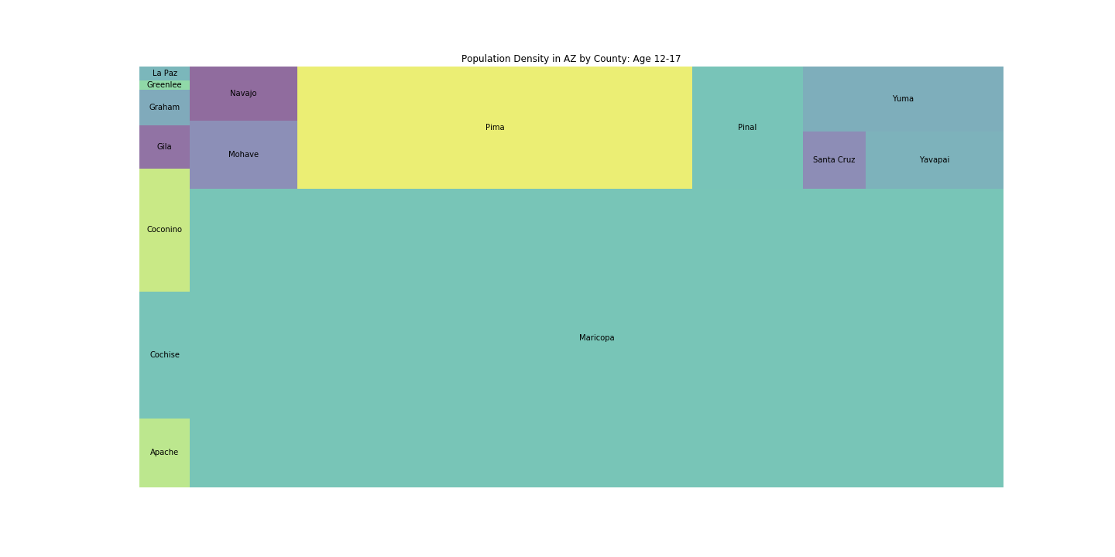
In Arizona
Enrollment in High School FY 2017-2018

Slide 5
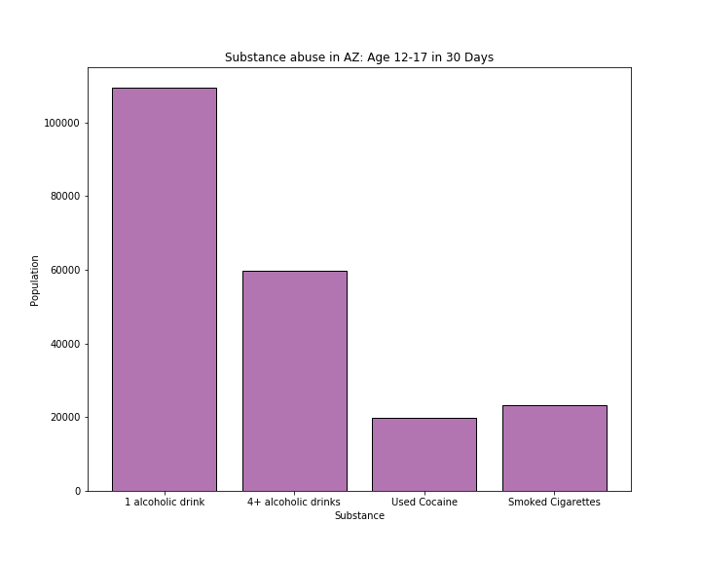
Substance Abuse Total
Based on substance used at least once 30 days before the survey
33% Had 1 alcoholic drink
18% Had 4 or more alcoholic drinks
6% Used Cocaine
7% Smoked Cigarettes

Slide 6
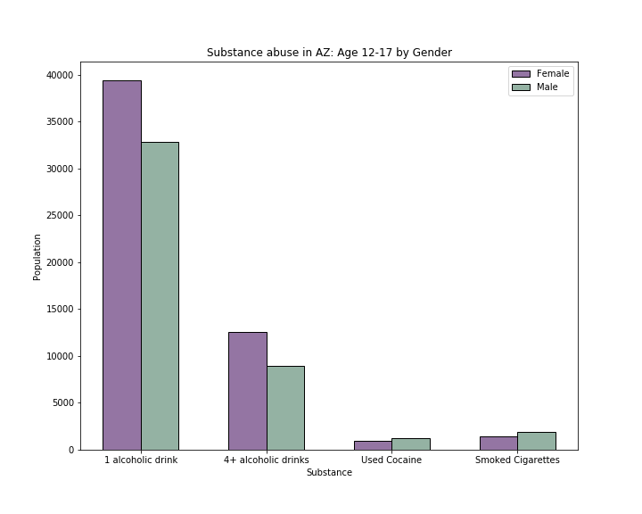
Substance Abuse by Gender
Had 1 alcoholic drink
36% Female, 30% Male
Had 4 or more alcoholic drinks in a row
21% Female (4), 15% Male(5)
Used Cocaine
5% Female, 6% Male
Smoked Cigarettes
6% Female, 8% Male

