Slide 1
Substance Abuse Among Adolescents Age 12-17
Thea Crockett
Sarath Kottur
Francis Okot
Jennis Vicente

Slide 2
Abstract
Substance abuse is a common problem among adolescents age 12 to 17. Data was acquired from difference sources and manipulated with Python. Trends were identified and results tabulated and plotted as shown in the following slides

Slide 3
Using ANOVA to determine if substance abuse is significantly different among HS students from grades 8-12.
Hypothesis

Slide 4
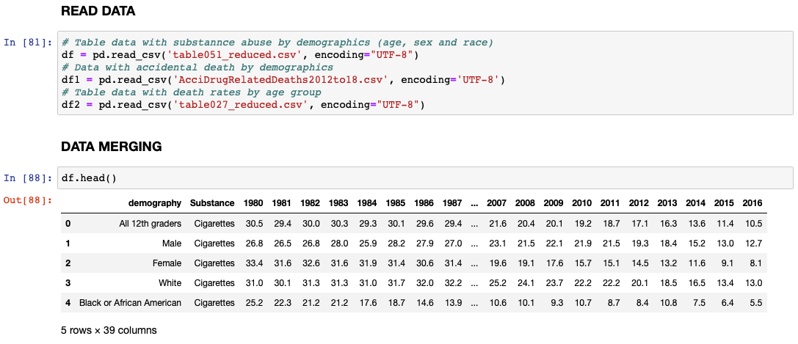

Slide 5
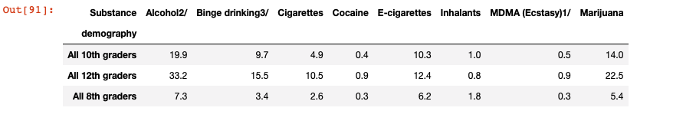
DataFrame by Grade level

Slide 6
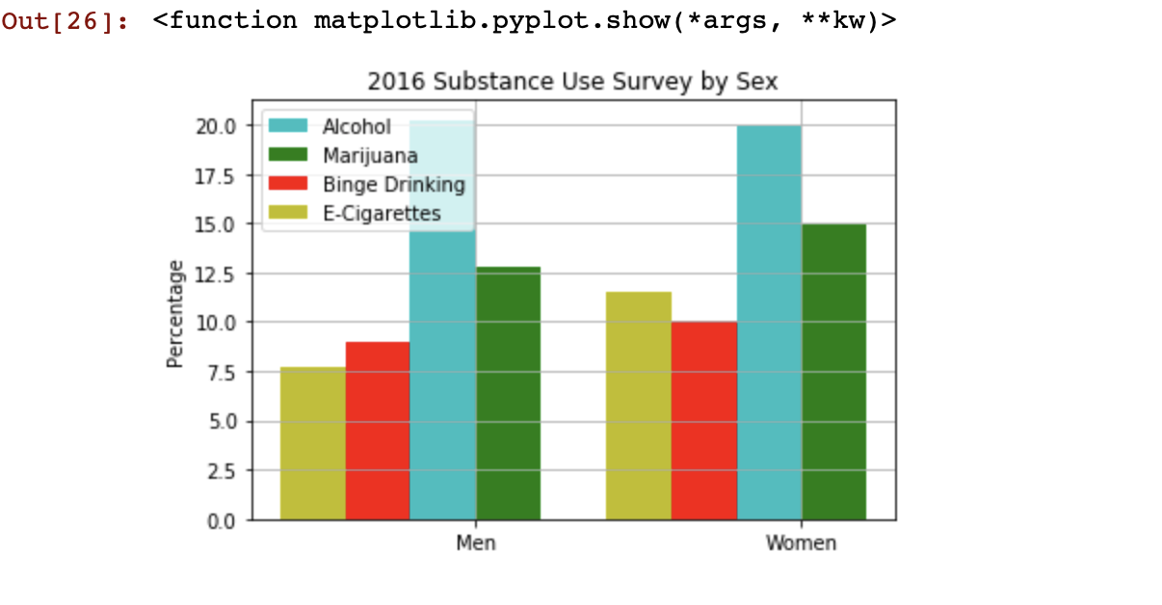
Plot by Gender Girls general abuse substance more than boys

Slide 7
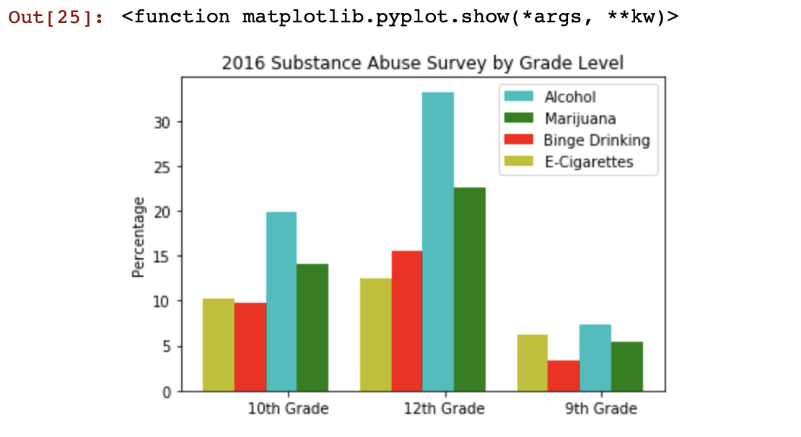
Plot by Grade Level
Notes:
15% of 8th graders, 24% of 10th graders, 30% of 12th graders, reported drinking 5 or more drinks within preceding 2 weeks

Slide 8
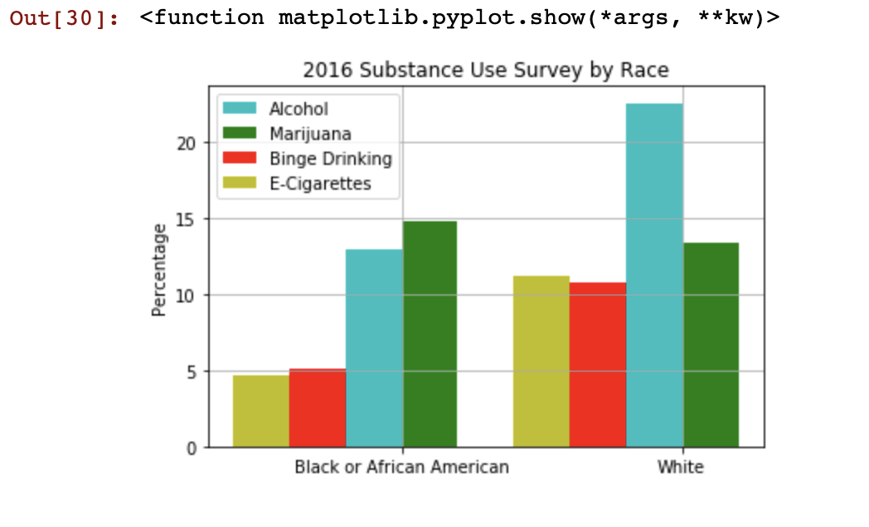
Plot by Race Caucasians drinking more Alcohol African Americans smoking more Marijuana

Slide 9
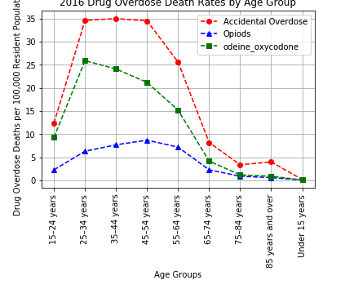
Death Rate by Age group

Slide 10
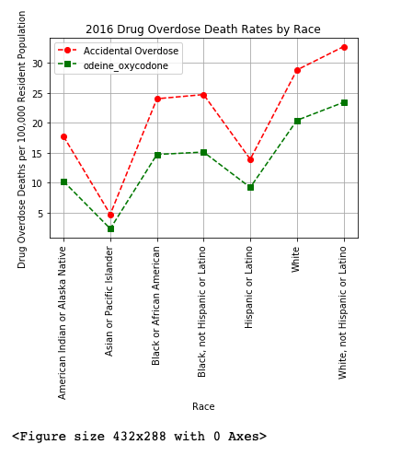
Drug Overdose Death Rates by Race

Slide 11
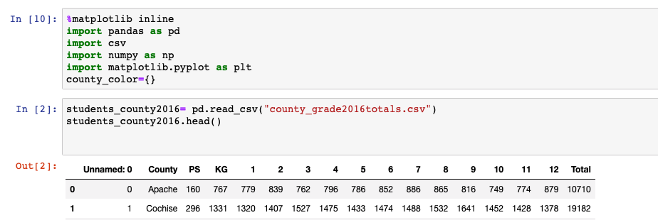
High school county - Arizona

Slide 12
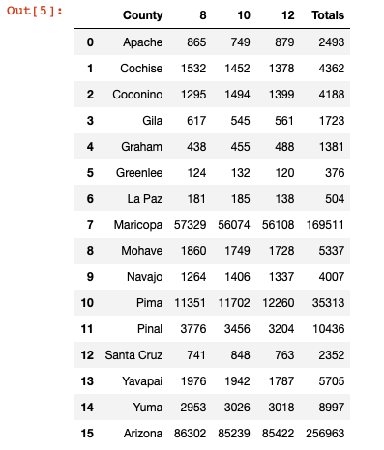
DataFrame for counties

Slide 13
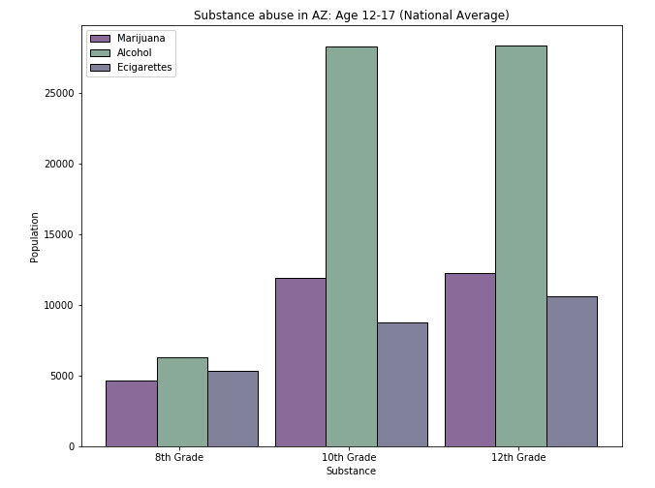

Slide 14
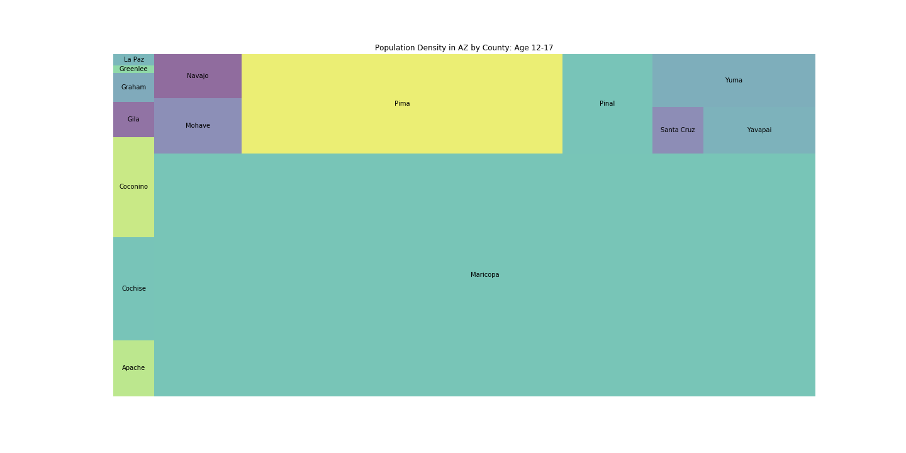
In Arizona
Enrollment in High School FY 2017-2018

Slide 15
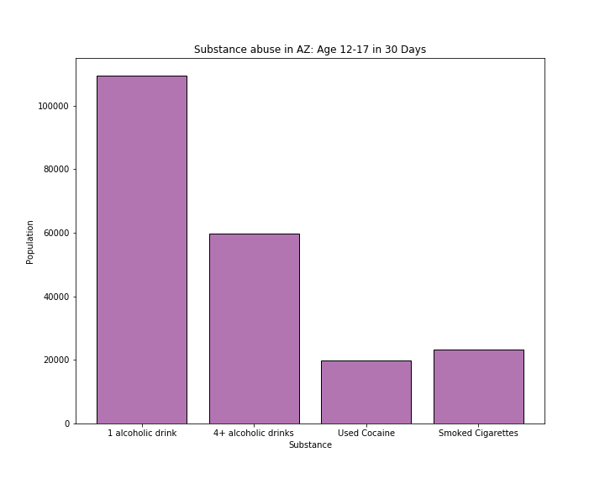
Substance Abuse Total
Based on substance used at least once 30 days before the survey
33% Had 1 alcoholic drink
18% Had 4 or more alcoholic drinks
6% Used Cocaine
7% Smoked Cigarettes

Slide 16
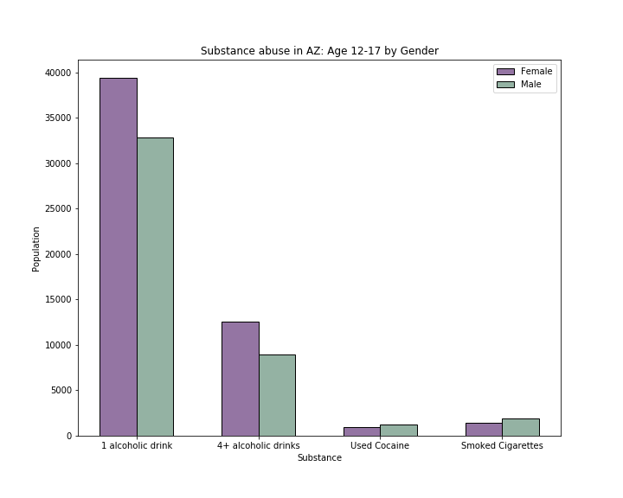
Substance Abuse by Gender
Had 1 alcoholic drink
36% Female, 30% Male
Had 4 or more alcoholic drinks in a row
21% Female (4), 15% Male(5)
Used Cocaine
5% Female, 6% Male
Smoked Cigarettes
6% Female, 8% Male

Slide 17
ANOVAs

Slide 18
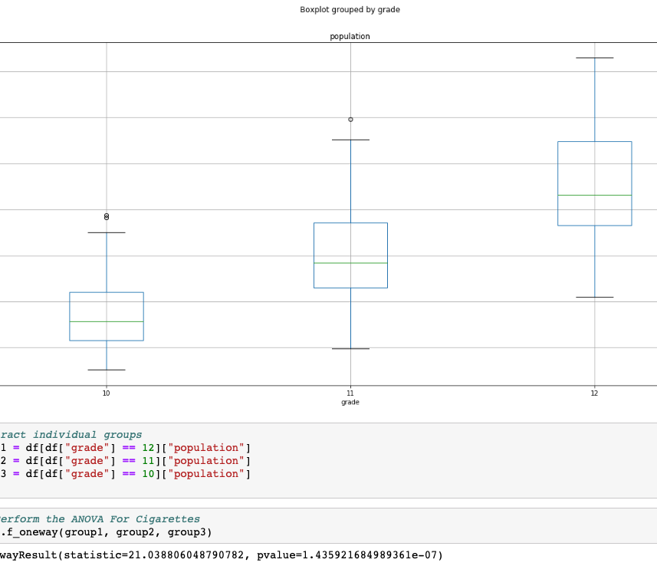
Cigarettes ANOVA for Arizona
Grades 10 – 12

Slide 19
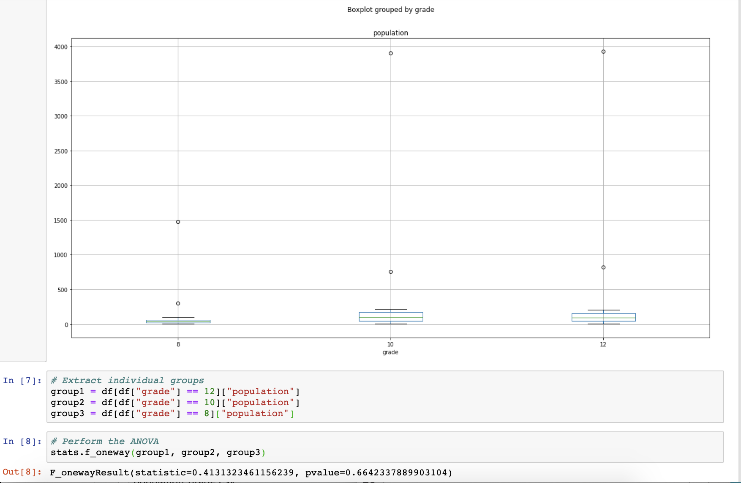
Cigarettes ANOVA, AZ
Including 8th Grade
8-12

Slide 20
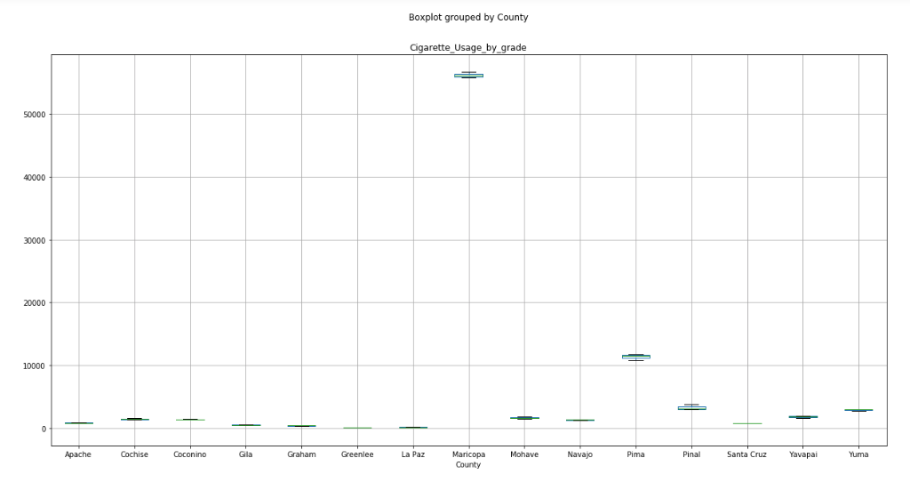

Slide 21
Conclusion
Cigarettes chosen due to the 20 years of available data
ANOVA chart shows that Cigarettes addictions (grade 8-11) show there is no enough evidence to reject null hypothesis and means are equal

