Slide 1
CIRCULAR SINGLY
LINKED LIST

Slide 2
Introduction
Linked list is a dynamic data structure, where the memory is allocated on
demand.
The memory size need not to be specified at the beginning and memory is allocated at run time.
It is the main advantage of linked list over the array.
A circular linked list is a type of linked list in which the first and the last nodes are also connected to each other to form a circle.
Here, the address of first node is stored in the second location of last node instead of NULL.

Slide 3
Insertion operations
A new node can be inserted at any position in the list, however we are considering three distinct cases:
1. Insertion at beginning
2. Insertion at last
3. Insertion at a specific node based on
  Key
  Position/Index of node
The first step is to insert a new node:
  allocate memory for the new node
  Assign the data to new node

Slide 4
In circular linked list, the insert operation requires traversing the entire list, as we need to change the next field of the last node and make it to point towards head pointer.
We create a class which consists of data part and address of next node.
class node
{
public:
int data;
node* next;
};
We allocate memory for the new node using keyword “new”.
node *New = new node();
cin>>New->data;
New->next = NULL;

Slide 5
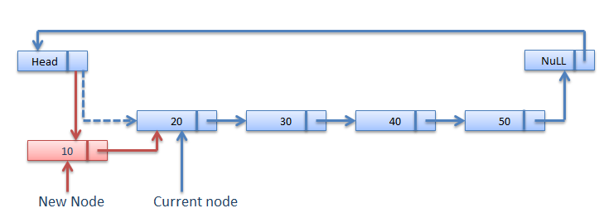
Pseudo code for insertion at beginning
if(head == NULL)
{
head = New;
New -> next = head;
}
else
{
node *p = head;
while(p->next != head)
p = p->next;
p->next = New;
New->next = head;
head = New;
}

Slide 6
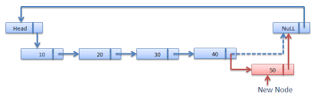
Pseudo code for insertion at end
if(head == NULL)
{
head = New;
New -> next = head;
}
else
{
node *p = head;
while(p->next != head)
p = p->next;
P->next = New;
New->next = head;
}

Slide 7
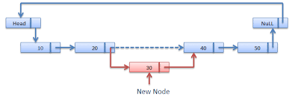
Pseudo code for insertion at specific position
int pos,count = 1;
cin>>pos;
if(head == NULL) {
head = New;
New -> next = head;
}
else{
node *p = head;
while(p->next != head && count != pos-1)
{
p = p->next;
count++;
}
New->next = p->next
p->next = New
}

Slide 8
Deletion operations
A node can be deleted from any position in the list, however we are considering three distinct cases:
1. Deletion from beginning
2. Deletion from last
3. Deletion of a specific node based on
  Key
  Position/Index of node
In circular linked list, the deletion operation requires traversing the entire list, as we need to change the next field of the last node and make it to point towards head pointer.
We create a class which consists of data part and address of next node.
class node
{
public:
int data;
node* next;
};

Slide 9
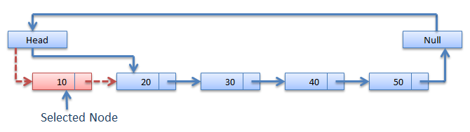
Pseudo code for deletion from beginning
if(head == NULL)
cout<<“List is empty!”;
else
{
node *p = head;
while(p->next != head)
p = p->next;
p->next = head->next;
p = head;
head = head->next;
cout<<“The deleted element is: “<<p->data;
p->next = NULL;
delete p;
}

Slide 10
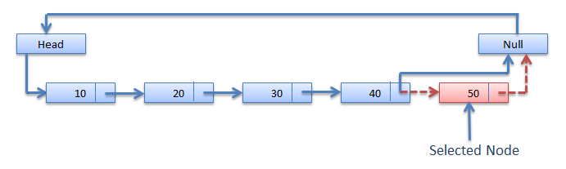
Pseudo code for deletion from end
if(head == NULL)
cout<<“The list is empty!”;
else
{
node *q,*p = head;
while(p->next != head)
{
q = p;
p = p->next;
}
q->next = head;
cout<<“The deleted element is: “<<p->data;
p->next = NULL;
delete p;
}

Slide 11
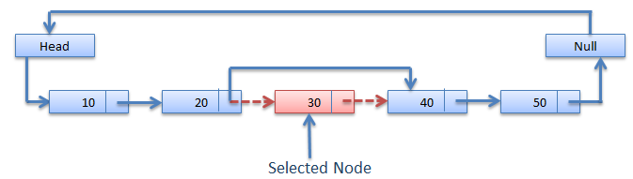
Pseudo code for deletion from specific position
int pos,count = 1;
cin>>pos;
if(head == NULL)
cout<<“The list is empty!”;
else
{
node *q,*p = head;
while(p->next != head && count != pos)
{
q = p;
p = p->next; count++;
}
q->next = p->next;
cout<<“The deleted element is: “<<p->data;
p->next = NULL;
delete p;
}

Slide 12
Searching an element
Searching in circular singly linked list needs traversing across the list.
The element which is to be searched in the list is matched with each node data of the list once and if the match found then the location of that item is returned otherwise -1 is returned.
Pseudo code:
int flag = 0,i = 0;
int key;
cin>>key;
if(head == NULL)
cout<<“The list is empty!”;
else if(head->data == key)
cout<<“Element is found at position-1”;

Slide 13
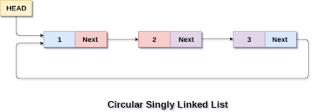
else
{
node *p = head;
while(p->next != head)
{
if(p->data == key)
{
flag=1;
break;
}
i++;
p = p -> next;
}
if(p->data == key || flag == 1)
cout<<“Element is found at position-”<<i+1;
else
cout<<“Element is not found!\n”;
}

Slide 14
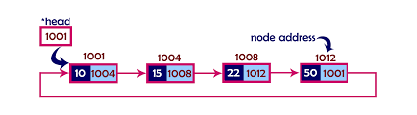
Traversal of circular linked list
cout<<“The elements in circular linked list are:”;
node *p = head;
while(p->next != head)
{
cout<<p->data<<“ “;
p = p->next;
}
cout<<p->data<<endl;
p = p->next;
while(p->next != head)
{
cout<<p->data<<“ “;
p = p->next;
}
cout<<p->data<<endl;

Slide 15
THANK YOU

