Slide 1
Purpose
The Execution Layer is responsible for orchestrating automated test execution using Jenkins and Selenium, collecting execution artifacts, and producing standardized execution work products. This acts a bridge between Quality Governance Layer and Failure Analysis Layer
Responsibilities:
Execution Results
Execution Logs
Execution Artifacts
Execution Metrics

Slide 2
Inputs
Primary Input:
Execution Ready Test Suite
Produced by:
Quality Governance Layer
Contains:
Feature Files
Step Definitions
Page Objects
Utilities
Execution Configurations
CP5 Report
CP6 Report

Slide 3
Outputs
Work Product 1
Execution Report
Work Product 2
Execution Logs
Work Product 3
Screenshots
Work Product 4
Test Evidence Package
Work Product 5
Execution Metrics Report
Final Output
Execution Result Package

Slide 4
High Level Flow
Execution Ready Suite
Jenkins Orchestrator
Test Execution Engine
Artifact Collection
Failure Analysis Layer
Execution Result Package
Execution Metrics Engine

Slide 5
Key Design Principle
Execute Once, Capture Everything
Every execution should produce sufficient evidence for downstream AI analysis.
Execution layer should never require:
Re-run to collect logs
Re-run to collect screenshots
Re-run to collect evidence
Everything should be captured during execution.

Slide 6
Components
Component | Purpose
Jenkins Orchestrator | Trigger and manage execution
Execution Engine | Run Selenium/Cucumber tests
Environment Manager | Manage execution environment
Artifact Collector | Collect execution evidence
Screenshot Collector | Capture failure screenshots
Log Collector | Capture execution logs
Metrics Engine | Calculate execution metrics
Execution Report Generator | Generate execution reports
Result Package Builder | Build execution result package

Slide 7
Jenkins Orchestrator
Purpose
Control execution workflow.
Responsibilities
Trigger Build
Execute Suite
Collect Results
Archive Artifacts
Publish Reports
Input
Execution Ready Suite
Output
Execution Results

Slide 8
Execution Engine
Technology
Selenium
Cucumber
Maven
Responsibilities
Execute
Smoke Tests
Regression Tests
Security Tests
Quality Scenarios
Output
{
"totalTests": 50,
"passed": 46,
"failed": 4,
"skipped": 0
}

Slide 9
Environment Manager
Purpose
Validate execution environment.
Checks
Browser Availability
Driver Availability
Application Availability
Test Data Availability
Configuration Availability
Output
{ "environmentReady": true }

Slide 10
Artifact Collector
Purpose
Capture execution evidence.
Collect
Execution Reports
Logs
Screenshots
Console Output
JUnit XML
Cucumber Reports
Output
evidence-package/

Slide 11
Screenshot Collector
Purpose
Capture screenshots automatically.
Triggers:
Test Failure
Assertion Failure
Unexpected Exception
Output
screenshots/

Slide 12
Log Collector
Purpose
Capture execution logs.
Collect:
Framework Logs
Selenium Logs
Browser Logs
Jenkins Logs
Output
execution.log

Slide 13
Execution Metrics Engine
Purpose
Calculate execution KPIs.
Example
{ "passPercentage": 92, "executionDuration": "18 minutes"
}
Metrics Captured
Total Tests
Passed
Failed
Skipped
Pass %
Fail %
Execution Time
Average Test Duration

Slide 14
Execution Report Generator
Purpose
Generate execution summary.
Output
{
"suite":"Regression",
"status":"FAILED",
"totalTests":50,
"passed":46,
"failed":4
}

Slide 15
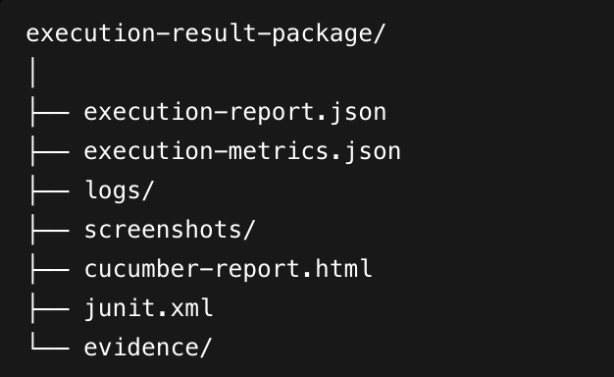
Result Package Builder
Purpose
Bundle all execution outputs.
Package

Slide 16
Human-in-the-Loop Conditions
Review required when:
Environment unavailable
Execution interrupted
Artifact collection failed
Results inconsistent
Evidence missing

Slide 17
Work Product
Work Product | Produced By
Execution Report | Report Generator
Execution Metrics | Metrics Engine
Logs | Log Collector
Screenshots | Screenshot Collector
Evidence Package | Artifact Collector
Execution Result Package | Package Builder

Slide 18
Integration with Next Layer
Output:
Execution Result Package
Containing:
Execution Report
Execution Metrics
Execution Logs
Screenshots
JUnit Results
Cucumber Results
Evidence Package
Consumed by:
Failure Analysis Layer

Slide 19
Implementation Task Breakdown
Jenkins Integration
Execution Engine
Task | Sub-task | Output
Jenkins Pipeline Integration | Configure execution pipeline | Jenkins execution
Artifact Archival | Archive reports and evidence | Archived artifacts
Report Publishing | Publish reports | Published reports
Task | Sub-task | Output
Environment Validation | Validate execution environment | Readiness status
Test Execution Runner | Execute automation suite | Test results
Error Handling | Handle execution failures | Failure logs

Slide 20
Implementation Task Breakdown
Artifact Collection
Reporting
Task | Sub-task | Output
Log Collection | Capture framework/browser logs | Log package
Screenshot Collection | Capture failure screenshots | Screenshot package
Evidence Packaging | Bundle artifacts | Evidence package
Task | Sub-task | Output
Metrics Calculation | Generate KPIs | Metrics report
Execution Report Generation | Generate summary report | Execution report
Result Package Builder | Package outputs | Execution result package

Slide 21
Implementation Task Breakdown
Testing
Task | Sub-task | Output
Unit Testing | Test collectors and generators | Test results
Integration Testing | Validate execution workflow | Integration results
End-to-End Dry Run | Execute complete execution flow | Demo package

Slide 22
Definition of Done
The Execution Layer is complete when:
Execution
Jenkins can trigger execution successfully.
Selenium/Cucumber suite executes successfully.
Environment validation completes successfully.
Evidence Collection
Logs are collected.
Screenshots are collected.
Reports are collected.
Evidence package is generated.
Reporting
Execution report generated.
Metrics report generated.
Result package generated.
Packaging
Execution Result Package created.
Artifacts archived.
Outputs consumable by Failure Analysis Layer.
Final Acceptance
Execution completed successfully.
Evidence collected successfully.
Reports generated successfully.
Execution Result Package handed over to CP7 Failure Analysis Layer.

Slide 23
Estimated Effort Summary
Workstream | Effort
Jenkins Integration | 2 PD
Execution Engine | 2 PD
Environment Validation | 1 PD
Artifact Collection | 2 PD
Screenshot & Log Collection | 2 PD
Metrics Engine | 2 PD
Reporting | 2 PD
Outputs & Testing | 2 PD
Total | 15 PD

