Slide 1

DEPARTMENT OF COMPUTER SCIENCE AND ENGINEERING WITH SPECIALIZATION IN DS/AIML/AIR
PROJECT PHASE-I
RT-IIPF: REAL-TIME INLINE INTERCEPTION OF FRAUDULENT UPI TRANSACTIONS USING UNSUPERVISED ANOMALY DETECTION AND TRANSACTIONAL ROLLBACK
PROJECT STUDENTS GUIDE
[Student Name 1], [Reg. No.] [Guide Name]
[Student Name 2], [Reg. No.] Assistant Professor, CSE
Notes:
Introduce the team and the title. One line: today's fraud systems detect AFTER money moves; we block BEFORE it moves.

Slide 2
AGENDA
Abstract
Objective(s)
Literature Survey
Inferences from Literature Survey
Proposed System
References
Notes:
Walk the agenda in ten seconds.

Slide 3
ABSTRACT
Conventional payment fraud systems operate retrospectively: a transaction settles, logs are analysed later, and recovery is attempted after the money has already moved. On real-time rails such as the Unified Payments Interface (UPI), funds are forwarded and withdrawn within minutes, making recovery largely infeasible. This project proposes RT-IIPF, a framework that relocates the fraud decision inside the payment transaction itself. When a payment arrives, the Spring Boot switch acquires pessimistic locks on both ledger rows, applies the debit and credit provisionally without committing, and suspends the executing thread while an isolated Python microservice scores the transaction using an unsupervised Isolation Forest. A clean verdict commits the ledger; a fraudulent verdict triggers an atomic rollback and locks the payer account, while the audit record survives the rollback through an independent transaction. The prototype achieves an end-to-end decision in 11-12 ms, so a blocked transfer never attains durable existence in the ledger and there is nothing to claw back.
Notes:
Key sentence: a blocked transfer never exists in the ledger, so there is nothing to claw back. Mention the 11-12 ms measured decision time.

Slide 4
OBJECTIVE(S)
Design an inline interception pipeline that suspends a UPI payment mid-transaction and arbitrates its commit on a machine-learning verdict.
Implement atomic rollback with a surviving audit trail, so a blocked transfer leaves no ledger effect while the security response persists.
Train an unsupervised Isolation Forest on 250,000 real UPI transactions that requires no fraud labels and can flag previously unseen patterns.
Enrich six user-entered fields into a 13-feature vector using client telemetry and server-side data the client cannot forge.
Validate the sub-50 ms design budget through latency and concurrency benchmarking of the complete three-service system.
Notes:
Five objectives. Emphasise objective 2 (atomic rollback with surviving audit) - that is the novel engineering contribution.

Slide 5
Base Paper Details
Base Paper Title: Enhancing Digital Payment Security: UPI Fraud Detection with Advanced Machine Learning Algorithms
Year: 2025
Journal / Conference: IEEE Xplore Conference Publication
Method: Hybrid Deep Q-Network (DQN) with XGBoost - reinforcement learning for adaptive policy combined with gradient boosting for tabular classification.
Identified Gap: The model scores transactions but is not integrated into the payment transaction boundary; detection remains advisory rather than preventive, and no rollback or ledger-integrity mechanism is provided.
Notes:
State the base paper and, importantly, the gap: it scores transactions but never integrates with the transaction boundary, so detection stays advisory.

Slide 6
LITERATURE SURVEY(1/4)
AUTHOR | JOURNAL NAME & YEAR | TITLE | DESCRIPTION | PROS | CONS
Liu, F.T., Ting, K.M., Zhou, Z.-H. | IEEE ICDM, 2008 | Isolation Forest | Isolates anomalies by random axis-parallel partitioning; anomaly score derived from average isolation depth. | Linear time complexity, low memory, needs no distance or density computation - suited to latency-bound inference. | Degrades on sparse one-hot categorical spaces; scores saturate for extreme values; no per-entity context.
Breunig, M.M., Kriegel, H.-P., Ng, R.T., Sander, J. | ACM SIGMOD, 2000 | LOF: Identifying Density-Based Local Outliers | Assigns outlierness by comparing a point's local reachability density with that of its neighbours. | Detects local outliers that global methods miss; strong recall in our own comparative evaluation. | Requires a reference set resident in memory; neighbour search cost grows with reference size.
Scholkopf, B., Platt, J.C., Shawe-Taylor, J., et al. | Neural Computation, 2001 | Estimating the Support of a High-Dimensional Distribution | One-Class SVM estimates a support boundary enclosing the normal class in kernel space. | Principled support estimation; kernel choice allows non-linear decision boundaries. | Training cost is quadratic in sample size; performance sensitive to kernel and nu selection.
Notes:
Foundational anomaly detection. Isolation Forest is what we deployed; LOF and One-Class SVM are our comparison baselines.

Slide 7
LITERATURE SURVEY(2/4)
AUTHOR | JOURNAL NAME & YEAR | TITLE | DESCRIPTION | PROS | CONS
Campos, G.O., Zimek, A., Sander, J., et al. | Data Mining and Knowledge Discovery, 2016 | On the Evaluation of Unsupervised Outlier Detection | Systematic comparison of unsupervised detectors across measures and benchmark datasets. | Establishes evaluation pitfalls and standardised benchmarking practice for unsupervised detection. | Does not address deployment constraints such as inference latency or false-positive budgets.
Abdallah, A., Maarof, M.A., Zainal, A. | Journal of Network and Computer Applications, 2016 | Fraud Detection System: A Survey | Surveys fraud detection systems across credit card, telecommunication and insurance domains. | Broad taxonomy of fraud types, detection techniques and evaluation criteria. | Predates modern real-time rails; no treatment of transactional integration or rollback semantics.
Adewumi, A.O., Akinyelu, A.A. | Int. J. of System Assurance Engineering and Management, 2017 | A Survey of ML and Nature-Inspired Credit Card Fraud Detection Techniques | Reviews machine-learning and nature-inspired algorithms applied to card fraud detection. | Comparative view of algorithm families with reported accuracy ranges. | Card-centric; does not cover UPI or any sub-second real-time payment rail.
Notes:
Evaluation methodology and the two fraud surveys that frame the field's reliance on supervised learning.

Slide 8
LITERATURE SURVEY(3/4)
AUTHOR | JOURNAL NAME & YEAR | TITLE | DESCRIPTION | PROS | CONS
Thayanidhi, V., Srivarshan, M., Shalini, M. | Springer, ICSMDI 2025 (pub. 2026) | UPI Fraud Detection Using Machine Learning | Analyses UPI transaction patterns and user behaviour using decision trees, random forests and neural networks. | Directly targets the UPI rail; reports real-time analysis of behavioural patterns. | Supervised approach requiring labelled fraud data; detection is post-transaction rather than inline.
Jani, R., Kumar, M.R., Gumasthi, N., Singla, S., Kailasam, T. | Springer, AIAI 2025 | Reinforcement Learning for UPI Fraud Detection: Actor Critic Optimization Approach | Applies actor-critic reinforcement learning to adapt the fraud decision policy over time. | Adapts to evolving fraud strategies without full retraining. | Training complexity and reward-design sensitivity; no ledger-level enforcement mechanism.
[Verify authors on IEEE Xplore] | IEEE Conference Publication, 2025 | Enhancing Digital Payment Security: UPI Fraud Detection with Advanced Machine Learning Algorithms | Hybrid Deep Q-Network with XGBoost combining adaptive learning and gradient-boosted tabular classification. | Strong reported accuracy on tabular UPI data; adaptive to drift. | Advisory scoring only - not integrated into the transaction boundary; no rollback or account-lock mechanism.
Notes:
Recent UPI-specific work. Note that all of it scores post-transaction.

Slide 9
LITERATURE SURVEY(4/4)
AUTHOR | JOURNAL NAME & YEAR | TITLE | DESCRIPTION | PROS | CONS
[Verify authors on IEEE Xplore] | IEEE Conference Publication, 2025 | PaySafe AI: Intelligent Fraud Detection for UPI Transactions using Machine Learning | Normalises typical account activity and classifies sequences of transactions as fraudulent or genuine. | Sequence-aware modelling captures behavioural drift over time. | No inline commit/rollback integration; sequence features require history unavailable at first transaction.
[Verify authors on IEEE Xplore] | IEEE Conference Publication, 2025 | Machine Learning-Driven Detection of UPI Fraudulent Activities | Multimodal pipeline processing transaction records, QR-code images and audio from vishing attempts. | Covers a broad attack surface beyond the transaction record itself. | Heavy multimodal pipeline unsuitable for a sub-50 ms inline decision path.
[Verify authors on IEEE Xplore] | IEEE Conference Publication, 2022 | Degree of Accuracy in Credit Card Fraud Detection Using LOF and Isolation Forest | Comparative evaluation of LOF and Isolation Forest on credit card transaction data. | Direct empirical comparison of the two detectors central to this work. | Card dataset only; no deployment architecture, latency measurement or concurrency analysis.
Notes:
Applied and comparative studies. The last row is the direct LOF vs Isolation Forest comparison on card data.

Slide 10
INFERENCES FROM LITERATURE SURVEY
Existing UPI fraud research is overwhelmingly post-transaction: models score a payment after it settles, leaving recovery as the only remedy.
Supervised approaches dominate, yet real fraud labels are scarce, delayed and unable to describe novel attack patterns.
No reviewed work integrates the fraud verdict with database transaction semantics - none provides atomic rollback of a flagged transfer.
Reported accuracy is rarely paired with latency measurement, so the feasibility of inline deployment remains unestablished.
Evaluation typically reports ROC-AUC alone, which is misleading for a blocker constrained by an operational false-positive budget.
Notes:
The critical inference is the third one: no reviewed work ties the fraud verdict to database transaction semantics. That gap is our project.

Slide 11
PROPOSED SYSTEM (1/4)
The React client captures payment inputs (payee VPA, amount, transaction type, merchant category, MPIN) together with silent device telemetry, and posts them to the Spring Boot switch.
The switch authenticates the MPIN, acquires PESSIMISTIC_WRITE locks on the payer and payee ledger rows in ascending id order, and applies the debit and credit without committing them.
The request thread is suspended while the FastAPI microservice scores a 13-feature vector with an Isolation Forest and returns a normalised anomaly score with a binary verdict.
A clean verdict commits the ledger; a fraudulent verdict writes the audit row and account lock in an independent transaction, then throws an exception that rolls the money movement back atomically.
Advantages of the Proposed System
Blocks fraud before settlement rather than detecting it afterwards.
Guarantees ledger integrity through ACID rollback with a surviving audit trail.
Requires no fraud labels, so novel attack patterns can be flagged.
Fails closed: an unreachable scoring node rejects payments rather than admitting them unscored.
Achieves an end-to-end decision in 11-12 ms, within the sub-50 ms budget.
Notes:
Walk the four numbered steps, then the advantages. If asked how the audit row survives a rollback: it is written in a separate REQUIRES_NEW transaction.

Slide 12
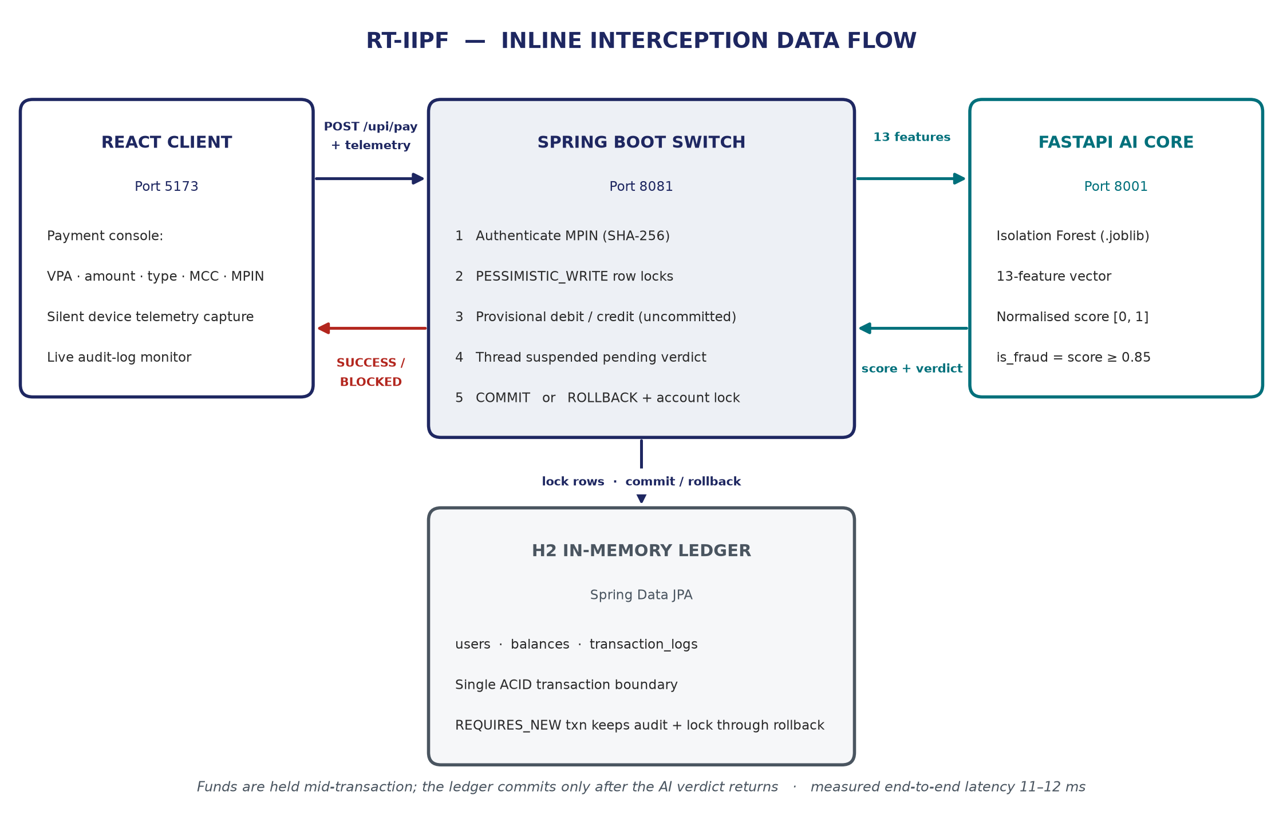
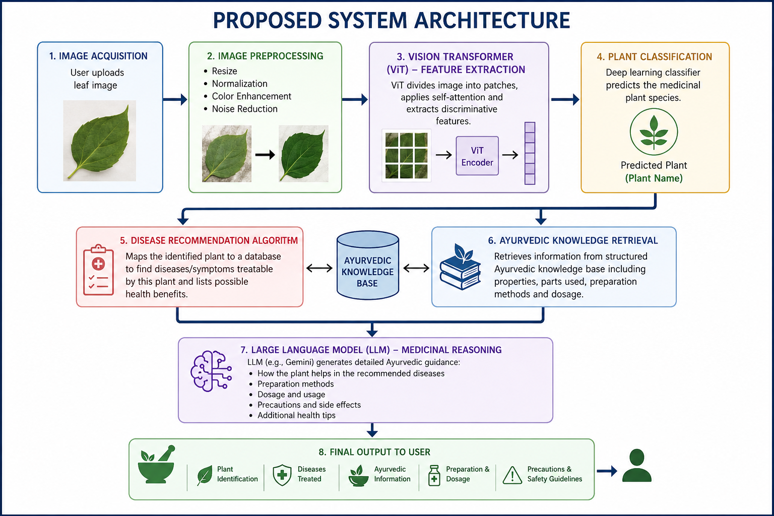
PROPOSED SYSTEM(2/4)
Notes:
Trace one payment left to right, then down to the ledger. Stress that the money is already debited but NOT committed while the AI is deciding.

Slide 13
PROPOSED SYSTEM(3/4)
Modules | Activities
Requirement Analysis | Study UPI transaction flows and fraud patterns; define the sub-50 ms inline decision budget and the fail-closed safety policy.
Data Preparation | Ingest 250,000 UPI transactions; clean and encode 13 pre-settlement features; exclude post-settlement fields that would leak the outcome.
Model Development | Train the unsupervised Isolation Forest, calibrate scores to [0,1] with a winsorised ceiling, and serialise the model bundle to .joblib.
Backend & Ledger Development | Build the Spring Boot switch with H2 ledger, pessimistic row locking, MPIN authentication, and the rollback-with-surviving-audit pattern.
Service Integration | Connect the React client, Spring Boot switch and FastAPI scoring node over REST with bounded timeouts and fail-closed error handling.
Testing & Evaluation | Verify commit, rollback, account-lock and fail-closed paths; benchmark latency, concurrency and detection under synthetic fraud injection.
Notes:
Six modules. Testing and Evaluation covers commit, rollback, account lock and fail-closed paths plus latency benchmarking.

Slide 14
PROPOSED SYSTEM-Algorithm(4/4)
Feature Assembly: 6 user inputs enriched to a 13-dimensional vector using client telemetry and server-resolved account and temporal data
Preprocessing: standard scaling of numeric features and one-hot encoding of categorical features (unknown categories handled safely)
Unsupervised Isolation Forest (200 estimators) for anomaly scoring
Score Calibration: min-max normalisation to [0,1] with the ceiling winsorised at the 99.95th percentile of the training distribution
Threshold Decision Rule: is_fraud = 1 when score >= 0.85, else 0
Concurrency Control: PESSIMISTIC_WRITE row locking in ascending account-id order to prevent deadlock during the scoring hop
Atomic Rollback: FraudulentTransactionException triggers ledger rollback while REQUIRES_NEW propagation preserves the audit row and account lock
*The inline interception and rollback mechanism overcomes the key limitation of existing work, in which fraud is scored only after the transaction has already settled.
Notes:
The last two items are what overcome the gap in existing work: pessimistic locking during the scoring hop, and exception-driven atomic rollback.

Slide 15
References
Abdallah, A., Maarof, M. A., & Zainal, A. (2016). Fraud detection system: A survey. Journal of Network and Computer Applications, 68, 90-113.
Adewumi, A. O., & Akinyelu, A. A. (2017). A survey of machine-learning and nature-inspired based credit card fraud detection techniques. International Journal of System Assurance Engineering and Management, 8(2), 937-953.
Breunig, M. M., Kriegel, H.-P., Ng, R. T., & Sander, J. (2000). LOF: Identifying density-based local outliers. Proceedings of the ACM SIGMOD International Conference on Management of Data, 93-104.
Campos, G. O., Zimek, A., Sander, J., et al. (2016). On the evaluation of unsupervised outlier detection: measures, datasets, and an empirical study. Data Mining and Knowledge Discovery, 30(4), 891-927.
Jani, R., Kumar, M. R., Gumasthi, N., Singla, S., & Kailasam, T. (2025). Reinforcement learning for UPI fraud detection: Actor critic optimization approach. Artificial Intelligence Applications and Innovations (AIAI 2025), Springer.
Liu, F. T., Ting, K. M., & Zhou, Z.-H. (2008). Isolation forest. Proceedings of the 8th IEEE International Conference on Data Mining, 413-422.
Scholkopf, B., Platt, J. C., Shawe-Taylor, J., Smola, A. J., & Williamson, R. C. (2001). Estimating the support of a high-dimensional distribution. Neural Computation, 13(7), 1443-1471.
Thayanidhi, V., Srivarshan, M., & Shalini, M. (2026). UPI fraud detection using machine learning. International Conference on Smart Data Intelligence (ICSMDI 2025), Springer.
[Add the four IEEE Xplore conference references cited in the Literature Survey with complete author lists, and any further papers needed to reach the required minimum of 12.]
Notes:
Alphabetical order. Four IEEE Xplore references still need complete author lists before submission.

Slide 16
THANK YOU
We thank God, Our Department, Guide, Panel Members, Supportive Professors and all Technical and non Technical staff who helped us in our Project.
Notes:
Thank the panel and invite questions. Offer the live demo if time permits.

