Slide 1

DEPARTMENT OF COMPUTER SCIENCE AND ENGINEERING WITH SPECIALIZATION IN DS/AIML/AIR
PROJECT PHASE-I
MULTIMODAL MEDICINAL PLANT RECOGNITION AND AYURVEDIC KNOWLEDGE REASONING USING VISION TRANSFORMERS AND LLMS
PROJECT STUDENTS GUIDE
Name1, 43111027 Dr.D.Menaka M.E.,Ph.D., Name2, 43110863 Assistant Professor, CSE

Slide 2
AGENDA
Abstract
Objective(s)
Literature Survey
Inferences from Literature Survey
Proposed System
References

Slide 3
ABSTRACT
Medicinal plants play a vital role in Ayurvedic healthcare, but identifying them accurately often requires expert botanical knowledge. This project presents an AI-powered platform that automates medicinal plant identification using a Vision Transformer (ViT) model, which accurately recognizes plants from leaf images. Based on the identified plant or a selected disease, the system recommends suitable medicinal plants and provides detailed Ayurvedic medicinal guidance using the Google Gemini Large Language Model. By combining computer vision and generative AI, the proposed system offers an accessible, accurate, and intelligent solution for healthcare, education, and agricultural applications, making medicinal plant knowledge available to a wider audience.
(Elaborate objective of the Work and the advantages of your proposed work should be written as ABSTRACT)

Slide 4
OBJECTIVE(S)
Develop an AI-powered system for accurate medicinal plant identification using Vision Transformer.
Build a structured Ayurvedic knowledge base containing medicinal properties, diseases treated, and preparation methods.
Implement disease-based medicinal plant recommendation using a searchable plant database.
Integrate Google Gemini to generate intelligent medicinal recommendations and safety guidelines.
(Four – Five lines only)

Slide 5
Base Paper Details
Base Paper Title: HerbGuard: An Ensemble Deep Learning Framework With EfficientNet and Vision Transformers for Fine-Grained Classification of Medicinal and Poisonous Plants
Year: 2025
Journal Name: IEEE Access
Year:2026 or 2025
JournalName:(ScienceDirect/IEEE Transaction/Springer/ Elsevier)

Slide 6
LITERATURE SURVEY(1/5)
AUTHOR | JOURNAL NAME & YEAR OF PUBLICATION | TITLE | DESCRIPTIONS | PROS | CONS
Faisal Firdous et al. | ECTI Transactions on Computer and Information Technology 2026 | AI-Based Smart Identification of Medicinal Plants Using Vision Transformer and CatBoost for Biodiversity and Healthcare | Vision Transformer (ViT) + CatBoost classifier (Optuna hyperparameter tuning) | High medicinal plant classification accuracy (93%), reduced false positives. | Supports only five medicinal plant species, does not include disease diagnosis or AI recommendation module
Mhd. Furqan et al. | Journal of Applied Data Sciences 2026 | Multiclass Skin Lesion Classification Algorithm using Attention-Based Vision Transformer with Metadata Fusion | Attention-based Vision Transformer (ViT) with metadata fusion and mutual-attention mechanism | Improved classification accuracy, utilizes clinical metadata . | Designed for skin lesion classification rather than plant diseases; evaluated only on the HAM10000 skin lesion dataset

Slide 7
LITERATURE SURVEY(1/5)
AUTHOR | JOURNAL NAME & YEAR OF PUBLICATION | TITLE | DESCRIPTIONS | PROS | CONS
Faisal Firdous et al. | ECTI Transactions on Computer and Information Technology 2026 | AI-Based Smart Identification of Medicinal Plants Using Vision Transformer and CatBoost for Biodiversity and Healthcare | Vision Transformer (ViT) + CatBoost classifier (Optuna hyperparameter tuning) | High medicinal plant classification accuracy (93%), reduced false positives. | Supports only five medicinal plant species, does not include disease diagnosis or AI recommendation module
Mhd. Furqan et al. | Journal of Applied Data Sciences 2026 | Multiclass Skin Lesion Classification Algorithm using Attention-Based Vision Transformer with Metadata Fusion | Attention-based Vision Transformer (ViT) with metadata fusion and mutual-attention mechanism | Improved classification accuracy, utilizes clinical metadata . | Designed for skin lesion classification rather than plant diseases; evaluated only on the HAM10000 skin lesion dataset

Slide 8
LITERATURE SURVEY(1/5)
AUTHOR | JOURNAL NAME & YEAR OF PUBLICATION | TITLE | DESCRIPTIONS | PROS | CONS
Faisal Firdous et al. | ECTI Transactions on Computer and Information Technology 2026 | AI-Based Smart Identification of Medicinal Plants Using Vision Transformer and CatBoost for Biodiversity and Healthcare | Vision Transformer (ViT) + CatBoost classifier (Optuna hyperparameter tuning) | High medicinal plant classification accuracy (93%), reduced false positives. | Supports only five medicinal plant species, does not include disease diagnosis or AI recommendation module
Mhd. Furqan et al. | Journal of Applied Data Sciences 2026 | Multiclass Skin Lesion Classification Algorithm using Attention-Based Vision Transformer with Metadata Fusion | Attention-based Vision Transformer (ViT) with metadata fusion and mutual-attention mechanism | Improved classification accuracy, utilizes clinical metadata . | Designed for skin lesion classification rather than plant diseases; evaluated only on the HAM10000 skin lesion dataset

Slide 9
LITERATURE SURVEY(1/5)
AUTHOR | JOURNAL NAME & YEAR OF PUBLICATION | TITLE | DESCRIPTIONS | PROS | CONS
Faisal Firdous et al. | ECTI Transactions on Computer and Information Technology 2026 | AI-Based Smart Identification of Medicinal Plants Using Vision Transformer and CatBoost for Biodiversity and Healthcare | Vision Transformer (ViT) + CatBoost classifier (Optuna hyperparameter tuning) | High medicinal plant classification accuracy (93%), reduced false positives. | Supports only five medicinal plant species, does not include disease diagnosis or AI recommendation module
Mhd. Furqan et al. | Journal of Applied Data Sciences 2026 | Multiclass Skin Lesion Classification Algorithm using Attention-Based Vision Transformer with Metadata Fusion | Attention-based Vision Transformer (ViT) with metadata fusion and mutual-attention mechanism | Improved classification accuracy, utilizes clinical metadata . | Designed for skin lesion classification rather than plant diseases; evaluated only on the HAM10000 skin lesion dataset

Slide 10
INFERENCES FROM LITERATURE SURVEY
Vision Transformer has emerged as one of the most effective architectures for plant image classification.
Attention mechanisms significantly improve feature extraction from complex leaf structures.
Existing studies mainly focus on classification accuracy while neglecting practical medicinal recommendation capabilities.
Structured botanical knowledge is rarely integrated with deep learning-based identification systems.
Large Language Models remain largely unexplored for generating personalized Ayurvedic medicinal recommendations.

Slide 11
PROPOSED SYSTEM (1/4)
Preprocesses the uploaded leaf image through resizing and normalization before extracting discriminative visual features using a Vision Transformer (ViT).
……….
Finally, a Large Language Model (Google Gemin..i) generates detailed Ayurvedic explanations, preparation methods, dosage recommendations, and safety precautions.
Advantages of Proposed System
Integrates disease recommendation with plant recognition.
Generates AI-powered Ayurvedic medicinal guidance.
Provides preparation methods and dosage information.
Supports conversational knowledge reasoning.
Improves practical usability beyond image classification.

Slide 12
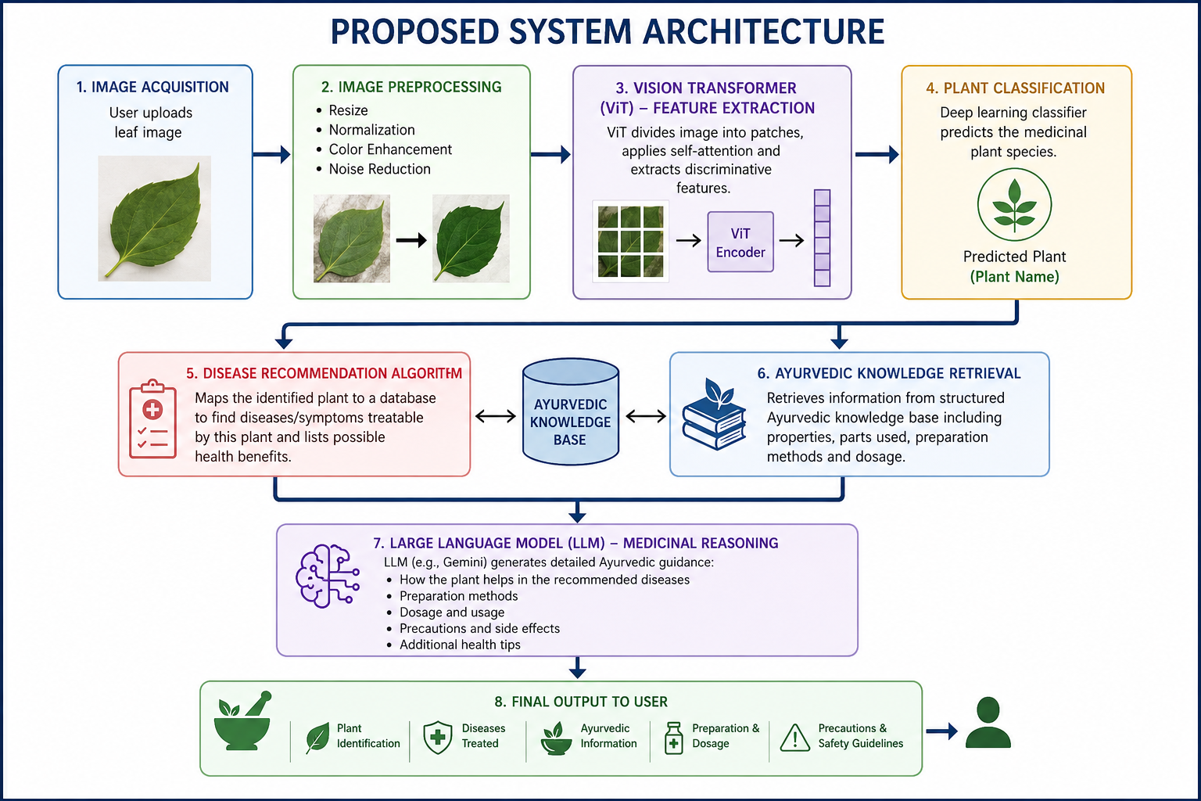
PROPOSED SYSTEM(2/4)

Slide 13
PROPOSED SYSTEM(3/4)
Modules | Activities
Requirement Analysis | Collect medicinal plant datasets, define project objectives, and analyze system requirements.
Data Preparation | Organize botanical datasets, disease mappings, and preprocess plant images for training.
Model Development | Train and fine-tune the Vision Transformer model for medicinal plant identification.
System Integration | Integrate Flask backend, knowledge base, disease search, and Google Gemini recommendation module.
Testing & Deployment | Validate classification accuracy, evaluate recommendation quality, and deploy the complete web application.

Slide 14
PROPOSED SYSTEM-Algorithm(4/4)
Image Preprocessing (Resizing, Normalization)
Vision Transformer (ViT) for Feature Extraction
Deep Learning-based Plant Classification
Disease Recommendation Algorithm
Ayurvedic Knowledge Retrieval
Large Language Model (Google Gemini) Recommendation
Natural Language Generation for Medicinal Guidance
*Please mention the specific algorithm or method used in the proposed work to overcome the limitations identified in the existing work.

Slide 15
References
Al Mamun, A., Zhang, M., Ahmedt-Aristizabal, D., Hayder, Z., & Awrangjeb, M. (2026). Conmamba: Contrastive vision mamba for plant disease detection. Pattern Recognition, 113177.
Anjum, M. N., & Akther, S. (2026). Enhanced Vision Transformer Model with Multi-Scale Attention for Robust Plant Leaf Disease Identification and Classification.
Firdous, F., Gupta, D., & Sood, H. (2026). AI-Based Smart Identification of Medicinal Plants Using Vision Transformer and CatBoost for Biodiversity and Healthcare. ECTI Transactions on Computer and Information Technology (ECTI-CIT), 20(1), 1–14.
Furqan, M., Katuk, N., & Hartama, D. (2026). Multiclass Skin Lesion Classification Algorithm using Attention-Based Vision Transformer with Metadata Fusion. Journal of Applied Data Sciences, 7(1), 203–217.
Gerz, F., Schneider, M. G., & Jelali, M. (2026). Integration of Vision Transformer Networks in YOLOv8 for Object Detection: Comparative Study on Plant Disease Detection. IEEE Access.
Öztaş, D. M., Salehi, H., Demir, Ö., Acici, K., Güzel, M. S., Eraslan, E. C., ... & Ekinci, F. (2026). Balancing Accuracy and Efficiency in Fine-Grained Image Classification: A Systematic Comparison of CNN, Vision Transformer, and Hybrid Architectures. Plant Systematics and Evolution, 312(4), 30
NOTE: All references must be arranged in Alphabetical Order(Author Name). Minimum 12 references.
DONOT give Website references.
.

Slide 16
THANK YOU
We thank God, Our Department, Guide, Panel Members, Supportive Professors and all Technical and non Technical staff who helped us in our Project.

