Slide 1
Smart Water Fountains
Phase 5: Project Documentation & Submission

Slide 2
Introduction:
In last years, people’s needs in the fields of
aesthetic taste, comfort and attention to details have
considerably changed. In outdoor furniture field, more and
more people requires particular features to make their
spaces cozy, liveable and original. This trend has also
affected a classical element of outdoor furnishings: the
fountains. The simple gush of a fountain now is not
enough, people wants and tries a greater visual impact. In
order to meet this demand, specialized designers have
created the dancing fountains (or musical fountains),
which combine water and light plays on the basis of a
reproduced music track.

Slide 3
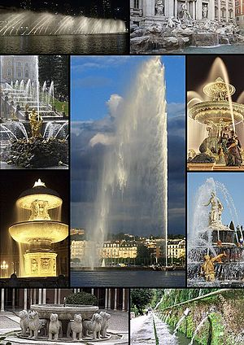
Smart water fountains:
A water fountain or drinking fountain is designed to provide drinking water and has a basin arrangement with either continuously running water or a tap. The drinker bends down to the stream of water and swallows water directly from the stream.

Slide 4
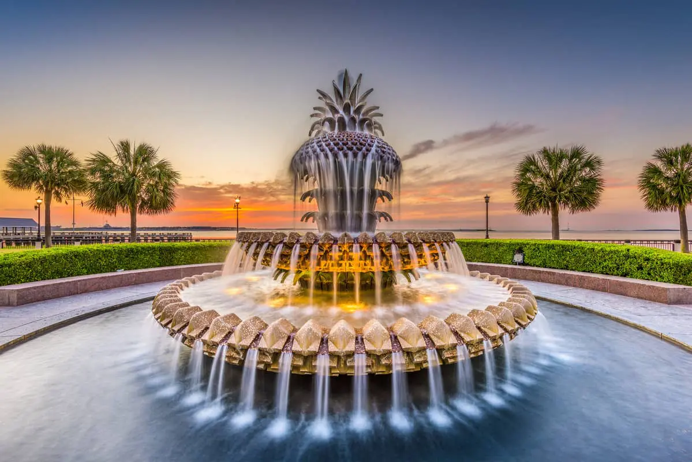
objective of water fountain:
A well-designed fountain adds freshness to any public space, boosting it both socially and economically by attracting more tourists and also local residents. In this way, people from near and far will have a place for leisure, fun, or just simple relaxation.

Slide 5
principle of water fountain:
The pump forces water upwards to create a falling effect into a lower basin.
The pump uses water pressure and tubes to force the water back into the reservoir to start the cycle over again.
The number of reservoirs and pumps in a fountain can vary, with large outdoor fountains commonly having multiple basins.

Slide 6
History of the water fountain:
AN EARLY example of a fountain, found in Mesopotamia, dates from around 3000 BC. It consisted of a series of basins which made use of a natural spring. A similar system is found in Greek and Roman remains. Mechanically-operated fountains became familiar during the 15th century in Italy.

Slide 7
Advantage & Disadvantage
Advantage:
Disadvantage
Indoor water fountains can improve the air in your home with negative ions, reducing the air pollution.
Dust is attracted by the negative ions so your water fountain is actively working to purify the air
You may have less flexibility in where you can place a drinking fountain because they must be near a mains water supply, whereas a water dispenser with a bottled water source can be placed anywhere and can change location. Drinking fountains also can't provide a hot water supply

Slide 8
Benefits:
Relaxing Ambience. The calming sound of water trickling in an indoor fountain can create a relaxing ambience for any room
Aesthetic, Beautiful Appeal
Improves Air Quality
Doubles as a Humidifier
Improves Quality of Life
Low Maintenance

Slide 9
Conclusion:
We get the conclusion from the observation that a fountain of water is created at the leaking joint of pipes of the main water supply line that the pressure exerted on the small hole of the pipe of main water supply that makes the water move out of the pipe through the pressure and hence form a fountain.

Slide 10
Thank you

