Slide 1
If you are not familiar with matlab, you can refer to ‘introduction to Matlab.pptx’
If you forget what you learnt in the class, you can refer to ‘6-Discrete Frequency Analysis.pptx’
All these file can be download
https://pan.baidu.com/s/1Ru5NnM9GRCUazlalmHsi9w
Password: m3ge [ Computer Vision/lab4.rar]

Slide 2
Vision Computing Experiment 4
Discrete Fourier Analysis
May 6, 2021

Slide 3
Introduction
Discrete Fourier Transform
2D Discrete Fourier Transform

Slide 4
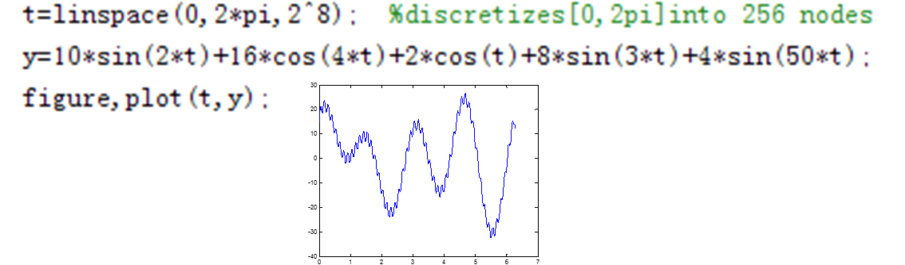
Discrete Fourier Transform
Task 1：
Given discrete signal y
Denoise the signal using the two methods
Gaussian filter
DFT
Compare the result

Slide 5
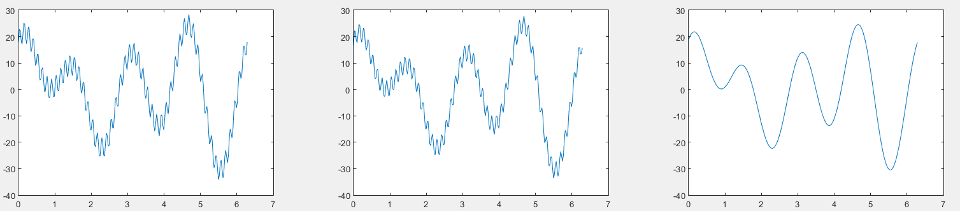
Sample Output

Slide 6
Hint
Signal noise is usually the high frequency components.
In order to denoise signal, you just need to remove high frequency components (set 0).

Slide 7
Hint
DFT Denoise
fft(X)
Discrete Fourier transform (DFT) of vector X
F(2+u:256-u)=0
Set the high-frequency component to zeros (you can set u=6 in the experiment)
ifft(X)
Inverse discrete Fourier transform of X
plot (X, Y)
Plot vector Y versus vector X

Slide 8
Hint
Gaussian Denoise
fspecial('gaussian',[1 L])
Get a Gaussian template (You can choose L=5 here)
conv(f,mask,'same')
Do convolution using mask. Please choose option ‘same’ to keep the length of signal unchanged

Slide 9
2D Discrete Fourier Transform
Task 2：
Plot the magnitude and phase response map of an image
Shift the image along vertical and plot the magnitude and phase response map of the shifted image
Scale the image and plot the magnitude and phase response map of the scaled image
Rotate the image and plot the magnitude and phase response map of the rotated image
Compare the results

Slide 10
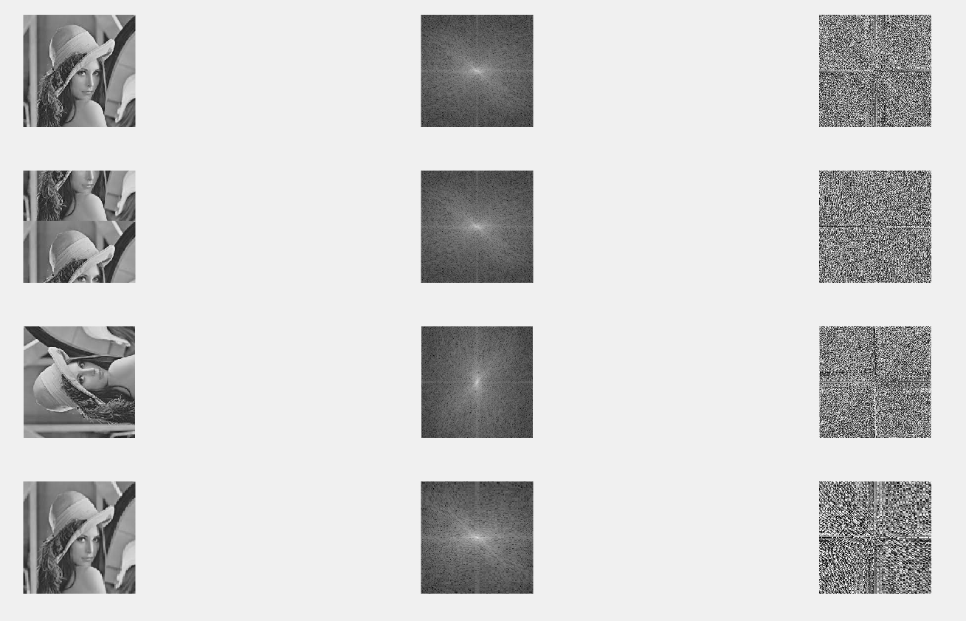
Sample Output

Slide 11
Hint
2D DFT
fft2(X)
return the two-dimensional Fourier transform of matrix
fftshift(X)
Shift zero-frequency component to center of spectrum. For matrices, fftshift(X) swaps the first and third quadrants and the second and fourth quadrants
abs(X)
Return the absolute value of the elements of X. When X is complex, abs(X) is the complex modulus (magnitude) of the elements of X ( You are required to output the log-magnitude in this task)
angle(H)
Return the phase angles, in radians, of a matrix with complex elements

Slide 12
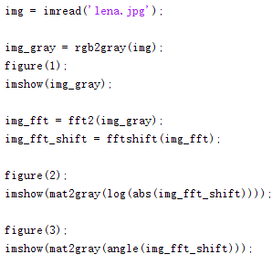
Example

Slide 13
Hint
Image Processing
circshift(X,K)
circularly shifts the elements in the array X by K positions along the first dimension (Choose k=100 here)
rot90(A)
Return the 90 degree counterclockwise rotation of matrix A
imresize(A, SCALE)
Return an image that is SCALE times the size of A, which is a grayscale, RGB, or binary image (Choose SCALE=0.5 here)

Slide 14
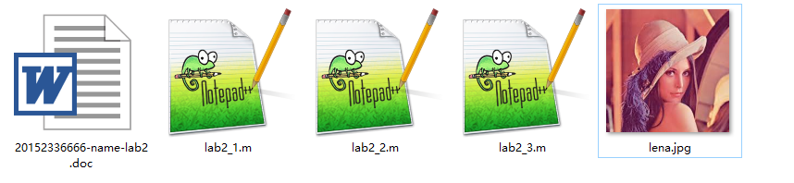
You are required to hand in your code and report
Name your file in this format
Package them and it name as ‘studentID-lab4.rar’
Graduate students send to mike_1997@126.com
Undergraduate and foreign students send to 545681197@qq.com.

