Slide 1
Vision Computing Experiment 2
Fourier Analysis
April 23, 2021

Slide 2
Introduction
Fourier series
Fourier transform

Slide 3
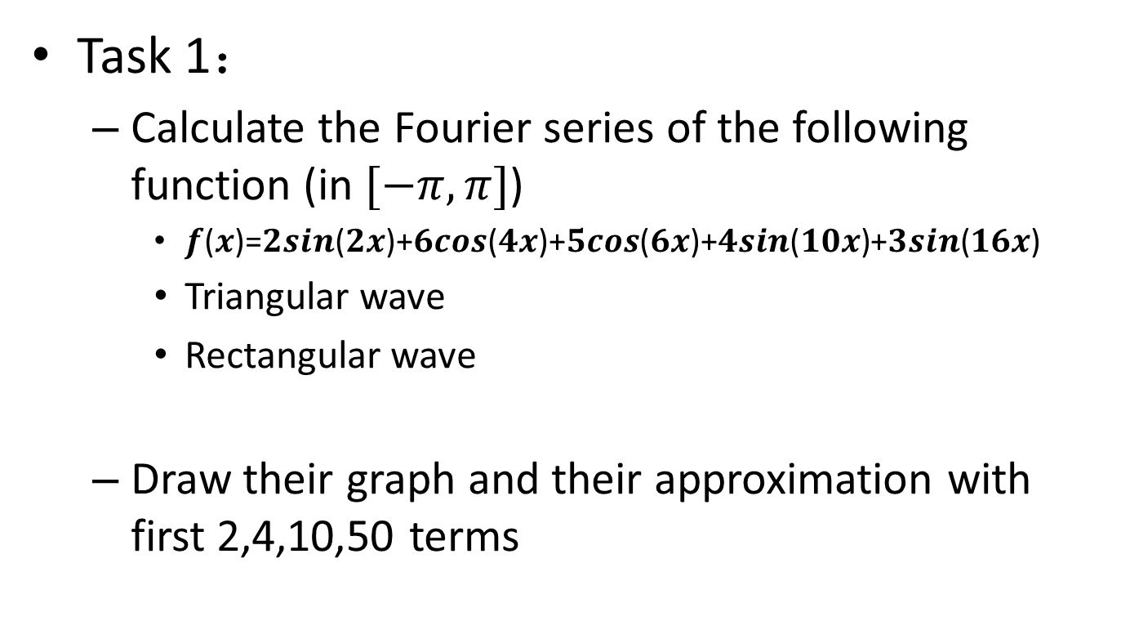
Fourier series
Task 1：
Calculate the Fourier series of the following function (in $[−π,π]$)
𝒇(𝒙)=𝟐𝒔𝒊𝒏(𝟐𝒙)+𝟔𝒄𝒐𝒔(𝟒𝒙)+𝟓𝒄𝒐𝒔(𝟔𝒙)+𝟒𝒔𝒊𝒏(𝟏𝟎𝒙)+𝟑𝒔𝒊𝒏(𝟏𝟔𝒙)
Triangular wave
Rectangular wave
Draw their graph and their approximation with first 2,4,10,50 terms

Slide 4
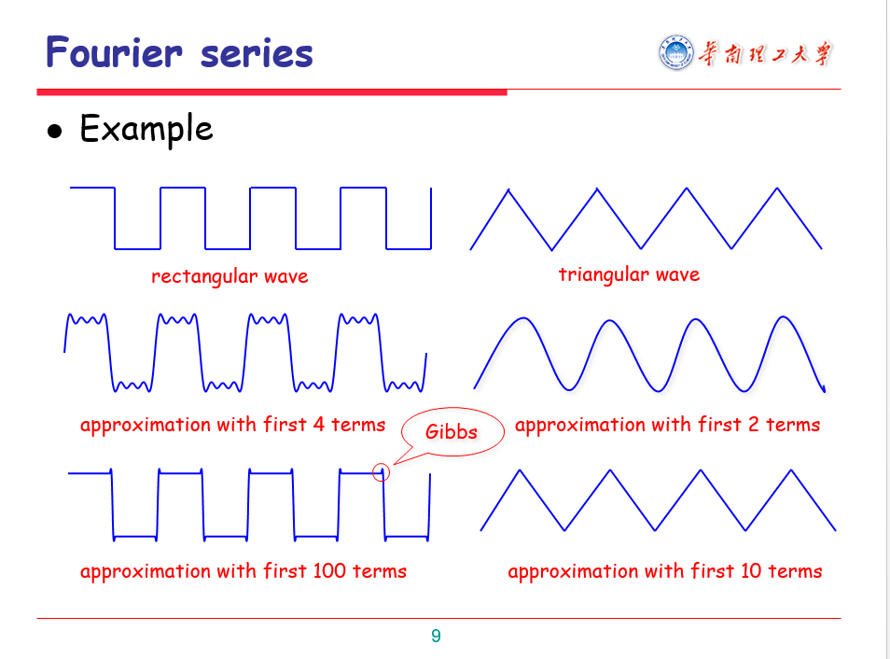
like what you have seen in the class

Slide 5
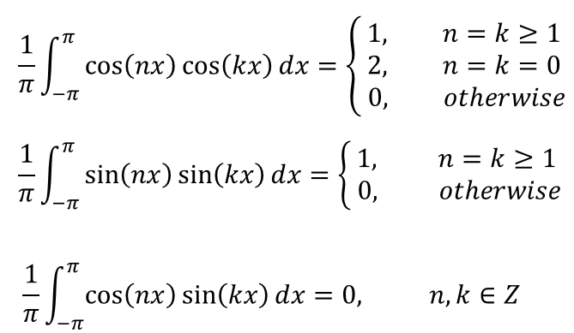
Fourier series
Theorem

Slide 6
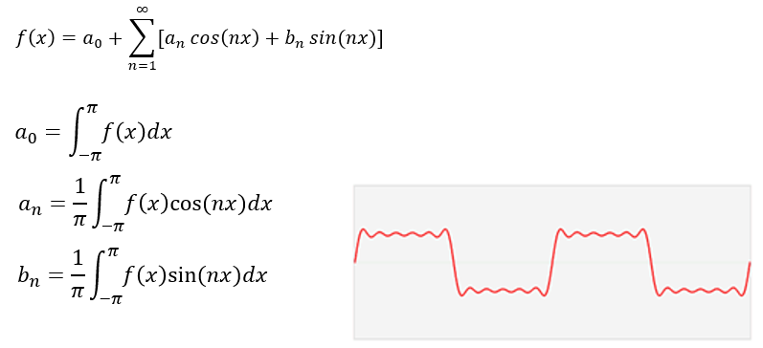
Fourier series
For a function

Slide 7
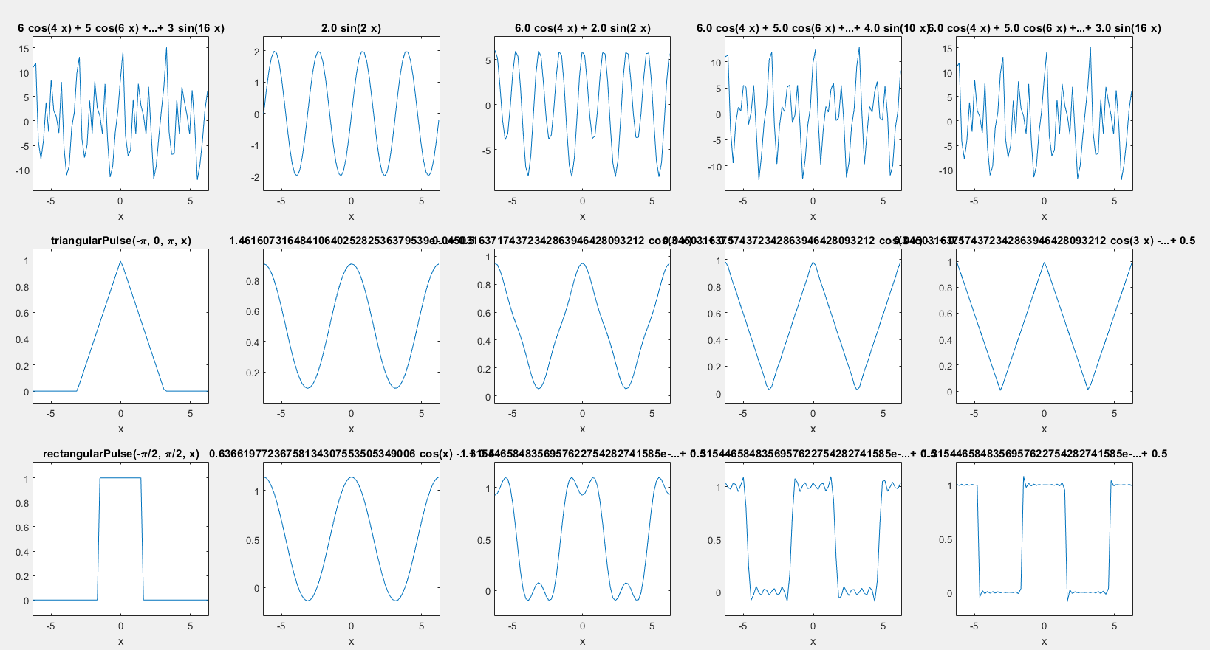
Sample Output

Slide 8
Hint
syms arg1 arg2 ...
Short-cut for constructing symbolic variables
ezplot(FUN,[A,B])
plots FUN(X) over A < X < B
int(S,v,a,b)
the definite integral of S with respect to v from a to b
R = vpa(S)
numerically evaluates S using variable precision floating point arithmetic

Slide 9
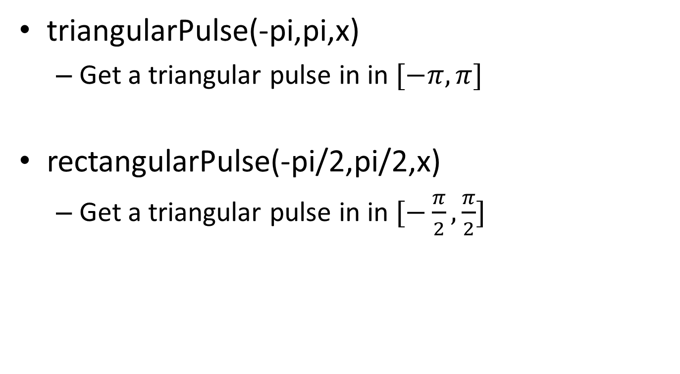
Hint
triangularPulse(-pi,pi,x)
Get a triangular pulse in in $[−π,π]$
rectangularPulse(-pi/2,pi/2,x)
Get a triangular pulse in in $[−\frac{π}{2},\frac{π}{2}]$

Slide 10
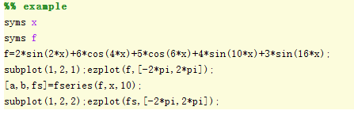
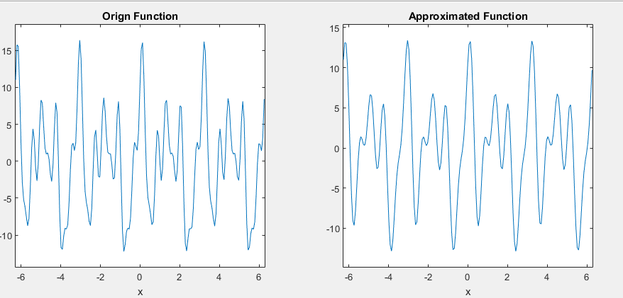
Hint
Example of using syms and ezplot

Slide 11
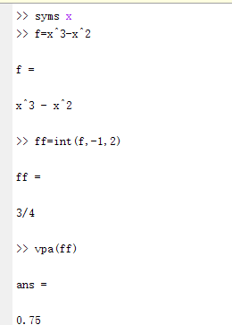
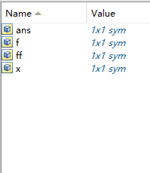
Hint
Example of using int and vpa

Slide 12
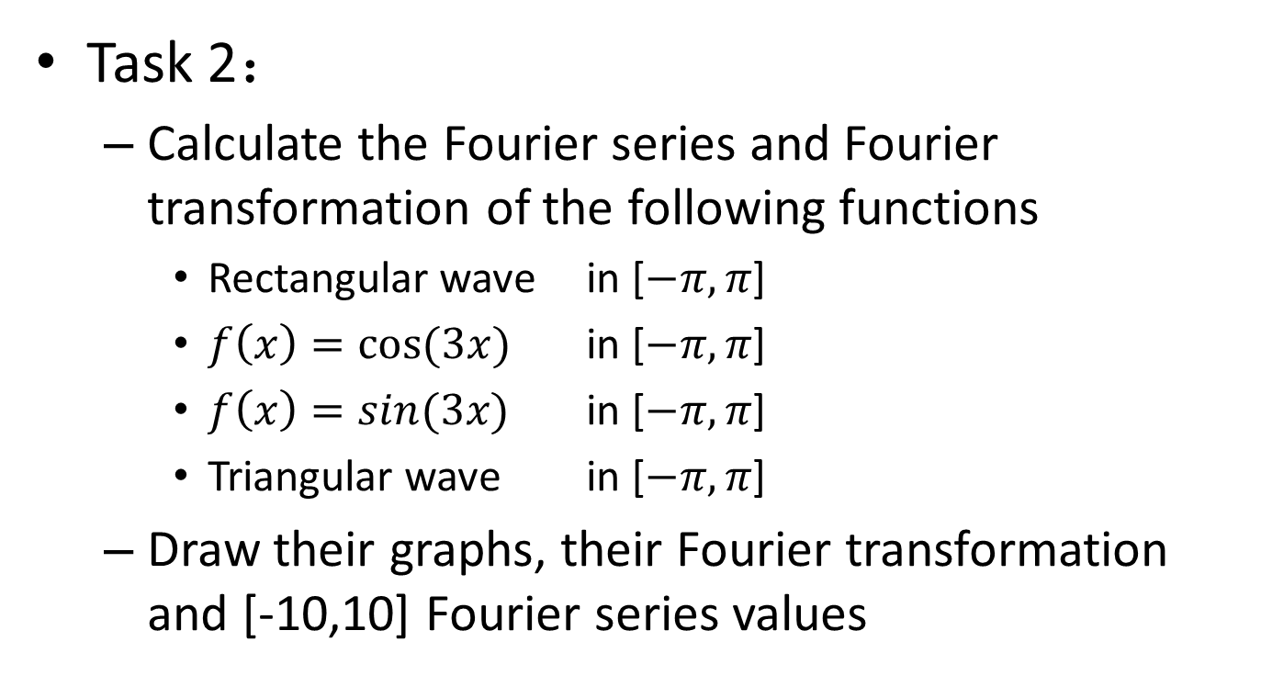
Fourier transform
Task 2：
Calculate the Fourier series and Fourier transformation of the following functions
Rectangular wave in [$−π,π$]
$f\left(x\right)=cos⁡(3x)$ in [$−π,π$]
$f\left(x\right)=sin(3x)$ in [$−π,π$]
Triangular wave in [$−π,π$]
Draw their graphs, their Fourier transformation and [-10,10] Fourier series values

Slide 13
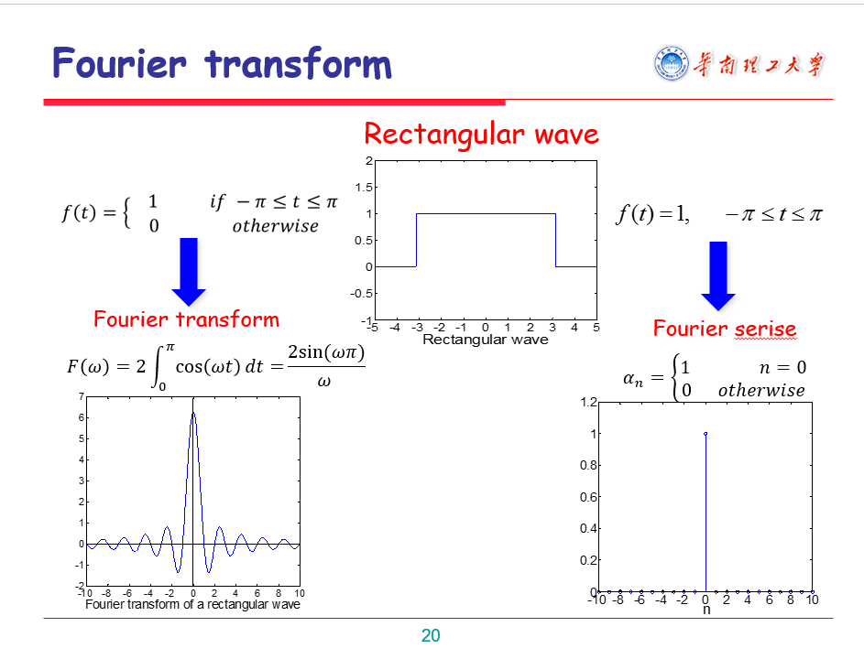
like what you have seen in the class

Slide 14
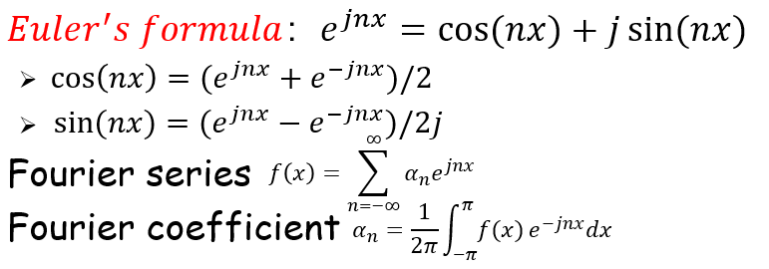
Fourier transform
Complex exponential representation
You are required to use complex
exponential representation in this task

Slide 15
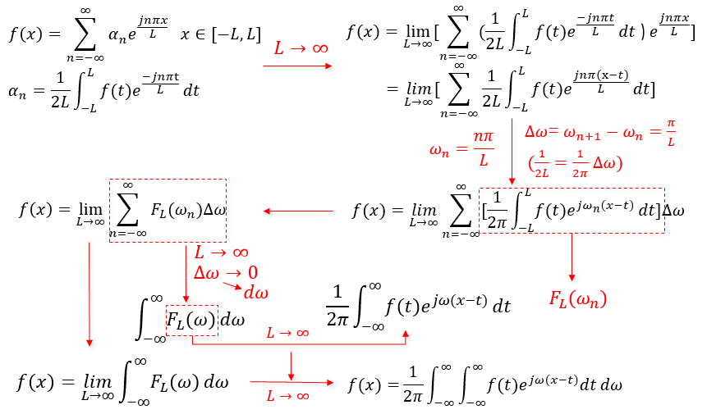
Fourier transform

Slide 16
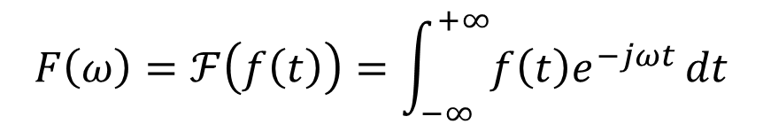

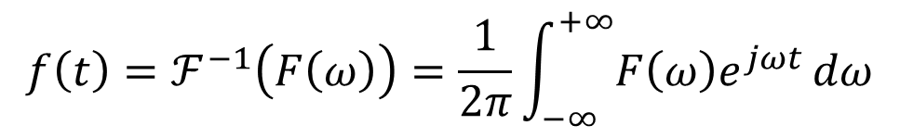
Fourier transform
We use $ℱ$to represent Fourier transform
$ℱ^{−1} \text{represents}$ inverse Fourier transform
You are required to calculate
Fourier transform in this task
$$F\left(ω\right)=ℱ\left(f\left(t\right)\right)=\int_{−∞}^{+∞}{f\left(t\right)e^{−jωt}}dt$$
$$f\left(t\right)=ℱ^{−1}\left(F\left(ω\right)\right)=\frac{1}{2π}\int_{−∞}^{+∞}{F\left(ω\right)e^{jωt}}dω$$

Slide 17
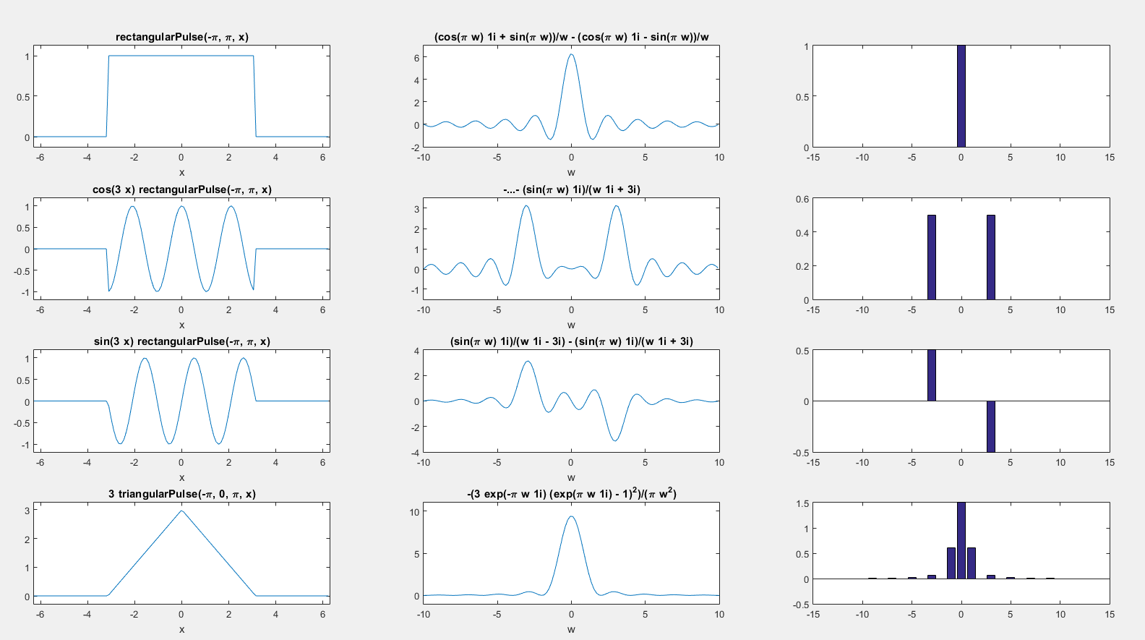
Sample Output

Slide 18
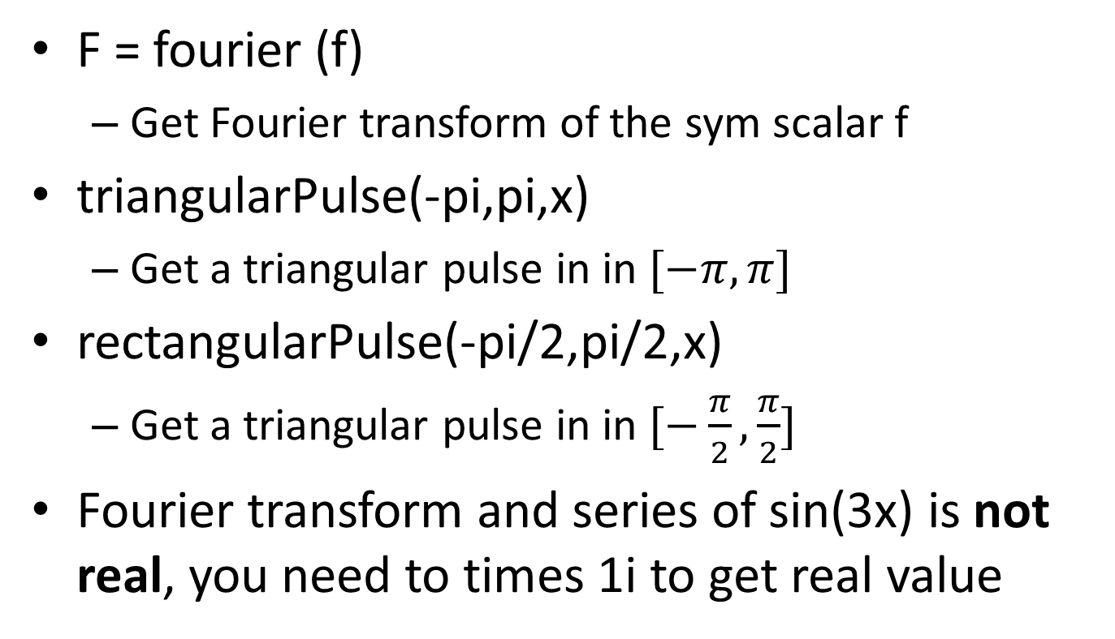
Hint
F = fourier (f)
Get Fourier transform of the sym scalar f
triangularPulse(-pi,pi,x)
Get a triangular pulse in in $[−π,π]$
rectangularPulse(-pi/2,pi/2,x)
Get a triangular pulse in in $[−\frac{π}{2},\frac{π}{2}]$
Fourier transform and series of sin(3x) is not real, you need to times 1i to get real value

Slide 19
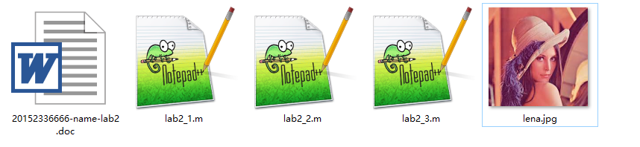
You are required to hand in your code and report
Name your file in this format
Package them and it name as ‘studentID-lab3.rar’
Monitor should collect them and package, name it as ‘class-lab3.rar’
Graduate students send to mike_1997@126.com
Undergraduate and foreign students send to 545681197@qq.com.

Slide 20
If you are not familiar with matlab, you can refer to ‘introduction to Matlab.pptx’
If you forget what you learnt in the class, you can refer to ‘5-Fourier Analysis.pptx’
All these file can be download
https://pan.baidu.com/s/1Ru5NnM9GRCUazlalmHsi9w
Password: m3ge [ Computer Vision/lab3.rar]

Slide 21
If it’s too difficult for you to implement function for Fourier series, you can refer to the following two pages

Slide 22
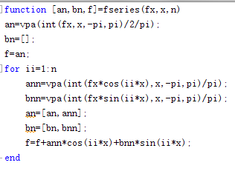
Function of Fourier series

Slide 23
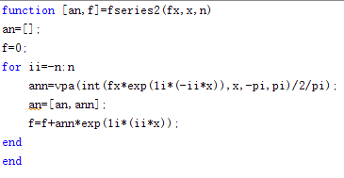
Function of Fourier series (complex exponential representation)

