Slide 1
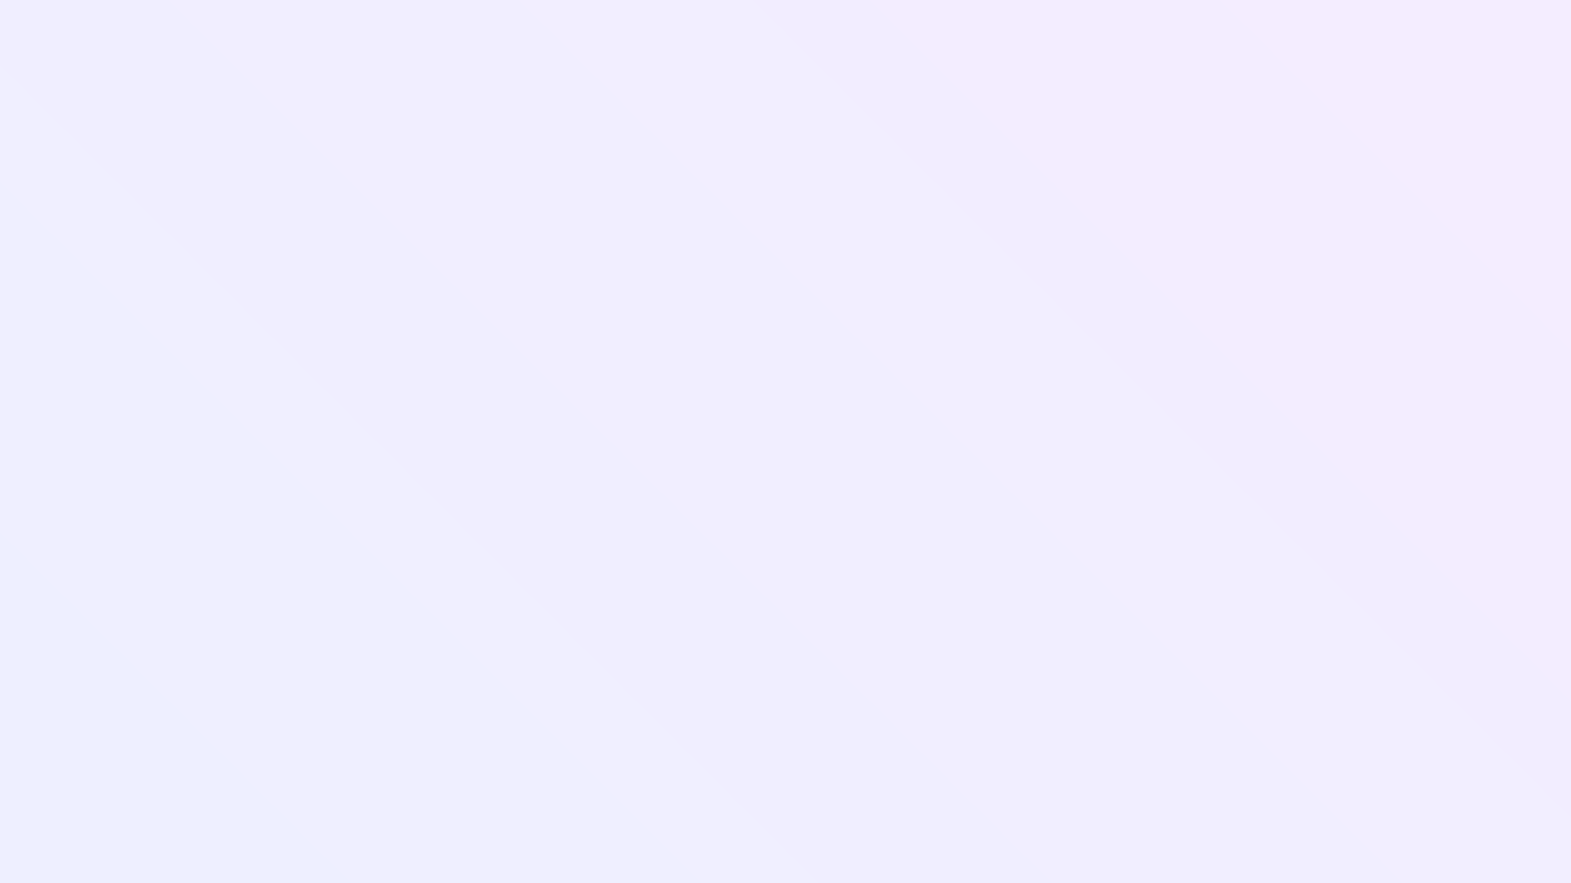
ONBOARDING · DAY 1 · LIVE FOLLOW-ALONG
IT and HRIS
Session.
Access, Bayzat, ticketing, Drata, AI tools and your assets — all verified live, in this room, before anything else starts.
IT ACCESS
BAYZAT PLATFORM
TICKETING
DRATA
AI TOOLS
IT ASSETS
Notes:
Welcome. This is the Day 1 IT and HRIS session — everything gets verified live in the room.

Slide 2
Today's topics.
01
02
03
IT Access
Bayzat Platform
Ticketing
What everyone gets by default, and what comes with your role.
Your profile, Knowledge Hub spaces, and Studio.
Raising IT and HR tickets, and the SLAs behind them.
04
05
06
Drata
AI Tools
IT Assets
Log in today. Our ISO 27001 evidence layer.
n8n, Claude, Anthropic and OpenAI models.
Your allocated device and its condition.
Notes:
Six sections today. Each one ends with something verified, not just explained.

Slide 3

01
IT Access
Default for everyone, then role-based on top.

Slide 4
DEFAULT ACCESS · EVERYONE HAS THIS
Four things
everyone gets
.
Google Workspace
Mail, Calendar and Drive all load under your Bayzat account
Bayzat Platform
You can open your own profile and see the payslips tab
No request needed. These are provisioned before your first day.
Slack
You're in the workspace and can see your team channels
VPN
Client installed, profile imported, connection tested once
Notes:
Open each of these now. Anything that doesn't load becomes an IT ticket before the session ends.

Slide 5
ROLE-BASED ACCESS · GRANTED ON APPROVAL
Everything else
follows your role
.
CRM
SHARED INBOX
CODE
AND MORE
Salesforce
Hiver
GitHub
Other team tools
Accounts, opportunities and activity history.
Shared mailboxes and email assignment inside Gmail.
Repositories, reviews and CI.
There are further team-related accesses beyond these — they'll be granted to you as well, based on what your role needs.
Notes:
These are scoped, not withheld. The approval is what makes the access defensible at audit.

Slide 6
02
Bayzat Platform
Your profile, Knowledge Hub, and Studio.

Slide 7
THREE PLACES YOU'LL LIVE
Open all three now.
01
02
03
Your Profile
Knowledge Hub
Bayzat Studio
Personal details, documents, emergency contacts, leave balance and payslips. You own the accuracy of this record — HR can't fix what they can't see is wrong.
Our internal documentation, organised into spaces. Policies, processes and how-tos live here rather than in someone's inbox.
Where workflows, approval flows and automations are built and configured. It's the engine that decides how a request moves, who approves it, and what happens next.
Check today: you can open the IT space and search returns results.
Notes:
Everyone opens all three now so we know they load.

Slide 8
KNOWLEDGE HUB · SPACES
How a space is put together
Spaces are how
KH stays usable
.
01
Pages
The content itself. A space is the container — pages are what people actually read, and they can be nested to keep structure.
02
Access
Every space and page carries permissions — who can view it, and who can edit it. Sensitive material stays scoped.
A space is a bounded area of documentation with its own owner and audience. One space per function keeps search honest and keeps policy separate from how-to.
03
Sharing
Use the share option to open a page to a person or team rather than copying it out. One source, one version.
04
The IT space
Your first stop — IT policies, acceptable use, and how-to guides for VPN, MFA and device setup.
Notes:
Cover pages, access permissions and the share option, then open the IT space together.

Slide 9
03
Ticketing
How you ask IT and HR for anything.

Slide 10
REQUESTS → MY TICKETS → CREATE TICKET
Two queues, one form.
My Tickets / Create ticket
IT TICKETS
HR TICKETS
Create ticket
Raise with IT when it's a system, device or access problem
Raise with HR when it's about you as an employee
Ticket details
Enter the ticket details below
Software or tool access requests
Hardware faults and replacements
VPN, MFA and account lockouts
New joiner and leaver access changes
Anything security-related, however small
Letters, certificates and document requests
Payroll and salary queries
Leave and attendance corrections
Benefits and insurance questions
Personal detail changes needing approval
Employees
Your name — pre-filled
Category > Ticket type
Select an item you need assistance with ›
Cancel
Submit
Pick the category first, then the ticket type — the type decides which fields you get and who approves it. Track everything afterwards under My Tickets.
IT TICKETS
HR TICKETS
4–6 hrs
4 hrs
Service level
Service level
Notes:
Walk through Create ticket live. Category first, then ticket type — that decides the fields and the approver.

Slide 11
04
Drata
Log in now. Everyone, before we move on.

Slide 12
DRATA · COMPLIANCE, CONTINUOUSLY
Everyone logs in
right now
.
Why it matters to you specifically
ISO 27001 runs on evidence
The standard doesn't reward good intentions. An incomplete record or a non-compliant laptop is a finding against the company — traced to an individual.
Drata continuously checks the controls behind our ISO 27001 certification. It watches devices and accounts daily so we're never reconstructing a year of evidence the week before an audit.
Invite accepted
Welcome email found, account active
It watches two things about you
MFA, and device compliance. That's the entire personal footprint — which is why keeping both green takes almost no effort once it's set up.
MFA enrolled
Second factor registered
Dashboard loads
You can see your own task list
Notes:
Everyone logs into Drata now. Confirm invite, MFA and dashboard before moving on.

Slide 13
05
AI Tools
The automation stack we actually run on.

Slide 14



WHAT WE USE, AND WHAT FOR
One orchestrator,
two model families
.
ORCHESTRATION
REASONING
GENERAL
n8n
Claude
ChatGPT
Where our workflows live. Moves data between systems, calls a model mid-flow, writes the result back. Most of what looks like "AI" here is really an n8n workflow with a model step inside it.
Anthropic's models. Long documents, call transcripts, drafting, code and structured deliverables. The default when there's a lot of context attached to the task.
OpenAI's models. General assistance and a useful second opinion. Same account rules and the same guardrails as everything else on this slide.
Always under your company workspace account — never a personal or free-tier login.
Notes:
n8n is the orchestrator; Claude and ChatGPT are the model layers. Always the company workspace account.

Slide 15
AI TOOLS
Using AI responsibly.
The short version: the AI does the first draft, you own the result.
DO
DON'T
Use company accounts, never personal ones, for work
Paste customer data, salaries or medical and insurance details into a personal AI account
Treat every output as a draft — verify facts, figures and names
Let AI-written text reach a customer without a human reading it
Keep a human approver on anything a customer will see
Build automations on personal accounts that only you can access
Redact or anonymise personal data wherever you can
Sign up for a new AI tool without IT reviewing the data terms
Document automations in n8n so a colleague can maintain them
Assume a citation, statistic or quote is real — check it
Notes:
The AI does the first draft; the human owns the result. Company accounts only.

Slide 16
06
IT Assets
What you've been given, and what condition it's in.

Slide 17
YOUR ALLOCATED ASSET
Every device is allocated
to a person
.
RECEIVED IT
NOT RECEIVED YET
Run the health check with us
We'll go through delivery now
Serial number matches your handover record
Disk encryption on
Screen lock at 5 minutes or less
OS and browser fully updated
Endpoint agent running
Drata reporting the device as compliant
If your device hasn't reached you, tell us in this session. We'll check where the request stands and give you a delivery timeline, plus interim access so you're not blocked.
Anything failing here gets fixed now, or raised as an IT ticket before you leave.
Notes:
Check who has their device and who doesn't. Run the health check live; discuss delivery for anyone still waiting.

Slide 18
Thank you.
Any queries?
Notes:
Open the floor.

