Slide 1
NAME:SARAVANAKUMAR V NM-ID:au71772118L08 BRANCH:INFORMATION TECHNOLOGY COLLEGE NAME:GOVERNMENT COLLEGE OF TECHNOLOGY
TNSDC_GENERATIVE_AI Final Project
3/21/2024 Annual Review

Slide 2
MNIST Alphabet Generation with Generative Adversarial Network (GAN)
3/21/2024 Annual Review

Slide 3


AGENDA
1. Dataset
MNIST dataset
2. Setup
Import & preprocess data
3. Model
Generator & Discriminator
4. Training
Define & train GAN
5. Results
Save & visualize
3/21/2024 Annual Review

Slide 4

PROBLEM STATEMENT
To develop a Generative Adversarial Network (GAN) to generate realistic handwritten Alphabets resembling those from the MNIST dataset.
3/21/2024 Annual Review

Slide 5

PROJECT OVERVIEW
This project aims to create a Generative Adversarial Network (GAN) to generate realistic handwritten Alphabets similar to those in the MNIST dataset. The MNIST dataset consists of 28x28 grayscale images of Alphabets from A to Z, commonly used for machine learning tasks. The GAN architecture comprises a generator and a discriminator, trained alternately to generate convincing Alphabets and distinguish between real and fake ones. The generator creates images from random noise, while the discriminator evaluates their authenticity. After training, the GAN should produce Alphabets images resembling those in the MNIST dataset. Results will be evaluated through visual inspection of generated Alphabet.
3/21/2024 Annual Review

Slide 6

WHO ARE THE END USERS?
Students Learning Handwriting Recognition:
Students studying handwriting recognition algorithms benefit from diverse datasets generated by the GAN.
These datasets can improve the accuracy and robustness of handwriting recognition systems.
Researchers in AI and Computer Vision:
Researchers use generated datasets to train and evaluate machine learning models for various tasks, such as character recognition and synthesis.
Educational Software Developers:
Developers of educational software can integrate the GAN-generated characters into their applications to provide interactive and engaging learning experiences for students.
3/21/2024 Annual Review

Slide 7
YOUR SOLUTION AND ITS VALUE PROPOSITION
Solution:
Our solution utilizes a GAN architecture to generate realistic handwritten characters.
The generator network learns to produce diverse and high-quality characters based on a given input noise vector.
Value Proposition:
It saves time and effort by providing a ready-to-use GAN implementation, facilitating quick experimentation and learning.
It enables practical applications such as generating synthetic data for training models, fostering innovation and collaboration in the AI community.
3/21/2024 Annual Review

Slide 8

THE WOW IN YOUR SOLUTION
Wow Factor:
This project provides an out-of-the-box solution for generating lifelike handwritten Alphabets, offering an accessible and efficient way to delve into the fascinating world of Generative Adversarial Networks (GANs) without the hassle of complex code or dataset handling.
3/21/2024 Annual Review
8

Slide 9
MODELLING
Teams cam add wireframes
Generator Model:
Comprises multiple dense layers with LeakyReLU activation and BatchNormalization.
Transforms input noise into realistic-looking handwritten characters.
Discriminator Model:
Differentiates between real and generated characters.
Consists of dense layers with LeakyReLU activation and a sigmoid output for binary classification.
3/21/2024 Annual Review
9

Slide 10
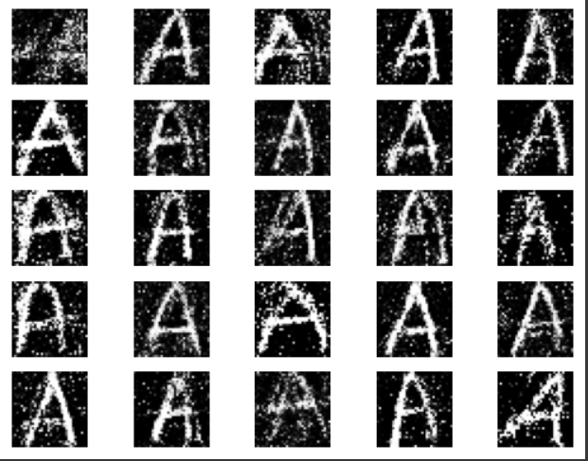
RESULTS
10

