Slide 1
Networking in Python

Slide 2

Network
A network is a collection of interconnected devices, such as computers, servers, routers, switches, and more, that can communicate and share resources.

Slide 3
Network
Protocol: A protocol is a set of rules and conventions that define how data is transmitted and received over a network. These rules ensure that devices on a network can communicate effectively and understand each other's messages. Common network protocols include TCP/IP (Transmission Control Protocol/Internet Protocol), HTTP (Hypertext Transfer Protocol), and others.
IP Address: An IP address is a numerical label assigned to each device on a network that uses the Internet Protocol for communication. IP addresses are crucial for identifying and locating devices in a network.
Address Families (AF_XXX):
AF_INET (IPv4):
AF_INET is used for Internet Protocol version 4 (IPv4) addresses.
AF_INET6 (IPv6):
AF_INET6 is used for Internet Protocol version 6 (IPv6) addresses.
AF_UNIX (Unix Domain Sockets):
AF_UNIX is used for communication between processes on the same machine using Unix domain sockets.

Slide 4
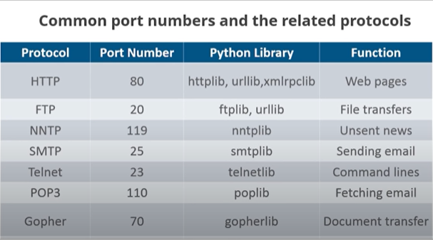
Common Port Numbers

Slide 5
Socket
Socket Types (SOCK_XXX):
SOCK_STREAM (TCP):
socket.SOCK_STREAM provides a reliable, stream-oriented connection, commonly used with TCP.
SOCK_DGRAM (UDP):
socket.SOCK_DGRAM provides a connectionless, datagram-oriented socket, commonly used with UDP.
SOCK_RAW (Raw Sockets):
socket.SOCK_RAW allows the application to directly interact with lower-level protocols, such as ICMP. Requires special privileges.
SOCK_SEQPACKET (Sequential Packet Socket):
socket.SOCK_SEQPACKET provides a sequenced, reliable, two-way connection.
SOCK_RDM (Reliably Delivered Message):
socket.SOCK_RDM provides a reliable, connection-oriented service, but the ordering of delivery is not guaranteed.

Slide 6
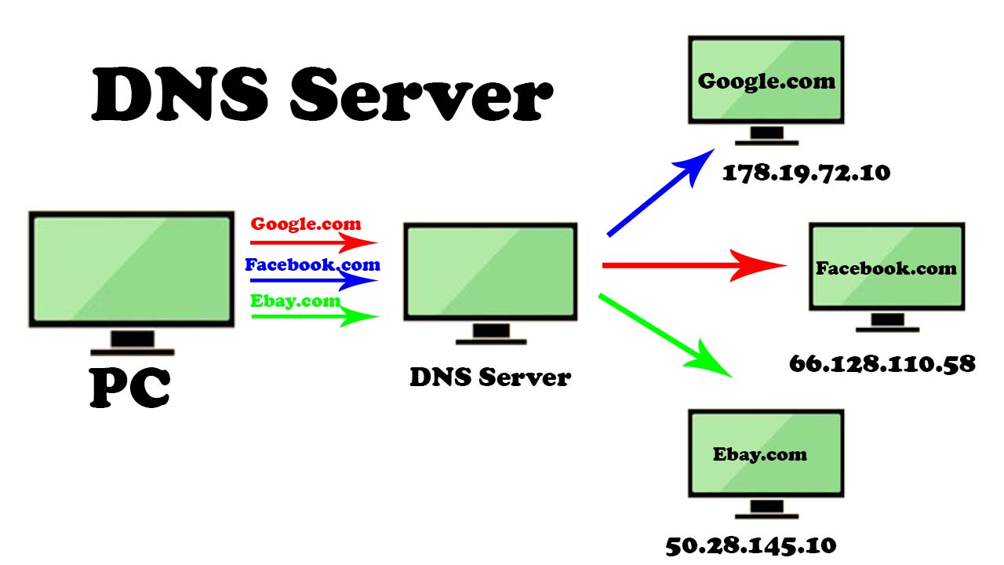
Network
Firewall: A firewall is a security device or software that monitors and controls incoming and outgoing network traffic based on predetermined security rules. It helps protect a network from unauthorized access and cyber threats.
DNS (Domain Name System): DNS translates human-readable domain names into IP addresses. It allows users to access websites using easy-to-remember names instead of numerical IP addresses.
LAN (Local Area Network) and WAN (Wide Area Network): LANs are networks that cover a small geographic area, like a single building or campus, while WANs cover larger areas, often spanning cities or countries.

Slide 7
Thanks

