Slide 1


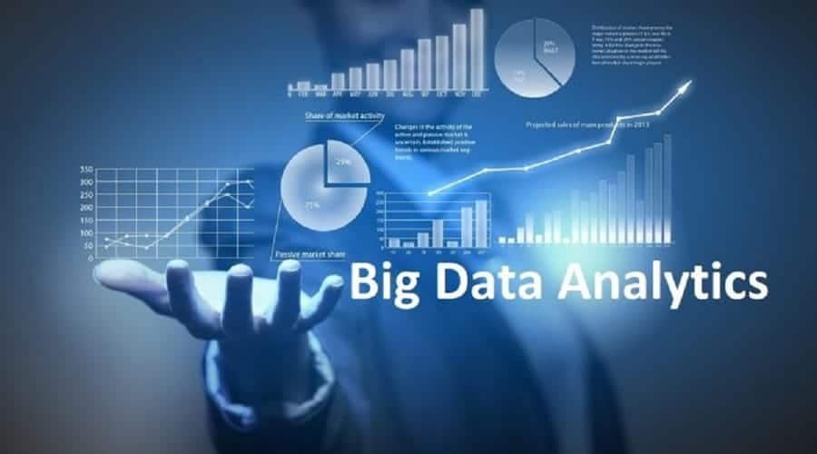
BIG DATA ANALYSIS WITH IBM CLOUD DATABASES

Slide 2
TEAM MEMBERS:
S.SARAVANAN
M.SRINIVASAN
E.SAKTHIKUMAR
K.LOGESHWARAN
S.SIMON DEEPAK

Slide 3
BIG DATA ANALYSIS WITH IBM CLOUD DATABASES :
Big data analytics is the process of collecting, examining, and analyzing large amounts of data to discover market trends, insights, and patterns that can help companies make better business decisions
With big data analytics, you can ultimately fuel better and faster decision-making, modelling and predicting of future outcomes and enhanced business intelligence.
Hydra is a fully-managed open source data warehouse built on Postgres. It's easy to use and designed to scale analytics (OLAP) & hybrid transactional workloads. Our team is excited to announce that Hydra is the fastest Postgres database for analytics.

Slide 4
Considerations for cloud databases :
Control options
Users can opt for a virtual machine image managed like a traditional database or a provider’s database as a service (DBaaS).
Database technology
SQL databases are difficult to scale but very common. NoSQL databases scale more easily but do not work with some applications.
Security
Most cloud database providers encrypt data and provide other security measures; organizations should research their options.
Maintenance
When using a virtual machine image, one should ensure that IT staffers can maintain the underlying infrastructure.

Slide 5
Benefits of Performing big data analytics in cloud :
Rapidity. The conventional approach to data management and storage is quickly becoming obsolete.
Elasticity.
Data processing.
Simplification.
Cost reduction through Big Data in the cloud.
Scalability.
Accessibility.
Improving analysis.
Enhance speed, reduce costs and realize faster time to value. Discover insights in real time from a range of streaming data including unstructured text, video and more.

Slide 6
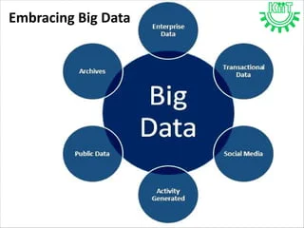
Implementation Framework :
The Big Data Framework provides a structure for organisations that want to start with Big Data or aim to develop their Big Data capabilities further. The Big Data Framework includes all organisational aspects that should be taken into account in a Big Data organization. The Big Data Framework is vendor independent.
The aim is to integrate data quality rules and standards into everyday business processes. Organizations should train teams on the new data quality practices. This may require modifications to existing workflows to include data quality checks.

Slide 7
Building a big data analysis solution with a cloud database involves several steps and technologies. Here's a high-level overview of how you can approach it, and I'll provide some sample code for each step:
Choose a Cloud Provider: Select a cloud provider (e.g., AWS, Azure, GCP) and set up your cloud environment.
Set up a Cloud Database: Create a cloud-based database service, such as Amazon Redshift, Azure SQL Data Warehouse, or Google BigQuery. Here's a simplified example of how you might create a table in Amazon Redshift using Python and the psycopg2 library
import psycopg2
# Connection parameters
db_params = {
"dbname": "your_database_name",
"user": "your_username",
"password": "your_password",
"host": "your_database_host",
"port": "5439", # Redshift port
}
# Connect to the database
conn = psycopg2.connect(**db_params)
# Create a table
create_table_query = """
CREATE TABLE IF NOT EXISTS your_table_name (
column1 data_type,
column2 data_type,
...
);
"""
with conn.cursor() as cur:
cur.execute(create_table_query)
conn.commit()

Slide 8
Data Ingestion
You need to ingest big data into your cloud database. You can use tools like Apache Kafka, AWS Kinesis, or cloud-based data transfer services. Here's a simplified example of ingesting data into Amazon Redshift using the ‘copy’ command.
# Example for ingesting data from an S3 bucket copy_query = f"""
COPY your_table_name
FROM 's3://your-s3-bucket/your-data.csv' ACCESS_KEY_ID 'your-access-key' SECRET_ACCESS_KEY 'your-secret-key’
CSV;
"""
with conn.cursor() as cur:
cur.execute(copy_query)
conn.commit()

Slide 9
Data Processing and Analysis:
For big data analysis, you can use frameworks like Apache Spark or cloud-based data analytics services. Here's a simple Spark example in Python to read data from your cloud database.
from pyspark.sql import SparkSession
spark = SparkSession.builder.appName("BigDataAnalysis").getOrCreate()
# Read data from the database
data = spark.read.format("jdbc").option("url", "your_jdbc_url").option("dbtable", "your_table_name").load()
# Perform data analysis using Spark transformations and actions
# Example: data.groupBy("column1").agg({"column2": "avg"}).show()
spark.stop()

Slide 10
CONCLUSION :
Visualization and Reporting: To visualize and report your findings, you can use tools like Tableau, Power BI, or Python libraries like Matplotlib and Seaborn.
Scaling and Monitoring: Implement auto-scaling and monitoring solutions to ensure your big data analysis system can handle increased workloads.
A field to analyze and extract information about the big data involved in the business or the data world so that proper conclusions can be made is called big data Analytics. These conclusions can be used to predict the future or to forecast the business. Also, this helps in creating a trend about the past.
And also it helps a business optimize its performance, perform more efficiently, maximize profit, or make more strategically-guided decisions.

