Slide 1
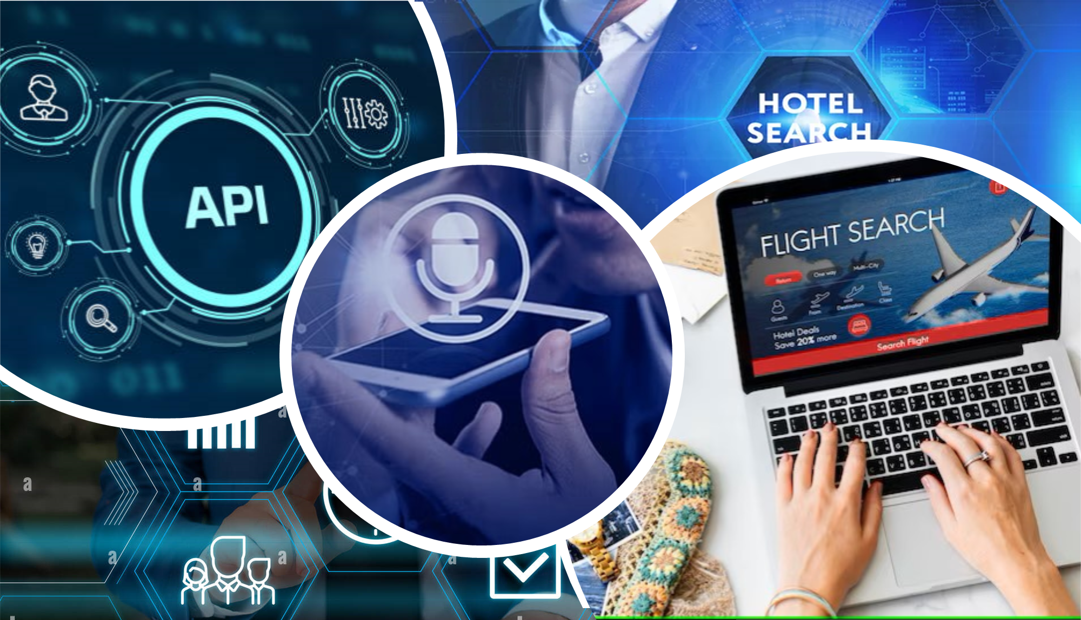

Slide 2
Breakthrough..!
Travel Planning and Booking
It integrates with external APIs (e.g., Amadeus API) to search, sort, and combine flight and hotel options into travel packages based on user preferences and budget.
It automates the booking process for flights and hotels, reducing manual effort.
Market Negotiation Assistance
It offers a negotiation interface to assist users in price negotiations, simulating intelligent decision-making.
Translation Support
The system integrates a translator API to provide multilingual support, enabling users to interact in their preferred language and enhancing accessibility.
Additionally, the system supports voice-based interaction and provides a user-friendly GUI for seamless interaction, making it an efficient and accessible assistant.

Slide 3
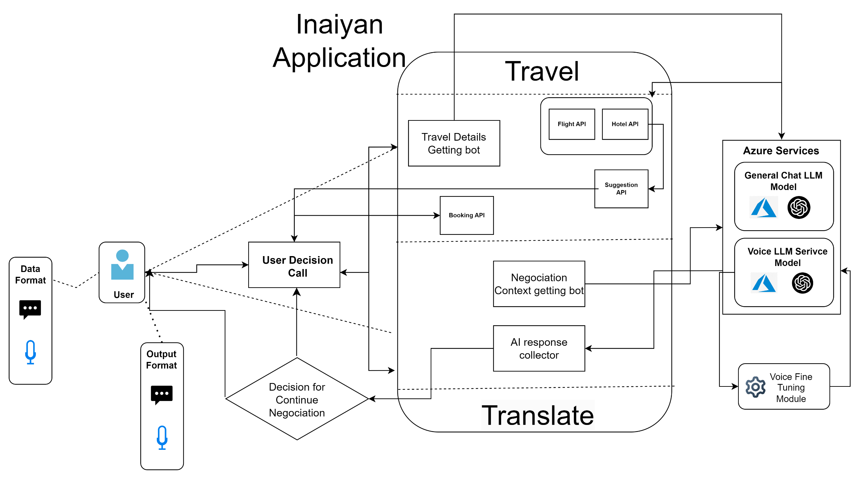

Slide 4

How it Operates as an AI Agent???
Data Sorting and Filtering: Algorithms sort flights and hotels by price and match them to user budgets.
1
Simulated Intelligence: The system automates complex tasks like travel planning, booking, and negotiation, which would otherwise require manual effort.
2
API Integration: The use of external APIs (e.g., Amadeus, Azure Cognitive Services) enables intelligent behavior by leveraging external data and services.
3
The code integrates perception, decision-making, and action components, along with automation and intelligent behavior, to act as an AI agent. It simplifies travel planning and negotiation tasks, demonstrating its role as an intelligent assistant.
4

Slide 5
Our Experience..!
Through this project we developed collective knowledge, skills, and tools utilized while developing this, AI Agent.
Integration: Combining travel booking and negotiation functionalities into a unified application.
UI Design: Creating a user-friendly interface using tkinter for seamless navigation between modes.
API Handling: Managing flight and hotel data using the Amadeus API, sorting, and formatting packages effectively.
Error Handling: Implementing robust mechanisms to handle exceptions during booking processes.
Budget Optimization: Designing algorithms to match flights and hotels within a given budget.
Scalability: Structuring the code to allow future enhancements or additional features.
Tools Used:
Python: For backend logic and API integration.
tkinter: For building the graphical user interface.
Amadeus API: For fetching flight and hotel offers.
PyCharm IDE: For efficient code development and debugging.

Slide 6
Futuristic Vision
AI-Driven Personalization: Advanced AI algorithms to create highly customized travel plans and negotiation strategies based on user preferences, historical data, and real-time trends.
Dynamic Negotiation: Autonomous negotiation capabilities to secure the best deals for flights, hotels, and other services.
Real-Time Assistance: Providing live support during travel, such as rebooking, finding alternatives, or offering local recommendations.
Multi-Platform Accessibility: Seamless integration across web, mobile, and desktop platforms for enhanced usability.
Voice and Chat Interfaces: Natural language processing for intuitive voice commands and chat-based interactions.
Sustainability Features: Promoting eco-friendly travel options and providing insights into carbon footprints.
Global Adaptability: Supporting multiple languages, currencies, and cultural preferences for worldwide usability.
Integration with Emerging Technologies:
Blockchain: Secure and transparent transactions for bookings.
Predictive Analytics: Leveraging AI to predict price trends and recommend the best times to book.
End-to-End Travel Solutions: Expanding to include transportation, dining, and local experiences for a comprehensive travel assistant.

