Slide 1
Digital Signage System

Slide 2

System Configuration
HDMI (or) VGA CABLE
DS Device

Slide 3
Purpose
GAIN THE KNOWLEDGE DAY BY DAY
NOTIFICATION
ANNOUNCEMENT
APPRECIATION
DISPLAYING CELEBRATION
THOUGHTS SHARING

Slide 4


Notice

Slide 5


Announcement

Slide 6


Appreciation

Slide 7
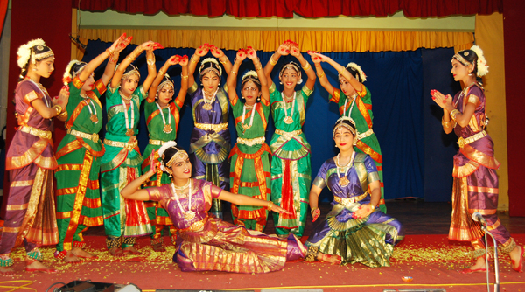

Celebration

Slide 8
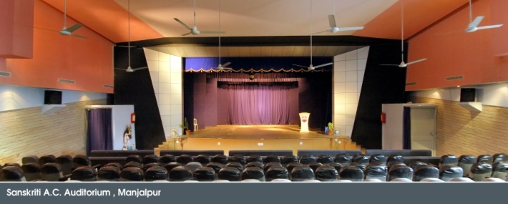
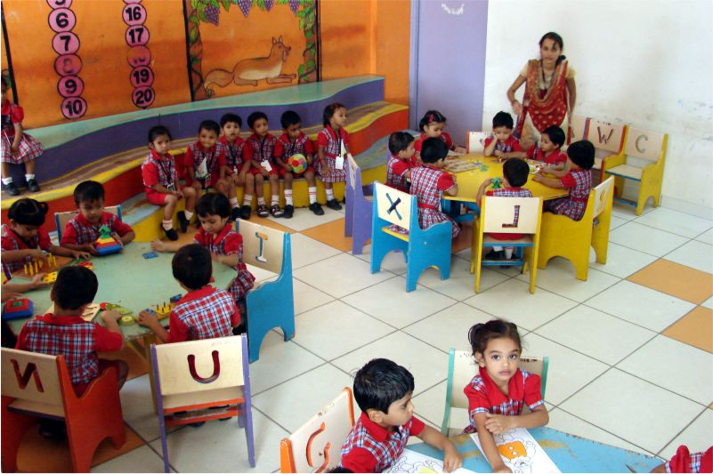

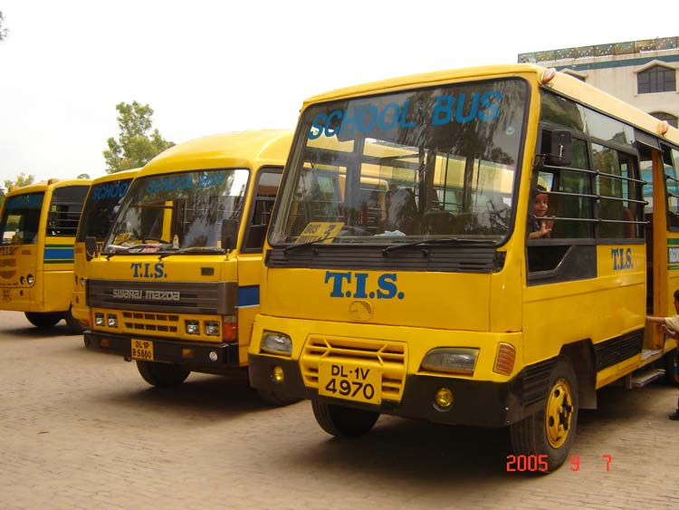
School Amenities

