Slide 1
KEYLOGGER
CYBER SECURITY PROJECT
Presented By:
SARAVANA KUMAR V - Jeppiaar Institute of Technology – B.E/ CSE

Slide 2
OUTLINE
Problem Statement
Proposed System/Solution
System Development Approach
Algorithm & Deployment
Result
Conclusion
Future Scope
References

Slide 3
PROBLEM STATEMENT
In today's digital landscape, protecting sensitive data from numerous threats is paramount. Keyloggers, among these threats, significantly jeopardize data integrity and confidentiality. Consequently, it's imperative to thoroughly examine keylogger implementation and the security challenges it presents to effectively tackle and mitigate these risks.

Slide 4
PROPOSED SOLUTION
Our proposed system involves leveraging Python's Tkinter library to design the graphical user interface (GUI) and the pynput library for capturing keyboard inputs. This keylogger will record keystrokes and store them in both text and JSON formats to facilitate thorough analysis.

Slide 5
SYSTEM APPROACH
Technology Used:
Python: For programming the keylogger functionality.
Tkinter: For building the graphical user interface (GUI).
pynput: For capturing keyboard inputs.
JSON: For storing keystroke data in a structured format.

Slide 6
ALGORITHM & DEPLOYMENT
Initialization: Initialize necessary variables and flags.
Event Handling:
on_press(key): Records pressed and held keys.
on_release(key): Records released keys and manages flag state.
Logging:
generate_text_log(key): Saves keystrokes in a text file.
generate_json_file(keys_used): Saves keystrokes in a JSON file.
Keylogger Control:
start_keylogger(): Initiates keylogging process.
stop_keylogger(): Stops keylogging.

Slide 7
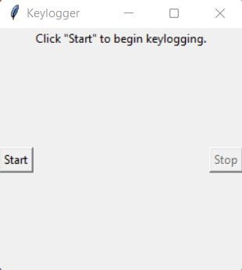
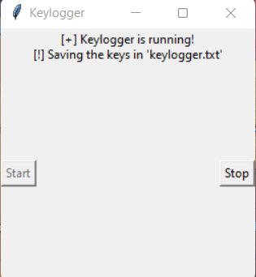
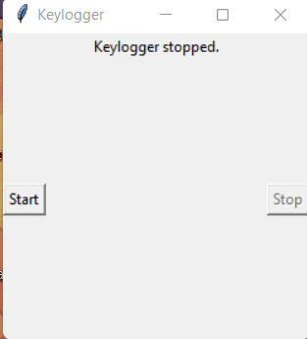
RESULT
The graphical user interface (GUI) features buttons labeled "Start" and "Stop" for managing the keylogging process. When initiated, the keylogger begins capturing keystrokes and storing them in predefined files. Ceasing the keylogger operation terminates the logging process..

Slide 8
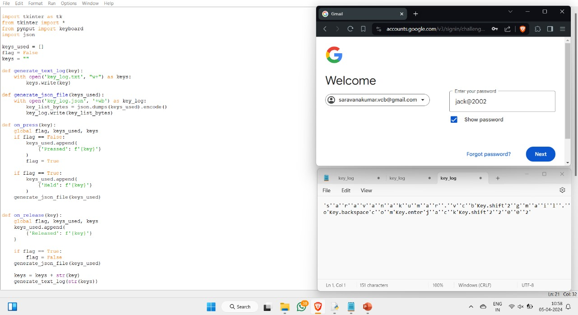
OUTPUT

Slide 9
CONCLUSION
Developing a keylogger underscores the simplicity of capturing keyboard inputs and emphasizes the critical need for strong security measures to safeguard sensitive data from unauthorized access. Acquiring knowledge about keylogging methods is essential for strengthening system defenses against potential security risks.

Slide 10
FUTURE SCOPE
Enhancing Security Measures:
Implement encryption techniques to secure logged data.
Explore multi-layer encryption strategies to enhance data security.
User Authentication:
Integrate user authentication mechanisms to prevent unauthorized access.
Integrate biometric authentication methods, such as fingerprint or facial recognition, for heightened security.
Advanced Logging:
Implement advanced logging features, such as timestamping and window tracking.
Implement anomaly detection algorithms to identify unusual behavior and trigger alerts for potential security breaches.

Slide 11
REFERENCES
Exploring Keylogger and Countermeasure Research:
1. "A Survey on Keylogger and its Detection Techniques" by Vishal Bharti, Aditya Kumar Gupta, and Shailendra Mishra
2. "Analysis of Keylogger Attacks and Countermeasures" by Hongliang Liu, Ruiying Du, and Quansheng Zhuang
3. "Detection of Keyloggers: A Review" by Shukor Abd Razak, Ku Ruhana Ku-Mahamud, and Ramlan Mahmod
4. "A Comprehensive Study on Keylogger Attack and Defense" by Shuo Chen, Rui Wang, XiaoFeng Wang, and Kehuan Zhang

Slide 12
THANK YOU

