Slide 1

Fine Tuning bert with pytorch and transformers
By: Bhavesh Laddagiri

Slide 2
Contents
What is BERT?
How BERT was trained?
Special Tokens of BERT
Transformers by Hugging Face
Preprocessing text for BERT
BertModel Class
Our Approach to Fine-tuning
Dataset Class and Data loaders
Building the Model
Training and Validation

Slide 3
What is bert? And its architecture
The Google AI Research team defines BERT as “Bidirectional Encoder Representations from Transformers. It is designed to pre-train deep bidirectional representations from the unlabeled text by jointly conditioning on both the left and right contexts. As a result, the pre-trained BERT model can be fine-tuned with just one additional output layer to create state-of-the-art models for a wide range of NLP tasks.”
BERT’s model architecture is a multi-layer bidirectional Transformer encoder
BERT Base has:
12 Transformers
Hidden Dimension Size of 768
12 Self-Attention Heads
BERT Large has:
24 Transformers
Hidden Dimension Size of 1024
16 Self-Attention Heads

Slide 4
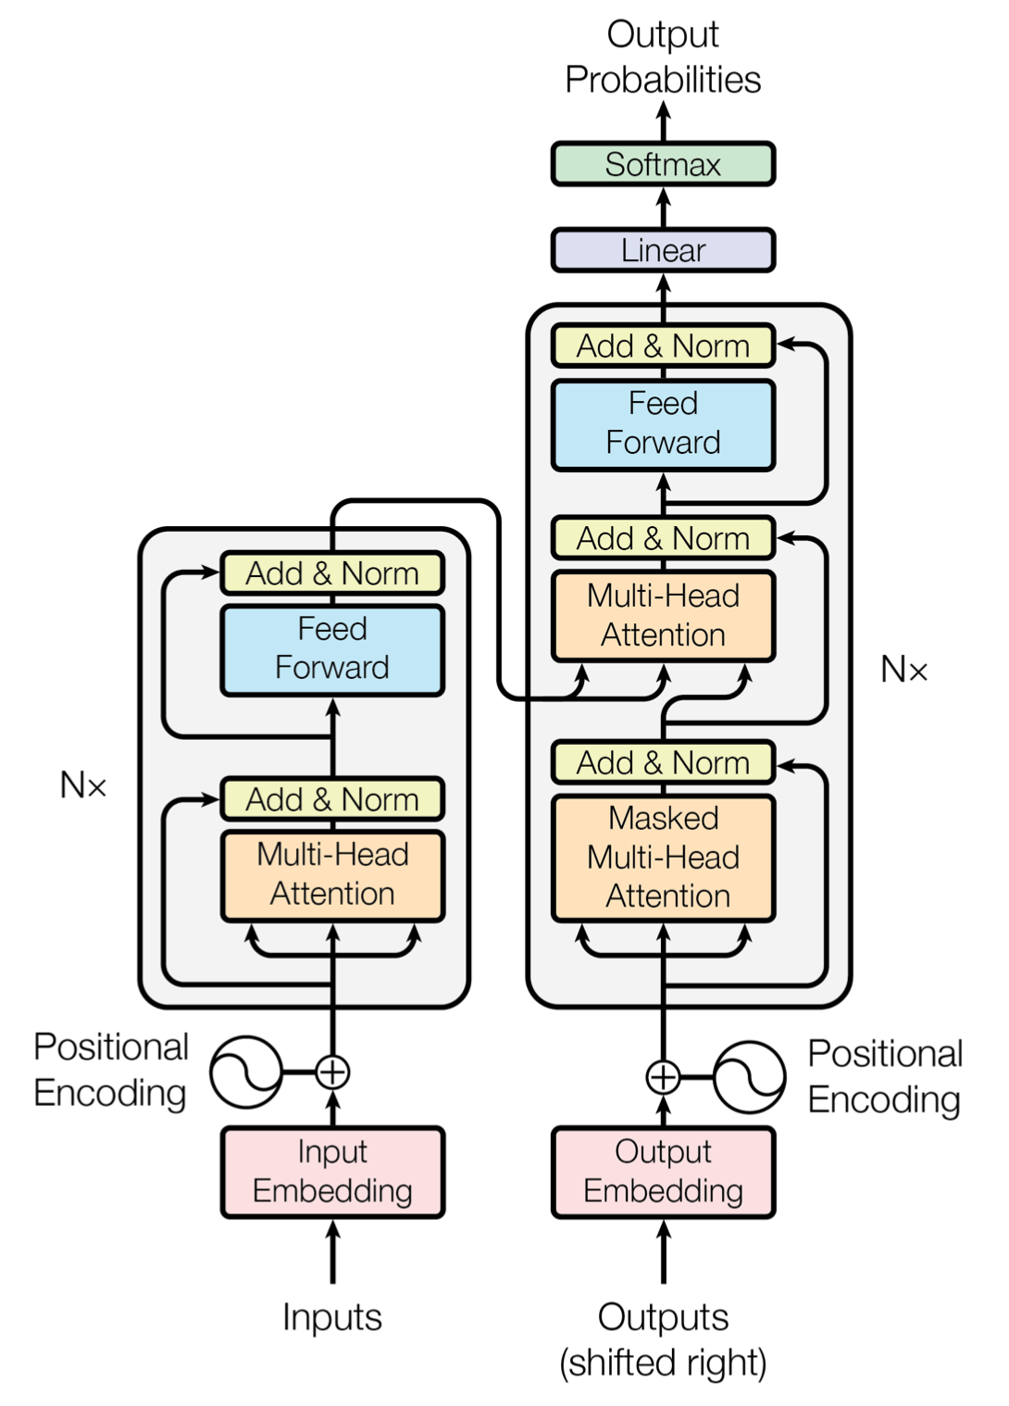
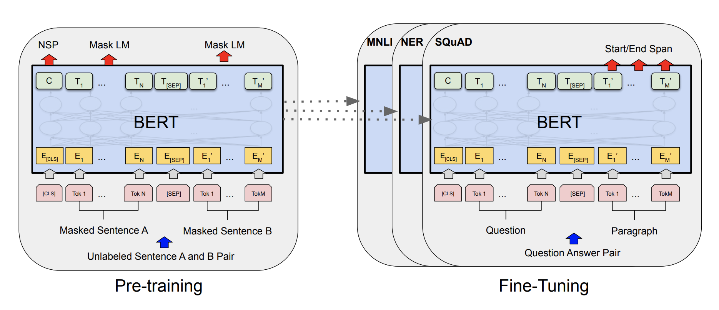
Transformer
BERT

Slide 5
How bert was trained?
Masked Language Model (MLM)
[CLS] my dog is [MASK] [SEP] he [MASK] playing [SEP]
Next Sentence Prediction (NSP)
[CLS] my dog is cute [SEP] he likes playing [SEP] YES
[CLS] my dog is cute [SEP] the river is flowing [SEP] NO

Slide 6
Special tokens of bert
[CLS] : The first token of every sequence is always a special classification token ([CLS]). The final hidden state corresponding to this token is used as the aggregate sequence representation for classification tasks. Sentence pairs are packed together into a single sequence.
[SEP] : It is basically a sequence delimiter. Must be used when sequence pair tasks are required. When a single sequence is used it is just appended at the end.
[MASK] : Token used for masked words. Only used for pre-training.
[PAD] : Token used for padding.

Slide 7
Transformers by hugging face
Transformers (formerly known as pytorch-transformers and pytorch-pretrained-bert) provides general-purpose architectures (BERT, GPT-2, RoBERTa, XLM, DistilBert, XLNet…) for Natural Language Understanding (NLU) and Natural Language Generation (NLG) with over 32+ pretrained models in 100+ languages and deep interoperability between TensorFlow 2.0 and PyTorch.
Features
As easy to use with modularity
As powerful and concise as Keras
High performance on NLU and NLG tasks
Seamlessly pick the right framework for training, evaluation, production (Pytorch/Tensorflow)

Slide 8
Preprocessing text for bert
Tokenization
Adding Special Tokens
Padding
Attention Mask
Segment IDs (for sequence pairs)
Convert sequence to integers
The dog is cute He likes to play
‘The’ ‘dog’ ‘is’ ‘cute’ ‘he’ ‘likes’ ‘to’ ‘play’
[CLS] ‘The’ ‘dog’ ‘is’ ‘cute’ [SEP] ‘he’ ‘likes’ ‘to’ ‘play’ [SEP]
[CLS] ‘The’ ‘dog’ ‘is’ ‘cute’ [SEP] ‘he’ ‘likes’ ‘to’ ‘play’ [SEP] [PAD]
1 1 1 1 1 1 1 1 1 1 1 0
0 0 0 0 0 1 1 1 1 1
[101, 1996, 3899, 2003, 10140, 102, 2002, 7777, 2000, 2377, 102, 0]

Slide 9
Bert model class
Input sequence
Attention Masks
Segment IDs (only for pairs)
BERT Model
Sequence Representations
[CLS] representation passed through linear and tanh
Hidden states (optional)
Attentions (optional)

Slide 10
Our approach to fine-tuning
Sequence Representations
Take the representation of the first token i.e. [CLS]
Linear layer
BERT Model
[CLS] representation passed through linear and tanh

Slide 11
Dataset class and data loaders
Requests data at a specific index
Data Loader
Dataset Class
Sends the data at that index

Slide 12
Training the model
Set the Model to train mode
Start the epoch
For every batch in the data loader
Zero out gradients
Get output of model
Compute loss
Backpropagate gradients
Optimizer step
At the end of epoch validate data
Finally save model

Slide 13
Thank you
Email: bhavesh.laddagiri1@gmail.com
Github: https://github.com/theneuralbeing
LinkedIn: Bhavesh Laddagiri

