Slide 1
PROBLEM STATEMENT:
Introduction to GenAI and Simple LLM Inference on CPU
Explore the fundamentals of Generative AI, demonstrating simple inference on CPUs and the process of fine-tuning LLMs to develop custom chatbots tailored to specific use cases.
Our dual-chatbot system integrates two specialized bots: one directly interacts with customers, while the other gathers and utilizes organizational insights. This setup ensures accurate customer responses and enhances service through AI-driven efficiency. By automating data collection and leveraging advanced AI models like BERT, businesses can streamline operations, boost customer satisfaction, and focus on strategic growth, ultimately standing out in competitive markets while delivering exceptional customer experiences.

Slide 2
UNIQUE IDEA BRIEF (SOLUTION):
Innovative Approach:
  Development of two integrated chatbots: one customer-facing and
  one organization - facing.
Customer-Facing Chatbot:
  Provides answers and solutions to customer queries.
  Delivers highly accurate and personalized responses.
Organization-Facing Chatbot:
  Gathers rich data and insights directly from the business.
  Continuously updates the customer-facing chatbot with the latest organizational information.
Empowerment for Small Businesses:
  Enables exceptional customer service through real-time, contextually accurate responses.
  Helps small businesses stand out in a competitive market.

Slide 3
FEATURES OFFERED:
Interactive Questionnaire:
Predefined questions for collecting essential business information.
Easy navigation with options to edit responses.
Data Submission and Management:
Saves responses to a file upon completion.
Offers functionality to read, display, and append content to response files.
PDF Upload and Text Extraction:
Converts uploaded PDF content to text.
Counts and displays the number of lines extracted from the PDF.
Robust File Handling:
Error handling for file not found and other unexpected exceptions.
UTF-8 encoding for proper text processing.
AI-Powered Contextual Answering:
Utilizes a fine-tuned BERT model for precise question answering.
Provides customer care contact numbers if an answer is not found in the context.

Slide 4
PROCESS FLOW:
STEP 1 - ORGANIZATION INFORMATION GATHERING:
Interactive Questionnaire: Collects essential business data through a series of predefined questions.
Navigation Features: Allows users to navigate back and forth to review and edit responses.
Data Submission: Saves the collected responses to a file for further use.
STEP 2 - PDF UPLOAD AND TEXT EXTRACTION:
File Upload: Users upload relevant PDFs (e.g., terms, conditions, policies).
Text Extraction: Converts PDF content to text and counts the number of lines.
File Management: Saves extracted text to a file and appends to the response file if needed.

Slide 5
STEP 3: CUSTOMER-FACING CHATBOT SETUP:
Contextual Data Loading: Reads the context from the response file and extracted text file.
Model and Tokenizer Setup: Utilizes a fine-tuned BERT model for question answering.
Customer Interaction: Engages with customers, answering queries based on the provided context.
Fallback Mechanism: Provides customer care contact numbers if the answer is not found.
STEP 4: CONTINUOUS IMPROVEMENT:
Data Update: Organization-facing chatbot continuously updates the context with new information.
Enhanced Responses: Customer-facing chatbot leverages updated context for improved accuracy.

Slide 6
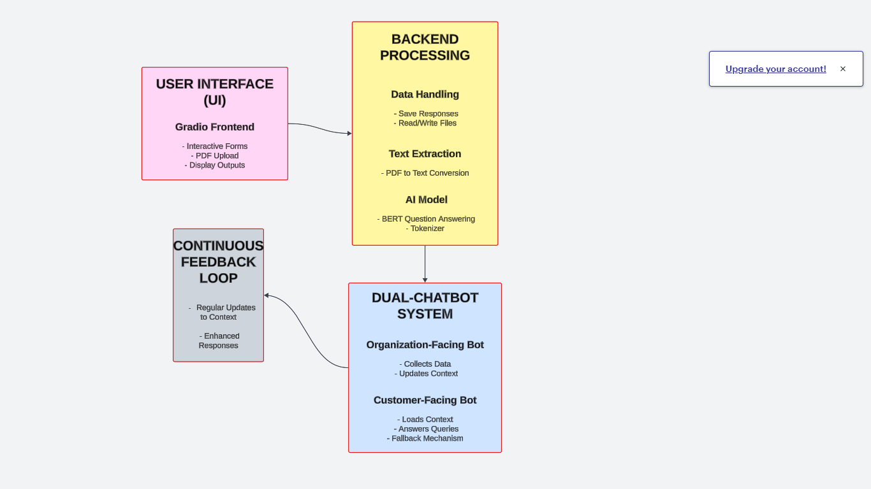
ARCHITECTURE DIAGRAM:

Slide 7
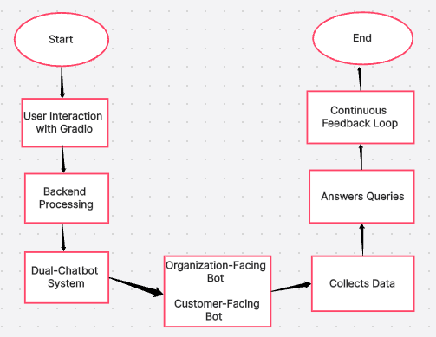
FLOW CHART:

Slide 8
TECHNOLOGIES USED:
User Interface:
Gradio:
  Simplifies building interactive UIs for machine learning applications.
  Provides components for forms, file uploads, and data display.
Data Processing:
Python:
  Core programming language for backend logic and data handling.
pdfminer:
  Extracts text content from PDF files.
File Handling Libraries:
  Read and write operations for text and PDF content.

Slide 9
AI and NLP:
Transformers Library:
  Provides state-of-the-art NLP models and tokenizers.
BERT Model:
  Pre-trained on SQuAD for question answering tasks.
PyTorch:
  Deep learning framework for loading and running the BERT model.
Data Storage and Management:
Text Files:
  Stores collected responses and extracted text.
  Efficiently manages simple data read/write operations.

Slide 10
TEAM MEMBERS AND CONTRIBUTION:
Project Lead (Saravana Kumar):
  Saravana Kumar led our project from start to finish, making sure everyone was on the same page.
  He came up with the initial idea and kept us focused on our goals.
  He also played a key role in planning how everything would fit together.
AI and NLP Specialist (Shree Shivani):
  Shree Shivani worked on the smart parts of our chatbots, like making sure they understood questions and gave helpful answers.
  She spent time teaching our bots to use fancy AI tricks like BERT, so they could get smarter over time.
  She made sure our bots could handle all kinds of questions people might ask.

Slide 11
UI/UX Designer and Frontend Developer (Shree Abhinaya):
She made sure our chatbot looked great and was easy to use.
  Shree Abhinaya created all the buttons and forms you see when you talk to our chatbots.
  She made sure everything worked smoothly, whether you're on a computer or a phone.
Backend Developer and Data Engineer (Sujatha):
  Sujatha took care of all the technical stuff behind the scenes.
  She built the systems that let our chatbots talk to databases and handle lots of data.
  She made sure our chatbots could find and use information quickly and accurately.
Together we made sure our dual-chatbot project not only worked well but also looked good and was easy for everyone to use.

Slide 12
CONCLUSION:
Our dual-chatbot system transforms customer service for small businesses by integrating two specialized chatbots: one for interacting directly with customers and another for gathering and utilizing organizational insights. This unique approach ensures that customer queries are answered accurately and that organizational data enhances the customer service experience effectively.
At the core of our system is the seamless integration of advanced technologies. Gradio provides an intuitive interface that simplifies user interaction, featuring easy-to-use forms, robust PDF upload capabilities, and clear data displays. This user-friendly setup empowers both users and administrators with efficient tools for gaining actionable insights.
Powered by cutting-edge AI models such as BERT and the Transformers library, our chatbots deliver precise and personalized responses. The customer-facing bot uses BERT's question answering capabilities to promptly address inquiries, while the organization-facing bot continually updates its understanding of organizational data, ensuring responses are tailored and accurate over time.

Slide 13
Our dual-chatbot system not only raises the bar for customer service but also optimizes data management processes. By automating data collection and leveraging AI-driven insights, businesses can focus on strategic growth initiatives. This streamlined approach not only enhances customer satisfaction but also boosts operational agility, enabling businesses to stay competitive in today's dynamic market landscape.
In conclusion, our innovative solution empowers small businesses to deliver exceptional customer experiences through advanced AI technology and streamlined data management. By adapting to changing customer needs and operational demands, our dual-chatbot system enables businesses to achieve sustainable growth and stand out in their respective markets.

