Slide 1
Quora insincere questions classification
Joseph lionel
Shabharinath tr
Saravanakumar velayutham

Slide 2
Motivation
To develop models that identify and flag insincere questions on the Quora platform.
Key challenge is to weed out insincere questions -- those founded upon false premises, or that intend to make a statement rather than look for helpful answers.
Help Quora uphold their policy of “Be Nice, Be Respectful” and continue to be a place for sharing and growing the world’s knowledge.

Slide 3
Key terminologies
NLP : Natural language processing is broadly defined as the automatic manipulation of natural language, like speech and text, by software.
Tokenizing is the process of converting each sentences into words and use those words as feature for machine learning model.
An embedding is a relatively low-dimensional space into which you can translate high-dimensional vectors.
Embeddings make it easier to do machine learning on large inputs like sparse vectors representing words.

Slide 4
Key Terminologies
A neural network is a series of algorithms that endeavors to recognize underlying relationships in a set of data through a process that mimics the way the human brain operates.
LSTM ( Long Short Term memory ) is a special kind of RNN, selectively remembers patterns for long durations of time.
Convolutional neural networks are deep artificial neural networks that are used primarily to classify images, cluster them by similarity (photo search), and perform object recognition within scenes. The same methodology can be applied to text also.

Slide 5
Key terminologies
Dense layer is in which every input is connected to every output by a weight. Generally followed by a non-linear activation function.
Pooling layer: Replace each patch in the input with a single output, which is the maximum (can also be average) of the input patch.
Adam is an optimization algorithm that can used instead of the classical stochastic gradient descent procedure to update network weights iterative based in training data. Uses adaptive learning rate rather than fixed learning rate.

Slide 6
Data preprocessing
Clean contractions : The words which are in short form for example doesn’t , clg for does not and college needed to be expanded for the embedding layer to use the vectorized values.
Clean special characters : Some of the special characters are present in the embedding but some needs to be removed as they are not present in the embedding. Also , some can be replaced to the most similar special characters present in the embedding dictionary.
Clean numbers : Since the embedding index have the numbers represented as ## for two digit , ### for three digit numbers , it needs to be replaced with corresponding characters in the text.

Slide 7
Data preprocessing
Correct spelling : some of the word in the data is mis-spelled like What for what, programr for programmer etc . Also, since the embedding we used is in US English and the data is in UK English , all such words needs to be replaced like colour to color , centre to center etc.
After all the above steps are done , the data needs to be tokenized by the Keras library and pad them according to the required length.
We chose the maximum length of a question to be 100 words.

Slide 8
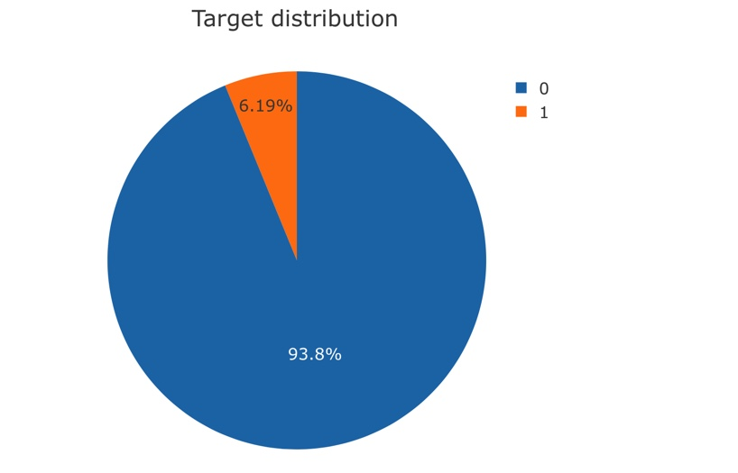
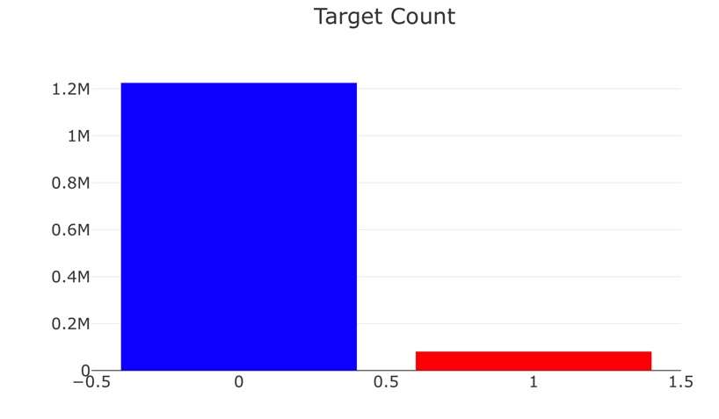
Data analysis

Slide 9
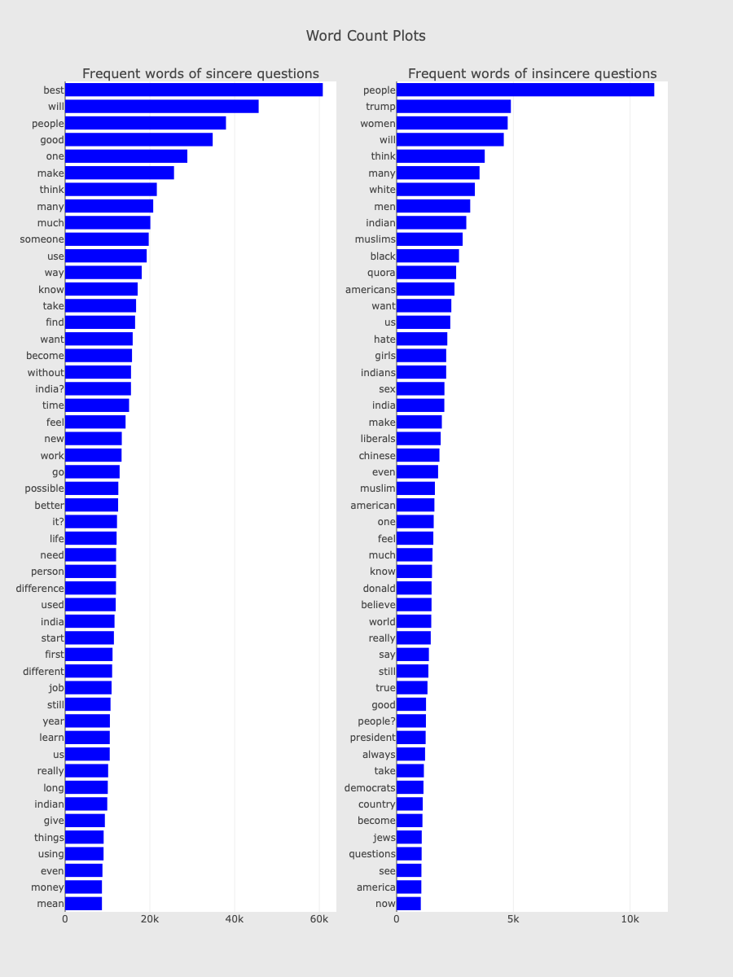
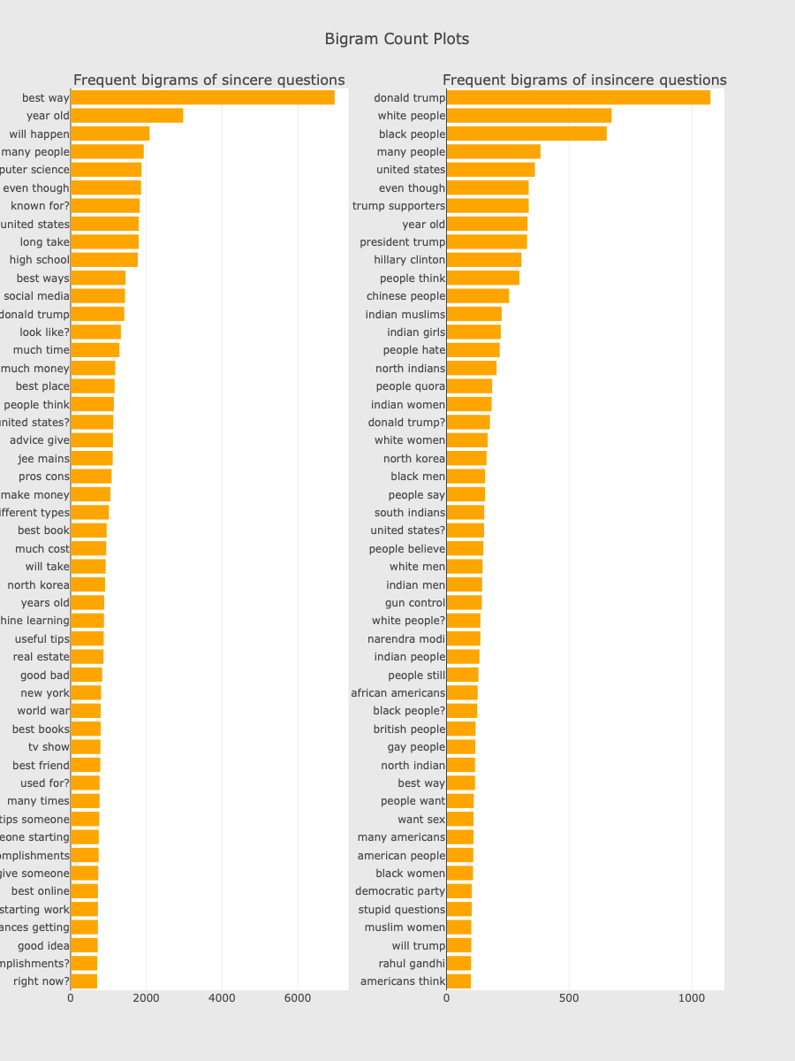
Data analysis

Slide 10
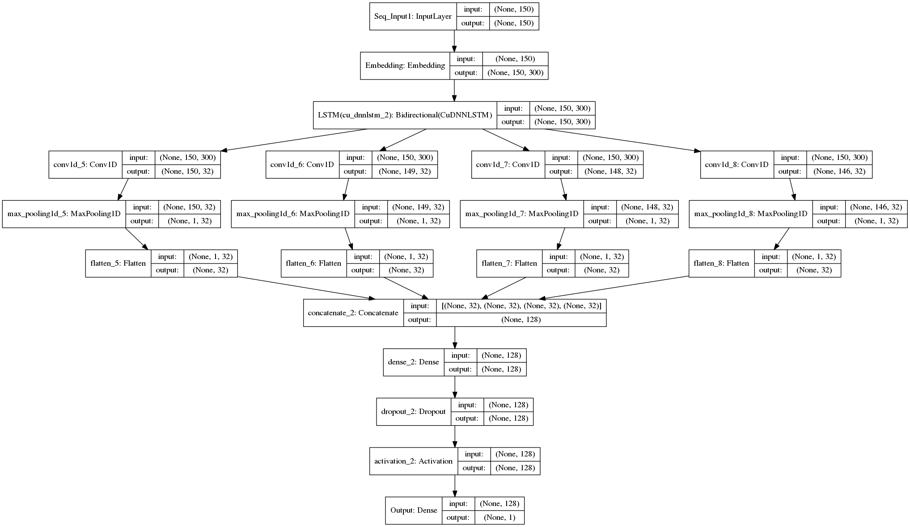
Architecture used
Conv O/P : ((n+2p –f)/ s ) + 1

Slide 11
Achieved results
Results during training on training set yielded 75% and on validation set yielded maximum of 69%.
With the above stated architecture and data cleaning, we were able to achieve a result of 66.4 % on the Quora competition (Top score of the whole competition being 71.1%)
With the private test set for the competition , we scored 66.9% weighted f1-score being in top 30% of the total competition.

