Slide 1

D. Saravanan
MEAN Stack Trainer
Chennai

Slide 2
What is data and database ?
A data is an information or records, for example a person name age qualification etc.,
Database is a collection of information to store, retrieve, and manipulate data efficiently.
A data is stored in structured formats, such as tables, documents, or key-value pairs.

Slide 3
Variety of Databases
Hierarchical databases
Network databases
Object-oriented databases
Relational databases
Cloud Database
Centralized Database
Operational Database
NoSQL databases

Slide 4
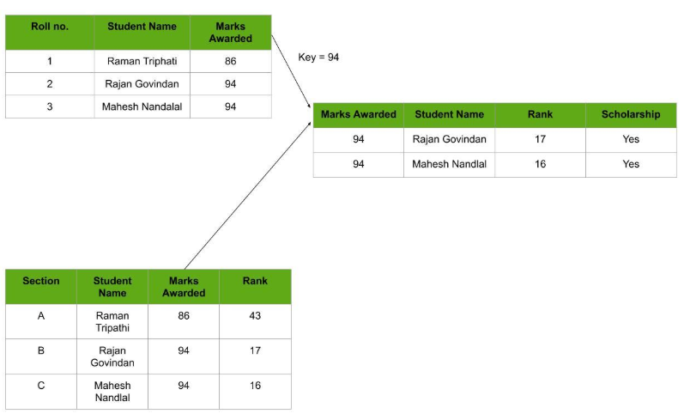
Relational Databases

Slide 5
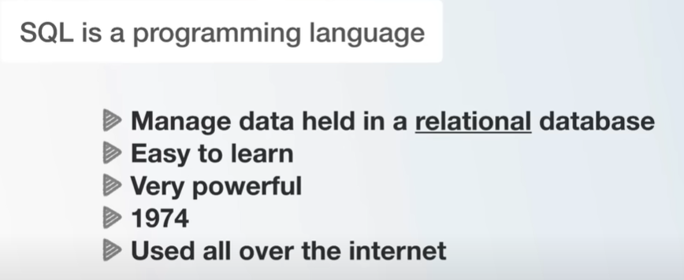
What is SQL ?

Slide 6
NoSQL Databases
A NoSQL database (short for “non-SQL” or “non-relational”) provides a mechanism for storing and retrieving data that does not rely on traditional table-based relational models.

Slide 7
Mongo Database
Open-source NoSQL database
Self-managed (on-premises or cloud)
Flexible schema design
Horizontal scaling
High performance

Slide 8
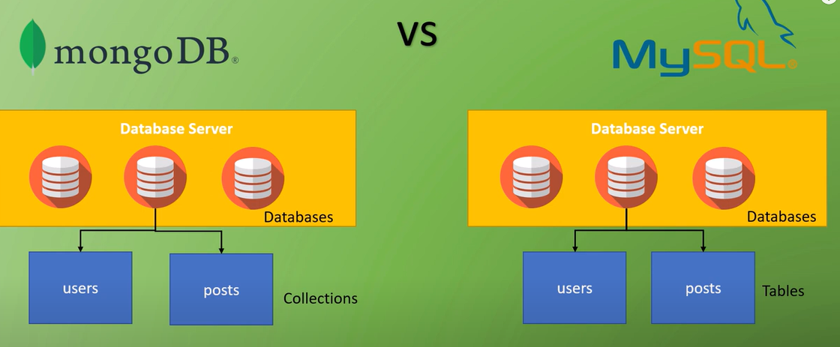
Mongo DB vs MySQL

Slide 9
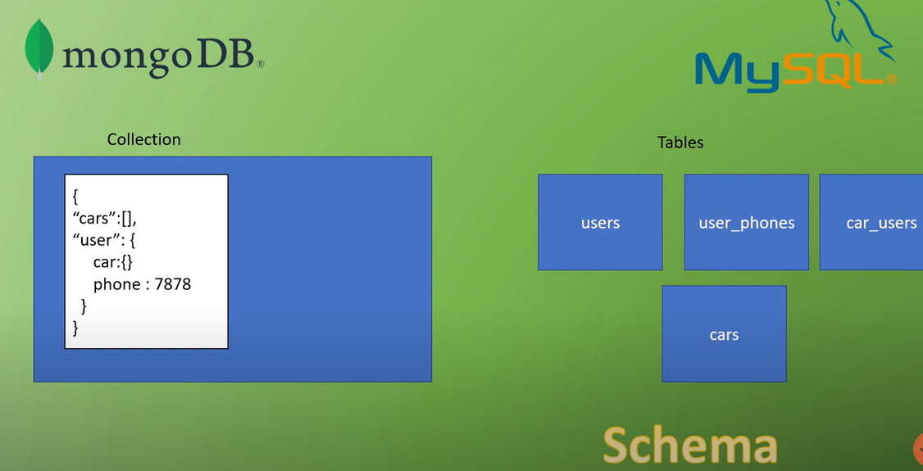
Mongo DB vs MySQL

Slide 10
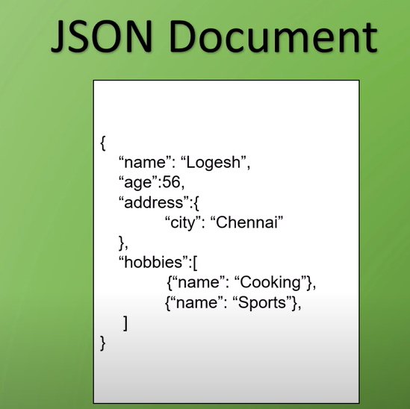
Collections
MongoDB stores documents known as collections.
A collection of documents known as collections.

Slide 11
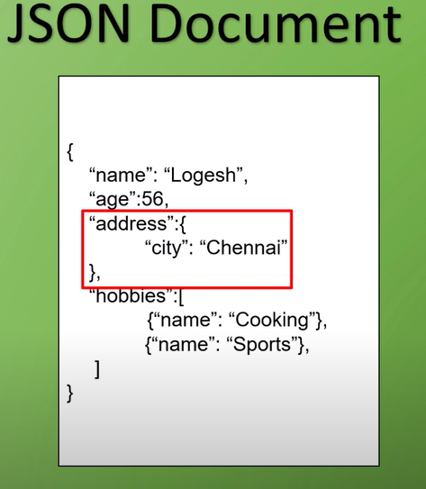
Embedded Document

Slide 12
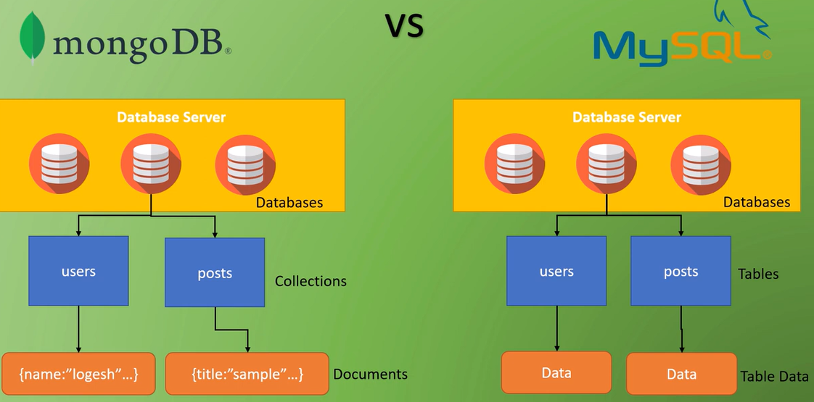

Slide 13
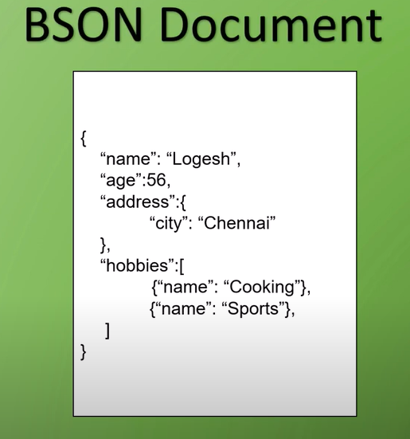
BSON Document – Binary Script object Notations

Slide 14
No-SQL Benefits
Scalability and flexibility
Simplified database management
Cost-effective
Reduced administrative burden
Improved performance and reliability

Slide 15
Environment setup
Go to official site (https://www.mongodb.com/try/download/community)
mogodb atlas and download community version and install it.
open that command prompt and navigate file path C:\Program Files\MongoDB\Server\5.0\bin
finally execute mongo.exe (or) mongosh.exe

Slide 16
Mongo Atlas – Cloud Database

Slide 17
Cloud Database - Setup
Go to mongodb atlas page and sign in your account with username and password
After login you have to see Explore page.
In left side panel find Database security tab you need to configure Database access and network access
once setup done you need to move cluster tab.
In cluster inside click connect button.
you have to find one popup that DB establish in your system.
you need to select shell based (or) compass based connect to local system.

