Slide 1
NPM – Node package manager
NPM is the package manager for Node.js,
It allowing developers to easily install, update, and manage packages
Such us (libraries, frameworks, and tools) for their Node.js projects.

Slide 2
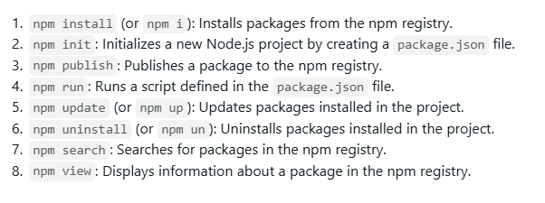
Npm - commands

Slide 3
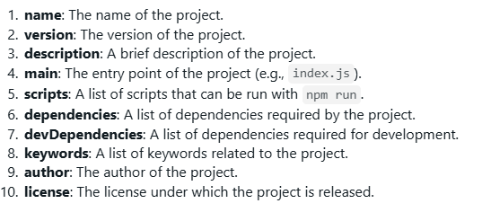
package.json
package.json is a JSON file that contains metadata about a Node.js project.
It's used to manage dependencies, scripts, and other project settings.

Slide 4
How to create & run a Node Server
Step 1: Install Node.js - download official site and install your system.
Step 2: Create a new project - Create a new folder for your project
Step 3: Initialize a New Node.js Project - run the command npm init to create a new package.json file for your project.
Step 4: Install Module - npm install
Step 5: Create a Server File - Create a new file called index.js

Slide 5
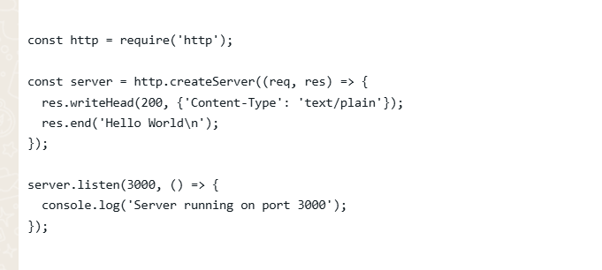

Slide 6
Step 6 : Run the Server - Run the command node index.js to start the server.
Nodemon : Node.js application for changes and automatically restarts the server when changes are detected.
npm i nodemon
nodemon index.js
Step 7 : Test the Server - Open a web browser and navigate to http://localhost:3000.

Slide 7
Core modules
http: The HTTP module provides functionality for creating HTTP servers.
fs (File System): The FS module provides functionality for interacting with the file system.
path: The Path module provides functionality for working with file paths.
url: The URL module provides functionality for working with URLs.

