Slide 1
REDUX
PRESENTED BY
SARAVANAN
MERN TRAINER

Slide 2
REACT - STATE

Slide 3
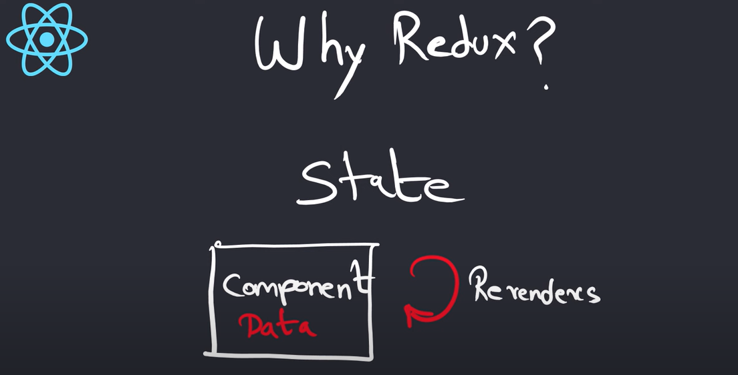
WHY REDUX ?

Slide 4
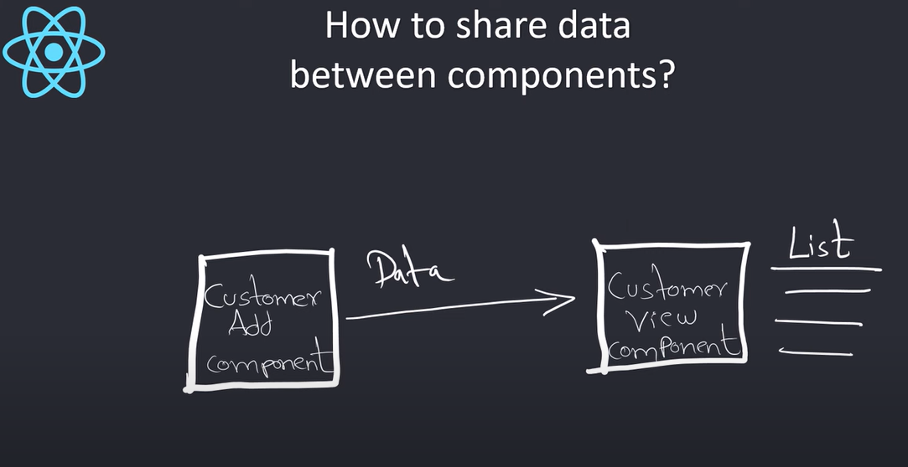
How to share data between components

Slide 5
REACT - PROPS

Slide 6
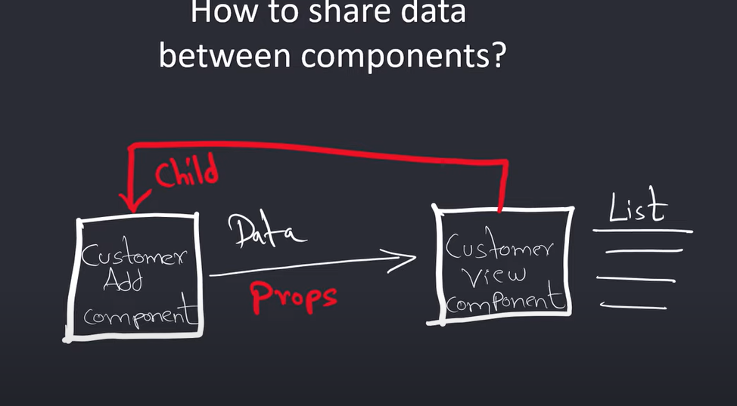

Slide 7
REACT CONTEXT

Slide 8
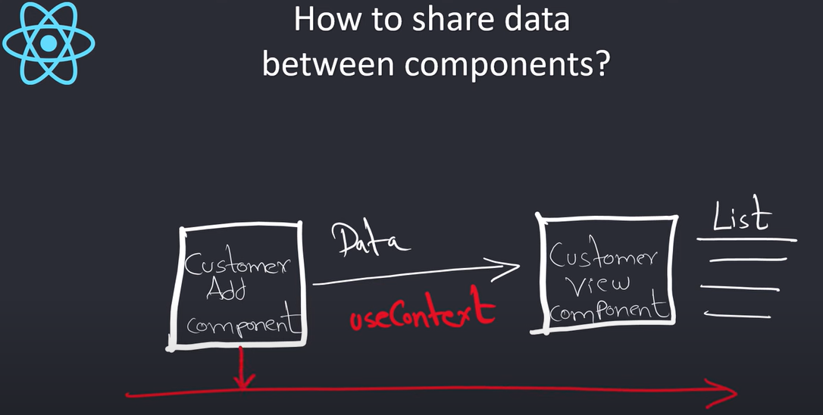
Create context / use context

Slide 9
REACT - REDUX

Slide 10
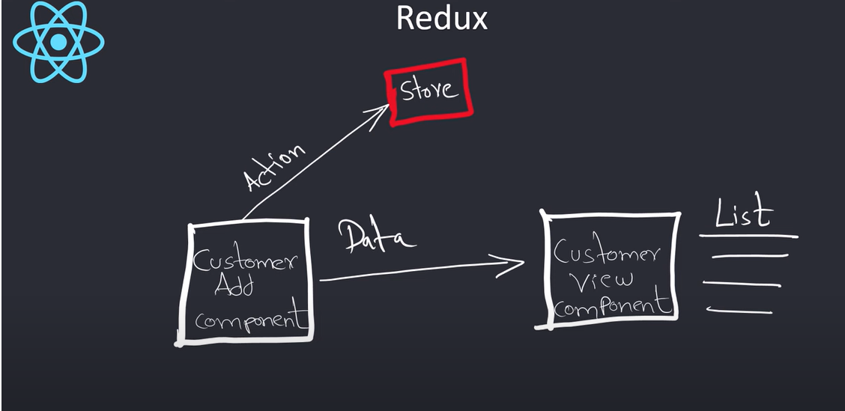
REDUX

Slide 11
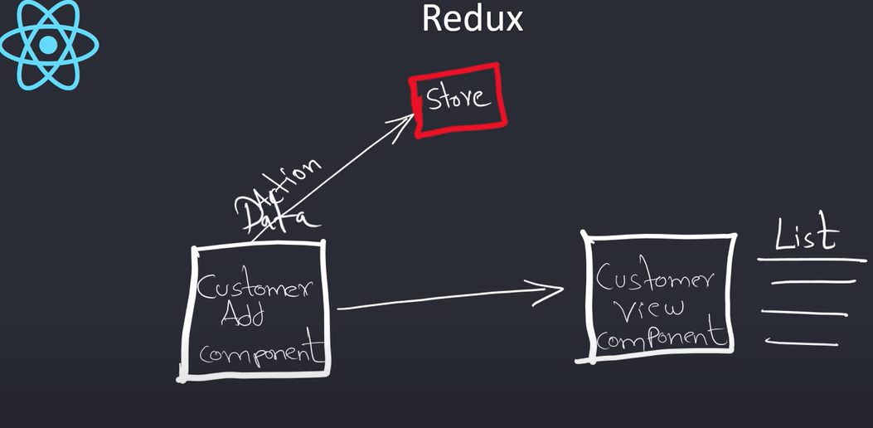

Slide 12
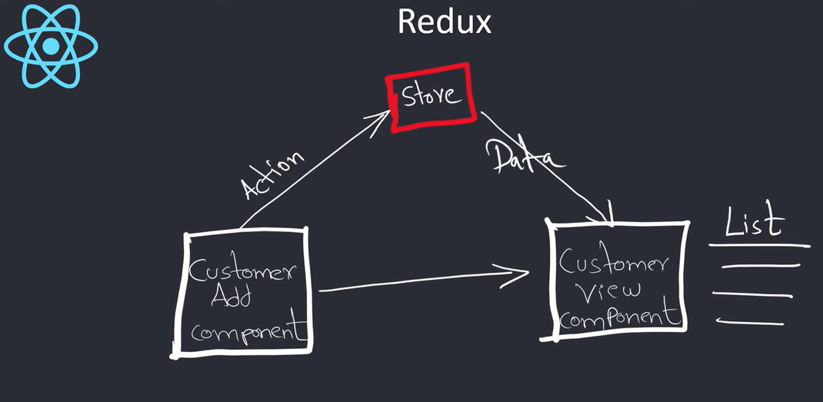

Slide 13
