Slide 1
Asymptotics, Recurrences, Elementary Sorting
Saravanan Thirumuruganathan

Slide 2
Outline
Intro to Asymptotic Analysis
Rate of growth of functions
Comparing and bounding functions – O, Θ, Ω
Specifying running time via recurrences
Solving recurrences
Elementary Sorting algorithms
Bubble, Insertion, Selection sort
Stability of sorting algorithms

Slide 3
In-Class Quizzes
URL: http://m.socrative.com/
Room Name: 4f2bb99e

Slide 4
Analyzing Algorithms
Time complexity:
Quantifies amount of time an algorithm needs as a function of its input
Space complexity:
Quantifies amount of space an algorithm requires as a function of its input
Function: Input size Vs {Time/Space}

Slide 5
Analyzing Algorithms
Best case complexity:
A function that defines the minimum number of steps taken on any instance of size n
Worst case complexity:
A function that defines the maximum number of steps taken on any instance of size n
Average case complexity:
Defines average number of steps

Slide 6
Rate of Growth of Functions
Growth function T(n):
Input is positive integers, n=1,2,3, ….
How does T(n) grow when n increases?
n is size of input and T(n) is the amount of time it takes for an algorithm to solve it

Slide 7
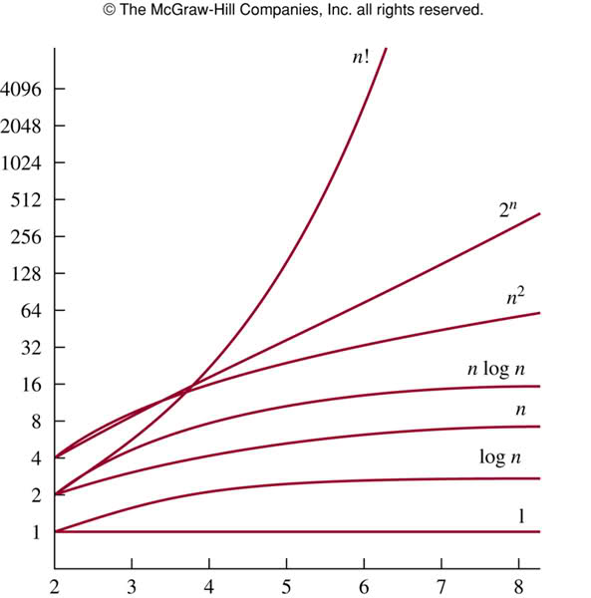
Rate of Growth of Functions

Slide 8
Quiz!
Machine Specification:
Suppose you have a machine that can do a million operations per second.
Question:
Suppose you have an algorithm that requires n² operations.
Suppose the input size is 1 M
How long does this algorithm take?

Slide 9
Quiz!
Machine Specification:
Suppose you have a machine that can do a million operations per second.
Question:
Suppose you have an algorithm that requires n² operations.
Suppose the input size is 1 M
How long does this algorithm take?

Slide 10
Quiz!
Machine Specification:
Suppose you have a machine that can do a million operations per second.
Question:
Suppose you have an algorithm that requires n² operations.
Suppose the input size is 1 M
How long does this algorithm take?

